Slide 1

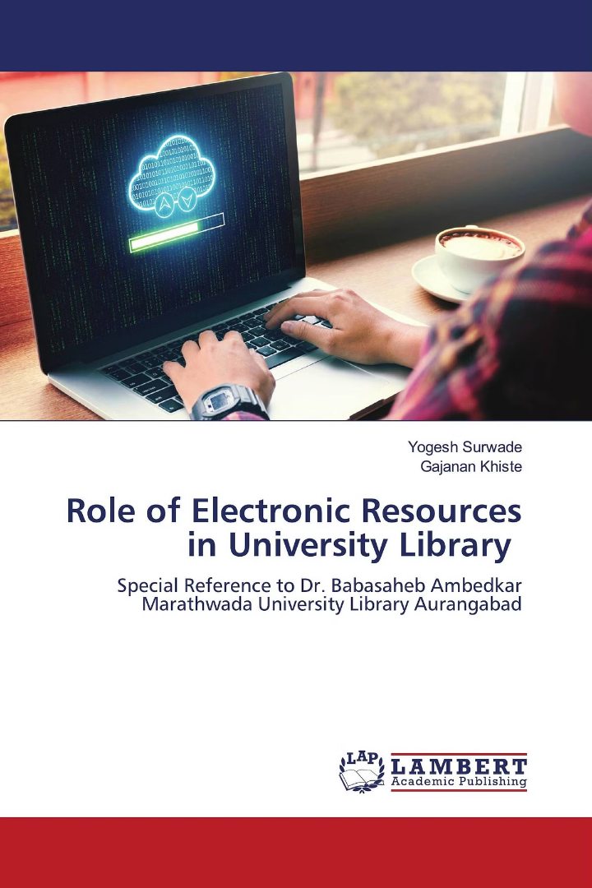
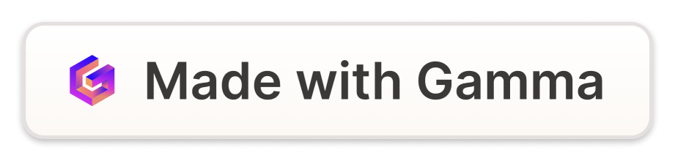
A Study on Use of E-Resources in College Libraries of Uttar Pradesh
Prem Prakash Yadav Research Scholar imppyadav@gmail.com Dr. Dharam Vir Singh Associate Professor Email- hodlirary@gmail.com Department of Library & Information Science, Mangalayatan University, Aligarh - U. P.

Slide 2
Introduction
An electronic resource is a resource that requires computer access or any electronic product that delivers a collection of data, such as full-text bases, electronic journals, image collections, and other multimedia products. These resources are more useful due to their inherent capabilities for manipulation and searching, providing information access at a cheaper cost and with savings in storage and maintenance. The use of web as a tool is changing the way users live and learn, leading to the rapid development and popularity of electronic resources.

Slide 3
Types of E-Resources
1
E-books
2
E-journals
3
E-Maps
E-books are helpful for easy portability and can incorporate more than one book in a single handheld device.
E-journals provide quick and easy access to a wide range of academic and professional content.
E-Maps offer interactive and detailed geographical information that can be accessed digitally.

Slide 4
Characteristics of E-Resources
Quicker Access
Ownership Not Important
Electronic Format
E-resources provide quicker access to information compared to print resources, enhancing efficiency.
Electronic format can encompass a collection of any media, making it versatile and adaptable.
In electronic format, ownership of resources is not as crucial, allowing access to every document by anyone, from anywhere.

Slide 5
Selection of E-Resources
1
Needs of Users
Selection of E-Resources should be based on the needs and demands of the users to ensure relevance and utility.
2
Content and Scope
Examine the quality and search facility of the e-resources to ensure they align with the library's objectives.
3
Educational Support
Evaluate the educational support and training provided by the e-resources to ensure they contribute to the users' learning and development.

Slide 6

Utilities of E-Resources
24/7 Access
Cost-Effectiveness
E-resources are available 24 hours a day, providing users with anytime access from home, campus, or the library.
E-publishing may be less costly than traditional paper publications, making it a cost-effective option for libraries.
User-Friendly Interface
E-resources provide a user-friendly interface, making searches and access easy and convenient for users.

Slide 7



E-Resources Issues
Licensing
IPR Concerns
Infrastructure Challenges
E-Resources need licensing from publishers, which can be a complex and costly process for libraries.
E-Resources can be easily copied and forwarded, raising concerns about intellectual property rights and proper usage.
Libraries often lack the infrastructure and skilled manpower required to effectively manage electronic collections.

Slide 8
Conclusion
1
Information Access
2
Advantages of E-Resources
E-resources play an important role in ensuring exhaustive and pinpointed information access for users and libraries.
Using e-resources enables libraries to save space and time, providing benefits to users and the library itself.
3
Technological Developments
The advancements in information and communication technology have brought about significant changes in library operations and user experiences.

Slide 9
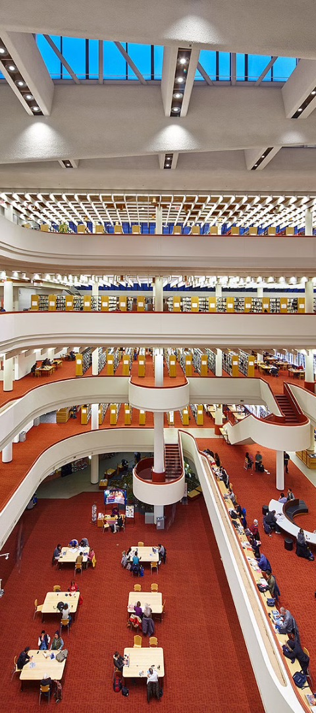
References
1
Min, Shao and Yi, Yang (2010)
2
Pareek, Namita and Gangrade, Anita (2016)
‘E-resources, services and user surveys in Tsinghua University Library. Program’, Electronic Library and Information Systems, 44(4), pp.314-327.
‘Role of the Libraries as Information Resources in Globalization’, International Journal of Librarianship and Administration, 7(1), pp. 13-23.
3
Saklani, Vipin Kumar (2020)
‘Modernization of Libraries: Use of e-resources in the Academic Library’, IP Indian Journal of Library Science and Information Technology, 5(2), pp. 86-87.

