Slide 1
Regenerative Braking System in Electric Vehicle
Praveen Kumar sharma¹, Nilam N. Ghuge²
¹ Research Scholar, University of Technology, Jaipur, Rajasthan, India,
Email: Praveenprem.sharma@gmail.com
² Professor ,Department of Electrical Engineering, JSPM’s BhivarabaiSawantInstitute of Tech. & Research, ,Wagholi,Pune, India. 412207
Email: ghuge1974@gmail.com

Slide 2
Abstract
Regenerative braking is a mechanism found on most hybrid and full-electric vehicles. It captures the kinetic energy from braking and converts it into the electrical power that charges the vehicle’s high voltage battery. Regenerative braking also slows the car down, which assists the use of traditional brakes In a conventional braking system, a car slows down due to friction between the brake pads and rotors. But this system is highly inefficient when it comes to conserving energy. Nearly all of the kinetic energy propelling your car forward is lost as heat when you apply the brakes. That’s a lot of wasted energy. Regenerative braking solves this problem by recapturing upwards of 70% of the kinetic energy that would otherwise be lost during braking. The amount of energy recovered depends on your car model and driving behavior. Regenerative braking turns kinetic energy into electricity by reversing the process that drives the car forward. In electric cars, the drive train is powered by a battery pack that powers a motor (or motors), creating torque–rotational force–on the wheels. In other words, electrical energy from the battery becomes mechanical energy that spins the wheels. With regenerative braking, the energy from your spinning wheels is used to reverse the direction of electricity - from the electric motor(s) to the battery. All you have to do is remove your foot from the accelerator or, in some cases, press the brake pedal to activate regenerative braking. The electric motor not only acts as an electric generator, but it also helps slow your car down because energy is consumed by the wheels as they rotate the shaft in the electric motor.
Keywords: Regenerative Braking System

Slide 3
Introduction
Regenerative Braking System is the way of slowing vehicle by using the motors as brakes. Instead of the surplus energy of the vehicle being wasted as unwanted heat, the motors act as generators and return some of it to the overhead wires as electricity.
The vehicle is primarily powered from the electrical energy generated from the generator, which burns gasoline.
This energy is stored in a large battery, and used by an electric motor that provides motive force to the wheels.
Regenerative Braking System comes into its own when you’re driving in the city, and spending a good deal of your time braking. You will still use more fuel in the city for each mile you drive than on the highway, though
Thermodynamics tells us that all inefficiency comes from heat generation. For instance, when you brake, the brake pedals heat up and a quantity of heat, or energy, is lost to the outside world. Friction in the engine produces heat in the same way
In most electric and hybrid electric vehicles on the road today, this is accomplished by operating the traction motor as a generator, providing braking torque to the wheels and recharging the traction batteries.

Slide 4
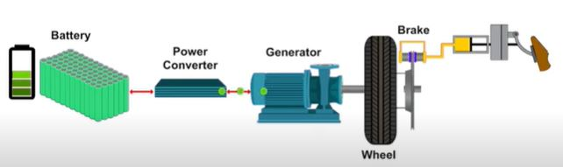
Idea of Regenerative Brakes
Concept of this regenerative brake is better understood from bicycle fitted with Dynamo. If our bicycle has a dynamo (a small electricity generator) on it for power the lights, we'll know it's harder to peddle when the dynamo is engaged than when it’s switched off.
That's because some of our peddling energy is being "stolen" by the dynamo and turned into electrical energy in the lights. If we're going along at speed and we suddenly stop peddling and turn on the dynamo, it'll bring us to a stop more quickly than we would normally, for the same reason: it's stealing our kinetic energy.
In practice, regenerative brakes take time to slow things down, so most vehicles that use them also have ordinary (friction) brakes working alongside (that's also a good idea in case the regenerative brakes fail).That's one reason why regenerative brakes don't save 100 percent of our braking energy
Fig. B - Basic Idea of Regenerative Brakes

Slide 5
Basic Elements of the System
There are four elements required which are necessary for the working of regenerative braking system, these are:)
(1) Batteries
With this system as we know, the electric motor of a car becomes a generator when the brake pedal is applied. The kinetic energy of the car is used to generate electricity that is then used to recharge the batteries
With this system, traditional friction brakes must also be used to ensure that the car slows down as much as necessary. Thus, not all of the kinetic energy of the car can be harnessed for the batteries because some of it is "lost" to waste heat.
The motor/generator produces AC, which is converted into DC, which is then used to charge the Battery Module
So, the regenerative systems must have an electric controller that regulates how much charge the battery receives and how much the friction brakes are used.

Slide 6
(2) Fly Wheels
In this system, the translational energy of the vehicle is transferred into rotational energy in the flywheel, which stores the energy until it is needed to accelerate the vehicle.
The benefit of using flywheel technology is that more of the forward inertial energy of the car can be captured than in batteries, because the flywheel can be engaged even during relatively short intervals of braking and acceleration
3) Controller
An “ON-OFF” engine control system is used. That means that the engine is “ON” until the energy storage unit has been reached the desired charge capacity and then is decoupled and stopped until the energy storage unit charge fall below its minimum requirement.

Slide 7
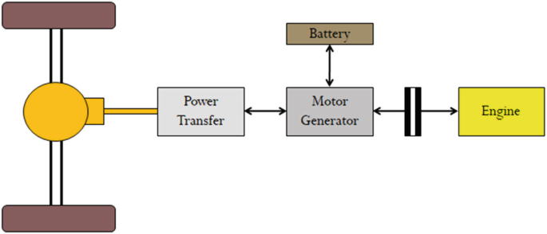
Different Types of Regenerative Braking
System
Electric Regenerative Braking
In an electric system which is driven only by means of electric motor the system consists of an electric motor which acts both as generator and motor

Slide 8
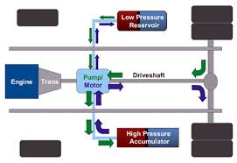
Hydraulic Regenerative Brakes
Hydrostatic Regenerative Braking (HRB) system uses electrical/electronic components as well as hydraulics to improve vehicle fuel economy. An alternative regenerative braking system is being developed by the Ford Motor Company and the Eaton Corporation. It's called Hydraulic Power Assist or HPA
The fluid remains under pressure in the accumulator until the driver pushes the accelerator again, at which point the pump is reversed and the pressurized fluid is used to accelerate the vehicle, effectively translating the kinetic energy that the car had before braking into the mechanical energy that helps get the vehicle back up to speed. It's predicted that a system like this could store 80 percent of the momentum lost by a vehicle during deceleration and use it to get the vehicle moving again.

Slide 9
Advantages and Disadvantages of Regenerative Braking
Advantages
Brake Pads & Rotors May Last Longer
Even though regenerative braking provides a lot of stopping force on its own, EVs and hybrids also come with conventional hydraulic brakes.
Extended Range Possibilities for EVs
Capturing braking energy and sending it right back to your EV’s battery pack can extend your driving range. Estimations show that regenerative braking can potentially add hundreds of miles of electric driving range throughout the year
Better Fuel Efficiency for Hybrids
While hybrids still have internal combustion engines under the hood, they’re designed to use their electric motor as much as possible.

Slide 10
Disadvantages
May Be Less Effective at Lower Speeds
Traveling at slower speeds means your vehicle has less kinetic energy and requires less braking force. As a result, the regenerative braking system is fed less energy and does not supply the battery pack with much charge.
Brake Pedal May Feel Different
One thing you want to be sure of while driving is that your brake pedal works. While the brake pedals on hybrid and electric vehicles certainly function, they may feel different in a way you’re not used to. You may experience momentary unresponsiveness or a pedal that doesn’t compress as smoothly as you expect
Potentially Less Stopping Power
While regenerative braking performs just fine in most braking situations where you gradually come to a stop, it may not provide the same level of stopping force that conventional brakes do. This means hybrid and EV drivers may have to press harder on the brakes to achieve the same effectiveness.

Slide 11
Comparisons
Energy Conservation
The flywheel absorbs energy when braking via a clutch system slowing the car down and speeding up the wheel.
Wear Reduction
An electric drive train also allows for regenerative breaking which increases Efficiency and reduces wear on the vehicle brakes
Fuel Consumption
The fuel consumption of the conventional vehicles and regenerative braking system vehicles was evaluated over a course of various fixed urban driving schedules
Comparison of Dynamic Brakes and Regenerative Brakes
Dynamic brakes ("rheostat brakes" in the UK), unlike regenerative brakes, dissipate the electric energy as heat by passing the current through large banks of variable resistors. Vehicles that use dynamic brakes include forklifts, Diesel-electric locomotives, and streetcars.

Slide 12
Conclusion
The beginning of the 21st century could very well mark the final period in which internal combustion engines are commonly used in cars. Already automakers are moving toward alternative energy carriers, such as electric batteries, hydrogen fuel and even compressed air
Regenerative braking is a small, yet very important, step toward our eventual independence from fossil fuels. These kinds of brakes allow batteries to be used for longer periods of time without the need to be plugged into an external charger
These types of brakes also extend the driving range of fully electric vehicles. In fact, this technology has already helped bring us cars like the Tesla Roadster, which runs entirely on battery power
When you think about the energy losses incurred by battery-electric hybrid systems, it seems plausible to reason that efficient flywheel hybrids would soon become the norm.
But of course it’s not quite so black and white, and further analysis shows that a combination of battery-electric and flywheel energy storage is probably the ideal solution for hybrid vehicles.
All vehicles in motion can benefit from utilizing regeneration to recapture energy that would otherwise be lost.

Slide 13
References
[1] Cibulka J. Kinetic energy recovery system by means of flywheel energy storage. Advanced engineering. 3. 2009
[2] howstuffswork.com
[3] Hewko L. O. Automotive traction drive CVTs – An overview. SAE paper 861355
[4] Juan W. Dixon, Micah Ortúzar, Eduardo Wiechmann. Regenerative Braking for an Electric Vehicle Using Ultracapacitors and a Buck-Boost Converter
[5] Chris Brockbank. Development of Full-Toroidal Traction Drives in Flywheel Based Mechanical Hybrids”

Slide 14
THANK YOU

