Slide 1
Low-Cost Adsorbents for Heavy Metal Removal: A Case Study Using Fly Ash and Red Mud at Damon Jodi
Maruwada Srinivasan1; Ramprasad Naik Desavathu2, Rakesh
Roshan Dash3
1Research Scholar, Dept. of Civil Engineering, Gandhi Institute of Engineering and Technology University, Gunupur, Odisha, India. Email: srinivasan.maruwada@giet.edu
2 Professor, Dept. of Civil Engineering, Gandhi Institute of Engineering and Technology University, Gunupur, Odisha, India. Email: dnaik@giet.edu.
3 Associate Professor, Dept. of Civil Engineering, VSSUT Burla, Sambalpur, Odisha,
India, Email: rrdash@gmail.com

Slide 2
ABSTRACT
This study assesses the efficacy of three inexpensive adsorbents—china clay, red mud, and fly ash—in removing chromium, lead, and cadmium from wastewater. In order to evaluate the adsorption capabilities of these materials, batch adsorption tests were carried out using water solutions that initially included 100 ppm of metal ions. The results indicated that red mud achieved the highest removal efficiencies: 91% for chromium, 94% for lead, and 89% for cadmium. China clay also demonstrated effective removal, with 89% for chromium, 86% for lead, and 90% for cadmium. Fly ash, though slightly less efficient, removed 84% of chromium, 89% of lead, and 83% of cadmium. The adsorption process was found to be time-dependent, with removal efficiency increasing as contact time was extended, suggesting a gradual adsorption mechanism influenced by the availability of active sites on the adsorbent materials. These findings show that fly ash, red mud, and china clay are effective for removing heavy metals from contaminated water. The study highlights the feasibility of using these low-cost, readily available materials as alternatives to expensive and less environmentally friendly adsorbents. These materials present a sustainable and economically viable option for large-scale wastewater treatment, offering a practical solution to address heavy metal pollution. This approach can contribute to more sustainable and cost-effective wastewater management, particularly in regions where affordable treatment options are critical for mitigating environmental contamination.
Key Words: Heavy metals, Adsorbents, Contact time, Agricultural waste, Wastewater treatment

Slide 3
Introduction
The discharge of toxic heavy metals such as chromium, copper, and lead into water bodies presents a significant environmental challenge with widespread implications for both ecological systems and human health
These metals, commonly introduced through industrial activities, remain persistent in the environment and pose severe risks to water quality, aquatic life, and public health.
This abstract explores the sources, effects, and regulatory measures concerning these metals in water, while emphasizing the need for effective remediation strategies to mitigate their impact
Chromium, a toxic metal widely found in industrial effluents from processes like metal plating, leather tanning, and dyeing, is particularly hazardous in its hexavalent form (Cr6+).
While copper is necessary for biological processes, it’s over accumulation can lead to copper poisoning in humans, resulting in symptoms like nausea, abdominal pain, and liver damage.
The Bureau of Indian Standards (ISI) has prescribed a maximum allowed quantity of 0.05 ppm for lead pollution in drinking water, which is subject to stringent regulation. Lead poisoning is still a major problem in communities with outdated infrastructure and insufficient water treatment facilities, even though these restrictions have been adopted

Slide 4
MATERIALS AND METHODS
Preparation of Adsorbents:
Fly ash
The Obera Thermal Power Plant in Mirzapur, Uttar Pradesh, India, was surveyed for fly ash. This fly ash was a byproduct of coal combustion in the power plant’s boilers and was obtained directly from the plant’s collection system. The collected fly ash was used without any pre-treatment.
Fly Ash Preparation:
The fly ash was sieved using a 53 μm pore size sieve to separate the finer particles. This fine fraction was selected for use in experiments due to its higher surface area, which enhances its ability to adsorb contaminants like heavy metals.

Slide 5
Chemical Analysis:
The findings of the analysis of the fly ash's chemical makeup are shown in Table 1:
This study explores the utilization of untreated fly ash from the Obera Thermal Power Plant in Mirzapur, Uttar Pradesh.
Red mud-
Red mud, a highly alkaline byproduct generated during the production of aluminum, poses significant environmental challenges due to its large volume and hazardous composition. However, its potential as an adsorbent material for environmental remediation has gained considerable attention.
Red mud exhibits a variety of characteristics that make it a promising material for environmental remediation. The bulk density and particle size of red mud were found to be conducive for both practical handling and its application in large-scale remediation processes.
Constituent | Percentage by weight
SiO₂ (Silicon Dioxide) | 56.04%
Al₂O₃ (Aluminum Oxide) | 25.90%
CaO (Calcium Oxide) | 2.22%
Fe₂O₃ (Iron Oxide) | 1.26%
MgO (Magnesium Oxide) | 0.94%
Loss of Ignition | 13.64%

Slide 6
Chemical Analysis of Red Mud as Adsorbent
Constituent | Percentage by Weight
Fe₂O₃ | 39.45%
Al₂O₃ | 22.65%
TiO₂ | 13.80%
SiO₂ | 8.55%
CaO | 5.20%
Loss of Ignition | 10.25%
Batch adsorption studies:
The metal stock solutions used in batch adsorption experiments have a concentration of 1000 mg/L. In a 250 mL conical flask, 1.0 g of each adsorbent was added individually to 100 mL of each metal solution.
To make sure the adsorbate and adsorbent were interacting properly, the mixture was agitated with a magnetic stirrer
The concentration of the filtered solution was then ascertained using a PerkinElmer model 2380 atomic absorption spectrophotometer. Using the following formula, we were able to determine the percentage of metal ions removed:

Slide 7
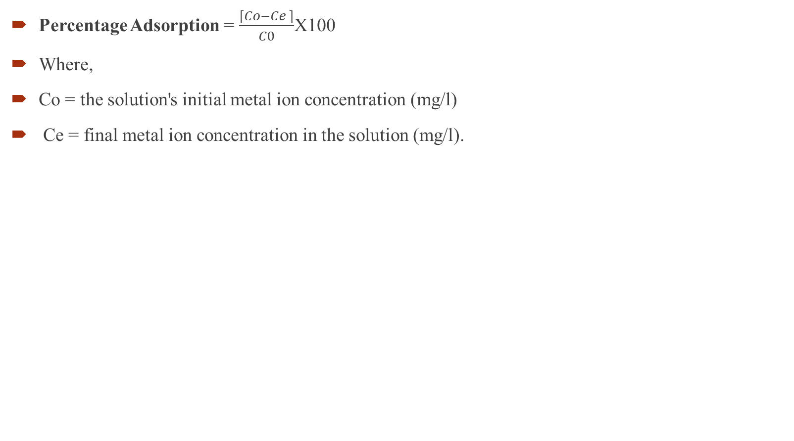
Percentage Adsorption = $\frac{[Co−Ce ]}{C0}$X100
Where,
Co = the solution's initial metal ion concentration (mg/l)
Ce = final metal ion concentration in the solution (mg/l).
Impact of Adsorption of Heavy Metals on Contact Time:
The adsorption of metal ions was observed to increase continuously with time until equilibrium was reached at 180 minutes. The percentage removal of cadmium varied as follows: red mud (64%-89%), and fly ash (60%-83%) (Figure 1) [12].
This variation may be attributed to the presence of alrger surface area active sites on the adsorbents. Similarly, the chromium removal rates were red mud (71%-91%), and fly ash (64%-84%) (Figure 2) [13].
Reduced adsorption efficiency, especially at the lower range, could be due to the limited availability of active sites on the adsorbents. For lead removal, the percentages for red mud, and fly ash were 63%-86%, 56%-94%, and 69%-89%, respectively (Figure 3) [14].

Slide 8
Fig 1 percentage removal of cadmium from different adsorbents

Slide 9
Fig 2 percentage removal of Chromium from different adsorbents

Slide 10
Fig 3 percentage removal of Lead from different adsorbents

Slide 11
CONCLUSION
Heavy metals like cadmium, lead, and chromium were selected for the current study's batch adsorption method of removing them from aqueous solutions.
The findings showed that adsorbents' adsorption effectiveness was greatly increased by decreasing their particle size. For the elimination of these metals, a particle size of 53 μm was shown to be quite effective
Because smaller particles have more surface area, there are more active sites available for adsorption, increasing removal efficiency. This emphasizes how crucial particle size is to raising an adsorbent's adsorption capability.
In order to remove lead, cadmium, and chromium from water and wastewater, the study used a variety of adsorbents, such as fly ash and red mud, all of which showed encouraging results .
Their high adsorption effectiveness guarantees little environmental impact in addition to lowering the concentration of hazardous metals in wastewater.
The use of these adsorbents in treating industrial effluents before discharge is crucial for preventing contamination of water bodies. By removing hazardous metals like Chromium, Lead, and Cadmium from wastewater, the risk of environmental and health hazards is significantly reduced.

Slide 12
REFERENCES
Ali, E. N., & Seng, H. T. (2018). Heavy metals (Fe, Cu, and Cr) removal from wastewater by Moringa oleifera press cake. MATEC Web of Conferences, 150, 02008, MUCET, EDP Sciences. https://doi.org/10.1051/matecconf/201815002008
Alinnor, I. J. (2007). Adsorption of heavy metal ions from aqueous solution by fly ash. Fuel, 86(5-6), 853–857.
Amin, N. M., Kaneco, S., Kitagawa, T., Begum, A., Katsumata, H., Suzuki, T., & Ohta, K. (2006). Removal of arsenic in aqueous solutions by adsorption onto waste rice husk. Indian Journal of Environmental Protection, 45(24), 8105–8110. https://doi.org/10.1021/ie060344j
Aziz, N., Jayasuriya, & Fan, N. L. (2016). Adsorption study on Moringa oleifera seeds and Musa cavendish as natural water purification agents for removal of Lead, Nickel and Cadmium from drinking water. Mat Sci Eng., 136, 1–9. https://doi.org/10.1088/1757-899X/136/1/012044
Bansal, M., Singh, D., & Garg, V. K. (2009). A comparative study for the removal of hexavalent chromium from aqueous solution by agriculture wastes’ carbons. Journal of Hazardous Materials, 171(1–3), 83–92. https://doi.org/10.1016/j.jhazmat.2009.05.124.

Slide 13
THANK YOU

