Slide 1
Global Perspectives on AI Innovations in Education: The Role of ChatGPT
Ms. Rashi Bhati, Assistant Professor, Department of Management, Mangalmay Institute of Management and Technology, Greater Noida, Uttar Pradesh
Dr. Diwakar Chaudhary, Assistant Professor, Department of Management, Mangalmay Institute of Management and Technology, Greater Noida, Uttar Pradesh
Mr. Rishi Jain, MBA Student, Department of Management, Mangalmay Institute of Management and Technology, Greater Noida, Uttar Pradesh

Slide 2
INTRODUCTION
The release and rapid difference of ChatGPT have caught the attention of educators worldwide. Some educators are enthusiastic about its potential to support learning.
Others are concerned about how it might circumvent learning opportunities or contribute to misinformation.
To better understand reactions about ChatGPT concerning education, we analyzed Twitter data (16,830,997 tweets from 5,541,457 users).
Based on topic modeling and sentiment analysis, we provide an overview of global perceptions and reactions to ChatGPT regarding education.
ChatGPT triggered a massive response on Twitter, with education being the most tweeted content topic. Topics ranged from specific (e.g., cheating) to broad (e.g., opportunities), which were discussed with mixed sentiment.

Slide 3
We traced that authority decisions may influence public opinions.
We discussed that the average reaction on Twitter (e.g., using ChatGPT to cheat in exams) different from discussions in which education and teaching learning researchers are likely to be more interested (e.g., ChatGPT as an intelligent learning partner).
This study provides insights into people’s reactions when new groundbreaking technology is released and implications for scientific and policy communication in rapidly changing circumstances.
Artificial intelligence (AI) has the potential to transform the eld of education, and its applications are becoming increasingly prevalent. e massive discussion and adoption of ChatGPT following its November 30, 2022 release suggest that AI can rapidly change how we learn and communicate.
The release of ChatGPT generated a great deal of excitement and trepidation as to its possible effects on education. The announcement from Microsoft to make programs like ChatGPT available for all users through its once program hints at the broad impact of how people may soon leverage AI in their written communication.
As generative AI tools such as ChatGPT become more integrated into education, educators must address crucial questions about the future of teaching and learning.
Students will need to understand how AI works, it’s accordance and challenges, and how they can harness its power without reproducing the biases inherent in its training data.

Slide 4
Teachers will have to walk along- side, learning as they go and reinforcing preexisting habits such as corroboration and interrogation of sources, critical thinking, and ethical use of sources.
Theoretical background
What is ChatGPT? ChatGPT (https://openai.com/blog/chatgpt) is the latest release of the Generative Pre- trained Transformer (GPT) family of language models released by OpenAI (https://openai.com) on November 30, 2022.
A language model is a statistical model that can predict the probability of a sequence of words. With this capability, a language model can generate natural language in a human style.
Like all statistical models, a language model needs to be trained by many word sequences to calculate the probability of each sequence. The number of word sequences or the training corpus size used to train a model determines how much experience a model can gain about the language and, more importantly, the knowledge incorporated in the language.
ChatGPT is a large language model trained with data from the Internet and many scanned books. Brown et al.6 reported using a corpus of 499 billion words to train the GPT-3 model, which was the base model for ChatGPT at its first release.
ChatGPT now draws on GPT-4, a much larger and more powerful model.

Slide 5
Opportunities and risks of ChatGPT for education. ChatGPT and other large language models can potentially have a large effect on teaching and learning in practice. is may include, for instance, the potential to facilitate more personalized and adaptive learning and organize assessment and evaluation processes more efficiently. Also, Kasneci et al. emphasize the potential to compensate for educational disadvantages.
Human reactions to groundbreaking technological innovations. New technologies like ChatGPT can only achieve their potential if they are used in pedagogically sound ways. Active use is likely if users have a positive attitude toward the technology. Numerous theories postulate the importance of rational processes for accepting and adapting technological innovations.
Twitter data as a measure to gain insights into human reactions. Twitter is a microblogging platform where registered users can post brief messages called tweets (up to 280 Unicode characters for non-paying users; tweets). Tweets can be linked to specific persons (through links [@]) or specific topics (via hashtags [#]). Users can follow other users’ tweets. Twitter provides access to real-time data that can capture the public perceptions on innovations like ChatGPT (another example CRISPR33), significant events (e.g., Arab spring, U.S. elections, COVID-19:34,35), or reforms36.

Slide 6
Aims and research questions. ChatGPT can potentially transform educational processes worldwide, but whether and how it does so may depend on how educators take it up. In this study, we aim to gain insights into an unvarnished and immediate global human reaction to the release of ChatGPT that goes beyond statements made by individual stakeholders in education. Our study may help estimate human reactions to technology innova- tions that can also be relevant to the education sector in the future (e.g., incorporating measures for acceptance of new educational technologies such as information on bene ts or guidelines on how to use this technology directly when they are introduced). In addition, we examine which education-related topics were discussed by users and which topics tend to be disregarded but should not be ignored in a critical discussion of ChatGPT in educational contexts. We focused on the following three research questions (RQs) in the rst two months a er the ChatGPT release (November 30, 2022):
(RQ1) What was the global reception on Twitter about ChatGPT?
(RQ2) What topics related to ChatGPT emerged in the education topical cluster during this initial period on Twitter?
(RQ3) How were the most prevalent educational topics related to ChatGPT discussed on Twitter?

Slide 7
Methods
Data collection and preparation. . Using the Twitter API for Academic Research, we collected 16,830,997 tweets posted from November 30, 2022, to January 31, 2023.
We chose this rollout period to get an initial reaction from the public before many had spent much time thinking about or using ChatGPT.
The data collection procedure was as follows: first, we queried the Tweets that mentioned ChatGPT. Second, we identified and collected all conversations with either a sparking tweet (i.e., tweets that start a discussion) or a reply mentioning ChatGPT.
A conversation is defined as the sparking tweet and all other tweets directly replying to the sparking tweet. Notably, a conversation needs to include at least two different users. is led to 127,749 unique conversations. Notably, we found no mentions of ChatGPT on Twitter before November 30, 2022.

Slide 8
We anonymized the data to protect users’ privacy by replacing Twitter-assigned tweet, author, and conversation identifiers with random numeric identifiers.
Email addresses and phone numbers were substituted with placeholders. Similarly, we replaced usernames with anonymous user identifiers. In addition, we removed tweets that were most likely generated by computer programs (i.e., bots) using unsupervised text-based and heuristics approaches.
First, we removed bots by removing those 257,858 accounts that posted more than ten tweets during the observation period, or contained the word bot in their screen name, or their screen name ended with app or included app followed by a non-letter symbol (self-declared bots).
We set the number of tweets threshold based on the assumption that bots are prone to tweet, on average, significantly more than humans38.
We also removed accounts from the dataset that posted more than 1000 tweets. Overall, 283 bots and their 80,389 tweets were deleted based on the first rule.

Slide 9
Second, we deleted repetitive tweets about unrelated topics (e.g., spam-like product advertisements or cryptocurrency). e groups of tweets were found by clustering the document (tweet) embeddings. is text-based approach is preferred over the available tools for bot detection, such as Botometer39, because of the large dataset size and heterogeneous nature of the data.
In addition, modern bots are prone to behave in groups rather than individually. e text-based approach can capture coordinated behavior40. is led to a sample size of 16,743,036 tweets, 5,537,942 users, and 125,151 conversations.
Analytical method. We applied a topic modeling procedure to gain insight into topics users discussed a er ChatGPT was released (RQ1 and RQ2). We selected only tweets in English, deleted empty tweets and duplicates, and removed user mentions starting with “@”, hashtags, and links in all tweets.
Sentiment analysis. We performed sentiment analysis to gain insight into how users discussed ChatGPT a er it was released (RQ1 and RQ3). For this, we used all tweets in English, including conversations. e preprocessing procedure was identical to the one applied at the topic modeling step. Next, we used the rule-based model VADER to perform the sentiment analysis45, as VADER showed a high accuracy on Twitter data46 and outper- formed other sentiment so ware like LIWC when using Twitter data on education47.
Ethical approval. An ethics committee approved the study and the collection of the data. It con rmed that the procedures aligned with ethical research standards with human subjects (date of approval: 09-02-2023, le number: AZ.: A2.5.4-275_bi).

Slide 10
result
The global reception of ChatGPT (RQ1). To gain insights into the global reception on Twitter about ChatGPT, we rst looked at all 16,743,036 tweets (without identi ed bots and spam) of the rst two months a er the release of ChatGPT that include the term ChatGPT and tweets in related conversations (for descriptive statistics regarding the number of likes, retweets, replies, and quotes see Table 1A,B). We found that the number of tweets per day increased on average from 0 tweets before November 30, 2022, to over 550,000 tweets per day at the end of January (Fig. 1A,B). is number is impressive compared to the number of tweets related to other prominent hashtags in the past. For instance, in their analyses of the social media response (i.e., Twitter) to the Black Lives Matter debate, Ince et al.48 found that the Hashtag #BlackLivesMatter (including di erent spellings) was mentioned 660,000 times from the beginning of 2014 to November 2014. A more current comparison is the number of tweets regarding vaccine manufacturers AstraZeneca/Oxford, P zer/BioNTech, and Moderna dur- ing the COVID-19 pandemic. From December 1, 2020, to March 31, 2021, Marcec and Likic49 retrieved 701,891 tweets in English.

Slide 11
An overview of the ten most prevalent topics in education discussed on Twitter is given in Table 1. e most prevalent topic in the education topical cluster consisted of statements regarding the opportunities, limitations, and consequences of using ChatGPT in educational processes in general (Table 1). ese statements comprised 22% of all conversations (see T1 in Table 1). For instance, the functions of ChatGPT for educational processes
 | M | Median |  | SD | min | 25% | 50% | 75% | Max
(A) All tweetsa
Likes | 4.568 | 0 | 236.468 | 236.468 | 0 | 0 | 0 | 1 | 176,848
Retweets | 229.981 | 0 | 1688.009 | 1688.009 | 0 | 0 | 0 | 0 | 35,579
Replies | 0.391 | 0 | 13.761 | 13.761 | 0 | 0 | 0 | 0 | 17,185
Quotes | 0.036 | 0 | 3.449 | 3.449 | 0 | 0 | 0 | 0 | 4612
(B) Sparking tweetsb
Likes | 76.837 | 4 |  | 972.979 | 0 | 1 | 4 | 16 | 159,790
Retweets | 13.026 | 0 |  | 186.667 | 0 | 0 | 0 | 2 | 35,568
Replies | 6.556 | 1 |  | 100.024 | 1 | 1 | 1 | 3 | 17,185
Quotes | 1.708 | 0 |  | 27.571 | 0 | 0 | 0 | 0 | 4612
Table 1. Descriptive statistics of likes, retweets, replies, and quotes. a ese statistics refer to all N = 16,743,036 tweets from November 30, 2022, to January 31, 2023. b ese statistics refer to all N = 125,151 tweets from November 30, 2022, to January 31, 2023.

Slide 12
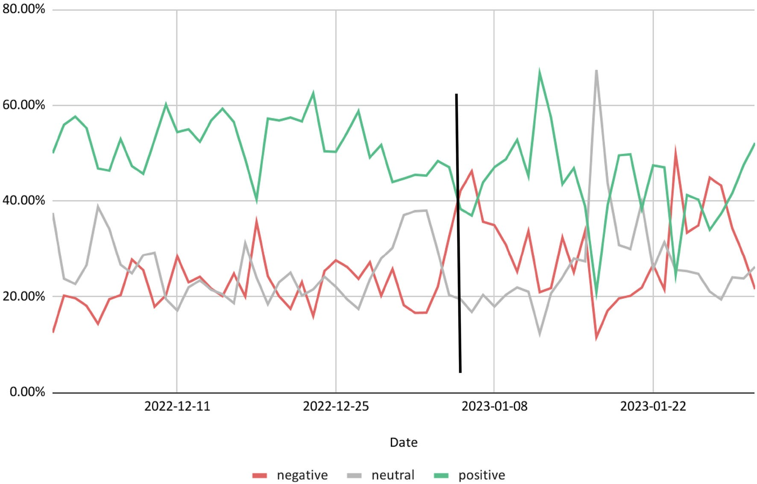
DISCUSSION
Fourth, although the ndings indicated that ChatGPT was generally discussed positively in the rst 2 months a er ChatGPT’s release, the statements regarding education were more mixed. is aligns with previous research on perceptions of technological innovations, which showed that users face most innovations with varying expec- tations and emotions.
Figure 1. Sentiment in education per day. e vertical line is plotted on January 5, 2023, which was the day when the proportion of negative tweets was greater than the proportion of positive tweets for the first time.

Slide 13
Limitations and future research. e results of this study must be interpreted considering at least the following limitations. First, although we have thoroughly prepared the data for the analyses, problems arise due to bots. Bots are computer programs that perform automated tasks, such as automatically retweeting tweets with a speci c hashtag. Bots are challenging to detect because their behavior constantly changes as technology advances40. We used heuristics and text-based approaches to identify and remove tweets posted by bots from our data but cannot guarantee that tweets from bots are still present in the data used. Second, due to our limitation of Tweets to those in English, our geographical focus is around 57% North America. us, our ndings may not be generalizable to other regions. ird, insight into the sample used for this study is limited by the informa- tion available through the Twitter API. For instance, we could not accurately determine whether politicians, academics, entrepreneurs, or opportunists tweeted. However, we were able to provide some general insights into the sample by analyzing, for instance, the sample’s experience with Twitter (operationalized by Twitter sign-up date) or the users’ reach (operationalized by number of followers; see Figs. D and E and Table A in the appen- dix). Fourth, we analyzed only the rst two months of conversations on Twitter a er the release of ChatGPT.

Slide 14
Conclusion
To conclude, ChatGPT is perhaps unique in how it exploded into the conversation and is only comparable to digital tools such as the Internet and computers that have proven to be of similar transformative magnitude.
The availability of social media, particularly Twitter, allowed many people to learn about and discuss generative AI quickly.
ChatGPT was also particularly impressive in its capabilities, far more functional, accessible, and conversational than other publicly available large language models. is ability for a worldwide conversation in real-time about the exploration of a potentially transformative digital tool is illustrated by the over half a mil- lion daily tweets we see only two months a er ChatGPT’s release.
Is rapid awareness in a space with an active academic user base allowed educators to participate in learning about and exploring the use of this new tool (and for many, over an academic break period when they perhaps had time and capacity more than usual).

Slide 15
Data availability
The datasets generated and analyzed during the current study are not publicly available as we use Twitter data that cannot be completely anonymized without signi cant e ort (i.e., individuals are identifiable through the tweets) but are available from the corresponding author on a reasonable request.
Received: 20 April 2023; Accepted: 7 September 2023

Slide 16
References
UNESCO. Beijing Consensus on arti cial intelligence and education. United Nations Educational, Scienti c and Cultural Organization (2019).
Kasneci, E., Sessler, K., Küchemann, S., Bannert, M., Dementieva, D., Fischer, F., Gasser, U., Groh, G., Günnemann, S., Hüllermeier, E., Krusche, S., Kutyniok, G., Michaeli, T., Nerdel, C., Pfe er, J., Poquet, O., Sailer, M., Schmidt, A., Seidel, T., Kasneci, G. ChatGPT for good? On opportunities and challenges of large language models for education. Learn. Indiv. Di . 103, 102274. https://doi.org/ 10.1016/j.lindif.2023.102274 (2023).
Warren, T. Microso to demo its new ChatGPT-like AI in Word, PowerPoint, and Outlook soon. e Verge. https://www.theve rge.com/2023/2/10/23593980/microso -bing-chatgpt-ai-teams-outlook-integration (2023).
Rudolph, J., Tan, S., & Tan, S. ChatGPT: Bullshit spewer or the end of traditional assessments in higher education? J. Appl. Learn. Teach. 6(1). https://doi.org/10.37074/jalt.2023.6.1.9 (2023).

Slide 17
THANK YOU

