Slide 1
SUSTAINABLE EDUCATION AND YOUTH EMPOWERMENT: FOUNDATIONS FOR A FUTURE CIVIL SOCIETY
Ms. Rashi Bhati, Assistant Professor, Department of Management, Mangalmay Institute of Management and Technology, Greater Noida, Uttar Pradesh
Dr. Diwakar Chaudhary, Assistant Professor, Department of Management, Mangalmay Institute of Management and Technology, Greater Noida, Uttar Pradesh
Ms. Akanksha Pandey, MBA Student, Department of Management, Mangalmay Institute of Management and Technology, Greater Noida, Uttar Pradesh

Slide 2
INTRODUCTION
While sustainability is at the center of many government agendas, there is a great risk of entrusting strategic decisions to those lacking in sustainability expertise.
It is therefore necessary to ensure that universities are the green engines of sustainable communities.
The present study administered a questionnaire to students enrolled in a Management Engineering programme at an Italian university, to collect their perceptions of and opinions on sustainability and energy issues. Students completed the questionnaire twice: once prior to beginning and once at the end of term.
The results showed that students held more sustainable attitudes at the end of term, and perceived sustainable education and youth confidence as the building blocks of future society.
They also observed that decarbonization of the Italian energy system and national energy independence would require the signify development of renewable systems and interventions to promote energy effi In addition, they recognized subsidies for green production, energy communities, defeated waste collection, and professional skills training as crucial.

Slide 3
The sustainable university should support younger generations by encouraging student engagement in real-world projects and the development of long-term, structured teacher-student relationships.
Amidst ongoing unsettling events, including a global pandemic and a war in Ukraine, the challenge of sustain- ability remains central.
In addition, there are many problems related to health, human rights, and the environment, including malnutrition and food insecurity, as well as water shortage.
The Sustainable Development Goals (SDGs) o er a pathway to reconciling economic growth with environmental concerns, through a highly interconnected framework of analysis.
All countries must develop policies and trackable objectives to support the achievement of these goals.
The dilemma of intergenerational sustainability refers to the challenge of determining whether one will sacrifice in the present for the sake of future generations.

Slide 4
METHODS
The present study adopted a behavioral methodology, in line with the classification proposed by Sovacool et al.29. More specifically, it took a multidisciplinary approach, fusing ideas from numerous disciplines (e.g., psychology, engineering, economics).
Questionnaires are commonly implemented to assess consumer30,31 and producer32 attitudes and behaviors in many areas. Similar to Menon and Suresh35, the present study deployed this methodology to collect information from a sample of students.
Ethics statement. Given that the research is a non-experimental voluntary survey, no ethical approval is necessary. Furthermore, the self-administered survey that is non-experimental in nature was conducted under complete anonymity for the participants. No personal or sensitive information that can be used to identify the respondents were collected. Besides, the consent of the respondents to partake in the online survey were seek before the survey was executed by including an electronic informed consent in the online survey form.

Slide 5
RESULTS
The present study combined a conventional methodological approach with an innovative approach to application.
While the concept of sustainability evokes opportunities for younger generations, the needs and opinions of youths are not always heard, and issues around sustainability have only recently gained space within educational curricula., us the present study administered a questionnaire to explore how and whether students’ responses changed when taking a course on sustainability.
All questionnaire items pertained to topics that were covered in the educational course.
General data. erst block of items concerned general sustainability (e.g., the de nition of sustainability) and its behavioural aspects (e.g., individual sustainability behaviours). In general, many individuals are unclear about the meaning of sustainability, tending to link it to only the environment.

Slide 6
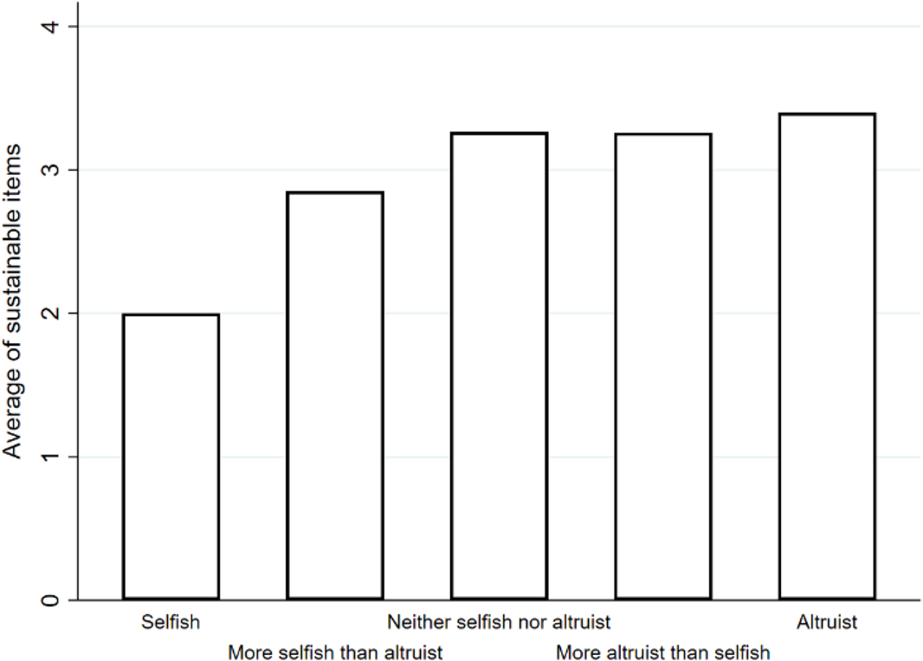
Sustainability behaviors. e literature shows that pro-environmental attitudes relate to certain character aspects, including altruism. Therefore, students were asked to assess their degree of altruism. Approximately 75% described themselves as more altruistic than sells (see question 7 in supplementary Appendix A).
Figure 1. Mean values for each degree of altruism, in relation to the index of sustainable behaviors.
Economics of sustainable energy. e second block of questionnaire items concerned more speci c energy issues discussed in the course. ese items assessed students’ willingness to pay (WTP) for green items and their particular behaviours as both producers and consumers (see questions 17–20 in supplementary Appendix A).

Slide 7
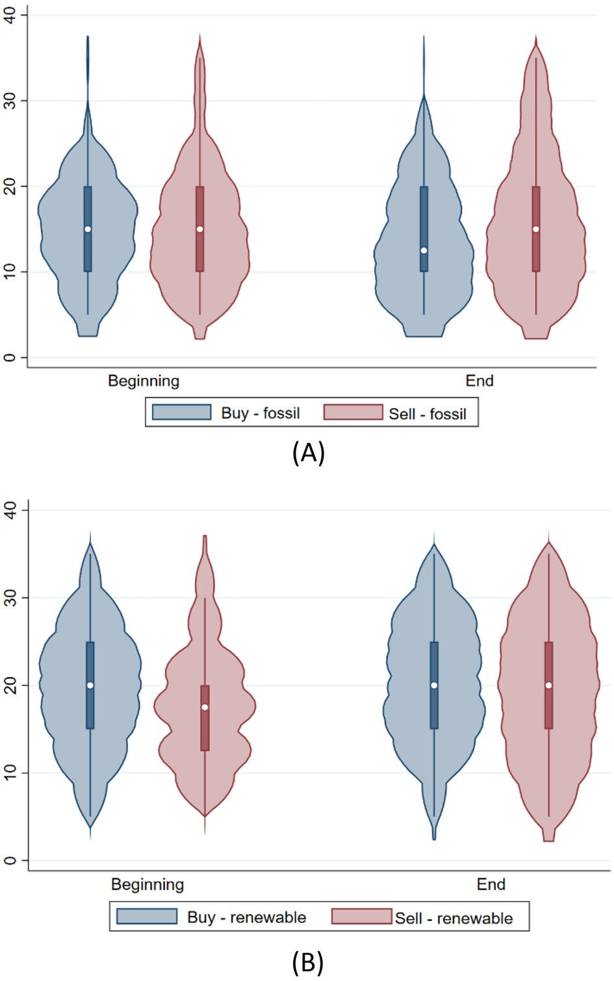
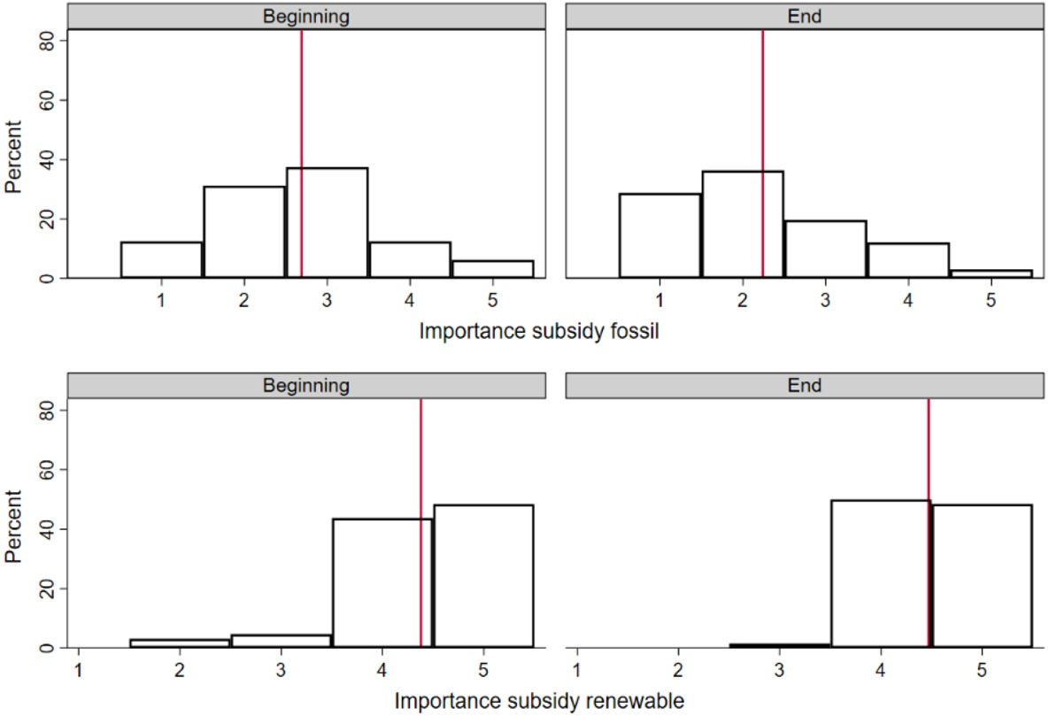
Subsidies for energy. Subsidies are a controversial topic. On the one hand, they are deemed necessary for the green transition, by reducing production costs for sustainable items to a point that they are competitive with those of fossil-based products (without considering externalities). On the other hand, their use must be metred to prevent any increase in public debt or the price paid by the nal consumer. Students were asked to express their opinion on a 5-point scale about the importance of subsidies for both renewable and fossil-based energy (see questions 21–24 in supplementary Appendix A).
Figure 2. WTP values for the purchase and sale of energy produced from fossil sources (A) and renewable sources (B).
Figure 3. Distribution of responses on the importance of subsidies for the production of energy from fossil or renewable sources. Red lines represent the mean values of 2.7 (beginning) and 2.2 (end) for energy from fossil sources and 4.4 (beginning) and 4.5 (end) for energy from renewable sources.

Slide 8
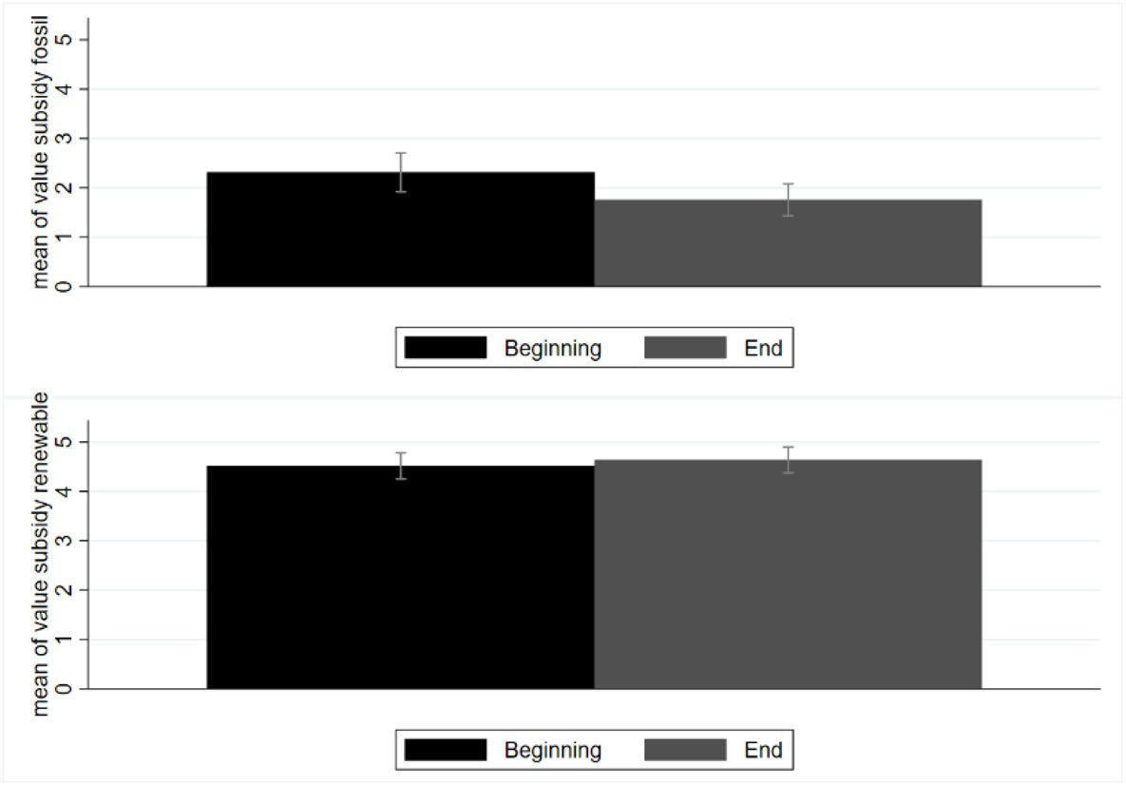
Energy communities, sustainable certifications and sustainable competitive advantage. Stu- dents were also asked to express their opinion on the importance of energy communities, certi cations and competitive advantages. ese variables showed the same and a maximum increase between the beginning and the end of the course (+ 0.4) (see Fig. 6 and see questions 21, 22 and 28 in supplementary Appendix A).
Energy-related policies. While a large proportion of engineering students (42%), who would be expected to support the use of technology, noted that current technologies should be su cient to meet the sustainability challenge, an equal proportion of students saw an additional change in behaviour as necessary to decarbonize the Italian system (see question 42 in supplementary Appendix A).
Figure 4. Average values assigned to subsidies for the self-consumption of energy from fossil and renewable sources. Black bars represent the average values at the beginning of the course and grey bars represent the average values at the end of the course. All values are expressed in cent€/kWh.

Slide 9
DISCUSSION
The present study, in accordance with the literature, emphasized the central role played by students in contributing to the sustainability challenge.
Especially, the results showed that the sustainability course was essential for changing students’ sustainability attitudes and behaviors. endings support the model of a sustainable community based on stakeholder engagement, which can fundamentally change even industrial systems.
However, sustainable communities require support from HEIs26, which in turn need to connect to the outside world52 and embrace change, on the basis of dynamic competencies.
Some authors have suggested rethinking the role of universities within society by strengthening their connection with local realities in order to increase their resilience54, without neglecting the importance of their internalization55. In this vein, empathy and trust have been identified as critical for achieving a cooperative model.

Slide 10
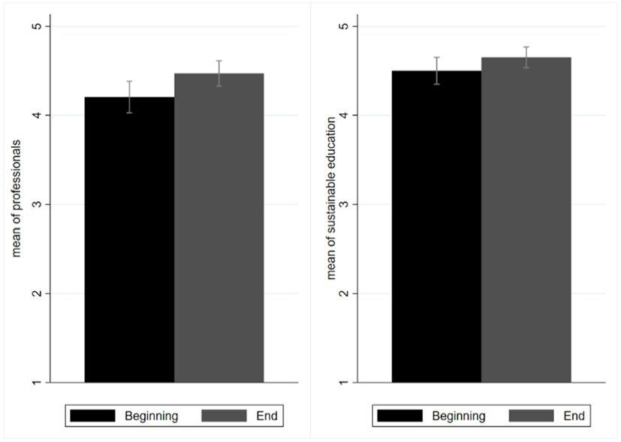
CONCLUSIONS
The sustainability challenge has not only led to a different approach to the creation of products and services, but it has also promoted the development of new social models. Previous research has explored the topic of sustainability within HEIs, where there are ongoing efforts to provide the right skills for future graduates.
Figure 5. Mean values for sustainable education and the need for new professionals to support the green transition. Black bars represent values recorded at the beginning of the course and grey bars represent values recorded at the end of the course. Values range from 1 to 5, according to the Likert scale.

Slide 11
DATA AVAILABILITY
All data generated or analysed during this study are included in this published article [and its supplementary information les].

Slide 12
REFERENCES
Pereira, P., Bašić, F., Bogunovic, I. & Barcelo, D. Russian–Ukrainian war impacts the total environment. Sci. Total Environ. 837, 155865 (2022).
Elavarasan, R. M. et al. Impacts of COVID-19 on sustainable development goals and e active approaches to maneuver them in the post-pandemic environment. Environ. Sci. Pollut. Res. 29, 33957–33987 (2022).
Osendarp, S. et al. Act now before Ukraine war plunges millions into malnutrition. Nature 604, 620–624 (2022).
Garg, K. K. et al. Identifying potential zones for rainwater harvesting interventions for sustainable intensi cation in the semi-arid tropics. Sci. Rep. 12, 3882 (2022).
Smith, T. B., Vacca, R., Mantegazza, L. & Capua, I. Natural language processing and network analysis provide novel insights on policy and scienti c discourse around sustainable development goals. Sci. Rep. 11, 22427 (2021).

Slide 13
THANK YOU

