Slide 1

NSF FELLOWS’ PERSPECTIVES ON INCENTIVES, RESEARCH MISCONDUCT, AND SCIENTIFIC INTEGRITY IN STEM ACADEMIA
Dr. Diwakar Chaudhary
Assistant Professor, Department of Management, Mangalmay Institute of Management and Technology, Greater Noida, Uttar Pradesh
Ms. Rashi Bhati
Assistant Professor, Department of Management, Mangalmay Institute of Management and Technology, Greater Noida, Uttar Pradesh
Ms. Ishita Goswami
MBA Student, Department of Management, Mangalmay Institute of Management and Technology, Greater Noida, Uttar Pradesh

Slide 2
ABSTRACT
There is increased concern about perverse incentives, quantitative performance metrics, and hyper- competition for funding and faculty positions in US academia. Recipients of the prestigious National Science Foundation Graduate Research Fellowships (n = 244) from Civil and Environmental Engineering (45.5%) and Computer Science and Engineering (54.5%) were anonymously surveyed to create a baseline snapshot of their perceptions, behaviors and experiences. NSF Fellows ranked scientific advancement as the top metric for evaluating academics followed by publishing in high-impact journals, social impact of research, and publication/citation counts. The self-reported rate of academic cheating was 16.7% and of research misconduct was 3.7%. Thirty-one percent of fellows reported direct knowledge of graduate peers cheating, and 11.9% had knowledge of research misconduct by colleagues. Only 30.7% said they would report suspected misconduct. A majority of fellows (55.3%) felt that mandatory ethics trainings left them unprepared for dealing with ethical issues. Fellows stated academic freedom, flexible schedules and opportunity to mentor students were the most positive aspects of academia, whereas pressures for funding, publication, and tenure were cited as the most negative aspects. These data may be useful in considering how to better prepare STEM graduate trainees for academic careers.

Slide 3
INTRODUCTION
U.S. scientific enterprise grew exponentially in the post-World War II era with large financial investments from the federal government.
In the twenty century, there are concerns that the rising importance of possible perverse incentives (i.e., emphasizing quantitative performance metrics, funding, high impact journal publications and prestige) in STEM academia might undermine the quality of research performed, maintenance of high ethical standards and productive use of taxpayer dollars.
For example, it is hypothesized that reward- ing researchers for higher publication or citation counts can lead to “natural selection” of substandard science and reduced emphasis on quality hypotheses and research questions.
Maintaining scientific integrity is deemed “vital” for the US’ national interest, but there is relatively little data on this subject from targeted surveys of high-performing US researchers.
In this article, we report results from an anonymous, online survey of U.S. National Science Foundation (NSF) Graduate Research Fellowship recipients (here a er, “NSF Fellows” or “Fellows”) on their perceptions of STEM and academia.

Slide 4
METHODS
study was approved by Virginia Tech’s Institutional Review Board (IRB #17-677) and administered online via Qualtrics (www.qualtrics.com) between February 18–May 02, 2019.
Active email addresses could be retrieved for 1078 fellows through online searches, who were each sent one recruitment and one reminder email containing a unique survey link.
Fisher’s exact test of independence and Pearson’s Chi-Square test were used to analyze cheating and misconduct responses by NSF Fellows’ gender, cohort year, discipline and academic stage.
A p-value below 0.05 was used to establish statistical significance for assigned variables.
Responses could be classified by discipline for 218 of 244 (89.3%) Fellows based on primary undergraduate major, dates respondents began filling out the survey (recruitment emails were sent to CEE and CSE email lists during di erent weeks) and responses to open-ended questions mentioning discipline.

Slide 5
RESULTS
The overall response rate for this survey was 22.6%, based on 1078 Fellows who received recruitment emails (Tables S1 and S2) containing unique links to the survey (Text S1).
As one survey eligibility criterion was that every respondent should have received formal ethics training, this may explain the somewhat low overall participation rates.
The respondent pool (n= 244) was relatively evenly distributed between the CSE (54.5%; n = 133) and CEE (45.5%; n = 111) disciplines, and between female (50.8%, n = 124) and male (48.4%, n = 118) genders. Eighty-one percent (n= 198) were awarded their fellowships in 2012–2017 and the rest (18.9%; n = 46) in 2002–2007.
A majority of Fellows agreed that research ideally is or should be about truth-seeking (87.3%; n = 213) and service to humanity (67.6%; n = 165).
In contrast, when asked about self-advancement only 24.3% (n = 59) felt that should be a primary objective while 67.5% stated it should sometimes be an objective. Only 8.2% (n = 20) said research should not be about self- advancement.

Slide 6
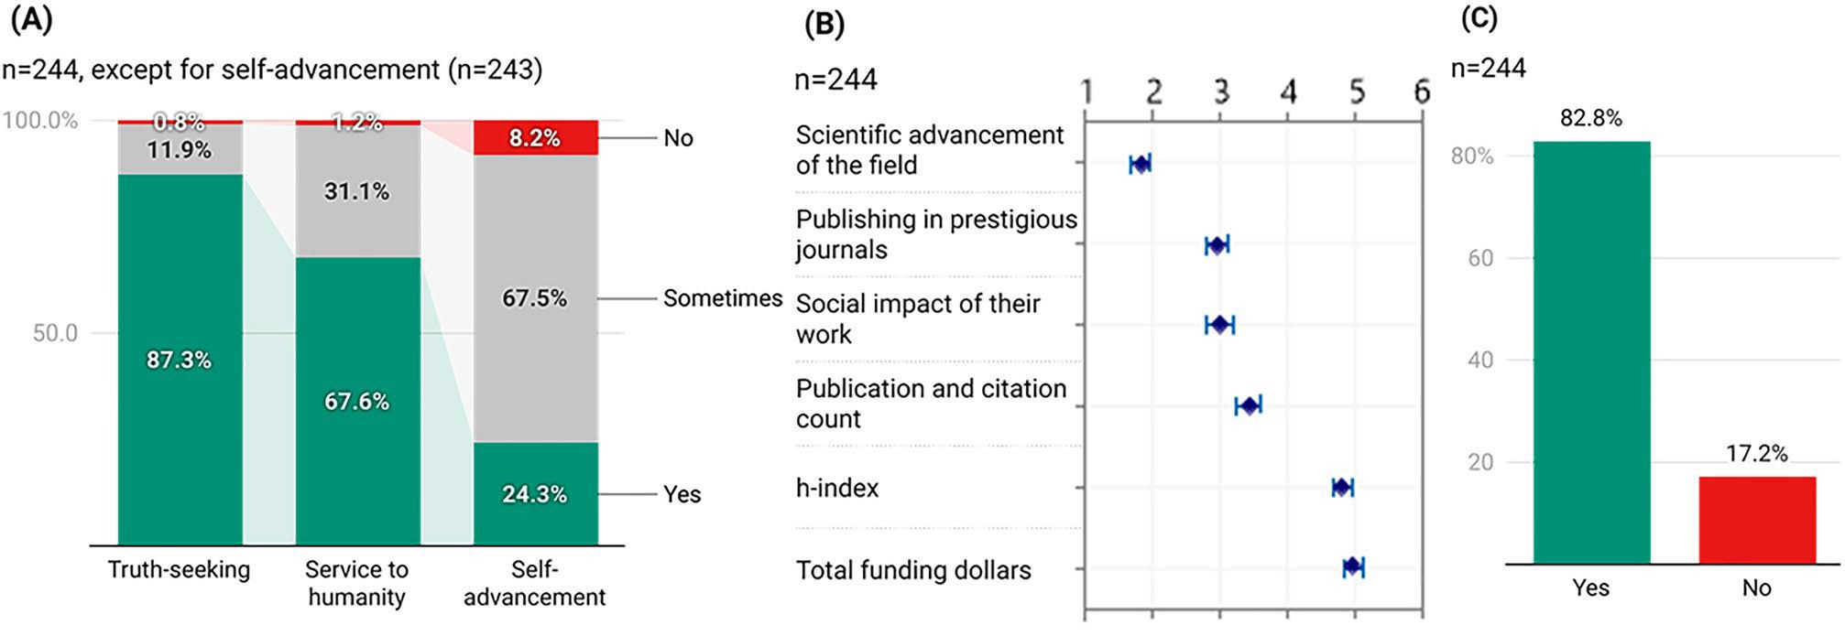
Science and scientists. (A) NSF Fellows who believe research is or should be about truth-seeking, service to humanity, or self-advancement. (B) Criteria Fellows use to evaluate academic peers (ranked in decreasing order of importance). (C) Whether Fellows applied the same criteria for themselves?
A majority of Fellows agreed that research ideally is or should be about truth-seeking (87.3%; n = 213) and service to humanity (67.6%; n = 165) shows in this figure. In contrast, when asked about self-advancement only 24.3% (n = 59) felt that should be a primary objective while 67.5% stated it should sometimes be an objective. Only 8.2% (n = 20) said research should not be about self- advancement.

Slide 7
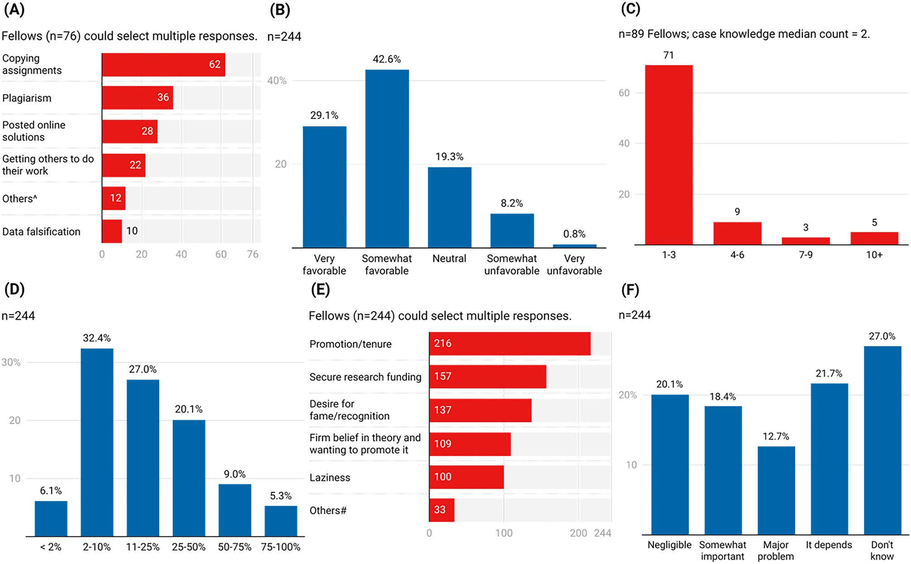
Academic cheating and research misconduct. (A) Types of cheating witnessed by NSF Fellows among graduate school peers. (B) Perceptions of research integrity practices based on graduate school experiences. (C) Histogram of research misconduct case counts Fellows reported direct knowledge of in their elds (original responses listed in Table S6). (D) Perceived proportion of researchers who succumb to pressures and commit misconduct at least once in their career. (E) Factors that contribute to misconduct or fraud. (F) Impact of uncovered fraud on their eld. ^,#Responses under “Others” listed in Tables S4 and S6, respectively.
Over half (62.3%; n = 152) noted that the level of cheating made them rethink their career choice and the people their eld was attracting. e top three most common types of cheating Fellows witnessed their gradu- ate school peers engage in (Fig. 2A). Based on their graduate school experiences, 71.7% fel- lows (n = 175) had a somewhat or very favorable perception of current research integrity practices, while only 9% (n = 22) viewed the policies as somewhat or very unfavorable (Fig. 2B).

Slide 8

Dishonesty In This Survey. Crosstab Of Nsf Fellows Tempted To Lie And Confessed To Actually Lying On This Survey
Table 6 presents a crosstab analysis of dishonesty among NSF Fellows regarding their temptation to lie and whether they confessed to actually lying in the survey. Out of 244 respondents, 6 (2.5%) admitted to lying, and all of them were among the 6 individuals (2.5%) who acknowledged being tempted to lie. This indicates that every respondent who confessed to lying also reported the temptation to do so, while none of the 238 individuals who denied lying (97.5%) reported being tempted.

Slide 9
REFERENCES
Braxton, J. M. Perspectives on Scholarly Misconduct in the Sciences. (Ohio State University Press, 1999).
Bush, V. Science, the endless frontier. Science, the Endless Frontier (Princeton University Press, 1945).
Franzen, S. University Responsibility for the Adjudication of Research Misconduct. (Springer, 2021).
Anderson, M. S., Ronning, E. A., De Vries, R. & Martinson, B. C. e perverse e ects of competition on scientists’ work and relationships. Sci. Eng. Ethics 13, 437–461 (2007).
Edwards, M. A. & Roy, S. Academic research in the 21st century: Maintaining scienti c integrity in a climate of perverse incentives and hypercompetition. Environ. Eng. Sci. 34, 51–61 (2017).

Slide 10
THANK YOU

