Slide 1
THE ENDURANCE OF COGNITIVE BIASES IN FINANCIAL DECISION-MAKING ACROSS ECONOMIC GROUPS
Mr. Piyush Kumar
Assistant Professor, Department of Management, Mangalmay Institute of Management and Technology, Greater Noida, Uttar Pradesh
Ms. Himani Chaudhary
Assistant Professor, Banarsidas Chandiwala Institute of Professional Studies, New Delhi
Mr. Swatm Rajyahan
MBA Student, Department of Management, Mangalmay Institute of Management and Technology, Greater Noida, Uttar Pradesh

Slide 2
ABSTRACT
While economic inequality continues to rise within countries, efforts to address it have been largely ineffective, particularly those involving behavioral approaches. It is often implied but not tested that choice patterns among low‑income individuals may be a factor impeding behavioral interventions aimed at improving upward economic mobility. To test this, we assessed rates of ten cognitive biases across nearly 5000 participants from 27 countries. Our analyses were primarily focused on 1458 individuals that were either low‑income adults or individuals who grew up in disadvantaged households but had above‑average fi well‑being as adults, known as positive deviants. Using discrete and complex models, we fix evidence of no differences within or between groups or countries. We therefore conclude that choices impeded by cognitive biases alone cannot explain why some individuals do not experience upward economic mobility. Policies must combine both behavioral and structural interventions to improve financial well‑being across populations.

Slide 3
INTRODUCTION
Economic inequality is a direct and global barrier to upward mobility and positive socioeconomic outcomes, perpetuating negative effects for individual and population health, well-being, and sustainability.
Within countries, economic inequality continues to rise, made worse by the COVID-19 pandemic, disrupting decades of improvement in which inequality between countries had declined.
Behavioral interventions have attempted to reduce inequalities by informing individuals of the decisions associated with better socioeconomic outcomes. For instance, the Swedish governments opt-out pension plan for workers facilitated better pension investment strategies

Slide 4
In Kenya, unconditional cash transfers (UCTs) promoted better socioeconomic outcomes by enabling the coverage of immediate costs and the investment of any excess funds (e.g. in durable assets or business activities)
“Positive deviance” is a framework which studies individuals from disadvantaged circumstances that experience notably better outcomes or routinely make more optimal choices than similarly disadvantaged peers
As general interventions for improving financial well-being may inadvertently back re among underprivileged groups, considering the patterns of positive deviants may aid in developing programs with more successful impact.
To ensure reliability, replicability, and generalizability prior to proposing a new construct for explaining behavior, there is consider- able value in taking a multi-country, large-sample approach

Slide 5
METHODS
Following data collection, 27 countries were fully included, using 22 languages. Two countries were attempted but were unable to ful 11 certain tasks or were removed for ethical concerns.
All survey instruments utilized forward-and-back translations for all countries in their primary language.
To measure cognitive biases with implications for decision-making in financial situations, we used 15 decision items that assessed 10 cognitive biases. ese items were selected following preliminary data from a parallel study that was pre-registered using the Open Science Framework prior to data collection.
Participant recruitment utilized Qualtrics surveying so ware to collect data. Most participants were recruited using the Demić-Većkalov method, which included posting links on discussion threads and online news articles (social media, popular forums, and news websites).

Slide 6
RESULTS
To test our pre-registered hypotheses (osf.io/wj9yn), we ran binomial logistic regressions to predict differences in the presence of individual cognitive biases between positive deviants and low-income individuals (we mostly ignore comparisons with high-income individuals for this research, though data are available for such use).
Across ten cognitive biases, rates observed ranged from 28.2% (temporal discounting) to 70% (ambiguity bias). On average, participants exhibited 3.23 (SD = 1) cognitive biases.
As a robustness check, we also ran complementary Bayesian logistic regressions, whose results are consistent with these. We conclude that this additional analysis provides further evidence that rates of cognitive biases do not seem to di er between positive deviants and low-income adults.

Slide 7
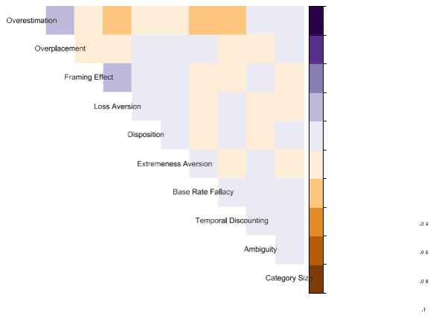
Correlation between ten biases within 3346 participants showed each bias was largely unique and not collinear with other biases assessed, with the exception of over placement and overestimation (which rely on the presence of some biases)
Across ten cognitive biases, rates observed ranged from 28.2% (temporal discounting) to 70% (ambiguity bias). On average, participants exhibited 3.23 (SD = 1) cognitive biases. As indicated in this figure, individual biases were not highly correlated within individuals, which is why we treated them in discrete analysis rather than creating an index.

Slide 8
DISCUSSION
We anticipated ending small-to-moderate effects between groups indicating positive deviants were less prone to biases involving risk and uncertainty in financial choices.
As our measures were effective at eliciting biases on a scale to be expected based on existing research, and as there were relatively low correlations between individual biases, we conclude that there is no evidence from our sample to support that biases are directly associated with potentially harming optimal choices uniquely amongst low-income individuals.
We do not argue that behavior has no link to individuals overcoming or remaining in negative nancial circumstances.

Slide 9
If those patterns were validated and still produced differential outcomes, it would likely be a result of substantial system barriers and scarcity of opportunities.
If validated, it would provide even stronger arguments toward investment in substantive structural changes to reducing inequality, rather than assuming that individual changes can alone overcome broader barriers.
Our approach is therefore limited by not having been previously validated and used items that only superficially elicit biases but not necessarily react behaviors in real-world settings.
We are also limited in how we identified income groups, both due to the self-report nature and that partici pants were typically higher income as adults.

Slide 10
CONCLUSION
We sought to determine if individuals that had overcome low-income childhoods showed significantly different rates of cognitive biases from individuals that remained low-income as adults. We comprehensively reject our initial hypotheses and conclude that outcomes are not tied—at least not exclusively or potentially even meaningfully—to resistance to cognitive biases. Our research does not reject the notion that individual behavior and decision-making may directly relate to upward economic mobility. Instead, we narrowly conclude that biased decision-making does not alone explain a significant proportion of population-level economic inequality.

