Slide 1
THE SYNERGISTIC ROLE OF BLOCKCHAIN, ARTIFICIAL INTELLIGENCE, AND THE INDUSTRIAL INTERNET OF THINGS IN DIGITIZING SMALL AND MEDIUM-SIZED ENTERPRISES
Mr. Piyush Kumar, Assistant Professor, Department of Management, Mangalmay Institute of Management and Technology, Greater Noida, Uttar Pradesh
Ms. Himani Chaudhary, Assistant Professor, Banarsidas Chandiwala Institute of Professional Studies, New Delhi
Mr. Raushan Kumar, MBA Student, Department of Management, Mangalmay Institute of Management and Technology, Greater Noida, Uttar Pradesh

Slide 2
INTRODUCTION
Due to digitalization, small and medium‑sized enterprises (SMEs) have significantly enhanced their efficiency and productivity in the past few years.
The process to automate SME transaction execution is getting highly multifaceted as the number of stakeholders of SMEs is connecting, accessing, exchanging, adding, and changing the transactional executions.
The balanced lifecycle of SMEs requires partnership exchanges, management, manufacturing, and productivity stabilities, along with privacy and security.
Interoperability platform issue is another critical challenging aspect while designing and managing a secure distributed Peer‑to‑Peer industrial development environment for SMEs.
However, till now, it is hard to maintain operations of SMEs’ integrity, transparency, reliability, provenance, availability, and trustworthiness between two different enterprises due to the current nature of centralized server‑based infrastructure.

Slide 3
This paper bridges these problems and proposes a novel and secure framework with a standardized process hierarchy/lifecycle for distributed SMEs using collaborative techniques of blockchain, the internet of things (IoT), and artificial intelligence (AI) with machine learning (ML).
A blockchain with IoT‑enabled permissionless network structure is designed called “B‑SMEs” that provides solutions to cross‑chain platforms.
In this, B‑SMEs address the lightweight stakeholder authentication problems as well.
For that purpose, three different chain codes are deployed.
It handles participating SMEs’ registration, day‑to‑day information management and exchange between nodes, and analysis of partnership exchange‑related transaction details before being preserved on the blockchain immutable storage.
Whereas AI‑enabled ML‑based artifineural networks are utilized, the aim is to handle and optimize day‑to‑day numbers of SME transactions; so that the proposed B‑SMEs consume fewer resources in terms of computational power, network bandwidth, and preservation‑related issues during the complete process of SMEs service deliverance.

Slide 4
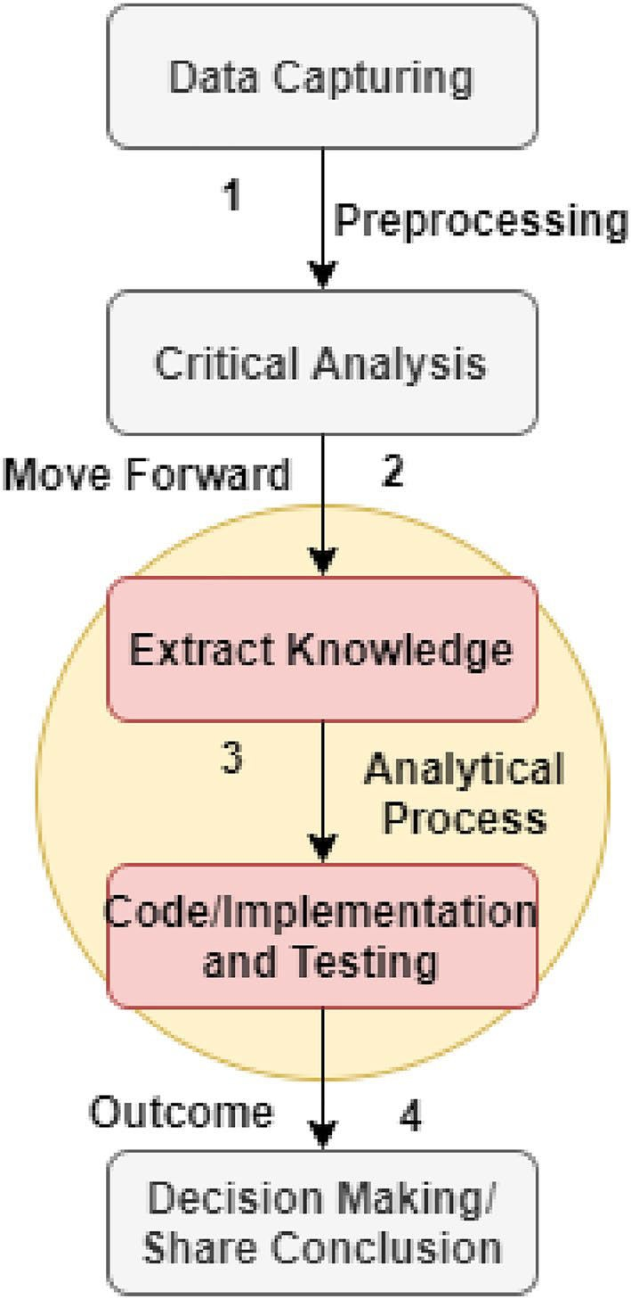
Thus, only 14.11% and 7.9% of B‑SME’s transactions use network bandwidth and storage capabilities compared to the current mechanism of SMEs, respectively.
The climate of global business and enterprises has changed the nature of development and related connectivity of SMEs.
It is also because of the competitive actuates in the market and day-to-day challenges rising in the recent era, in which small and medium-sized businesses are performing only as receiving and adopting regulatory bodies.
Manufacturing sectors contribute most of the ratio to economic development1.
Figure 1. e current process of SMEs with IoT for data management and decision making.

Slide 5
THE MAIN RESEARCH CONTRIBUTINS AND OBJECTIVES OF THIS PAPER ARE DISCUSSED AS FOLLOWS:
This paper addresses the current process between customers and SMEs, such as manufacturing, production, and industrial units interconnective, including data gathering, management, and optimization.
It is also analyzed that the implementation of digital technology with AI creates a new paradigm.
Probably analysis of the impacts of SMEs on the countries’ economy highlights the benefits of adoption.
In this paper, we highlight comparative research results related to digitalization, SMEs, industrial IoT, AI, blockchain, and their transformation conducted in Asia over the past few years.
The outcome of the research in which a standard process hierarchy is derived, that led to managing customer relationships with SMEs at a secure, protected, and standard level. The proposed B-SMEs (a blockchain and AI-enabled distributed framework) provide a platform where the DApp is designed, created, and deployed for the sake of a transparent transactional environment.

Slide 6
The main objectives are to handle SMEs-related automation, especially transaction verification and validation, exhaling, and sharing of resources among participants.
With the development of blockchain distributed public permissionless networks integrated with AI provide a lightweight authentication mechanism that reduces the cost of computational resources along with network bandwidth and storage.
There are three different chaincodes created and deployed for stakeholders’ registration, SME transactions and exchange updates, and information management and optimization of immutable storage.
However, individual transactions are protected with the use of the NuCypher threshold re-encrypted throughout the deliverance.
And so, the proof-of-work (PoW) and proof-of-stack (PoS) pre-de ned ethereum consensus is adopted along with a digital signature to schedule, initiate, manage, and approve transactions and related information exchange among participating stakeholders.
At last, this paper highlights a few of the open challenges, limitations, and issues involved in the imple- mentation and deployment of DApp BSMEs in real-time, which will consider as future developments for technological maturity.

Slide 7
RELATED WORK
In digitalization, the concept of digital transformation is considered an e client and active business approach used to build improved enterprises’ business practices compared to the traditional ones14.
It reduces the impact of external limitations and introduces a great change in SMEs’ operations by providing business strategies. While the adaptation of digital technology (DT), various challenging issues rises in both the sustainable economic development and social values of enterprises.
However, the proper utilization of DT improves the regional economical-social conditions.
To empower enterprises at every level, need to focus on the different phases of manufacturing growth, production, and sustainability.
Due to this, there are various studies presented that investigated the types of issues, challenges, and limitations, and proposed different methods, such as moderating the role of entrepreneurial orientation, dynamic capability IoT strategy, resource-based views, etc.

Slide 8
In this manner, SMEs and IoT collectively utilized blockchain as a secure infrastructure or a ledger that records events of node transactions and logs the changes in SMEs’ expert status. However, there are various other benefits of using collaboratively blockchain, IoT, and AI, for the sake of improving the eficiency and capability of SMEs, cost-e client transactions deliverance, and a secure information exchange environment. Therefore, we systematically reviewed various related studies that highlight the role of technology and its involvement in building a secure and protected SME environment (as discussed in Table 2). e list of comparison is mentioned as follows:
Using artificial intelligence technique.
Machine learning.
Internet of things.
Industrial and manufacturing process hierarchy.
Process development.
Customer oriented strategy.
De ne relationship between customer and SMEs.
Information management and organization.
Blockchain involvement.
Addresses privacy and security.

Slide 9
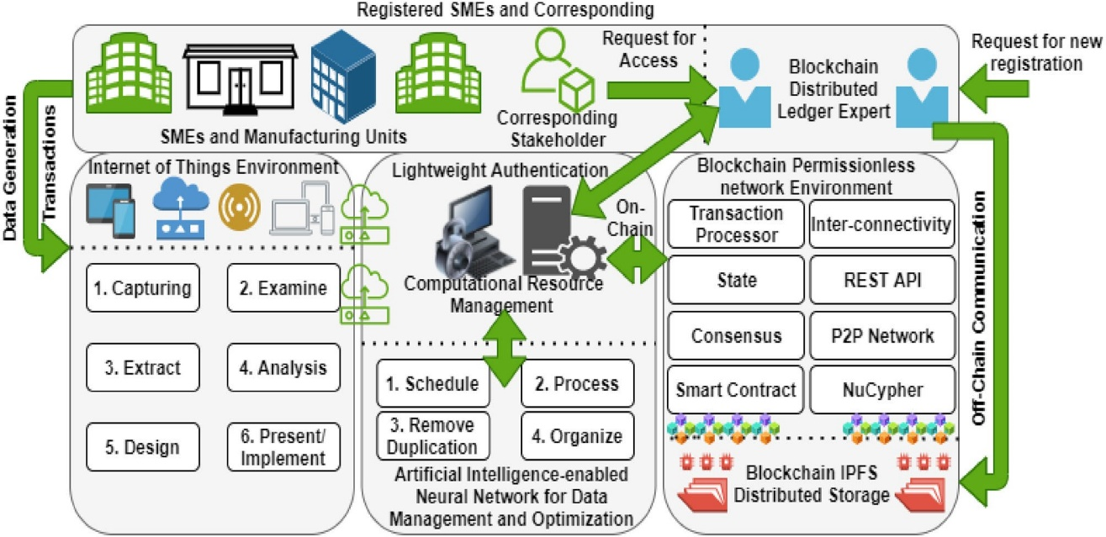
PROPOSED FRAMEWORK
Figure 2. The proposed B-SMEs.
Figure 2 presents the working hierarchy of the proposed B-SMEs.
An integrated blockchain and AI-enabled framework that is divided into three different folds. e rst is the IoT process hierarchy, which is designed to collect, separate, examine, and analyze generated data or transactions of SMEs.
A er proper examination, we design a schedule to transmit data via wireless sensor networks and implement a managerial hierarchy that manages day-to-day transactions.
Second, the AI compartment is split into two, such as computational resource management and AI-enabled neural network algorithm.

Slide 10
RESULTS AND DISCUSSION
A er the problem description of data management and optimization using ANN (as discussed in Section “Notation, problem formulation, and description”).
In this section, we present the work- ing operation along with the simulation results of B-SMEs ledger data management, optimization, computa- tional processing with lightweight authentication, and privacy preservation.
For lightweight B-SMEs authentica- tion, we connect a blockchain permissionless P2P public network with additional computing nodes to power the data processing.
Individual node is equipped with the eight-core i9 Evo processors (3.0 GHz with turbo boost). e systems run on Windows 11 with the blockchain docker and on their backend, the generic kernel is performed. ese nodes are implemented with two di erent types of memories, such as static (limited in nature) and dynamic to preserve data/transactions during overall execution.
However, the B-SMEs practically simulate on the simulated data with a few assumptions that are discussed as follows:
A xed size of node transactions = 4 MB.

Slide 11
FUTURE DIRECTION
In this context, the open research areas are presented in four different subsections; two are related to the digitalization and scope of SMEs in the future.
And so, others are based on the customer relationship between SMEs- enabled privacy, security, and automation concerns using industrial IoT, AI, and blockchain.
Blockchains and digitalization and scope of SMEs in the next decade. Nowadays, various nancial institutions invest their assets in the development of blockchain infrastructure to create their all operations digitally and ensure security and robust eficiency.
It is due to the increase acceleration in the development of information communication technology and digitalization that make SMEs and related activities more reliable.
For this infrastructure management, the designed system facilitates the process hierarchy of SMEs to manage reporting to top enterprises and regulatory authorities and provides convenience to combat money laundering.

Slide 12
CONCLUSION
Is paper discusses the existing security and privacy procedure and separates the loopholes while SMEs are interconnected and exchange related information during the intercommunication between node-to-node over the centralized network.
In this paper, we propose a B-SME, a collaborative technological framework using block- chain, IoT, and AI, that alleviates the resource usage of the collaborative technologies in the distributed network environment and create the system more reliable and efficient.
Is B-SMEs has implemented and deployed a secure process hierarchy of data management and optimization to be cost-effective and resource-efficient creating no problem in terms of the system’s provenance. It maintains efficient data integrity and a transparent, traceable, and reliable environment without affecting the container of blockchain docker.
The experimental results shows that the exchanging information between interoperable chains increases up to 17.3%, where it reduces the consumption of the system’s computational resources down to 9.13%.
Us, only 14.11% and 7.9% of B-SME’s transactions use network bandwidth and storage capabilities compared to the current mechanism running for SMEs, respectively.
However, for this purpose, we created three different chain codes (smart contracts), along with customizing consensus policies (such as PoW and PoS) to automate and investigate individual transactions of SMEs with proper verification and validation process.

Slide 13
THANK YOU

