Slide 1
CONNECTED COMMERCE: DIGITIZATION MEETS B2B MARKETING FOR SUPPLY CHAIN SUCCESS
GOPALA B
Research Scholar,
Alliance University, Bangalore.
gopalgopi765@gmail.com 9901107319
Subject: Management

Slide 2
Introduction
One of the major business challenges today is the increasing digitization in supply chain management and its introduction and use by B2B marketing organizations. In this report, digitization refers to the introduction and use of digital platforms, data, algorithms, and process automation in the B2B supply chain to enhance the efficiency and effectiveness of its management.
The method used to answer these three research questions was in-depth literature research followed by an in-depth case analysis using observational studies from senior executives’ interactions at various leading events in the B2B marketing and supply chain domain.
There is now a consensus that additional digitized, data-driven operations improvement and a seamless integration between these operations lead to enhanced competitive advantage.
Logistics and procurement should implement AI-based autonomous flow systems that are adjusted and improved by their own data to give the customer exactly what they need when they need it.

Slide 3
Literature Review
This section provides a review of previous studies and theoretical frameworks, determining the questions and focus areas in each of them based on the literature. In recent decades, extensive literature has been published on the opportunities that technology offers in the field of B2B marketing processes.
The researchers present a comprehensive and systematic review of digital data exchange, opportunities, and technology used in establishing digital marketing integration.
In recent years, there has been a growing emphasis on the intersection of digital marketing and supply chain management. However, academic research on this combined issue is relatively limited.
These studies collectively highlight the potential for digital tools to enhance B2B relationships and improve supply chain management performance.

Slide 4
Methodology
In the present study, we adopt a qualitative approach focusing on a collective case study underpinned by a survey among a group of marketing scholars to address the research questions defined.
In the present case study, the authors decided to use an electronic group-administered survey among a group of marketing scholars interested in supply chain management issues.
The first phase of our research consisted of a panel of well-recognized marketing scholars from Europe, the USA, Australia, and Asia. In this respect, a well-recognized refereed marketing journal was identified, and a special issue was distributed to a large number of marketing scholars from all over the world.
Consistent with the research objectives and the case study approach, the survey mainly focused on open-ended questions.

Slide 5
Dataset Structure
Category | Description | Measure/Metric | Value
Survey Participants | Total number of scholars surveyed | Count | 50
Regional Distribution | Scholars from Europe, USA, Australia, and Asia | % Representation | Europe: 25%, USA: 30%, Australia: 20%, Asia: 25%
Key Findings | Enhanced B2B Marketing | Recurrence in Responses (%) | 60%
Key Findings | Improved Supply Chain Management | Recurrence in Responses (%) | 70%
Tools Identified | AI-based Digital Tools | Adoption Rate (%) | 80%
Tools Identified | Supply Chain Agility | Recurrence in Responses (%) | 65%
Key Insights | Reduced Bullwhip Effect | Observed Impact (%) | 55%
Key Insights | Improved Collaboration | Observed Impact (%) | 75%
The information and the graph provided below show that with the help of digitization, B2B marketing and supply chain management (SCM) have been revolutionized.
For instance, artificial intelligence digital tools are adopted most by 80% of scholars that noted that such tools help in increasing operational efficiency and adaptability.

Slide 6
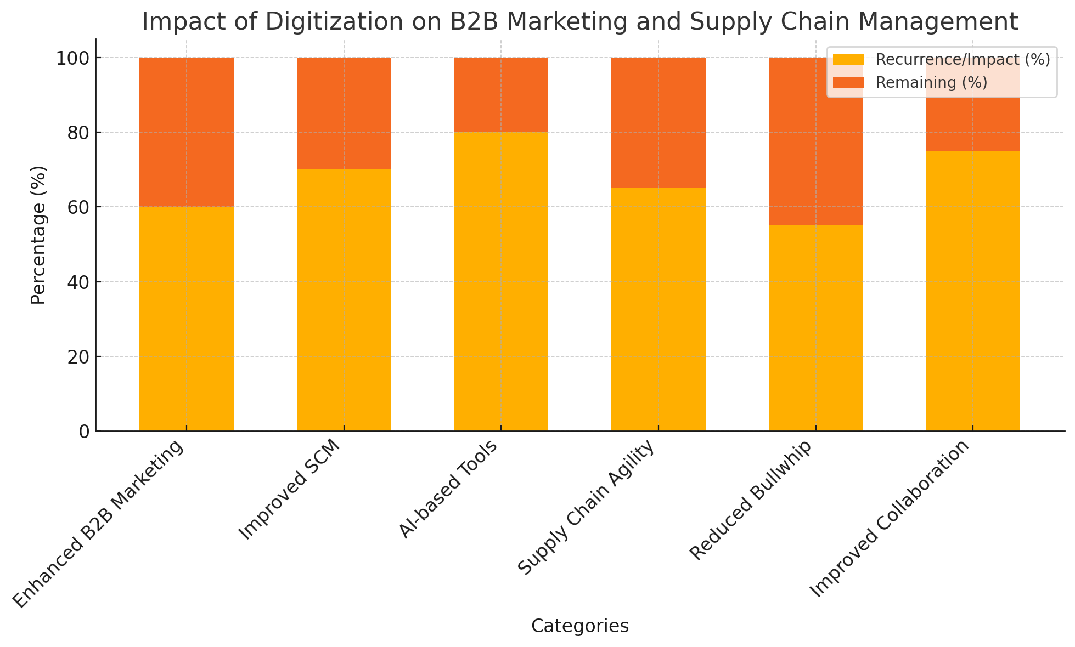
DIGITIZATION ON B2B MARKETING
This is also evident in the Improved Collaboration category, which records a high percentage impact of 75%,
which calls for an improved partnership that will enhance the optimization of the various digital systems.
While the Reduction in the Bullwhip Effect, this percentage is 55% which also shows the impact of digital tools in reducing supply-demand variability

Slide 7
Findings
First and foremost, the practical implications of the research findings will be outlined in an accessible manner. Most importantly, these can provide a unique insight into the ways in which digitization is facilitating both B2B marketing and supply chain management.
The data were analyzed and are presented here, discussing, where necessary, to affirm links to existing literature; and where differing from the existing models and frameworks, they are posed as a tentative framework due to the limitations of the initial research sample that only acquires one perspective of a particular company.
The keys to a high-performing company are explored in more detail in interviews and survey responses, where the specific transcript data elucidates the speculation posed.
The study also discusses how these findings can be applied, offering a practical guide for businesses looking to leverage the insights from the research.

Slide 8
Conclusions
Companies are increasingly investing in digitization to enhance supply chain management, potentially introducing a new approach to B2B marketing. For makers, to meet this level of digitization it is not enough to use descriptive indicators, but also to use predictive ones.
The results of this research directly answered the questions of the research topic. Based on this, it can be said that this research has contributed to the development of knowledge in the fields of supply chain management and B2B marketing.
Accordingly, further and expanded research is necessary. Nevertheless, the benefits for beneficiaries are clear. As digitization becomes popular, there is a need for literacy about the tools and structures for practitioners, decision-makers, and policy-makers.

Slide 9
References
business-to-business (B2B) marketing: A study to determine the scope and uniqueness of the practical learning opportunities provided in the program for students. Industrial Marketing Management. http://nscpolteksby.ac.id/
Hsu, C. H., Yang, X. H., Zhang, T. Y., Chang, A. Y., & Zheng, Q. W. (2021) Deploying big data enablers to strengthen supply chain agility to mitigate bullwhip effect: An examination of the electronics manufactures in China on a quantitative basis. Journal of Theoretical and Applied Electronic Commerce Research, 16(7), 3375-3405. http://www.mdpi.com
EH Lacka, HKC Chan and X Wang (2020). Technological advancements and B2B international trade: Defined technological characteristics of manufacturing business technological activities South England: a literature review and bibliometric analysis. Industrial Marketing Management Brisbane University bris.ac.uk
Medeiros, M. M. & Maçada, A. C. G. (2022) Competitive advantage of data-driven analytical capabilities: On a micro-level this concerns the place of big data visualization and of flexibility in an organization. Management Decision. [HTML]
Oliveira-Dias, D.; Maqueira-Marín, J.M.; Moyano-Fuentes, J. "The link between information and digital technologies of industry 4.0 and agile supply chain: A review of literature and proposed direction of the research." Computers & Industrial Engineering, Volume 167, Issue 2, Page 108000. Available at: [sciencedirect].

Slide 10
THANK YOU

