Slide 1

DATA IMBALANCE HANDLING TECHNIQUES IN DISEASE PREDICTION MODELS
Deepak Yashwantrao Bhadane
Research Scholar,
P.K. University, Shivpuri, M .P. India, Pin- 473665,
dybhadane@gmail.com
Dr. Indrabhan Supdu Borse
Reserch Guide,
Department of Computer Science & Engineering
P. K. University, Shivpuri, M .P. India, Pin- 473665, Madhya Pradesh, India
indrabhan2000@gmail.com

Slide 2
INTRODUCTION
Every company or organization nowadays produces massive volumes of data across a range of areas, such as banking, business, finance, and healthcare. Medical data may be provided by hospitals, physicians, care providers, and insurance organizations.
Upon obtaining the required medical datasets, the next steps would be to analyze and develop suitable modeling algorithms to extract significant information for probable prediction.
Thanks to the rapid improvements in data collection and storage technology, organizations may now get vast amounts of data.
The databases are so large that conventional data analysis techniques and instruments are out of date. Data mining is the process of combining sophisticated algorithms with traditional data analysis methods to manage large volumes of data.
The exciting opportunities it has offered for finding and analyzing new forms of data as well as assessing old types of data in new ways have made the whole process of converting raw data into useful information conceivable.

Slide 3
A branch of computer science known as machine learning (ML) uses a range of statistical, probable, and optimization methods to help computers "learn" from previous encounters and find difficult connections in large, noisy, or complicated data sets. Solutions in medicine, specifically ones that rely on intricate proteomics and genomic information, are especially well-suited for this capacity.
As a result, cancer detection and diagnosis heavily rely on machine learning. Machine learning has just recently been used to predict and prognosticate cancer. This latter strategy is especially interesting since it aligns with the emerging trend of predicted personalized medicine.
This work was put together by carefully examining the various data imbalance handling procedures, the kinds of data that were utilized, and how well these techniques performed in terms of unevenly distributed data.
Due to prejudice against the majority class, imbalanced datasets are more likely to provide altered results, which lower the effectiveness of tools for predictive analysis. This article provides a comprehensive overview of how to deal with unbalanced datasets.

Slide 4
PREDICITVE MODELS IN HEALTHCARE
Utilising data, statistics, and machine learning algorithms, predictive modelling is a potent and developing subject in healthcare that aims to enhance patient care, expedite medical procedures, and predict future health outcomes.
Thanks to technological developments, the availability of large healthcare datasets, and a growing understanding of its potential to completely transform healthcare delivery, it has been increasingly well-known in recent years.
Clinical expertise, data analysis, and prediction algorithms are all used in this interdisciplinary approach to help healthcare workers make better decisions, use resources more effectively, and improve patient outcomes while cutting costs.
Fundamentally, predictive modeling in the healthcare industry depends on the extraction and examination of big datasets that include a wide range of patient records, medical histories, test results, and other characteristics relevant to healthcare.
To produce a thorough information repository, these data sources are painstakingly selected, cleansed, and organised. The development of predictive models that can predict a range of health-related events, including illness diagnoses, treatment outcomes, readmissions, and even the probability that a person would develop a certain medical condition, is based on this resource.

Slide 5
Predictive modeling's capacity to support early illness identification and prevention is among its most important benefits in the healthcare industry
These algorithms can identify individuals who might be more susceptible to specific illnesses by examining past data and finding trends. For example, depending on lifestyle choices, genetic predisposition, and past medical data, a predictive model can assist in identifying those who are more likely to acquire diabetes.
Predictive modeling is also essential for allocating healthcare resources as efficiently as possible. Effectively managing resources, such as beds, personnel, and medical supplies, are a continuous issue for hospitals and healthcare systems.
Hospitals may more effectively manage resources and shorten wait times by using predictive algorithms to estimate patient admission rates. In addition to increasing patient pleasure, this guarantees more economical operation of healthcare institutions.
Improving drug adherence is a significant use case for predictive modelling. A common problem in healthcare is prescription non-adherence, which can result in lower health outcomes and higher medical expenses.

Slide 6
DISEASE IDENTIFICATION AND RISK ASSESSMENT
Risk assessment and disease diagnosis have become essential components of contemporary healthcare, transforming our knowledge of, approach to, and management of diseases.
From conventional clinical evaluations to state-of-the-art artificial intelligence algorithms, these domains cover a wide range of scientific and technical developments with the goal of enhancing patient outcomes and lowering the burden of illness.
The process of determining a particular sickness or condition in a person based on a collection of clinical signs, symptoms, and laboratory testing is known as disease diagnosis. This essential component of healthcare enables doctors to determine the kind and severity of a patient's condition, allowing them to create individualized treatment regimens.
A new age of illness diagnosis has emerged in recent decades as a result of the merging of genetics and molecular biology. For example, genetic testing makes it possible to identify particular genetic variants linked to hereditary disorders, facilitating family planning and early intervention.
These biomarkers provide important information about how a disease develops and how well a therapy works.

Slide 7
RESEARCH MOTIVATION
In the healthcare industry, predictive data analytics methods have been shown to be very helpful for early disease detection and for enhancing medication and therapeutic treatment, which helps to reduce the rising death rate from diseases like COVID-19, diabetes, heart disease, breast cancer, and chronic kidney disease.
By merging mathematical models, computer applications, and clinical data, researchers were able to construct a sizable number of models over the course of several persistent attempts, producing an incredibly valuable multidisciplinary study with societal value. Quality assurance and management are two ongoing activities that oversee quality improvement.
The rise in many fatal diseases has been linked to a shift in eating patterns from traditional to fast food, changes in the climate caused by increasing pollution, and a lack of physical exercise.
Early disease detection in this situation will be crucial to keeping the illness under control with the appropriate, closely watched therapy.
A preliminary review of some of the already available models reveals substantial knowledge gaps in the areas of exploratory data analysis, data treatment analysis, and classifier constraints. By employing hybrid frameworks, one may increase accuracy in terms of synergy with the rapidly expanding mathematical and computational models.

Slide 8
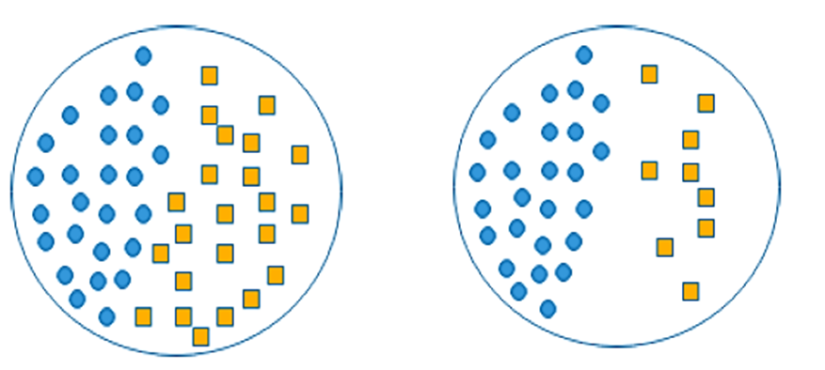
DATA IMBALANCE PROBLEM
If the positive and negative values in a dataset are nearly equal, it is said to be balanced. On the other hand, unbalanced datasets are unique situations in which there is an uneven distribution of values across the classes, giving rise to two separate classes: the majority, or negative class, and the minority, or positive class
Figure 1. Balanced dataset Vs Imbalanced dataset
CLASS IMALANCE PROBLEM TACKLING PROCEDURES
Extremely unbalanced class distributions are a sign of class imbalance issues. A class imbalance may exist in the dataset if samples from one or more classes significantly outnumber those from other classes. Because class imbalance affects the quality and reliability of the output from the machine learning assignment, it has to be addressed using specific techniques and measures. There are three main approaches to addressing the problem of class inequality

Slide 9
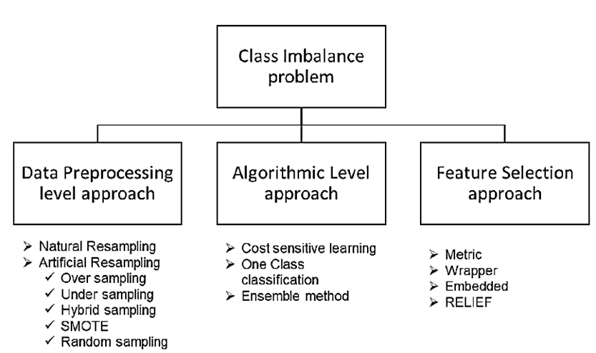
1. Data Driven Methods
2. Algorithm Based Methods
3. Feature Based Methods
Figure 2. Different approaches to tackle Class Imbalance Problem

Slide 10
DATA PRE-PROCESSING LEVEL APPROACH
The main objective of this strategy is to resample the data. A pre-processing method called resampling is used to change the class distribution before the model is trained. There are two types of resamplinn:
  Natural Resampling: The imbalance problem in the dataset is part of its nature of the dataset. the main goal is to the majority class. It’s not always possible, but it’s simple to obtain.
  Artificial Resampling: It can be accomplished by:
Undersampling: The elimination of cases from the dominant class is carried out at arbitrary from the collection of cases..
Oversampling: instances from the minority class are added to the dataset where the replication is done either randomly or using an algorithm.
SMOTE : S-MOTE oversamples to produce fresh minority class examples by inter-plotting several minority class examples. The freshly generated examples of a majority group are called synthesised observations, and they are obtained by determining the nearest neighbours of each minority group.
Random sampling: The last type of distributed that is produced by the resampling approach can be parameterised to any ratio or fixed to a completely symmetrical allocation. It is the simplest technique to utilise and may be applied to both undersampling and over-sampling.

Slide 11
  3. Algorithmic methods
Cost-sensitive learning: The learning algorithms charge for inaccurate categorisation. This branch of machine learning focuses on training models using data that has unequal costs or penalties in order to produce predictions. The major objective is to reduce a loss function in order to sway the algorithm in the minority class's favor.
One-class classification: The uni-class categorisation branch of machine learning provides techniques for identifying anomalies and outliers. The categorisation target differs from other categories in that it is a one-class objective. It ignores the other classes, the outliers, and only considers the new target class. By fitting a model to the normal data, or OCC for short, one may determine if fresh sample is usual or noise.

Slide 12
CHALLENGES OF IMBALANCED DATASETS
Challenge 1- Bias: The degree of bias between the classes. The closer the ratio between the classes, the higher the chances the classifier will perform better. The dataset can be in different degrees of bias 1:10, 1:00, 1:1000, 1:10000 and so on.
Challenge 2- Overlap: When there is no clear boundary between the two classes, the minority and majority classes occupy the same area. The higher the degree of overlap between classes the more difficult for classifiers to distinguish between them.
Challenge 3- Dataset size: The more samples that artificial intelligence systems have, the greater learning they receive and, thus, the quality of the predictions that is produced.
Challenge 4- Feature Vector size: Whether the data is balanced or not, the classifier has a harder time building an appropriate model the higher the feature vector size. Engineers often do a dimensionality step before applying a machine learning algorithm to the dataset. They just take into account the most important factors in this way. Therefore, if our dataset is also of an imbalanced kind and includes a lot of features, dimensionality reduction may be a really fantastic step to do before you start the research.

Slide 13
CONLUSION
Class imbalances have been a difficult issue in the data mining field in recent years. If a particular group in the information has instances that are greater than the others, it is referred to as the dominant class; when there are less instances, it is referred to as the minority class.
Because the bigger class had more impacts on the categorization, the circumstance resulted in a less-than-ideal classification.
A class imbalance arises whenever any of the groups in the data set has a greater amount of occurrences than the others; these instances are referred to as majority classes and minority classes, respectively.
The difficult terrain of uneven data has been thoroughly examined in this book, including everything from its fundamental causes and impacts to a thorough analysis of strategies and evaluation measures meant to alleviate this problem.
These principles emphasize the necessity of experimentation, parameter tweaking, and the exploration of different approaches in order to tailor solutions to specific datasets and problem circumstances.

Slide 14
REFERENCES
  Govind M. Poddar, Rajendra V. Patill, Satish Kumar N, “Approaches to handle Data Imbalance Problem in Predictive Machine Learning Models: A Comprehensive Review”, Int J Intell Syst Appl Eng, vol. 12, no. 21s, pp. 841–856, Mar. 2024.
  Gaikwad, V. S. ., Shivaji Deore, S. ., Poddar, G. M. ., V. Patil, R. ., Sandeep Hirolikar, D. ., Pravin Borawake, M. ., & Swarnkar, S. K., “Unveiling Market Dynamics through Machine Learning: Strategic Insights and Analysis”,. International Journal of Intelligent Systems and Applications in Engineering, 12(14s), 388–397, 2024.
  Tarambale, M. ., Naik, K. ., Patil, R. M. ., Patil, R. V. ., Deore, S. S. ., & Bhowmik, M., Detecting Fraudulent Patterns: Real-Time Identification using Machine Learning. International Journal of Intelligent Systems and Applications in Engineering, 12(14s), 2024
  Iqbal H. Sarrkar, “Machine Learning: Algorithms, Real-World Applications and Research Directions.” SN Computer Science, 2:160, 2021
  Hafsa Habehh, Sunil Gohel, “Machine in Healthcare”, Current Genomics, vol. 22, issue 4, pp, 291-300, Dec. 2021.

Slide 15
THANK YOU

