Slide 1

THE UNITED NATIONS SECURITY COUNCIL IN THE TWENTY FIRST CENTURY - A CRITICAL EVALUATION

Slide 2
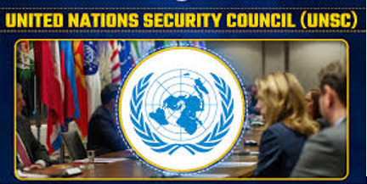
INTRODUCTION
The establishment of the UNSC in 1945 marked an important change in the balance of world power. The UNSC has ten elected, or non-permanent, members with rotating seats, but their impact is still quite small.
The P5 maintains control over the other nations, frequently relegating them to a supporting position and limiting other UN members' capacity to significantly alter the structure and operations of the Council.
Figure 1: UNSC
The end effect is a system where the influence of more powerful governments reduces the voices of the majority. Due to the changing global political landscape of the twenty-first century, this significantly impairs the UNSC's capacity to address contemporary concerns. In order to create a more effective and responsive Council that can meet the current threats to global peace and security, the structural defect must be fixed.

Slide 3
The worldwide system's tectonic plates have seen significant changes as a result of the advancements of the twenty-first century.
The political and economic landscape is always changing, and the issues that threaten global security are becoming more complex.
The development of technology, organized crime, climate change, and other societal challenges force us to reevaluate the kind of dangers that can undermine global security in the twenty-first century. War is no longer the only threat we confront.
An internationally recognized body, the UNSC was created to maintain world peace and avert international crises. But because of "the lack of unanimity of the permanent members," which undermines its structure, the Security Council regularly "fails to exercise its primary responsibility," as the P5 prioritize their own interests over the pursuit of world peace. Carswell raises questions about how change might be implemented, and the best means to do so would conflict with UNSC articles about the proper structure.

Slide 4
LITERATURE REVIEW
Hardt, J. N. (2021) given an intensive triple analysis, adding to the corpus of research currently accessible on the relationship between climate change and security. Since its inception in 2007, the UNSC continuing discussion about the choice about whether to include climate change on its plan has continued to create. The creator starts by analyzing the dominant perspectives on the relationship between climate change and security, highlighting the 2020 joint announcement issued by ten UNSC members. Second, Hardt identifies the normal presumptions among UNSC part states in 2020 by fundamentally examining the difficulties surrounding diverse definitions of climate-security.
Tobey, W. H. (2018) gave a unique explanation of Resolution 1540's beginnings and goals. The author's experience, first-hand recollections, and conversations with former government officials—such as Stephen Hadley, John Bolton, and Robert Joseph—formed the basis of the study. Tobey aimed to provide understanding of the resolution's drafting process, its intended use, and the diplomacy involved in its passing. The study also looked at how these factors affected the final Security Council wording. By doing this, Tobey sought to place Resolution 1540 in the larger framework of other counter-WMD-terrorism and non-proliferation instruments and programs.

Slide 5
Adefisoye, T. O., & Adefisoye, I. D. (2019) examined the efforts of UNSC, which, in October 2000, passed Resolution 1325 fully intent on addressing the adverse consequences of vicious conflicts and wars on ladies and girls. The resolution sought to reposition ladies and girls in dynamic roles in peace and security, urging the involvement of UN part states in its execution. In response, the Nigerian government, through the Bureaucratic Ministry of Ladies Affairs and Social Turn of events, figured out the first Public Activity Plan (Rest) in 2013. Notwithstanding, despite being introduced twelve years after the resolution, the first Rest neglected to accomplish its essential plan goals.
Zähringer, N. (2024) analyzed the role of the ICC and the UNSC in carrying out the Responsibility to Protect (RtoP) principle. This chapter discussed the current and past difficulties of coordinating international reactions to mass atrocities within the Responsibility to Protect framework; it was included in Africa's Engagement with the Responsibility to Protect in the 21st Century. The author provided a critical analysis of previous RtoP interventions, drawing attention to both the UNSC's and the ICC's accomplishments and failures in their coordination.

Slide 6
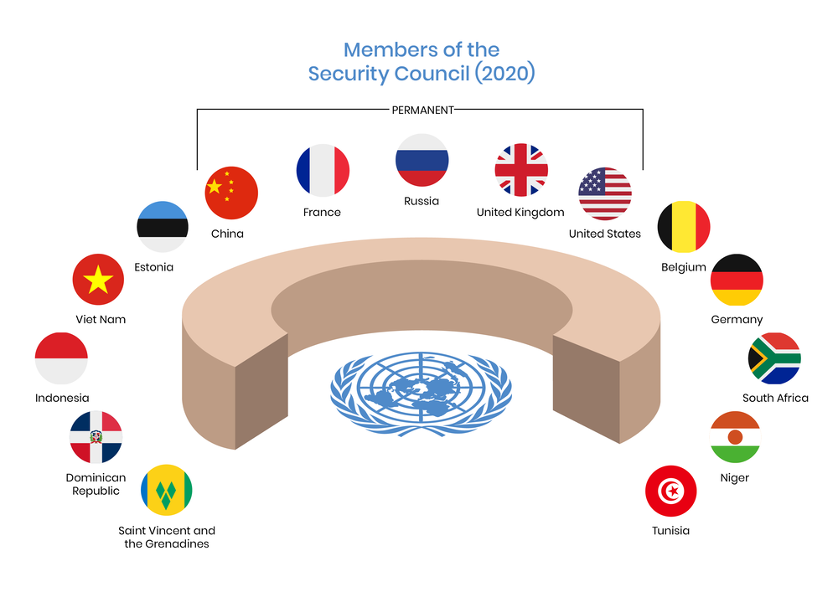
HISTORICAL EVOLUTION AND STRUCTURE OF THE UNSC
  Overview of the UNSC's formation
In 1945, in the result of the devastation caused by The Second Great War, the United Nations Security Council was established as a foundational part of the recently framed United Nations. The anticipation of future conflicts and the maintenance of global stability were its principal reasons for being. While encompassing a more extensive scope of global interest, the framework of the United powers Security Council was designed to strike an overall influence among the victorious Partnered powers.
  Permanent and non-permanent members
The United States of America, Russia, China, France, and the United Kingdom make up the five permanent members (P5) of the United Nations Security Council. The other ten members are elected for terms of two years each and are not permanent. The permanent members exert considerable influence due to their veto power, while the non-permanent members contribute regional perspectives and expertise.
Figure 2: Non-Permanent member in UNSC

Slide 7

Non- Permanent Members: The five-person permanent membership of the United Nations Security Council is complemented by the rotating roster of non-permanent members who represent different regions. One possibility is that the non-permanent members will be involved in the security briefing. For the first two decades, the Security Council was comprised of six countries: Poland, Egypt, Brazil, Mexico, and Brazil. Ten further non-permanent members were admitted
Permanent members: The five members of the Security Council who are designated as permanent members are able to veto any resolution that addresses substantive matters. This implies that a permanent member can veto the adoption of a resolution, but they cannot stop or end debate on such a resolution.
Figure 3: Permanent Member of UNSC

Slide 8
RELEVANCE AND EFFECTIVENESS IN THE 21ST CENTURY
  Role in maintaining international peace and security
As the 21st century has progressed, the United Nations Security Council has continued to face urgent global concerns, such as the crises in Syria, Yemen, and Ukraine.
It has been of great assistance in reducing the amount of violence and fostering stability through its role in the deployment of peacekeeping forces and its endorsement of resolutions.
  Success stories and landmark resolutions
The UNSC has helped resolve global crises and promote peace and security through major resolutions and initiatives. Peacekeeping missions have been authorized to stabilize conflict zones, protect people, and aid post-conflict reconstruction.
In the Balkans, Africa, and the Middle East, UNSC peacekeeping efforts have prevented further escalation and promoted peace processes. These actions target aggression, human rights abuses, and WMD proliferation. In 2000, UNSC Resolution 1325 focused on women in peace and security and is a landmark. These achievements show the UNSC's centrality in creating global norms, addressing conflict's core causes, and promoting inclusive peace and security.

Slide 9
THE PAST, PRESENT, AND FUTURE OF SECURITY COUNCIL REFORM
The UNSC is essential to world peace and security, as discussed. However, 21st-century emergent challenges raise questions about the Council's current design and structure. Critics point to its outmoded composition, poor representation, and the five permanent members' oppressive veto power.
Russia's veto-backed invasion of Ukraine in February 2022 and the US' unapproved invasion of Iraq in 2003 have both frustrated the Council. Ukrainian President Volodymyr Zelenskyy expressed issues about the Council's ability to provide security in April 2022 after these occurrences, which violate the UN Charter and international law, went unresolved.
The UNSC's General Assembly membership increased as additional decolonized countries joined, starting with six non-permanent states.
This spike signaled the need for more global decision-making engagement. Non-Aligned Movement, led by decolonized countries, campaigned for reform, prompting the 1963 General Assembly resolution. This resolution added ten non-permanent seats and competitive elections for geographical divisions.
The revision allowed for more creative and imaginative chamber use and multilateral action without diverting power from the P5.

Slide 10
The P5's consensus requirement hinders decision-making, hindering the UNSC's adoption of global changes and reform requests. However, major UNSC reforms demonstrate its ability to adapt to international community requirements.
UNSC reforms are championed by advocacy groups including the G4, Brazil, Germany, India, and Japan. These states propose permanent and non-permanent seat additions to reflect geopolitical realities and regional representation.
The G4 wants equal representation in Africa, Asia, Europe, and Latin America to strengthen the UNSC. The G4 hopes to strengthen its proposals and steer discussions toward a more balanced and representative Council with support from some permanent members, such as the UK and France, and regional powers like the BRICS group.

Slide 11
CHALLENGES AND CRITICISMS FACING THE UNSC
Geopolitical tensions, power dynamics, and structural flaws are the main causes of the UNSC many problems and critiques.
The conflicting interests of superpowers can cause paralysis in a time of increased international tensions, and the P5 members' rivalry regularly prevent agreement on how to successfully handle crises.
Concerns regarding the fairness and inclusion of the decision-making process are raised by the P5's veto power, which allows individual countries to thwart decisions even when they have the support of the majority.
The geopolitical realities of the twenty-first century are also not reflected in the composition of the UNSC, as new powers like Brazil, South Africa, and India are calling for changes to better represent the changing global order, such as permanent membership and increased inclusivity.

Slide 12
CONCLUSION
The UNSC is essential to maintaining international peace, but it confronts several difficulties in the twenty-first century because of its antiquated design, unequal representation, and the abuse of its permanent members' veto power.
Because the P5 cannot agree, the UNSC has had difficulty responding to modern challenges like cyberwarfare, climate change, and political disputes, despite important achievements like peacekeeping missions and historic resolutions.
Advocated by countries such as the G4, the urgent appeal for reform reflects a worldwide desire for more fair representation and greater inclusivity.
Future of the United Nations Security Council
UNSC future depends on its capacity to adjust to new worldwide dangers like pandemics, wars brought on by climate change, and cybersecurity breaches.
The UNSC must adapt its tactics to proactively handle these unconventional issues if it hopes to stay relevant. To ensure that multilateralism flourishes and member state collaboration is reinforced, the UNSC must find a balance between defending national interests and maintaining international peace.

Slide 13
REFERENCES
Adefisoye, T. O., & Adefisoye, I. D. (2019). Nigeria and the implementation of the United Nations Security Council Resolution 1325 on women, peace and security. Journal of Public Administration and Development Alternatives (JPADA), 4(1), 16-29.
Hardt, J. N. (2021). The United Nations Security Council at the forefront of (climate) change? Confusion, stalemate, ignorance. Politics and Governance, 9, 5-15.
Tobey, W. H. (2018). A History of United Nations Security Council Resolution 1540. Preventing the Proliferation of WMDs: Measuring the Success of UN Security Council Resolution 1540, 13-32.
Zähringer, N. (2024). Implementing the Responsibility to Protect (RtoP): Coordinating Approaches Between the United Nations Security Council and the International Criminal Court. In Africa's Engagement with the Responsibility to Protect in the 21st Century (pp. 219-233). Singapore: Springer Nature Singapore.
Hurd, I. (2002) ‘Legitimacy, power, and the symbolic life of the UN Security Council’, Global Governance: A Review of Multilateralism and International Organizations, 8(1), pp. 35–51.

Slide 14
THANK YOU

