Slide 1

Power Aware-Deep Learning Based Virtual Machine Allocation in Cloud Computing
Presented by: Vipan
Department of Computer Applications
RIMT UNIVERSITY
MANDI GOBINDGARH (Punjab)

Slide 2
“Introduction”

Slide 3
Introduction (1/3)

Slide 4
Introduction (2/3)
PMs and VMs:
  PMs: Physical machines that contain hardware components.
  VMs: Virtual machines that utilize PM resources.
Cloud Computing Challenges:
  Resource Provisioning: Difficulty in managing large-scale resource allocation due to increasing user demand.
  Energy Consumption: High energy usage caused by heavy workloads on cloud servers.
  Environmental Impact: High carbon footprint associated with energy consumption.
Green Oriented Computing Services (GOS):
  VM Migration: Shifting VMs between PMs to optimize energy usage and reduce emissions.
  Hotspot PMs: PMs that are either over-utilized or under-utilized.

Slide 5
Introduction (3/3)
Research Focus:
  VM Replacement: Selecting and replacing VMs from hotspot PMs based on their previous SLA and QoS parameters.
  Goal: Maintain performance of cloud server and reduce energy consumption.
Evolution of Cloud Computing:
  Early Focus: Faster execution and accurate results.
  Shift: Handling requests and power-efficient scheduling.
Power Consumption:
  Idle Power: Power consumed by a VM when not actively working.
  Execution Power: Power consumed by a VM while executing a job.
  Total Energy: Idle power + Execution power.

Slide 6
VM Allocation and Migration policy
Goal: Efficient allocation and migration of VMs to PMs for optimal performance and energy efficiency.
VM Allocation Policies: Strategies for distributing VMs across PMs to achieve resource optimization, fault tolerance, scalability, energy efficiency, and QoS.
VM Reallocation: Dynamically moving VMs between PMs to maintain efficiency and resilience in the face of changing workloads or hardware failures.
Process of allocation and migration is divided into 4 steps:
  VM Allocation: Assigning VMs to PMs based on workload and resource requirements.
  Hotspot PM Identification: Identifying PMs with excessive or insufficient workload.
  VM Selection: Choosing VMs from hotspot PMs for migration.
  VM Reallocation: Moving selected VMs from overloaded PMs to target PMs.

Slide 7
The Hotspot PMs
A PM that is either not using its resources at the minimum demand or if the PM is using the resources to its maximum capacity, will be termed as underutilized and overutilized PMs respectively and in combination, these PMs are termed as hotspot.
Where Q1 and Q2 are the upper and lower threshold of the normalised CPU utilisation, RAM consumption and Bandwidth utilisation.
Background 2/3

Slide 8
  Statement of Problem
  VM Reallocation (1/3)
Issue: Inadequacies of Minimum Cost Policy in VM Replacement
Current Performance Assessment: The minimum cost policy(e.g. MBFD) typically assesses the immediate resource usage and availability on a physical machine to decide where to migrate a VM. This assessment includes factors like CPU, memory, and I/O availability at the moment of migration.
Lack of Future Performance Consideration: This policy, still, does not account for the future performance and workload variations that the physical machine might encounter. Consequently, while a PM might appear to be the optimal choice based on current metrics, it could soon become overloaded due to incoming workloads or other VMs migrating to it.

Slide 9
Statement of Problem
VM Reallocation (2/3)
Scenario Illustration (minimum cost policy)
• Initial Migration Decision: Suppose a VM1 is currently being hosted on PM1 and needs to be migrated due to performance degradation or maintenance (using minimum cost policy). And migrated to PM2 (Based on minimum cost).
• Post-Migration Performance: After the migration, PM2 begins to experience increased workloads from other VMs. This will lead to performance bottleneck.
Solution
Reputation Matrics
• Historical Performance Data: Reputation management involves maintaining a record of factual performance data for all physical machine.
• Predictive Analysis: By analyzing these historical metrics, a predictive model can be developed to forecast future performance trends and potential bottlenecks.

Slide 10
Statement of Problem
VM Reallocation (3/3)
Scenario Illustration (with reputation management)
Reputation-Based Decision Making: Before migrating a VM1 from PM1, the system evaluates not only the current resource availability on PM2 but also its historical performance and predicted future workloads.
Proactive Performance Assurance: By factoring in reputation mechanism, the system ensures that the chosen PM for migration is less likely to encounter unexpected performance issues.
Scenario (Minimum Cost Policy)
Reputation Metrics
Scenario (Reputation management)

Slide 11
CHAPTER – 2
“Related Work-Literature Review”

Slide 12
Literature Survey (1/2)
Year | Algorithm Used | Purpose of Algorithm | Evaluation Parameters
2018 | Enhanced Cuckoo Search Algorithm | Optimize resource utilization and minimize energy consumption | Resource demand, energy efficiency, load balancing
2023 | Updated SESA | Reducing migration time & down time | Improved performance in terms of QoS, Power consumption & SLA-V
2022 | Order Exchange and Migration Ant Colony System | Optimize VM placement and migration for balanced resource utilization | Load balancing, energy consumption, migration costs
2020 | PAPSO (Particle Swarm Optimization) | Reduce power consumption while maintaining performance levels | Server power usage, CPU and memory utilization, migration costs
2021 | Monarch Butterfly Algorithm | Optimize VM placement balancing energy efficiency and resource utilization | Computational overhead, energy consumption, migration costs

Slide 13
Literature Survey (2/2)
Year | Algorithm Used | Purpose of Algorithm | Evaluation Parameters
2024 | Adaptive Threshold-based Modified Artificial Bee Colony Optimization | Dynamically adjust placement thresholds based on real-time resource availability | CPU utilization, memory usage, network bandwidth
2023 | Dynamic Arithmetic Optimized Double Deep Q-Network | Optimize task allocation and resource management to enhance performance and reduce energy consumption | Task execution time, resource availability, energy efficiency
2022 | Energy-Aware Virtual Machines Consolidation Method | Minimize energy consumption while maintaining performance levels | CPU utilization, memory usage, power consumption
2020 | Energy-Efficient and Quality-Aware VM Consolidation Method | Optimize trade-offs between energy efficiency and service quality | Energy consumption, VM performance, SLA compliance
2023 | Dynamic Virtual Machine Relocation System | Energy-efficient resource management | CPU utilization, memory usage, power consumption

Slide 14
“Proposed Work”

Slide 15
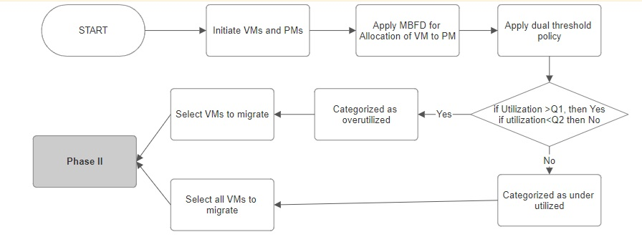
Flow Diagram- Phase 1
Where Q1 and Q2 are Upper and Lower thresholds resp.

Slide 16
Phase 1: Modelling, Allocation and VM selection
Initial Placement: All VMs are assigned to PMs based on their resource requirements and PM capacities using MBFD algorithm.
Overutilized PM Identification: PMs exceeding predefined thresholds for CPU, memory, or power consumption are flagged as O_PMs.
VM Selection for Migration: VMs with highest resource usage or significant impact on performance metrics are selected for migration.
Migration Criteria: Selected VMs should reduce load on O_PMs without significantly impacting destination PMs.

Slide 17
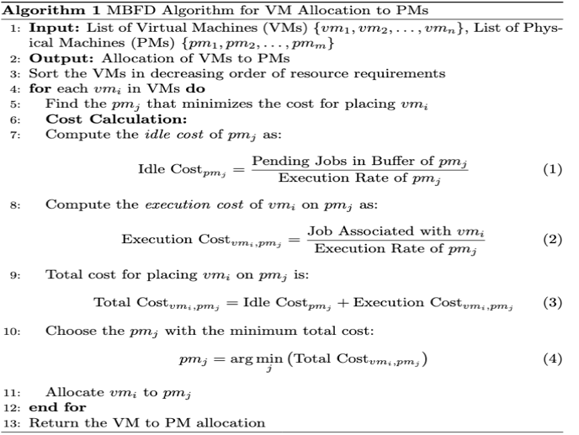
MBFD Algorithm with dual threshold policy

Slide 18
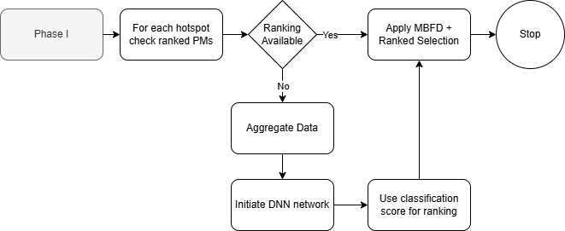
Flow Diagram - Phase 2

Slide 19
Phase 2: Ranking of PMs (1/2)
Data Aggregation from Previous Allocations
Data Collection: Aggregate data from previous VM allocations, including resource utilization metrics, performance metrics, and historical VM performance.
Data Preprocessing: Clean and preprocess the data to ensure consistency and accuracy.
Rank Generation Using Deep Learning
Training DNN Model: Train a DNN model on the categorized data to generate ranks for the PMs. Calculate the classification score, which will act as the PM score, reflecting the effectiveness of each PM in handling VMs.

Slide 20
Results and Discussion
Total Number of PMs | Total Number of VMs | Power consumption in kw Proposed | Power consumption in kw Talwani et al. | Power consumption in kw Saurabh et al.
10 | 50 | 8.21177311 | 9.24046912 | 9.24629075
20 | 100 | 8.44843247 | 9.25644142 | 8.94288731
30 | 150 | 8.63953571 | 9.35088385 | 10.0008405
40 | 200 | 8.80679928 | 9.21069871 | 9.16195288
50 | 250 | 9.00014388 | 9.7493235 | 9.68760032
60 | 300 | 9.22290818 | 9.78921715 | 10.2312493
70 | 350 | 9.50083664 | 10.6694907 | 10.4355932
80 | 400 | 9.62387925 | 10.6759108 | 10.403652
90 | 450 | 9.93802867 | 10.9795823 | 10.9053276
100 | 500 | 10.1618279 | 11.1566654 | 11.4807152
110 | 550 | 10.4099638 | 11.5865119 | 11.8564956

Slide 21
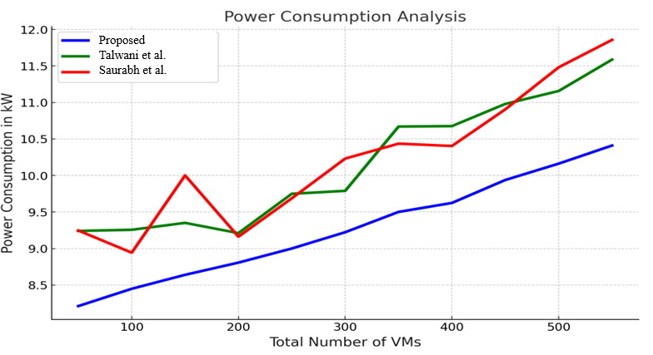

Slide 22
Conclusion
Proposed work introduces a method for optimizing the allocation of virtual machines (VMs) and resource management in cloud computing, aiming to enhance energy efficiency and improve task scheduling.
A ranking system for physical machines (PMs) based on their historical performance, using a deep neural network (DNN) for accurate PM ranking.
The approach improves VM allocation by accounting for both idle and active costs, leading to better overall utilization of resources.
The model achieves a reduction in power consumption of up to 11.12% (8.21 kW for 50 VMs and 10.40 kW for 550 VMs, compared to 9.24 kW and 11.58 kW in existing methods).
The proposed approach outperforms current methods in reducing energy consumption.

Slide 23
References
Yao, W., Shen, Y., and Wang, D., 2019. A weighted pagerank-based algorithm for virtual machine placement in cloud computing. IEEE Access, 7, pp. 176369-176381.
Saurabh and Dhanaraj, R.K., 2024. Enhance QoS with fog computing based on sigmoid NN clustering and entropy-based scheduling. Multimedia Tools and Applications, 83(1), pp. 305-326.
Ruan, X., Chen, H., Tian, Y., and Yin, S., 2019. Virtual machine allocation and migration based on performance-to-power ratio in energy-efficient clouds. Future Generation Computer Systems, 100, pp. 380-394.
Talwani, S., Alhazmi, K., Singla, J., Alyamani, H.J., and Bashir, A.K., 2022. Allocation and migration of virtual machines using machine learning. Computers, Materials and Continua, 70(2), pp. 3349-3364.
Saxena, D., and Singh, A.K., 2022. A high availability management model based on VM significance ranking and resource estimation for cloud applications. IEEE Transactions on Services Computing, 16(3), pp. 1604-1615.
Li, Z., Shen, H., and Miles, C., 2018. PageRankVM: A pagerank based algorithm with anti-collocation constraints for virtual machine placement in cloud datacenters. In 2018 IEEE 38th International Conference on Distributed Computing Systems (ICDCS), pp. 634-644.
Quang-Hung, N., Thoai, N., and Son, N.T., 2014. EPOBF: energy efficient allocation of virtual machines in high performance computing cloud. Transactions on Large-Scale Data-and Knowledge-Centered Systems XVI: Selected Papers From ACOMP 2013, pp. 71-86.

Slide 24
References
Kumar, S., Pal, S., Singh, S., Singh, R.P., Singh, S.K., and Jaiswal, P., 2022. An energy & cost efficient task consolidation algorithm for cloud computing systems. In International Conference on Advancements in Smart Computing and Information Security, pp. 446-454.
Saidi, K., and Bardou, D., 2023. Task scheduling and VM placement to resource allocation in cloud computing: challenges and opportunities. Cluster Computing, 26(5), pp. 3069-3087.
Liu, J., Zhao, G., Xu, H., Yang, P., Wang, B., and Qiao, C., 2024. Toward a service availability-guaranteed cloud through VM placement. IEEE/ACM Transactions on Networking.
Kaur, A., Kumar, S., Gupta, D., Hamid, Y., Hamdi, M., Ksibi, A., Elmannai, H., and Saini, S., 2023. Algorithmic approach to virtual machine migration in cloud computing with updated SESA algorithm. Sensors, 23(13), 6117.
Kaur, A., and Kumar, S., 2023. Cosine elastic cluster scheduling algorithm for VM migration in cloud computing. In AIP Conference Proceedings, 2916(1).
Alsubai, S., Garg, H., and Alqahtani, A., 2023. A novel hybrid MSA-CSA algorithm for cloud computing task scheduling problems. Symmetry, 15(10), 1931.
Talwani, S., Singla, J., Mathur, G., Malik, N., Jhanjhi, N.Z., Masud, M., and Aljahdali, S., 2022. Machine-learning-based approach for virtual machine allocation and migration. Electronics, 11(19), 3249.

Slide 25
Thank you

