Slide 1
Clinical application Protease from Acinetobacteria Species
Salunke.S M, Dr. Jadhav B. N, Dr. Satpute. R. A.
Department Of Biotechnology, Vinayakrao Patil Mahavidyalaya, Art’s Commerce And Science College Vaijapur. Chhatrapati Sambhajinagar-423701, Maharashtra, India.
Department Of Zoology, Vinayakrao Patil Mahavidyalaya, Art’s Commerce And Science College Vaijapur. Chhatrapati Sambhajinagar-423701, Maharashtra, India.
Government Institute Of Science, Department Of Botany Chhatrapati Sambhajinagar-423701, Maharashtra, India.
Corresponding Email Id:- Sweetysalunke25@gmail.Com

Slide 2
Introduction
Protease are the important class of enzymes can be extracted by microbial source for large scale production. Acinetobacteria species are gram negative bacteria belong to class gammaproteobacteria and family Moraxellaceae [2]. It has ability to produce extracellular protease like serine protease S1A trypsin [5]. The extracellular protease can be easily recovered by downstream process during batch fermentation [8]. The trypsin plays important in inflammation and cancerous activity. It makes the macrophages and monocytes active and move at the site of infection [10,11]. Trypsin role in gelatin degradation at the time of fertilization, it helps the sperm to swim [3]. It has diverse role in different industry like dehairing of hair in leather industry, destaining in detergent, eye lenes cleaning, silver recovery from X-ray film [1,4,6,7,9].
In the present study the extracellular protease was purified and studied for clinical application against IL-6 by ELISA and LNCAP cell line of prostate gland by MTT assay.

Slide 3
Material and Methods:-
  Pure culture of Acinetobacteria bacteria
  Inoculum Preparation
  A loopful suspension Acinetobacteria bacteria was inoculated in 20ml Nutrient broth.
Production Media
The Batch culture media was prepared by adding in 250 ml of Yeast extract 3gm, Maltose 3gm, MgSO₄ 0.5, K₂HPO₄, 0.5, CaCl_{2,} 0.2, KCl 0.2, NaCO₃ 0.5% was autoclave at 121ºC for 15-20min. After media cool down was transferred to laminar air flow and 5ml overnight grown culture was inoculated.
Enzyme purification
Precipitation by 40-60% w/w Ammonium persulphate, dialysis membrane preparation by 2% sodium bicarbonate and EDTA and boil for 15-20 min, pack the one end of dialysis with thread add precipitated protease then again seal the other end, suspend the dialysis bag in the Tris buffer HCl 20mM overnight, Tris Buffer gel Chromatography glass column chromatography 2×50ml, stationary phase Sephadex-G 25 mobile phase 25mM Tris Tris buffer.

Slide 4
Results
The overnight grown culture 5ml was inoculated in 250ml of production media and incubated in orbital shaker at 120-150rpm at 30-40ºC. After 24 -48 hours the extracellular protease by collecting filtrated the filtrate was used as crude protease the protein and protease activity was measured by Lowry’s and Anson method.
The collected samples were further for precipitation by salt ammonium per sulphate, then molecular size separation by gel filtration and depending upon charge Ion-Exchange chromatography, after each step protein and protease activity was measured, HPLC shows two peak of trypsin as compared with standard trypsin and then SDS- PAGE to determine molecular weight was in between 23-25 KD Characterization was done by using BAPNA trypsin activity was 10U.
HPLC collected fraction used for MALDI-TOF it shows 51% percentage score of matching HPLC fraction was further used to check the anti-inflammatory and anti- cancerous activity. The clinical application of purified protease anti-inflammatory activity against IL-6 was 0.348mg/ml and anti-cancerous activity against LNCAP prostate gland cell line was 30.11µg/ml.

Slide 5
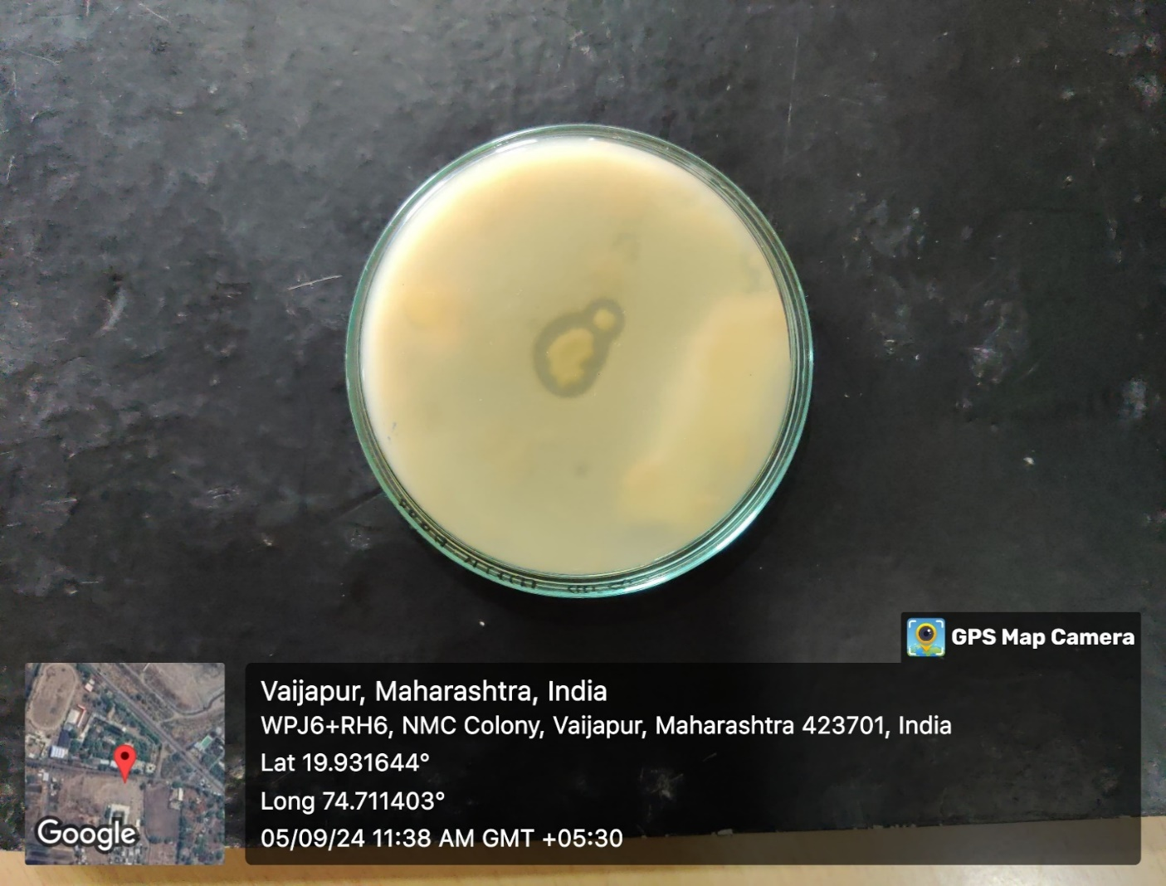
Table No:1 Protease Activity Assay By Acinetobacteria
Fig No:1 Acinetobacter bacteria on Skim Milk Agar
Sr.No | Purification steps | Total Protein in mg/ml | Total Protease U/ml | Specific Activity U/mg
1 | Crude Enzyme | 58 | 170 | 2.9
2 | Ammonium Per Sulphate | 20 | 98 | 4.9
3 | Dialysis | 12 | 75 | 6.2
4 | Sephadex G-25 | 8 | 54 | 6.7
5 | Ion Exchange Chromatography | 2 | 17 | 8.5

Slide 6
References
A.M Wolff, M.S. Showell, M.G Venegas, B.L. Barnett, and W.C. Wertz, “Laundudry performance of subtilisin proteases,” in Substilisin Enzymes: Practical Protein Engineering, R.Bolt and C. Betzel, Eds., pp. 113-120, Plenum Press, New York, NY, USA, 1993.
Aoife Howard, Michael O Donoghue, Audrey and Roy. Sleator, “Acinetobacter baumannii An emerging opportunistic pathogen”Virulence3:3, 243-250, 2012.
Chiemi Miura, Takashi Ohta, Yuichi Ozaki, Hideki Tanaka and Takeshi Miura, Trypsin is a multifunctional factor in spermatogenesis, www.pnas.org/cgi/doi/10.1073/pnas.090761106, 2009.
H.Outtrup, C. Dambmann, M.D. Christiansen, and A. Aaslyng, “Bacillus sp. JP 395, method of making and detergent composition,” US patent no5461366, 1988.
J. Singh, N. Batra, and R.C. Sobti, “Serine alkaline protease from a newly isolated Bacillus sp. SSR1,” Process Biochemistry vol.36, no. 8-9 pp.781-785,2001.

