Slide 1
THE ROLE OF BIOTECHNOLOGY IN DEVELOPING SUSTAINABLE BIOFUELS
Reena Mol S
Dept of Biotechnology
Sree Narayana Arts and Science College, Kumarakom, Kottayam

Slide 2
INTRODUCTION
The global reliance on fossil fuels has resulted in significant environmental degradation, including the release of greenhouse gases (GHGs) that contribute to climate change, and the disruption of ecosystems through practices like deforestation and habitat loss.
Fossil fuel extraction and combustion release carbon dioxide (CO2) and other GHGs into the atmosphere, exacerbating global warming.
In this context, sustainable biofuels, derived from biomass such as agricultural residues, algae, and forestry waste, offer a promising solution.
Because of these characteristics, the production of biofuels from a vast range of feedstocks, most of which are not in competition with food crops and do not entail significant changes in land use, makes this energy source highly preferable to fossil fuels.

Slide 3
LITERATURE REVIEW
Liu et al. (2021) gave an overview of the potential of biofuels in transitioning toward a sustainable energy future. The authors underscored the necessity of replacing fossil fuels with renewable energy sources in the face of environmental and socio-economic challenges..
Sindhu et al. (2019) considered the prospect of biomass as a feedstock for biofuel production and its impact on sustainable development. The authors discussed different types of biomasses, including agricultural residues, forestry waste, and dedicated energy crops, highlighting their availability and cost-effectiveness.
Maharjan et al. (2024) discussed advanced biofuels, such as second- and third-generation biofuels, as a sustainable solution for energy. The authors discussed why advanced biofuels are more preferred over first-generation biofuels: feedstock diversity and reduced competition with food crops.
Lokko et al. (2018) explored biotechnology and the bioeconomy, highlighting their importance in ensuring inclusive and sustainable industrial development. The authors examined the capability of biotechnology to power the bioeconomy. They looked at potential applications in the production of biofuels, bioplastics, and other renewable chemicals from biomass.

Slide 4
TYPES OF BIOFUELS AND THEIR SUSTAINABILITY
Biofuels are categorized into three generations
First-Generation Biofuels
These are derived from food crops, including corn, sugarcane, and soybeans, through fermentation and transesterification.
Second-Generation Biofuels
These are derived from non-food biomass sources including agricultural residues, for example wheat straw, corn stover, forestry waste, and other lignocellulosic materials.
Third-Generation Biofuels
These are produced from algae and other microorganisms. Algae can be cultivated on non-arable land, require minimal freshwater resources, and show high productivity in oil and biomass yield.

Slide 5
Table 1: Comparison of Biofuel Generations
Generation | Source | Features | Sustainability | Challenges
First | Food crops (corn, sugarcane) | Early biofuels; "food vs. fuel" | Impacts food security | Competes with food production
Second | Non-food biomass, waste | Waste-to-energy approach | Reduces food competition | High cost, complex processes
Third | Algae, microorganisms | High yield, minimal land use | Highly efficient, eco-friendly | Expensive, scaling is difficult

Slide 6
ROLE OF BIOTECHNOLOGY IN BIOFUEL DEVELOPMENT
The role of biotechnology in biofuel development involves optimizing microorganisms for efficient biomass conversion.
Genetic Engineering of Feedstocks
Plant genetic modification, also referred to as genetically modified organisms, is employed in increasing biomass yield and lowering environmental inputs like water and fertilizers for the production of biofuel.
Microbial Engineering
Advances in synthetic biology have made it possible to engineer microorganisms, such as bacteria and yeast, to produce biofuels.
Enzyme Optimization
The process of enzymatic hydrolysis is essential to break down lignocellulosic biomass, such as wood and straw, into fermentable sugars that can further be converted into biofuels.

Slide 7
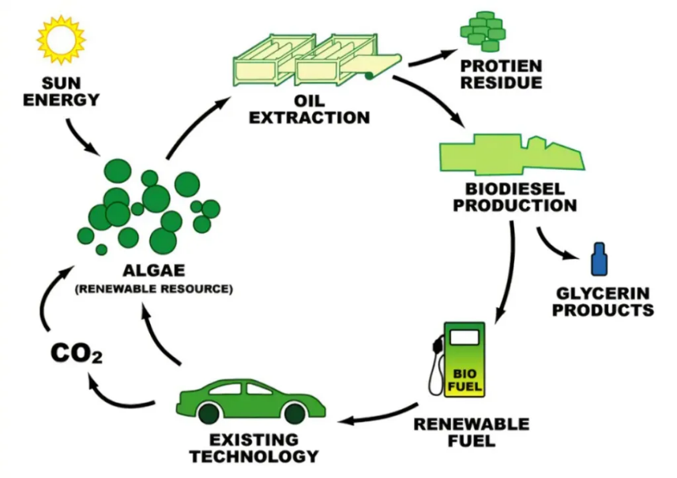
  Algal Biotechnology
  Microalgae are being exploited as a viable source of biofuels today because they carry a high level of lipids along with a maximum growth rate, and genetic manipulation has improved lipid production in the algae by regulating the metabolic pathway that produces such precursors in the form of biodiesel or biogas.
Feedstocks in Biofuel Production

Slide 8
ANALYTICAL EVALUATION OF BIOTECHNOLOGY’S IMPACT
Analytical assessment of the influence of biotechnology on society requires consideration of the contributions made by this sector in agriculture, medicine, and environmental sustainability.
Economic Feasibility
Biotechnological innovations in the production of biofuels, for instance, have led to reduced costs associated with the process in some sectors, such as increased yield and optimized processes.
Scalability Challenges
Scaling up laboratory-scale innovations to commercial production levels is one of the significant challenges faced by feedstock availability, bioreactor design, and supply chain logistics.
Environmental Impacts
Advancements in biofuel biotechnologies significantly help in reducing negative environmental impacts especially through the reductions in greenhouse gas emissions and generation of wastes

Slide 9
FUTURE PROSPECTS AND INNOVATIONS
Biofuel production would experience a substantial transformation with emergent technologies coming to the rescue in the next couple of years.
CRISPR-Cas9 gene editing and metabolic engineering would solve two long-standing and key challenges confronting the efficiency of production, economies of scale and sustainability of biofuel.
The novelty of these advances is not just that they should make biofuels more price-competitive compared to traditional fossil fuels but will also contribute towards a more sustainable energy future: reducing dependency on non-renewable resources, and mitigating the environmental impacts associated with consumption.
These technologies are, therefore, on the verge of revolutionizing the biofuel industry into a much more efficient, cost-effective, and environmentally friendly sector that will meet global energy demands in a sustainable manner.

Slide 10
CONCLUSION
Biotechnology significantly contributes to developing sustainable biofuels by promoting biological processes and optimizing resources toward more efficient and effective fuel production.
Innovations such as genetic engineering, CRISPR-Cas9 gene editing, and metabolic engineering contribute to the current significant advancements being made in biofuel technology as it continues to address the historical challenges that have prevented large-scale biofuel production.
Continued development and integration of such biotechnological solutions will go a long way toward an improved shift towards sustainability, a much cleaner and environmentally friendlier energy system, with further improved security and diminished impacts from conventional sources of energy.
The ultimate secret to the door that could lead the world towards a much cleaner, much greener future lies in biotechnology.

Slide 11
REFERENCES
Liu, Y., Cruz-Morales, P., Zargar, A., Belcher, M. S., Pang, B., Englund, E., ... & Keasling, J. D. (2021). Biofuels for a sustainable future. Cell, 184(6), 1636-1647.
Sindhu, R., Binod, P., Pandey, A., Ankaram, S., Duan, Y., & Awasthi, M. K. (2019). Biofuel production from biomass: toward sustainable development. In Current developments in biotechnology and bioengineering (pp. 79-92). Elsevier.
Maharjan, A., Kim, M. R., Choi, W., Kim, H. C., & Park, J. H. (2024). Advanced biofuels: a path to sustainable energy. Sustainable Energy & Fuels, 8(15), 3247-3265.
Lokko, Y., Heijde, M., Schebesta, K., Scholtès, P., Van Montagu, M., & Giacca, M. (2018). Biotechnology and the bioeconomy—Towards inclusive and sustainable industrial development. New biotechnology, 40, 5-10.
Chandel, A. K., Garlapati, V. K., Jeevan Kumar, S. P., Hans, M., Singh, A. K., & Kumar, S. (2020). The role of renewable chemicals and biofuels in building a bioeconomy. Biofuels, Bioproducts and Biorefining, 14(4), 830-844.

Slide 12
THANK YOU

