Slide 1

Review Paper on Watermarking Algorithm for Protecting Software Code against Cyber-Attack
Bharati Devidas Patil Research scholar Department of computer science and Engineering, P.K. University, Shivpuri(MP), India bharatip175@gmail.com Mobile No.8805540075 Prof. Dr. Rohita Yamaganti Research Supervisor Department of computer science and Engineering, P.K. University, Shivpuri (MP), India Mobile No.9700300725

Slide 2
INTRODUCTION
In today’s digital era, software is integral to our daily lives, powering everything from our smartphones to critical infrastructure. However, with the widespread distribution of software, concerns about copyright infringement and unauthorized modifications are growing. Traditional methods like code obfuscation often fall short in providing comprehensive protection.
This is where source code watermarking comes into play, offering a robust solution to enhance software security. In the past, being able to download open-source code or clone it and then subsequently modify it, encouraged development of software without authorization. Often, developers and organizations mentioned the copyright of the open source, at the most.

Slide 3
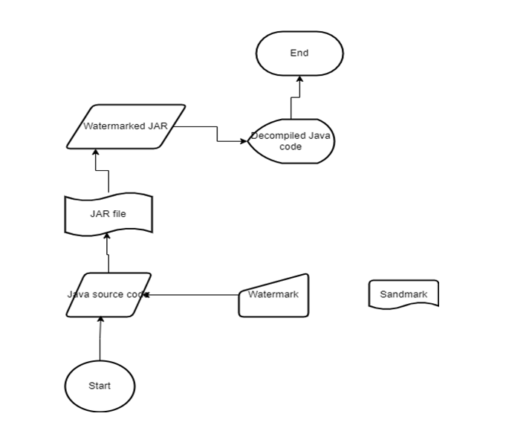
PROCESS OF WATERMARKING
Implementing watermarking involves several steps:
Embedding: Inserting the watermark into the source code. This can be done at various stages of the development lifecycle.
Compilation: Converting the watermarked source code into executable form.
Distribution: Distributing the software with the embedded watermark.
Verification: Detecting and verifying the watermark in the distributed software to ensure integrity and ownership. Following figure 1 shows watermark embedding Process

Slide 4
LITERATURE REVIEW
There are several watermarking techniques, each with its own strengths and applications. Watermarking techniques can be based on three major categories, based on robustness & embedding techniques. Here we shall consider based on embedding techniques, these are the following:
3.1 Static Watermarking: Embeds the watermark into the code structure, making it a part of the compiled program. This method is highly resilient against reverse engineering. This technique hides a watermark within the source code by introducing a fake expression, assigned to a new local variable. The watermark is identified by this variable’s unique name [1,2]. How It Works: • The watermark is represented as a numeric value, divided into two-digit segments. • These segments are embedded into the program by modifying existing constants in the code. • The watermark is encoded in the sum of these altered constants.
3.2 Zero-Digital Watermarking Zero watermarking is a unique method that protects code without altering it. Instead of embedding visible marks, it analyzes the code to identify key features like its structure and meaning and mathematically converts these features into a “watermark.” This watermark is stored separately, leaving the original code untouched [3].

Slide 5
Common Types of Cyber Attacks
Malware: A malware cyberattack involves malicious code used to infiltrate and compromise a computer system, network, or device without the owner’s consent. Many users are familiar with viruses, but others include worms, trojans, and ransomware. Once installed on a host device, malware is programmed to spread to other areas. Its damage can range from minor inconveniences to severe data breaches and financial losses[5].
Phishing and Spear Phishing: Spear phishing is a more targeted form in which an email is customized for specific individuals or organizations using personal details to appear more convincing. An example might be a request from the CFO to someone in accounts payable to perform a financial transaction by clicking a link or someone receiving a shared file from their boss that they are to click on to open. These tailored approaches make spear phishing attacks particularly deceptive and potentially more successful than broader phishing attempts [5]

Slide 6
Different Strategies to Prevent Cyber Attacks
Below are some strategies outlining how to avoid cyber-attacks. There are many ways to prevent cyber-attacks, and when implemented collectively, they will help create a multilayer strategy that will significantly contribute to cyber-attack protection [7]:
Use Strong, Unique Passwords: The first step in preventing unauthorized access is creating strong, unique passwords. A strong password should include a mix of upper- and lower-case letters, numbers, and special characters. It would be best to consider using a password manager to securely store and generate complex passwords to reduce the risk of password reuse.
Enable Multi-Factor Authentication (MFA): Multi-factor authentication adds an extra layer of security by requiring two or more verification methods to access an account. These typically include something you know (password), something you have (smartphone or security token), and/or something you are (biometric data).

Slide 7
CONCLUSION
In this paper we have discuss different types of watermarking technique such as static, Dynamic and zero watermarking. Along with that we discuss Cyber attcks and its different types. Source code watermarking is a powerful tool in the arsenal of software security. By embedding unique markers into the code, developers can protect their intellectual property, ensure traceability, and detect tampering. In this work, we proposed KeySplitWatermark, a novel zero watermarking approach to protect software code against cyber-attacks. The algorithm is blind and adds watermark logically into the code using the inherent properties of code and provides a robust solution.

Slide 8
REFERENCES
[1] A. R. Javed, M. O. Beg, M. Asim, T. Baker, and A. H. Al-Bayatti, “Detecting motion-based side-channel attack using smart phone keystrokes”, J. Ambient Intell. Humanized Comput., pp. 114, Feb. 2020.
[2] A. K. Abdulrahman and S. Ozturk, “A novel hybrid DCT and DWT based robust watermarking algorithm for color images”, Multimedia Tools Appl., vol. 78, no. 12, pp. 1702717049, Jun. 2019.
[3] W. Hu, R.-G. Zhou,J.Luo,andB.Liu, LSBs-basedquantumcolorimages watermarking algorithm in edge region, Quantum Inf. Process., vol. 18, no. 1, p. 16, Jan. 2019.
[4] Z. Jalil and A. M. Mirza, “An invisible text watermarking algorithm using image watermark, in Innovations in Computing Sciences and Software Engineering.” Dordrecht, The Netherlands: Springer, 2010.
[5] C. Iwendi, Z. Jalil, A. R. Javed, T. Reddy G., “Keysplitwatermark: Zero Watermarking Algorithm For Software Protection Against Cyber-Attacks”,Ieee Acess ,March2020 .

Slide 9
THANK
YOU

