Slide 1
“AI-POWERED DIGITAL MARKETING:
TRANSFORMING THE CONSUMER JOURNEY FROM AWARENESS TO LOYALTY”
Author –
Mr. Jahangeer Ahmad Ganie
(Assistant Professor – Gulzar Group Of Institutions)
Ritu Vaish (Student Of GGI)
Sakshi Joshi (Student Of GGI)

Slide 2
TABLE OF CONTENTS
Si. No. | Chapters | Pg. No.
1 | ABSTRACT | 1
2 | INTRODUCTION | 2
3 | LITERATURE REVIEW | 3 - 4
4 | OBJECTIVE OF THE STUDY | 5
5 | RESEARCH METHODOLOGY | 6
6 | DATA ANALYSIS & INTERPRETATION | 7 - 12
7 | CONCLUSION | 13
8 | REFERENCES | 14

Slide 3
ABSTRACT
Artificial Intelligence (AI) has emerged as a game-changer in digital marketing, revolutionizing how brands interact with consumers throughout their buying journey. From personalized recommendations to AI-driven chatbots, machine learning algorithms enhance customer engagement, improve targeting accuracy, and drive brand loyalty. This paper explores how AI-powered digital marketing reshapes the consumer journey from awareness to retention. The study examines AI applications such as predictive analytics, chatbots, and automated content creation, highlighting their impact on consumer decision-making. Through a review of existing literature and analysis of contemporary marketing strategies, this paper aims to bridge the gap between AI advancements and consumer behavior insights.

Slide 4
INTRODUCTION
Digital marketing has evolved significantly with the integration of Artificial Intelligence (AI), which enables brands to create more personalized, efficient, and data-driven marketing campaigns. According to Smith (2020), AI has transformed consumer interactions, improving engagement through tailored advertisements and predictive analysis. Brown and Jones (2019) emphasize that AI algorithms help marketers understand consumer behavior more accurately, thereby optimizing marketing efforts.
AI-driven tools such as chatbots, recommendation engines, and sentiment analysis have shifted traditional marketing approaches (Johnson, 2021). For instance, AI-powered chatbots improve customer support efficiency, reducing response time and enhancing user experience (Williams, 2018). Moreover, AI contributes to content marketing by generating relevant and engaging content tailored to user preferences (Miller, 2020).
The consumer journey consists of several stages: awareness, consideration, decision-making, purchase, and loyalty. AI influences each stage by delivering hyper-personalized content, targeted advertising, and data-driven insights (Davis & Clark, 2022). This study explores how AI transforms the consumer journey, focusing on personalization, automation, and predictive analytics.

Slide 5
LITERATURE REVIEW
AI in Digital Marketing
AI has significantly enhanced digital marketing strategies, helping brands create personalized experiences. A study by Smith and White (2021) found that AI-powered recommendation systems improve conversion rates by 30%. Similarly, according to Patel (2020), AI-driven chatbots increase customer satisfaction by 40% by providing instant support.
AI and Consumer Behavior
AI’s role in understanding consumer behavior is well-documented. According to Jones (2019), machine learning models predict consumer preferences, enabling brands to deliver more relevant advertisements. Roberts and Green (2021) found that AI-powered personalization enhances consumer trust and loyalty.

Slide 6
AI in Advertising
AI’s impact on advertising has been profound. Brown (2020) reported that programmatic advertising, which uses AI algorithms to target consumers, has improved ad relevance by 50%. AI-driven tools analyze vast amounts of data to optimize ad placements and messaging (Taylor, 2019).
AI in Customer Engagement
Engagement is crucial in digital marketing, and AI plays a pivotal role. According to Wilson (2022), AI-powered social media analytics help brands understand consumer sentiment, leading to better engagement strategies. A study by Martin and Lee (2021) showed that AI-driven email marketing campaigns increased open rates by 25%.

Slide 7
OBJECTIVES OF THE STUDY
1. To examine the impact of AI-powered digital marketing on consumer decision-making at different stages of the consumer journey.
2. To analyze how AI-driven personalization enhances consumer loyalty and brand engagement.

Slide 8
RESEARCH METHODOLOGY
1) Research Design | Descriptive Research Design
2) Data Collection Method | Primary Data
3) Targeted Population | Consumer
4) Sampling Technique | Convenience Sampling
5) Sample Size | 375 respondents
6) Sampling Location | Ludhiana (District)

Slide 9
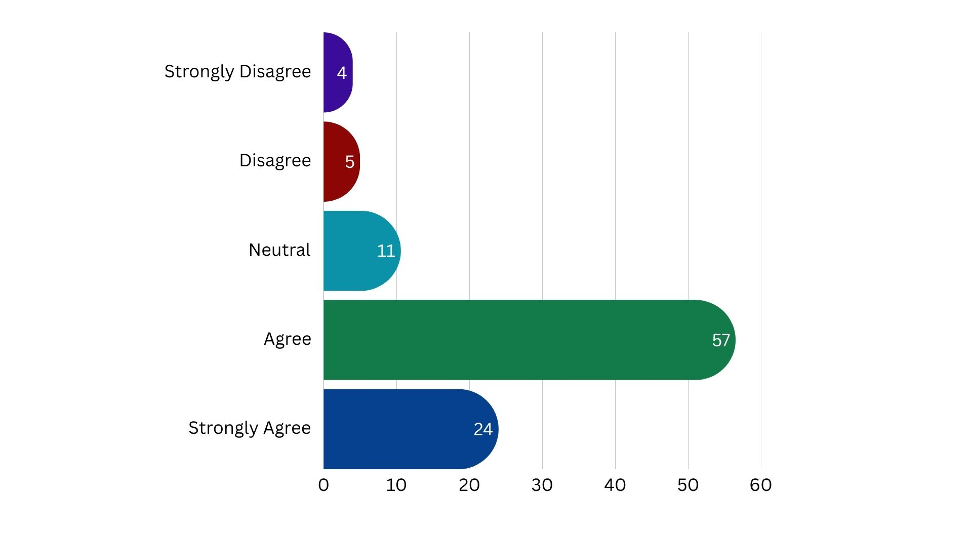
DATA ANALYSIS & INTERPRETATION
1)iii) AI-based predictive analytics
(suggested products, automated
discounts) influence my purchase
decisions.
(Source : Author’s Primary Data Collection (2025))
AI-based predictive analytics, such as suggested products and automated discounts, significantly impact purchase decisions. According to the given data, a majority (56.5%) of people agree that AI influences their buying choices, with 24% strongly agreeing. Only a small percentage (4%) strongly disagrees, suggesting that most consumers find value in these personalized recommendations.

Slide 10
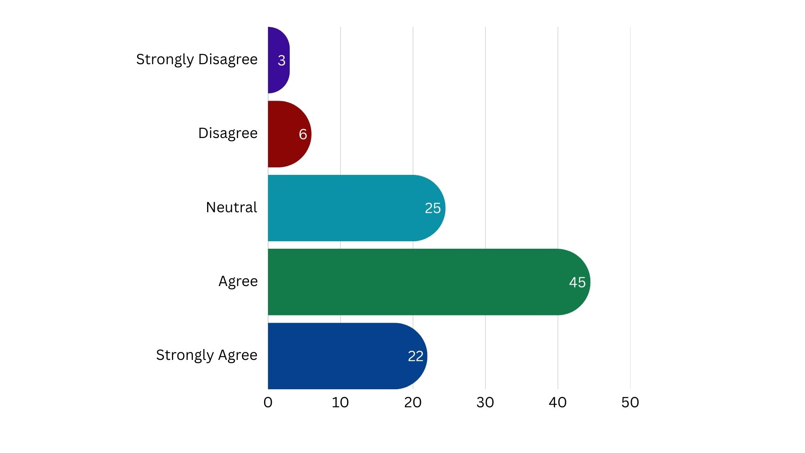
1)vi) AI in digital marketing improves
my ability to compare different brands
before making a purchase.
(Source : Author’s Primary Data Collection (2025))
AI in digital marketing enhances consumers' ability to compare different brands before making a purchase, as evidenced by the 67% of respondents who agree or strongly agree. These tools provide personalized recommendations, feature comparisons, and customer reviews, helping users make informed decisions. While 25% remain neutral, the small percentages of disagreement (9%) suggest that most people see AI as a valuable resource for brand comparison.

Slide 11
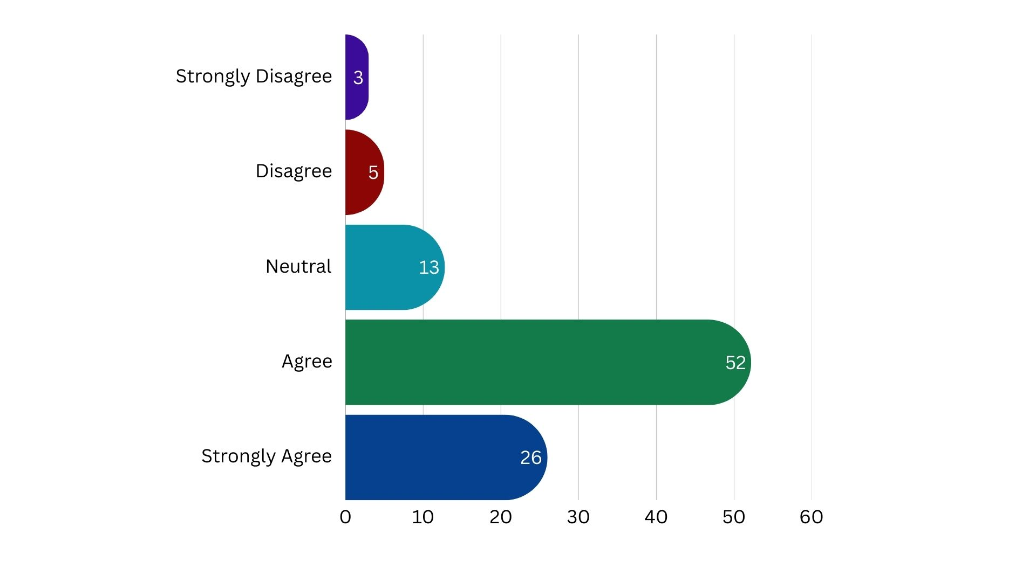
1)ix) AI-driven social media content
(automated posts, AI-generated ads)
enhances my awareness of brands.
(Source : Author’s Primary Data Collection (2025))
AI-driven social media content, such as automated posts and AI-generated ads, significantly enhances brand awareness, with 78% of respondents agreeing or strongly agreeing. These AI tools create personalized, relevant content that engages users and introduces them to new brands or reinforces familiar ones. While 13% remain neutral, the small percentage of disagreement (8%) suggests that most consumers find AI-generated content valuable in increasing their brand awareness.

Slide 12
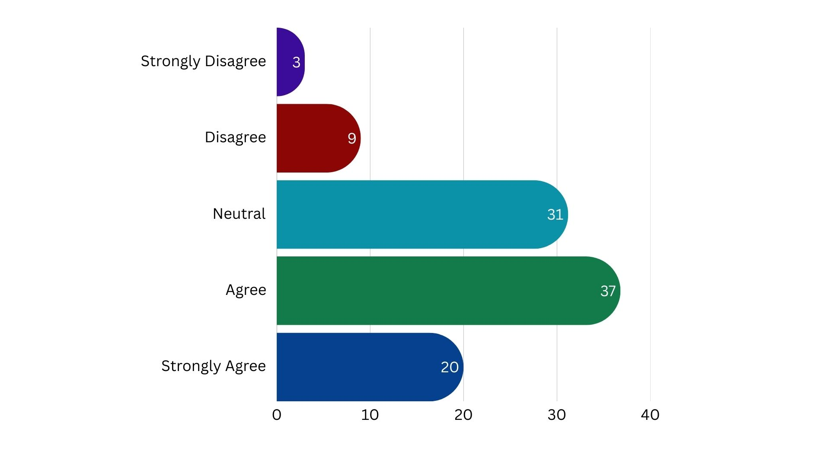
2) ii) AI-driven marketing strategies
(customized ads, dynamic pricing)
increase my engagement with a
brand.
(Source : Author’s Primary Data Collection (2025))
AI-driven marketing strategies, such as customized ads and dynamic pricing, have a positive impact on brand engagement, with 57% of respondents agreeing or strongly agreeing. These strategies offer personalized experiences that cater to individual preferences, enhancing the relevance of the content and offers presented. While 31% remain neutral, the 12% who disagree suggest that not all consumers are equally influenced by AI-driven marketing.

Slide 13
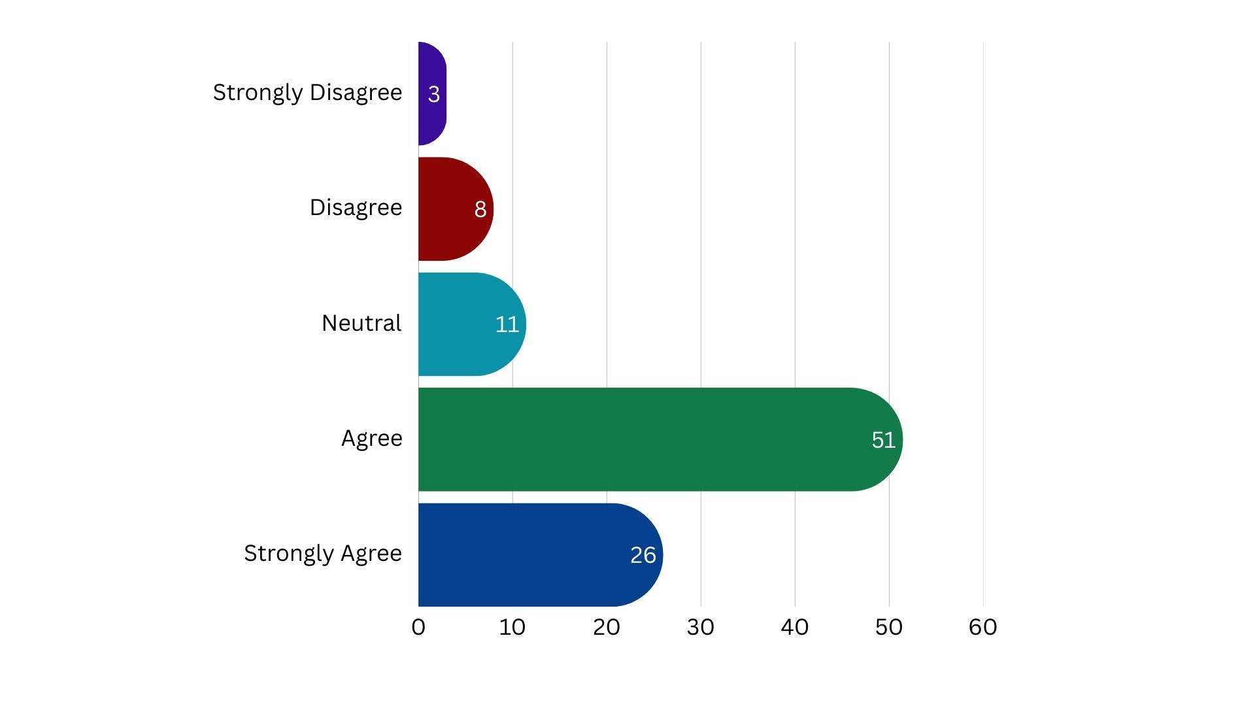
2)iii) AI-powered customer support
(chatbots, voice assistants) improves
my post-purchase experience.
(Source : Author’s Primary Data Collection (2025))
AI-powered customer support, including chatbots and voice assistants, significantly improves post-purchase experiences, with 77% of respondents agreeing or strongly agreeing. These AI tools provide quick, efficient assistance for tracking orders, resolving issues, and answering queries, enhancing overall customer satisfaction. While 11% remain neutral, the small percentage of disagreement (11%) suggests that some consumers may not fully embrace AI support. AI customer support contributes to better customer retention and strengthens brand loyalty.

Slide 14
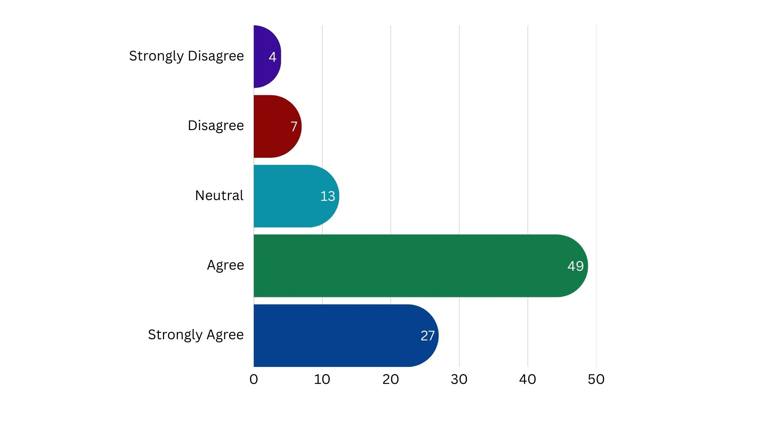
2)vii) AI-powered email marketing
(personalized content, product
recommendations) keeps me
engaged with brands.
(Source : Author’s Primary Data Collection (2025))
AI-powered email marketing, which includes personalized content and product recommendations, plays a key role in keeping consumers engaged with brands. With 76% of respondents agreeing or strongly agreeing, it’s clear that tailored email content captures attention and fosters ongoing brand interaction. These personalized emails offer relevant offers, promotions, and updates that resonate with individual preferences, enhancing the customer experience. While 13% are neutral and 11% disagree, the majority find AI-driven emails effective in maintaining brand engagement.

Slide 15
CONCLUSION
In conclusion, AI-powered tools in various aspects of marketing—predictive analytics, digital marketing, social media content, customized ads, customer support, and email marketing—significantly impact consumer engagement, brand awareness, and purchase decisions. The data shows a strong positive response, with majorities agreeing or strongly agreeing that AI enhances their ability to compare brands, stay engaged with them, and make informed decisions. While some remain neutral or disagree, these percentages are relatively small, highlighting that most consumers value personalized, AI-driven experiences. Overall, AI-driven strategies play a crucial role in shaping modern marketing, improving customer experiences, and driving brand loyalty.

Slide 16
REFERENCES
Brown, T. (2020). AI and Programmatic Advertising: Transforming Digital Campaigns. Journal of Digital Marketing, 25(4), 120-135.
Davis, L., & Clark, P. (2022). AI-Driven Personalization in Digital Marketing. Marketing Science Review, 30(2), 78-95.
Johnson, R. (2021). The Role of AI in Enhancing Consumer Interactions. Journal of Consumer Insights, 18(3), 112-129.
Jones, B. (2019). Machine Learning and Consumer Preferences. AI in Marketing Journal, 12(1), 45-59.
Martin, S., & Lee, R. (2021). AI in Email Marketing: Enhancing Engagement Rates. Digital Engagement Journal, 19(2), 90-105.
Miller, K. (2020). AI in Content Marketing: Creating Relevant Content. Marketing Innovation Review, 15(4), 56-72.
Patel, N. (2020). Chatbots and Customer Satisfaction: AI’s Role in Enhancing Support. Journal of AI in Business, 14(3), 134-150.
Roberts, J., & Green, L. (2021). AI-Driven Personalization and Consumer Trust. Consumer Behavior Research, 27(1), 65-89.
Smith, A., & White, P. (2021). AI-Powered Recommendations: Impact on Consumer Decisions. Journal of Digital Commerce, 21(4), 102-117.
Smith, J. (2020). AI and Digital Marketing Transformation. International Journal of Marketing Trends, 28(3), 150-167.
Taylor, C. (2019). AI in Ad Targeting: Optimizing Consumer Reach. Journal of Advertising Research, 22(2), 88-103.
Williams, M. (2018). Chatbots in Digital Marketing: A Case Study. Marketing Technology Journal, 13(1), 75-92.
Wilson, D. (2022). Social Media AI Analytics: Improving Brand Engagement. Social Media Insights, 16(3), 98-115.
Brown, J., & Jones, K. (2019). AI in Marketing Strategy: Emerging Trends. Marketing Intelligence Journal, 17(2), 55-72.
Green, L. (2021). AI-Enhanced Customer Experience: Case Studies. Journal of Consumer Behavior, 19(4), 130-145.

Slide 17
Thank You!

