Slide 1
“Understanding the Drivers of Brand Loyalty in Millennials and Gen Z Consumers”
Prabhjot Singh¹, Pratibha Khullar², Sodagar Singh³

Slide 2
Table of Content
Introduction
Review of Literature
Objectives of the study
Research Methodology
Analysis and Interpretations
Finding of the study
Conclusion
References

Slide 3
01- Introduction
Brand loyalty remains essential for client retention, repeat business, and long-term profitability. In today’s competitive market, understanding consumer loyalty across generational cohorts is crucial for brands seeking strong audience connections. Millennials (1981–1996) grew up amid digital transformation, prioritizing quality, trust, and emotional ties with brands that align with their values. Gen Z (1997–2012), as digital natives, favor authenticity, diversity, and socially responsible brands, shaped by social media and instant connectivity.
The rise of digital platforms and corporate responsibility has reshaped brand loyalty, with digital engagement, personalized experiences, and social cause alignment playing key roles alongside traditional factors like quality and price. To foster loyalty, businesses must understand how Millennials and Gen Z interact with brands.
This paper explores the key drivers of brand loyalty in these groups, highlighting their similarities and differences. By analyzing digital behavior, emotional connections, and social and environmental values, this study provides actionable insights for companies adapting to an evolving market.

Slide 4
02- Review of Literature
Building Strong brands | Aaker, D.A. (2018)
The impact of Customer Relationship Management and Company reputation on customer loyalty: The mediating role of customer satisfaction | Khan, R.U. et al. (2020)
Whence consumer loyalty | Oliver, R.L. (1999)
Marketing to millennials: Reach the largest and most influential generation of consumers ever. | Fromm, J. and Garton, C. (2024)
Millennials’ response toward cause-related marketing advertisements via social media and magazines: Which is more effective? | Anuar, M.M., Mohamad, O. and Omar, M.W. (2020)
Major shifts in sustainable consumer behaviour in Romania and retailers’ priorities in agilely adapting to it’, Sustainability | Purcărea, T. et al. (2022)
‘true gen’: Generation Z and its implications for companies, McKinsey & Company. | Francis, T. and Hoefel, F. (2018)
‘Users of the world, unite! the challenges and opportunities of social media’ | Kaplan, A.M. and Haenlein, M. (2010)

Slide 5
03- Objectives of the Study
To determine the main elements affecting Gen Z and Millennial customers' brand loyalty.
To examine how social media and tailored marketing, among other forms of digital engagement, influence both cohorts' brand loyalty.
To investigate how consumer loyalty is affected by values that align, such as social responsibility, diversity, and authenticity.

Slide 6
04- Research Methodology
1. Design of Research
The nature of the study is descriptive and exploratory. It aims to compare the habits of Gen Z and Millennials, pinpoint important factors that influence brand loyalty, and offer marketers useful information.
2.Information Gathering Primary Information:
Survey: A representative sample of Gen Z (ages 12–25) and Millennials (ages 26–43) were given structured online surveys. Purchase patterns, digital engagement, values alignment, and brand loyalty opinions were all included in the poll.
3. Taking samples
Target Audience: Gen Z and Millennial shoppers from a range of socioeconomic backgrounds.
The online survey had 105 participants, 50 of whom were Millennials and 55 of whom were Gen Z

Slide 7
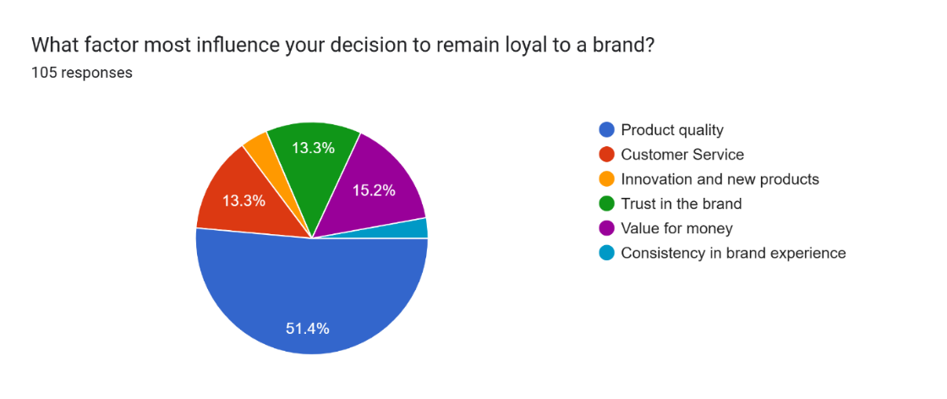
05- Analysis and Interpretation
A survey reveals that product quality (51.4%) is the primary driver of brand loyalty, emphasizing reliability and performance. Value for money (15.2%) ranks second, highlighting cost-effectiveness. Customer service and brand trust (13.3% each) play vital roles in retention. Innovation and consistency rank lowest, suggesting that while new features and uniform experiences matter, they are not the primary factors influencing consumer loyalty. Brands must prioritize quality and value.

Slide 8
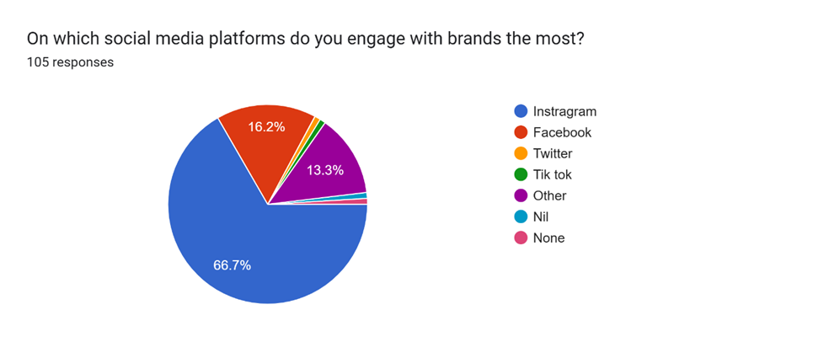
05- Analysis and Interpretation
A survey shows Instagram (66.7%) as the top platform for brand engagement, emphasizing visual content, reels, and influencer marketing. Facebook (16.2%) remains relevant for community building and long-form content. Twitter (13.3%) sees lower engagement, mainly for customer support and trend discussions. Other platforms, including TikTok, have minimal usage. Brands should adopt an Instagram-first strategy while maintaining a presence on Facebook and Twitter for niche interactions and customer engagement.
A survey reveals that product quality (51.4%) is the primary driver of brand loyalty, emphasizing reliability and performance. Value for money (15.2%) ranks second, highlighting cost-effectiveness. Customer service and brand trust (13.3% each) play vital roles in retention. Innovation and consistency rank lowest, suggesting that while new features and uniform experiences matter, they are not the primary factors influencing consumer loyalty. Brands must prioritize quality and value.

Slide 9
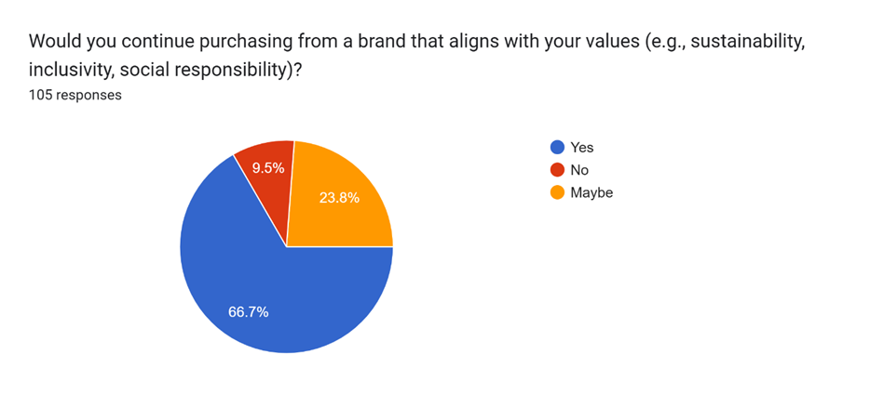
05- Analysis and Interpretation
A survey shows 66.7% of consumers remain loyal to brands that align with their values, highlighting the importance of CSR and ethical branding in fostering long-term trust. 23.8% are undecided, suggesting that price, product quality, and brand communication could influence their choices. This presents an opportunity for brands to strengthen their commitment to sustainability, inclusivity, and transparency. Only 9.5% reject value-based loyalty, indicating that most consumers consider ethical alignment important. Brands should focus on targeted marketing, responsible practices, and engagement strategies to reinforce trust and attract the undecided segment while maintaining their value-driven customer base.
A survey reveals that product quality (51.4%) is the primary driver of brand loyalty, emphasizing reliability and performance. Value for money (15.2%) ranks second, highlighting cost-effectiveness. Customer service and brand trust (13.3% each) play vital roles in retention. Innovation and consistency rank lowest, suggesting that while new features and uniform experiences matter, they are not the primary factors influencing consumer loyalty. Brands must prioritize quality and value.
A survey shows Instagram (66.7%) as the top platform for brand engagement, emphasizing visual content, reels, and influencer marketing. Facebook (16.2%) remains relevant for community building and long-form content. Twitter (13.3%) sees lower engagement, mainly for customer support and trend discussions. Other platforms, including TikTok, have minimal usage. Brands should adopt an Instagram-first strategy while maintaining a presence on Facebook and Twitter for niche interactions and customer engagement.

Slide 10
06- Findings of the Study
Product Quality: The most important factor influencing brand loyalty among Gen Z and Millennials.
Brand Reputation & Trust: Important, especially for Millennials.
Emotional Connection: Valued but less important than physical brand features.
Generational Differences:
Gen Z values authenticity, diversity, and social responsibility.
Millennials prioritize trust, quality, and long-term relationships.
Digital Engagement:
Instagram dominates brand interactions (66.7%).
61.9% of customers find tailored marketing effective.

Slide 11
06- Findings of the Study
Ethical Branding:
76.2% of consumers have stopped supporting firms due to value misalignment.
77.1% prefer brands that support social concerns.
Challenges for Brands:
Bridging generational gaps in priorities (35.2%).
Adapting to shifting digital trends (34.3%).
Retaining cross-generational loyalty (90.5%).
Consumer Advocacy: 77.1% of consumers are eager to recommend brands that support digital interaction tactics and ethical values, emphasizing the growing significance of social media presence and corporate responsibility.

Slide 12
07- Conclusion
This study highlights the evolving nature of brand loyalty among Gen Z and Millennials. While trust and product quality remain essential, brands must engage consumers through interactive content, ethical branding, and personalized digital interactions. A one-size-fits-all approach is ineffective, as these generations differ in values, digital behavior, and engagement styles. Brands that fail to adapt risk losing relevance in an increasingly competitive market.
To build lasting loyalty, businesses must prioritize authenticity and transparency, especially for Gen Z, who value social responsibility and diversity. Strengthening digital marketing through influencer collaborations and platforms like Instagram and TikTok is crucial. Consumers expect brands to align with social and environmental causes, making ethical branding a key factor. Additionally, personalized marketing enhances engagement by creating tailored experiences. To stay relevant, brands must continuously adapt to digital trends, ensuring they meet the evolving expectations of younger consumers and foster long-term loyalty.

Slide 13
08- References
Aaker, D.A. (2018) Building Strong brands David A. Aaker. Johanneshov: MTM.
Khan, R.U. et al. (2020) ‘The impact of Customer Relationship Management and Company reputation on customer loyalty: The mediating role of customer satisfaction’, Journal of Relationship Marketing, 21(1), pp. 1–26. doi:10.1080/15332667.2020.1840904.
Oliver, R.L. (1999) ‘Whence consumer loyalty?’, Journal of Marketing, 63(4_suppl1), pp. 33–44. doi:10.1177/00222429990634s105.
Fromm, J. and Garton, C. (2024) Marketing to millennials: Reach the largest and most influential generation of consumers ever. Nashville, TN: HarperCollins Leadership, an imprint of HarperCollins.
Anuar, M.M., Mohamad, O. and Omar, M.W. (2020) ‘Millennials’ response toward cause-related marketing advertisements via social media and magazines: Which is more effective?’, Eurasian Studies in Business and Economics, pp. 239–250. doi:10.1007/978-3-030-40160-3_17.
Purcărea, T. et al. (2022) ‘Major shifts in sustainable consumer behavior in Romania and retailers’ priorities in agilely adapting to it’, Sustainability, 14(3), p. 1627. doi:10.3390/su14031627.
Francis, T. and Hoefel, F. (2018) ‘true gen’: Generation Z and its implications for companies, McKinsey & Company. Available at: https://www.mckinsey.com/industries/consumer-packaged-goods/our-insights/true-gen-generation-z-and-its-implications-for-companies (Accessed: 12 February 2025).
Kaplan, A.M. and Haenlein, M. (2010) ‘Users of the world, unite! the challenges and opportunities of social media’, Business Horizons, 53(1), pp. 59–68. doi:10.1016/j.bushor.2009.09.003.

