Slide 1
EXPLORING THE INFLUENCE OF WORK-LIFE BALANCE ON JOB SATISFACTION AND EMPLOYEE RETENTION
Doshi Setu Swapnilkumar¹, Dr Anand Joshi²
¹Research Scholar, Management , setudoshi121@gmail.com
²PhD in Management, RK University, Rajkot, Gujarat

Slide 2
ABSTRACT
In today's quick-moving workplace, the preservation of healthy work-life balance is emerging as a cornerstone of individual well-being and organizational success. This study is aimed at assessing the effects of work-life balance on the job satisfaction and retention of millennial employees in India. A quantitative methodology was used for the study, and data was collected from the respondents through an online structured survey of 200 respondents. Many tested assessment tools were used to measure the three key variables, namely employee retention, job satisfaction, and work-life balance. In order to test these correlations between the variables, we used regression analysis on all data that we showed was both valid and reliable. Balance work-life has greater relevance for job satisfaction than for employee retention, according to the findings. Overall, this research emphasizes the significance of creating a good workplace, as work-life balance relates to job satisfaction concerning employee retention.

Slide 3
INTRODUCTION
Today's hectic and competitive business environment makes it nearly impossible to find ways of merging work with personal commitments.
One of the elements that directly affects an employee's degree of job satisfaction is work-life balance.
Employees that have a poor work-life balance are less dedicated to their jobs and experience stress, low morale, and discontent.
Organizations that are eager to have a trained and stable workforce are very concerned about employee retention.
Work-life balance efforts, such as paid leave policies, career development programs, and mental health assistance, helps in retaining employees in an organization since a friendly work environment may better support its staff.
Employees who work in a balanced environment where their work-life concerns are taken seriously and handled well will stick with their company.

Slide 4
LITERATURE REVIEW
Puspitasari (2023) examines the potential effects of pay and work-life balance on PT Sandang Asia Maju Abadi Semarang's employee retention rate using job satisfaction. One hundred Likert scale questionnaires were used to collect data, and these questionnaires were then subjected to Partial Least Squares tests to ensure their validity and reliability.
Islam and Reaz (2022) In the setting of small private enterprises in Bangladesh, a South Asian economy that is expanding quickly, the study examined the effects of work-life balance (WLB) on the retention of Generation Y (Gen Y) employees.
Nawaz and Tahir (2021) examined how important work-life balance is to Emirati women's lives and how it affects their retention and job satisfaction. The researchers came to the conclusion that, similar to their counterparts in the West, women in the United Arab Emirates have significant challenges in balancing work and family life, particularly when employed in the private sector.
Fahlevi (2024) examined the potential effects of green work-life balance policies on staff retention and business sustainability performance in UK manufacturing companies.

Slide 5
RESEARCH METHODOLOGY
The present study employs a quantitative research methodology and employs the survey method to examine work-life balance, job satisfaction, and employee retention among millennial employees in Indian cities.
200 employees were given online questionnaires to complete in order to gather data on these three important criteria. It involved 15 questions regarding retention, job happiness, and work-life balance.
The quantitative strategy was used for the research since it can gather numerical data that can be statistically examined. The survey approach was chosen because it provided an organized response from a large number of respondents, guaranteeing the consistency and dependability of data collecting.
A total of 200 employees were selected to form the sample for the study.

Slide 6
RESEARCH METHODOLOGY
Participants were chosen based on their age group: from 1981 to 1996.
The sample size is big enough to provide enough information for the study on the millennial workforce in India to ensure that those conclusions will have the validity they deserve.
This sample size is adequate to provide this study with trustworthy data that would guarantee factually met conclusions with regard to the millennial workforce in India as a whole.
The 5 questions included in this work-life balance tool intend to reveal how well each has managed their personal and professional lives.
The 5 questions included in this work-life balance tool intend to reveal how well each has managed their personal and professional lives.

Slide 7
RESEARCH METHODOLOGY
A sample of 200 employees in an Indian city will be sampled for the study by means of an online questionnaire.
A reliability test was conducted to establish the items that elicit consistent responses in the survey.
To evaluate the two Hypothesis, a regression analysis was performed to explore the connection among the variables.
The study includes two hypotheses:
  Hypothesis 1: Work-life balance has a significant effect on job satisfaction.
  Hypothesis 2: Job satisfaction has a significant effect on employee retention.

Slide 8
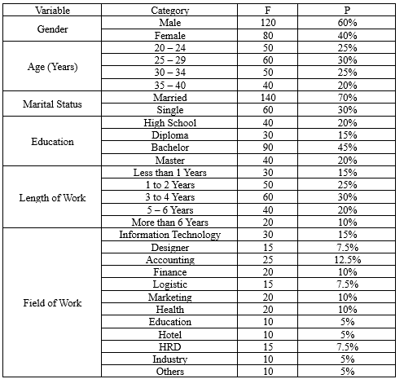
DATA ANALYSIS
Demographics Data
The demographic details display a well-mixed workforce with an ample representation of both the genders and a majority in the early to middle stages of their careers. Most employees are married and do have at least a degree indicating an average educated workforce. Experience also varies, most of whom have worked for only several years, with a few who have worked for longer than that. Employees in this organization are designated for work in various professions, among which the highest number of workers are in information technology, accounting, finance, marketing, and health. Such diversities of age, education, experience, and profession give a great view of the work atmosphere and the experience of the employees.

Slide 9
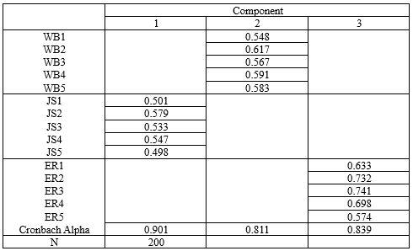
DATA ANALYSIS
Validity and Reliability Tests Result
This Table demonstrate that the work-life balance (WB), job satisfaction (JS), and employee retention (ER) measurement tools have construct validity and reliability that are acceptable. Each component's factor loadings are far higher than the typical cutoff of 0.5, ensuring that the items accurately assess the corresponding construct. Component 2's work-life balance varies from 0.548 to 0.617, Component 1's job satisfaction ranges from 0.498 to 0.579, and Component 3's employee retention spans from 0.574 to 0.741 with strong convergent validity. All three elements exhibit strong internal consistency and dependability, with Cronbach's Alpha significantly over 0.8: 0.811 for work-life balance, 0.839 for employee retention, and 0.901 for job satisfaction.

Slide 10

DATA ANALYSIS
This table shows the relationship between Work-Life Balance (WB), Job Satisfaction (JS), and Employee Retention (ER). With an R2 value of 0.078 for the first hypothesis, WB-JS, work-life balance can explain 7.8% of the variation in job satisfaction. The negative relationship indicated by the β value of -0.551 indicates that job satisfaction declines as work-life balance declines. The fact that the t-value is -4.213 and the significance level is 0.001 is evidence enough that the association is statistically significant. However, the second theory, WB-ER, should also be taken into account. With an R2 value of 0.039, work-life balance accounts for 3.9% of the variation in employee retention. The impact is negative, as shown by the β coefficient of -0.153 and the t-value of -2.987, at a significance level of 0.002.
Summary of Hypotheses

Slide 11
CONCLUSION
The millennial workforce in India is the target population for this study, which aims to examine the connection between work-life balance and employee happiness and loyalty.
The findings indicate a strong inverse connection between work-life balance, job happiness, and retention rates.
For firms looking to boost employee happiness and loyalty over the long haul, it pays to foster work-life balance-promoting settings.
According to regression research, work-life balance has a bigger impact on job satisfaction than retention.
In order to increase employee retention and job happiness generally, the report urges more businesses to create policies that support professional development possibilities, flexible work schedules, and employee well-being initiatives.

Slide 12
THANK YOU

