Slide 1
Enhancing Cybersecurity In Healthcare IoT Ecosystems And Cloud Computing Environments: A Comprehensive Framework
Darshan Madhani
PhD Research Scholar, Department of Computer Science, Atmiya University
Prakash Gujarati
Research Supervisor, Department of Computer Science, Atmiya University

Slide 2
INTRODUCTION
The digital conversion of health care has changed patient care, operating process and information management. But that also causes serious cyber security issues.
IT management and protection is essential to ensure high quality patient care, performance and security of sensitive health data. Because the greater dependence is granted to digital systems, health care organizations are becoming more and more sensitive to carriers and security architecture, safe.
Acceleration of health care has inaugurated unprecedented levels of patient care, data management and operating efficiency.
Electronic health files (DSE), remote and other digital health technologies have optimized the provision of health care services and improving the results for patients.
Data violations, ransomware attacks and other cyber criminals may have catastrophic effects, violate patients' privacy, break the provision of tending and imposing fees. legitimate.

Slide 3
LITERATURE REVIEW
Gadde and Kalli (2020 [4]) emphasizes the growing importance of cloud -based cyber security solutions in medical facilities. The authors emphasize the need for executives can be expanded and powerful to reduce the effectiveness of men. Their work emphasizes the role of cloud computing platforms in empowering health organizations to implement advanced safety measures, such as aggressive detection systems and bad encryption.
Rehan's comparative analysis (2023 [11]) has verified the effectiveness of different cloud management managers based on clouds in the health care environment for the IT environment. This research assesses the performance of the main cloud service providers, including Amazon Web Services (AWS), Microsoft Azure and Google Cloud platforms, depending on the security features, compliance certification and ability Data protection power.
Rasel (2024 [5]) provide valuable information about the main components and principles as the basis for effective cybersecurity frames based on. On the cloud. The authors argue for a multi -class approach to cybersecurity, including preventive measures, detectives and overcome, to minimize the diversity of men on the network that the care organizations Health faces.

Slide 4
The following table summarizes the main results of document evaluation on cybersecurity in health care IT, highlighting their important studies and contributing to this field.
Study | Key Findings
Mazumder et al.,2019 [1] | Research on cyber threats and regulatory compliance in healthcare IT.
Gadde & Kalli,2020 [2] | Importance of scalable and robust cloud-based cybersecurity frameworks in healthcare.
Rasel, 2024 [3] | Multi-layered approach to cybersecurity using AI, blockchain, and cryptographic protocols.
Rehan, 2023 [11] | Comparative analysis of cloud service providers in healthcare IT.
Habib et al.,2019 [1] | Alignment of cloud security measures with regulations like HIPAA, GDPR, and HITECH.
Patel et al.,2020 [8] | Novel encryption algorithm for healthcare IoT applications.
Li and Wang, 2021[12] | Integration of homomorphic encryption for secure data processing in IoT.
Garcia and Brown,2022 [13] | Analysis of anomaly detection algorithms for healthcare IoT security.
Chen et al., 2023[13] | Importance of incident response plans in cybersecurity.

Slide 5
Protecting Data: Encryption and Confidentiality
The safety of patient information during storage and transmission is very important. Patel et al. (2020) presented a new sewing encryption algorithm for IoT health care applications. In addition to highlighting the effectiveness of the algorithm in calculation, their results emphasized the advantage of the integrity of the data it presented on the existing practices. Research helps protect secret information about health care.
Detecting Threats and Responding Swiftly
Abnormal detection systems thanks to automatic learning serving as a basis for detecting abnormal models or trends in IoT health care networks. A detailed study of Garcia and Brown anomalies (2022) explained learning models in detecting real -time threats. Researching to establish lessons applied to enhance the safety of health care on the basis of advanced abnormal detection.
The Human Factor: User Awareness and Training
The effectiveness of safety measures depends on raising users' awareness and participation. Research by Kim and Rodriguez (2024) on how user awareness raising programs affect the compliance with security showed a strong positive influence. Their article emphasizes the need for security methods combined with consideration of human factors, preparing the foundation for safe culture in health care organizations.

Slide 6
RESEARCH GAP
Although the current research has progressed significantly, the continuous development of emerging technologies has promising roads to develop next.
Gupta et al. (2025) Blockchain application has been studied for data exchange security. Their research proposes an interesting and decentralized registration system to improve the integrity and transparency of data, with new opportunities to secure IoT's data layer on health care.
Wang et al. (2026) proposal to research on artificial intelligence in prediction security, offering a strong research orientation for the future.
Their research shows that the use of automatic learning algorithms to detect predictions of threats capable of significantly improving the general security position for IoT of health care.
This field of research has a potential security approach that suits the nature of the cyber operators.

Slide 7
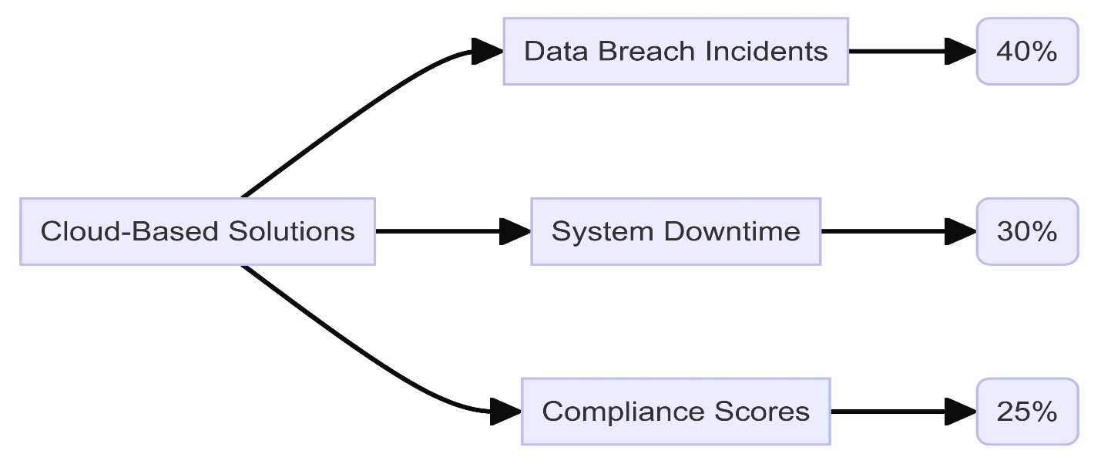
COMPARATIVE ANALYSIS
Comparing different cyber security executives used by health care shows that cloud -based solutions provide many advantages compared to the old On -Site architecture. For example, cloud -based executives have improved the detection and response characteristics of threats in the form of automatic learning algorithms that can analyze and combat threats in time. real. In addition, cloud -based executives provide complete data encoding, versatile authentication and real -time supervision, ensuring that health care organizations comply with the requirements.
Figure 1 : "Comparative Analysis of Cybersecurity Frameworks in Healthcare."

Slide 8
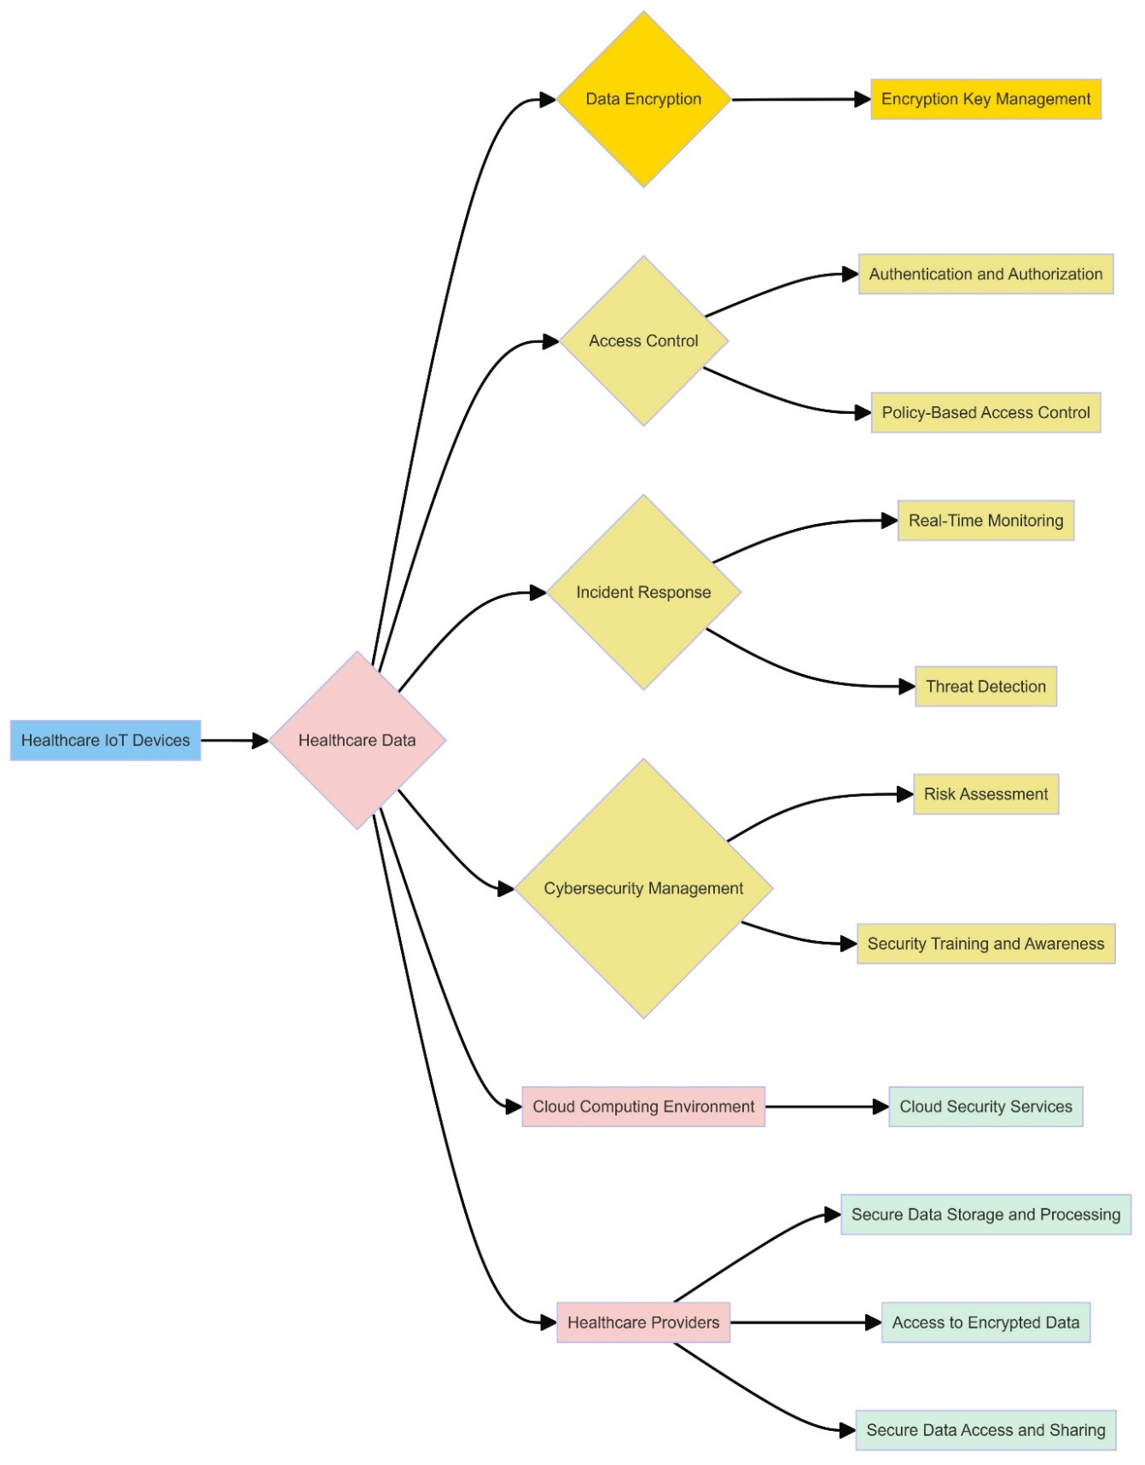
METHODOLOGY
Research Design
Using the design of mixed methods, this research blends the qualitative cases of cybersecurity deployment based on cloud -based with quantitative analysis of IT performance data. Essential performance measures such as data violations, system errors and compliance audit results are the focus of quantitative research. A series of health care facilities have invested in cloud -based cyber security solutions.
Figure 2 : "Healthcare IoT Security Framework”

Slide 9
Data Collection Methods
Quantitative data were obtained using electronic health records (EHR) systems, audit reports on compliance, and IT performance monitoring software. Data points like the volume of data breach incidents, system downtime, and compliance ratings were captured and compared. Qualitative data were obtained using semi-structured interviews with the IT managers and cybersecurity professionals in the chosen healthcare organizations.
Analysis Techniques
The quantitative data were statistically analyzed by means of paired t-tests and regression analysis to determine the important changes in the performance metrics prior to and post implementing cloud-based solutions. Descriptive statistics were applied on the data and the results were charted using bar charts and line graphs.

Slide 10
RESULTS
Quantitative Analysis: Quantitative analysis has shown a significant decline in data violations and the system stopping time after implementing cloud -based cyber security models. The compliance score also increased by an average of 25%, showing better compliance with the prescribed standards.
Qualitative Insights: The qualitative information from interviews with IT managers and cyber security experts emphasized some important success factors for cloud -based cyber security platforms. Interview participants emphasize the role of training programs and employees' awareness to ensure a solid cyber security position.
Key Themes from Qualitative Data
Robust Threat Detection: The interviewers emphasized the need to detect sophisticated threats in cloud -based safety architectures.
Transparency integration: The integration of cloud -based transparency solutions in the IT infrastructure of current health care is recorded as a central factor in successfully applying the successful applications.
Employee training and awareness: Values ​​of employees' training initiatives and awareness have been emphasized as an essential element to maintain a strong cyber security position.

Slide 11
CONCLUSION
In short, the protection of sensitive medical information in IoT health care networks and cloud computing environment requires a global strategy to target holes and resolve risks.
The executives are provided in this work to provide management to enhance cybersecurity in these essential health environments to protect the privacy and integrity of patient information.
Research proves that cloud security executives -based executives are mandatory to stimulate the effectiveness and security of health systems.
The significant decline in data violations and the system arrest time, involving better compliance notes, reflecting the effectiveness of these frames to keep the patient data secret and facilitate for uninterrupted activities of health.
The challenge of data movement, incompatible challenges of the system and challenges in staff training are certain limits for cloud computing. However, the advantages of cloud computing beyond these obstacles.
Future studies will exist in the study of vehicles to overcome these obstacles and promote the effectiveness of cloud -based cybersecurity models in the field of health care.

Slide 12
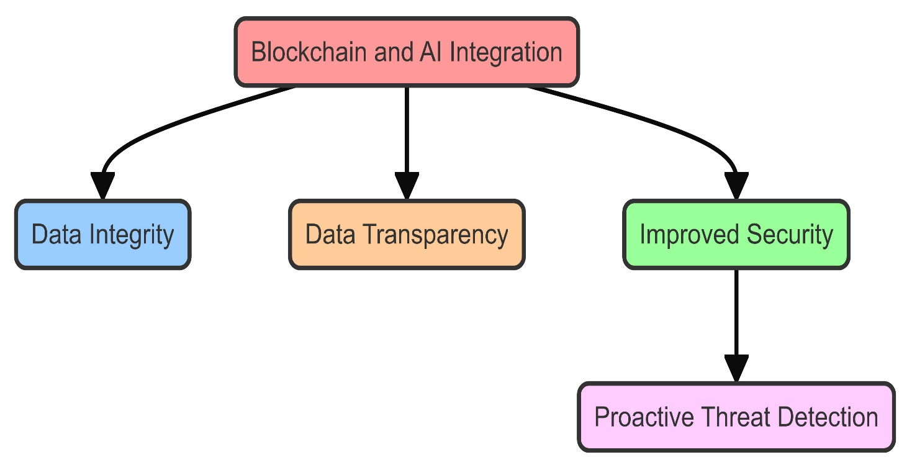
FUTURE DIRECTIONS: EMERGING TECHNOLOGIES
Although the current research has made significant progress, continuous development in emerging technologies with promising prospects for new progress. For example, Blockchain technology provides a large book platform and stimulates support to improve the integrity and transparency of data.
Blockchain technology with IoT health care systems can improve data layer, minimize data violations and maintain the security of sensitive data. Artificial intelligence (AI) also promises a lot of predictable security.

Slide 13
BIBLIOGRAPHY
Mazumder, G. C., Ibrahim, A. S. M., Shams, S. N., & Huque, S. (2019). Assessment of wind power potential at the Chittagong coastline in Bangladesh. The Dhaka University Journal of Science, 67(1), 27-32.
Gadde, S. S., & Kalli, V. D. R. (2020). Descriptive analysis of machine learning and its application in healthcare. International Journal of Computer Science Trends and Technology, 8(2), 189-196.
Rasel, M. (2024). Synergizing cyber threat intelligence sharing and risk assessment for enhanced government cybersecurity: A holistic approach. Journal of Environmental Sciences and Technology, 3(1), 649-673.
Gadde, S. S., & Kalli, V. D. R. (2020). Technology engineering for medical devices—a lean manufacturing plant viewpoint. Technology, 9(4).
Rasel, M. (2024). Ethical data-driven innovation: Integrating cybersecurity analytics and business intelligence for responsible governance. Journal of Environmental Sciences and Technology, 3(1), 674-699.

Slide 14
Thank you

