Slide 1
MODERN APPROACH TO HUMAN RIGHTS IN INTERNATIONAL LAW
Dr. Ramesh Kumar Singh
Assistant Professor (Law)
Veer Kunwar Singh University, Ara Bihar
Posted at Maharaja Law College, Ara
singhrameshkumar148@gmail.com

Slide 2
INTRODUCTION
The concept of human rights has undergone significant transformation in international law, evolving from a primarily state-centered framework to a more individual-centric approach.
Traditionally, human rights protections were limited to domestic legal systems, with little international intervention. However, historical events, particularly the atrocities of the world wars, led to the establishment of international legal instruments that recognize and protect fundamental rights globally.
The adoption of various conventions and treaties has reinforced the notion that human dignity transcends national boundaries, necessitating a collective commitment to upholding these rights.
Today, human rights are no longer seen as mere moral aspirations but as legally binding principles enforced through global and regional judicial mechanisms.
The modern approach to human rights in international law reflects a dynamic and evolving legal landscape that responds to contemporary challenges such as digital privacy, climate justice, and migration crises.

Slide 3
OBJECTIVES OF THE STUDY
To look into how treaties and international organizations support the defense and progress of human rights.
To analyze the evolution of human rights under international law, including key turning points and historical development.

Slide 4
LITERATURE REVIEW
Orakhelashvili, A. (2022) provided a full overview of the development, structure and guiding principles of international law. The origin of international law and the responsibility and the rights of the nations in the community. bridge. Orakhelashvili has prioritized the relationship between global management and international law, investigating the development of the role of non -subject subjects and the driving force of state sovereignty.
Smith, R. K. (2022) provided an inspection in the growth and evolution of the Global Human Rights Law. This book has checked protection measures provided by international organizations, treaties and conventions and determines the activities of human rights in the region and the United Nations. Smith emphasizes the importance of the main legal tools.
Shelton (2015) checked legal appeals that individuals and groups may search for justice for human rights violations according to international law. Research has included different types of appeals, such as compensation, rehabilitation and non -repetitive insurance, with a specific reference to international courts. Shelton's research has illuminated political, ethical and legal aspects of confrontation with human rights violations by checking traditional standards and contemporary practices of international law.

Slide 5
EVOLUTION OF HUMAN RIGHTS IN INTERNATIONAL LAW
The evolution of human rights in international law has been gradual, influenced by historical events, philosophical ideas, and legal advancements. Key milestones include:
  Early Influences: Ancient civilizations and religious texts laid the groundwork for concepts of justice and equality.
  Magna Carta and Enlightenment: The Magna Carta (1215) limited monarchical power and introduced natural rights, while Enlightenment thinkers like Locke and Rousseau emphasized liberty and social contracts.
  Abolition of Slavery: The 19th century saw movements against slavery and the establishment of humanitarian organizations like the Red Cross, promoting early human rights through international law.
  League of Nations: Formed post-World War I, it aimed to protect minorities and labor rights, despite limited success.

Slide 6
5. United Nations: Established in 1945 after WWII atrocities, the UN prioritized human rights, culminating in the Universal Declaration of Human Rights (UDHR) in 1948, which influenced national laws.
6. Binding Treaties: Following the UDHR, treaties like the ICCPR and ICESCR created enforceable human rights obligations for states.
  International Covenant on Civil and Political Rights (ICCPR, 1966) – Treated rights like freedom of expression, impartial trials, and protection against torture.
  International Covenant on Economic, Social, and Cultural Rights (ICESCR, 1966) – Identified the right to education, healthcare, and equal working conditions.
  Convention on the Elimination of Racial Discrimination (CERD, 1965) – Intended to end racial disparity.
  Convention on the Rights of the Child (CRC, 1989) – Provided special safeguards for children.
7. Post-Cold War Era: The end of the Cold War heightened the focus on human rights, leading to war crime tribunals and the establishment of the International Criminal Court (ICC) in 2002. Globalization introduced new challenges, including corporate accountability, refugee rights, and climate justice.

Slide 7
CONTEMPORARY CHALLENGES IN HUMAN RIGHTS LAW
a) Digital and Technological Human Rights: Legislation like the GDPR enhances individual control over personal data, while the UNGPs require companies to respect digital rights. Key ICCPR articles address freedom of expression and privacy concerns in the digital age.
b) Environmental and Climate Justice: The UN Human Rights Council recognizes the right to a healthy environment, urging countries to mitigate environmental harm. International legal frameworks aim to ensure all individuals can enjoy a sustainable environment.
c) Migration and Refugee Rights: Global migration issues, driven by conflict and inequality, lead to human rights violations for refugees and migrants. International laws, including the 1951 Refugee Convention, aim to protect their rights and promote safe migration, ensuring access to labor, healthcare, and education
d) Gender and LGBTQ+ Rights: Despite progress, significant barriers remain for gender equality and LGBTQ+ rights. International law promotes non-discrimination, with CEDAW and the Yogyakarta Principles advocating for protection against discrimination based on gender and sexual orientation.

Slide 8
ROLE OF INTERNATIONAL ORGANIZATIONS AND LEGAL INSTRUMENTS
International organizations are crucial for promoting and protecting human rights globally through conventions and treaties. Key players include:
The UN: The UN is the primary agency for human rights, focusing on dignity, equality, and international cooperation. Its main legal tools include:
  - UDHR (1948): Establishes fundamental human rights but is not legally binding.
  - ICCPR (1966): Guarantees rights such as life, freedom of speech, and anti-torture measures for signatory states.
  - ICESCR: Addresses rights related to health, education, and employment.
  - Various UN Human Rights Councils monitor compliance.

Slide 9
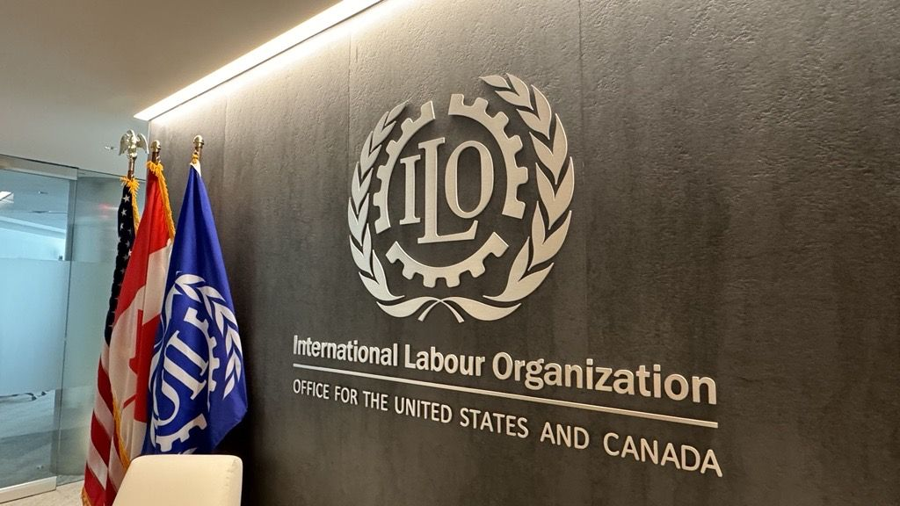
International Labor Organization (ILO): An agency of the UN that advocates for labor rights and social justice, ensuring fair wages and working conditions. Key legal instruments include: ILO conventions that protect workers' rights, including the right to organize and collective bargaining.; ILO 138 Convention (1973) aims to prevent child labor.
World Health Organization (WHO): A UN specialized agency focused on global health. Important legal documents include: International Health Regulations (IHR) (2005) A legally binding framework for managing global health threats while upholding human rights.; 2006 UN Convention on the Rights of Persons with Disabilities: Ensures equal access to health services and education for individuals with disabilities.
Figure 1: International Labour Organization (ILO)

Slide 10
CASE LAW AND LEGAL PRECEDENTS
Significant legal precedents have shaped modern human rights legislation through landmark cases addressing human rights violations and setting global standards.
  Filártiga v. Peña-Irala (1980)
This case established that torture violates human rights laws globally. The U.S. court ruled that the Filártiga family could sue a Paraguayan police officer for torture under the Alien Tort Statute, allowing U.S. courts to hear international law violation cases occurring abroad. This expanded human rights protections under universal jurisdiction.
  2. Soering v. United Kingdom (1989)
The European Court of Human Rights addressed the risk of brutal treatment or the death penalty upon extradition. The court ruled that extraditing Soering to the U.S. would violate Article 3 of the ECHR, which prohibits torture. This decision reinforced the non-refoulement principle, preventing states from extraditing individuals to countries where they may face inhumane treatment.

Slide 11
CONCLUSION
As human rights have evolved within international law, they have shown a dramatic shift away from the primacy of states and toward the primacy of individuals as subjects of legal protection.
Human rights have been defined and sought to be enforced in a variety of cultural and geopolitical contexts through a series of international treaties, conventions, and legal organizations.
Yet, modern challenges like technological monitoring, global warming, displacement, and structural inequalities still challenge the strength of these legal frameworks.
The ever-changing nature of human rights requires ongoing adaptation, more effective enforcement mechanisms, and greater international cooperation to counter new threats.
Going forward, the efficacy of international human rights law will be a function of states and institutions' readiness to maintain fundamental values of dignity, justice, and equality in checking that human rights are the bedrock of international governance in a continuously changing world.

Slide 12
REFERENCES
Orakhelashvili, A. (2022). Akehurst's modern introduction to international law. Routledge.
Smith, R. K. (2022). International human rights law. Oxford University Press.
Shelton, D. (2015). Remedies in international human rights law. Oxford University Press (UK).
Donnelly, J., & Whelan, D. J. (2020). International human rights. Routledge.
Addison, C. H. L., & Koh, H. (2017). How is international human rights law enforced?. In International Law of Human Rights (pp. 241-262). Routledge.
Mayer, A. E. (2018). Islam and human rights: Tradition and politics. Routledge.
Charlesworth, H., & Chinkin, C. (2022). The boundaries of international law: A feminist analysis, with a new introduction. Manchester University Press.
Forsythe, D. P. (2012). Human rights in international relations. Cambridge University Press.

Slide 13
Thank you

