Slide 1
ADMINISTRATION OF JUSTICE AND THEORIES OF PUNISHMENT -A CRITICAL EVALUATION
Dr. Ramesh Kumar Singh
Assistant Professor (Law)
Veer Kunwar Singh University, Ara Bihar
Posted at Maharaja Law College, Ara singhrameshkumar148@gmail.com

Slide 2
INTRODUCTION
Any contemporary society depends to a great extent on the dispensation of justice, where laws are read, enforced, and maintained to safeguard individual rights and promote communal peace.
It is an organized system with executive, judicial, and legislative arms that maintain law and order, interpret the law, and enact laws.
Justice administration entails beyond punishing the offenders; it entails protecting victims' rights, conducting fair trials, and espousing principles of equality before the law.
Equitable administration of justice by a good judicial system encourages stability in society, deters crime, and generates confidence in its members.
But the presence of legal frameworks, judicial independence, procedural justice, and the effectiveness of law enforcement agencies are also often required for the effective administration of justice.
Punishment has various functions within the justice system and is an integral part of administering justice. Theories of punishment have progressed over time under the impetus of social, ethical, and philosophical arguments.

Slide 3
OBJECTIVES OF THE STUDY
To analyze the role of justice administration in ensuring fairness, social order, and legal effectiveness.
To examine key punishment theories and their impact on crime prevention and rehabilitation.
To assess challenges and propose reforms for a more balanced and efficient justice system.

Slide 4
LITERATURE REVIEW
Bronsther (2021) analyzed the United States criminal justice system and concluded that punishment was still necessary for social cooperation and harmony, even though it was ineffective, discriminatory, and humiliating. In his view, current criminal justice theories cannot account for why punishing an offender is necessary to deter similar behavior in the future.
Daly and Stubbs (2017) analyzed the crossroads of feminist theory and restorative justice, considering both the possibilities and the limitations of restorative justice in addressing gendered violence and structural inequalities. They pointed out that while restorative justice offered a different option to punitive legal models by prioritizing victim involvement, offender accountability, and community healing.
Vogt (2018) examined state punishment in terms of justice, where justice is the activity of correcting injustice. He examined theories of retributive justice critically by examining various conceptions of the wrongfulness of crime, such as violation of mutual freedom, freeloading, and victim harm. He concluded that punishment was just if it corrected the wrong done.

Slide 5

ADMINISTRATION OF JUSTICE
The organizational and procedural structure put in place for the interpretation and application of the law is implicit within the administration of justice. Its principal objectives are to uphold equity, equality, and safeguard individual rights and promote social order.
Key Components of Justice Administration
Judiciary: Judiciaries, through courts and judges, have been charged with maintaining justice and interpreting the law.
Law Enforcement Agencies: Police departments and investigative agencies have traditionally been responsible for enforcing the rule of law and ensuring public order.
Legislative Framework: Judicial rulings throughout history have been shaped by legal codes, statutes, and provisions of the constitution.
Penitentiary Institutions: Penitentiaries, probation departments, and prisons have penalized the offending parties and tried to reform them.
Figure 1: Administration of Justice

Slide 6
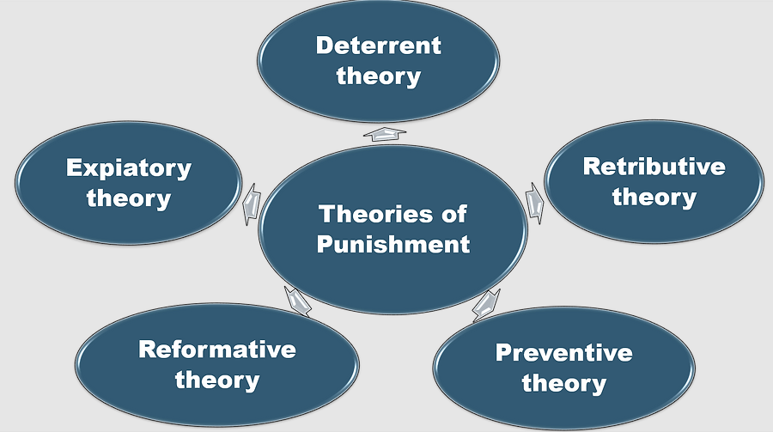
THEORIES OF PUNISHMENT
Punishment serves a variety of functions, from rehabilitation to retaliation. Depending on their philosophical and ethical foundations, legal systems adopt a variety of theories that influence how they approach criminal justice.
Figure 2: Theories of Punishment

Slide 7
1) Retributive Theory: This theory advocates for punishment proportional to the crime, emphasizing justice over rehabilitation. It is reflected in Indian laws like section 302 (murder) and section 376 (rape). Critics argue it ignores rehabilitation and mitigating factors.
2) Deterrent Theory: Aims to prevent crime by instilling fear of punishment, operating on specific (individual) and general (societal) levels. Indian laws like section 392 (robbery) and the NDPS Act focus on deterrence. However, its effectiveness is questioned, as severe punishments alone may not reduce crime.
3) Preventive Theory: Seeks to incapacitate criminals to prevent further offenses, supported by laws like the National Security Act and the Habitual Offenders Act. Critics highlight potential human rights violations and increased recidivism due to lack of rehabilitation.
4) Reformative Theory: Focuses on rehabilitating offenders into law-abiding citizens through education and support, as seen in the Juvenile Justice Act and the Probation of Offenders Act. Its success depends on resources and societal acceptance, with poor programs potentially leading to recidivism.
5) Expiatory Theory: Views punishment as atonement for guilt, rooted in religious thought. It includes provisions for plea bargaining and community service, but critics argue it fails to prevent crime or address underlying issues.

Slide 8
COMPARATIVE ANALYSIS OF PUNISHMENT THEORIES IN LEGAL SYSTEMS
Table 1: Comparative Analysis of Punishment Theories Across Different Countries
Country/Region | Dominant Punishment Theory | Key Features & Legal Framework
United States | Retributive & Deterrent | Harsh sentencing laws, including the death penalty, life imprisonment without parole, and three-strikes laws (such as California’s Three Strikes Law under the Violent Crime Control and Law Enforcement Act, 1994).
Scandinavian Countries | Reformative | Prioritizes rehabilitation over punishment, with reintegration programs and short prison sentences. Norway's Correctional Service Act prioritizes humane treatment, and open prisons such as Bastøy Prison offer vocational training.
India | Mixed Approach | Incorporates retributive, deterrent, and reformative theories. The Indian Penal Code (IPC), 1860, allows capital punishment in extreme cases (e.g., Section 302 IPC for murder). Bachan Singh v. State of Punjab (1980) established the "rarest of rare" doctrine for awarding the death penalty.
Japan | Deterrent & Reformative | Maintains strict sentencing policies under the Penal Code of Japan, but also provides educational and vocational training. The Lay Judge System (2009) increased public participation in sentencing.
Germany | Reformative & Restorative | Prioritizes rehabilitation with probation, psychological counseling, and victim-offender mediation under the German Penal Code (Strafgesetzbuch, StGB). In M (1997), a juvenile offender was given probation and therapy instead of imprisonment, illustrating Germany’s focus on reform rather than incarceration.

Slide 9
CHALLENGES AND REFORMS IN JUSTICE AND PUNISHMENT
Legal systems worldwide face challenges in applying punishment and administering justice due to outdated practices, inefficiencies, and evolving public attitudes. Key issues and potential reforms include:
  Balancing Rehabilitation and Retribution: Integrating rehabilitative and retributive justice can address the root causes of crime while ensuring public safety. Programs offering vocational training and counseling can reduce recidivism.
  Judicial Efficiency: Delays in the judicial process undermine public trust. Implementing digital court systems, improving case management, and utilizing AI for legal research can expedite justice delivery.
  Prison Reforms: Overcrowded prisons hinder rehabilitation. Alternatives like probation, community service, and improved prison conditions can enhance reintegration and reduce recidivism
  Victim Rights and Participation: Enhancing victim-focused strategies, such as restorative justice and compensation schemes, can empower victims and promote healing.

Slide 10
CONCLUSION
The research indicates the importance of justice administration to social order maintenance and promotion of equity in legal systems.
It stresses the requirement for a holistic approach that encompasses restorative, retributive, deterrent, and rehabilitative justice by examining the core elements of the legal system, police, and theories of punishment.
Efficient law enforcement bodies, ongoing legal reforms, and an impartial judiciary that ensures accessibility are all required for the effective administration of justice.
In addition, maintaining public confidence in the legal system relies on reducing recidivism and wrongful convictions.
Ultimately, a successful justice system enhances and vindicates society by punishing criminals but also rehabilitating and reintegrating them into society.

Slide 11
REFERENCES
Azizi, A., Mir Khalili, S. S., & Najafi Abrandabadi, A. H. (2022). Dignity-Based Punishment in the Democrat Model of Criminal Policy. Criminal Law Research, 13(1), 177-204.
Banks, C. (2018). Criminal justice ethics: Theory and practice. Sage publications.
Bronsther, J. (2021). The corrective justice theory of punishment. Virginia Law Review, 107(2), 227-279.
Cragg, W. (2003). The practice of punishment: Towards a theory of restorative justice. Routledge.
Daly, K., & Stubbs, J. (2017). Feminist engagement with restorative justice. In Feminist Theories of Crime (pp. 503-522). Routledge.
Easton, S., & Piper, C. (2012). Sentencing and punishment: The quest for justice.

Slide 12
Thank You

