Slide 1
Exploring the Technical And Economic Hurdles of Smart Grids: A Case Study on Future Opportunities
Kamaljeet Singh
Assistant Professor (HOD)
IET Bhaddal Technical Campus Ropar

Slide 2
INTRODUCTION
Due to rising global electricity use and the need for renewable energy, power grids need upgrading. Digital solutions, automation, and real-time monitoring in smart grids have altered energy distribution.
By improving dependability and sustainability, energy optimization and demand-response operations make smart grids more efficient.
Smart grids have many benefits but face technological and financial challenges. Solar and wind power systems as intermittent renewable energy sources in the smart grid create stability and energy management control issues.
These intermittent power sources require cutting-edge prediction technology, distribution control systems, and energy storage to sustain power delivery. Smart grids are vulnerable to assaults due to their large digital networks, making data security and client privacy crucial.
Cybersecurity threats, component compatibility issues, and management strategy complexity complicate smart grid adoption. Early deployment of smart meters sensors and communication networks is limited by high investment costs.

Slide 3
LITERATURE REVIEW
Ahmad, et al. (2022) identified potential obstacles for past ML energy distribution system smoothness investigations. Data-driven probabilistic ML techniques and real-time smart energy system and network applications showed the urgency of this topic. This study examined ML in fundamental energy technologies and energy distribution utility applications. In energy distribution networks, ML examined energy usage, price predicting merit order, and consumer lifetime value.
Bhattarai et al. (2019) examined big data analytics in power grids from utility, industrial, and academic viewpoints, noting issues and opportunities. Big data revealed new power grid choices that improved technology, society, and economy. The report identified research gaps and suggested big data analytics for power system planning and operations. Big data analytics for utilities and revenue growth and innovation were discussed.
Khan et al. (2022) analyzed the energy control system's structure, goals, benefits, and problems by thoroughly analyzing stakeholders and players. The demand response, demand management, and energy quality management programs in the power management system were thoroughly examined in this paper. It also summarized smart grid functions, features, and methodologies and identified research gaps, obstacles, and issues.

Slide 4
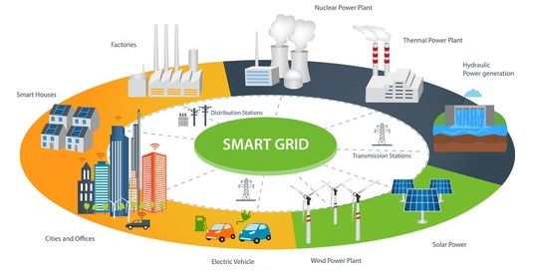
TECHNICAL CHALLENGES IN SMART GRID IMPLEMENTATION
Implementation of a smart grid is accompanied by various technological issues to be solved in order to provide effective and secure operation. Upstreaming the electrical grid, improving energy efficiency, and evolving with changing energy production and consumption levels demand that these issues be addressed. Utility companies, technology suppliers, government bodies, and other parties need to come together to solve them.
Figure: The Concept of Smart Grid

Slide 5
The smart grid faces several key challenges that need to be addressed for effective operation:
  1. Interoperability: Different components from various vendors must communicate cohesively, necessitating established standards and frameworks.
  2. Cybersecurity: As digital systems are vulnerable to cyber-attacks, ongoing improvements in security measures like encryption and intrusion detection are essential.
  3. Data Management: The vast amounts of data generated require advanced management and analytics for optimal grid operations and real-time decision-making.
  4. Grid Reliability and Resilience: High reliability and resilience are crucial, with self-healing architectures and real-time fault detection to quickly restore service after disruptions.
  5. Integration of Renewable Energy: To maintain grid stability with intermittent renewable sources, advanced forecasting and energy management systems are necessary.
  6. Communication Infrastructure: A robust communication framework is vital for interoperability among various grid components, highlighting the need for integrated standards to address technology and protocol diversity.

Slide 6
ECONOMIC CHALLENGES IN SMART GRID IMPLEMENTATION
Smart grids must overcome economic obstacles to be widely used and durable. To make smart networks profitable, meticulously planning, creative financial programs and coordination between stakeholders are necessary.
Initial investment cost
Smart watches, sensors, network automation, media networks, and network security must be purchased for smart grid. These initial expenditures may hinder government and public services in mandatory financial areas or when smart network benefits are unclear quickly. Innovative financial structures like PPP, government allowances, and green requirements overcome this barrier.
Consumer and Utility Financial Burden
Smart grid implementation requires balancing infrastructure spending and electricity affordability. Smart grids reduce energy costs and increase efficiency, but their initial investment may raise electricity prices. Utilities must cover these expenditures without burdening subscribers, especially low-income ones.

Slide 7
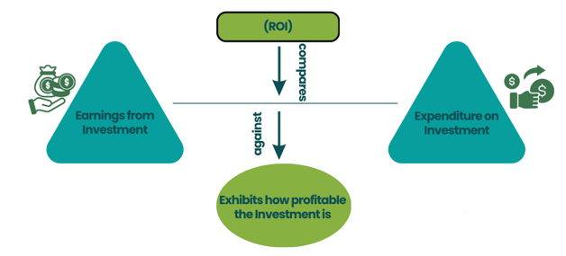
ROI and Economic Viability
The economic feasibility of smart grids depends on their ability to save money in terms of efficiency, energy conservation, demand-side management, and reduced power outages.
Figure: Return on Investment (ROI) and Economic Viability
Market and Stakeholder Conflicts
Smart grids affect energy suppliers, technology suppliers, consumers, regulators, and legislators. Priorities conflict, making it hard to align the interests of these diverse groups. Utility companies might prioritize cost recovery, consumers' affordable prices, and technology suppliers' smart grid profits.

Slide 8
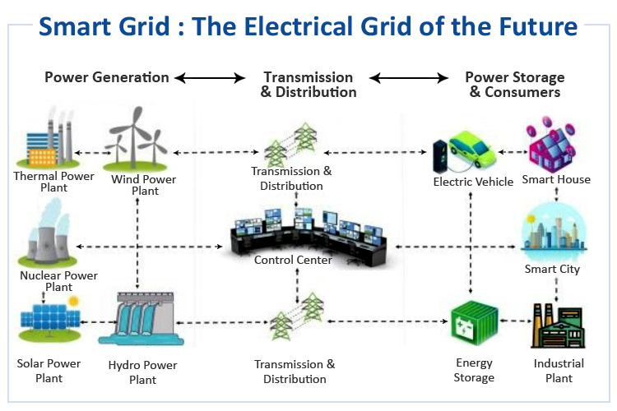
FUTURE OPPORTUNITIES AND BENEFITS OF SMART GRIDS
Smart grids can provide decreased greenhouse gas emissions and worldwide efforts at improving sustainability by saving energy through smaller losses in transportation, efficient consumption, and efficient dispatching according to demand.
Fault detection is automatically enhanced using the self-healing capability that maximizes resilience for the grid, while there are decreased loss hours due to its ability to easily separate the faults and spot them.
Widespread interruptions are prevented in the process as this improves grid security against disaster strikes and hacker attempts, delivering an improved form of energy assurance.
Figure 3: Future Opportunities of Smart Grid

Slide 9
CONCLUSION
Smart grids are a critical innovation in the modernization of the electricity sector, with enhanced efficiency, sustainability, and resilience.
However, they are confronted with daunting technical and economic challenges like integrating renewable sources of power with intermittent generation, cybersecurity threats, interoperability issues, and huge initial investment.
Overcoming these challenges requires a multi-faceted approach involving technological innovation, policy support, and stakeholder collaboration.
Artificial intelligence breakthroughs, energy storage technology, and high-reliability communication networks can optimize grid stability and operational efficiency, while regulatory and investment incentives can encourage investor investment and consumer interaction.
Daunting as these challenges are, the future of smart grids remains bright, promising to revolutionize the management of energy, facilitate electric vehicle charging infrastructure, and place consumers in full control of real-time energy.
By surmounting these difficulties through collaborative efforts and constant innovation, intelligent grids can be the solution to constructing a more resilient and sustainable future for energy.

Slide 10
REFERENCES
Ahmad, T., Madonski, R., Zhang, D., Huang, C., & Mujeeb, A. (2022). Data-driven probabilistic machine learning in sustainable smart energy/smart energy systems: Key developments, challenges, and future research opportunities in the context of smart grid paradigm. Renewable and Sustainable Energy Reviews, 160, 112128.
Amin, S. M. (2011). Smart grid: Overview, issues and opportunities. advances and challenges in sensing, modeling, simulation, optimization and control. European Journal of Control, 17(5-6), 547-567.
Bhattarai, B. P., Paudyal, S., Luo, Y., Mohanpurkar, M., Cheung, K., Tonkoski, R., ... & Zhang, X. (2019). Big data analytics in smart grids: state‐of‐the‐art, challenges, opportunities, and future directions. IET Smart Grid, 2(2), 141-154.
El-Hawary, M. E. (2014). The smart grid—state-of-the-art and future trends. Electric Power Components and Systems, 42(3-4), 239-250.
Giordano, V., & Fulli, G. (2012). A business case for Smart Grid technologies: A systemic perspective. Energy Policy, 40, 252-259.

Slide 11
Thank You

