Slide 1
CORE CONCEPTS AND EMERGING TRENDS IN ELECTRICAL ENGINEERING RESEARCH
Kamaljeet Singh
Assistant Professor (HOD)
IET Bhaddal Technical Campus Ropar

Slide 2
INTRODUCTION
Electrical engineering is at the cutting edge of technological developments that impact numerous various businesses and everyday life.
Electrical engineering, rooted in basic principles such as circuit theory, electromagnetism, and power systems, has evolved to encompass a wide variety of areas, ranging from advanced electronic systems to power generation and transmission.
Electrical engineers are now looking into new approaches to solve these problems while ensuring the ongoing expansion of modern infrastructure, as demand for effective and sustainable energy systems increases worldwide.
The discipline of electrical engineering has undergone dramatic transformation over the past few decades with advancements in power electronics, smart grid, energy storage systems, and renewable energy systems.
More sophisticated and versatile systems are now achievable due to the incorporation of digital technologies and the growing influence of machine learning (ML) and artificial intelligence (AI).

Slide 3
LITERATURE REVIEW
Manoj, V., Khampariya, P., & Pilla, R. (2022) reviewed power filter and other power quality investigations. The state of research and its potential benefits were also described. The increased usage of electrically powered devices caused many problems for the electricity sector. Energy demand expanded quickly in India due to rapid economic growth. Electrical equipment was used in practically every business then.
Lucia, et al. (2021) claimed that a broad range of technical fields focused on the use of electronics and electrical sciences to improve manufacturing and industrial processes were included in the field of industrial electronics (IE). Inherently, it served as a crucial enabling technology for a wide range of applications, encompassing the most recent advancements in robotics, factory communications and automation, vision systems, power electronics, intelligent and computer control systems, and the human and educational aspects of these fields.
Sidhu, M. S., & Kang, L. C. (2010) investigated the issues raised by the literature that affected mechanical engineering faculty and students. One of the main objectives of higher education institutions was to improve and enhance education by offering better teaching methods, technology, and instructors as well as producing competent students who could meet industry demands.

Slide 4
CORE CONCEPTS IN ELECTRICAL ENGINEERING
Design, development, and improvement of electric systems are regulated by basic principles that are the pillars of electrical engineering. These concepts vary from elementary principles of circuits to advanced concepts concerning the generation, transmission, and utilization of electricity. One of the most significant fields of contemporary electrical engineering are:
Power Generation and Systems: With non-renewable energy sources like gas and coal being replaced with renewable systems, such as hydro, wind, solar, and geothermal, these are supposed to decrease carbon emissions and shape a sustainable power future.
Table 1: Comparison of Renewable Energy Sources for Power Generation
Energy Source | Efficiency (%) | Capacity Factor | Cost (per kWh)
Solar Power | 15-25% | 20-30% | $0.02 - $0.12
Wind Power | 30-45% | 25-40% | $0.03 - $0.08
Hydroelectric Power | 60-80% | 40-60% | $0.04 - $0.12
Geothermal Power | 70-90% | 60-80% | $0.05 - $0.10

Slide 5
Power Electronics: This technology addresses the design and control of electronic circuits that govern the conversion of electrical power. Power electronics development is enhancing efficiency, diminishing size, and performance in applications from electric vehicles (EVs) to industrial automation.
Table 2: Performance Comparison of Power Electronics Devices
Device | Efficiency (%) | Applications
Inverters | 90-98% | Solar Power, Wind Power, Electric Vehicles
DC-DC Converters | 85-98% | Power Supplies, Electric Vehicles, Telecommunications
Rectifiers | 90-95% | AC to DC Conversion, Renewable Energy Integration
Thyristors (SCR) | 95-99% | High Voltage Power Control, Electric Traction Systems
Smart Grids and Energy Management: Smart grids use digital technology to handle electricity distribution in a more optimized manner and counter the variable requirements of consumers. They facilitate bidirectional communication between consumers and utilities, which further improves real-time control and energy flow optimization.

Slide 6
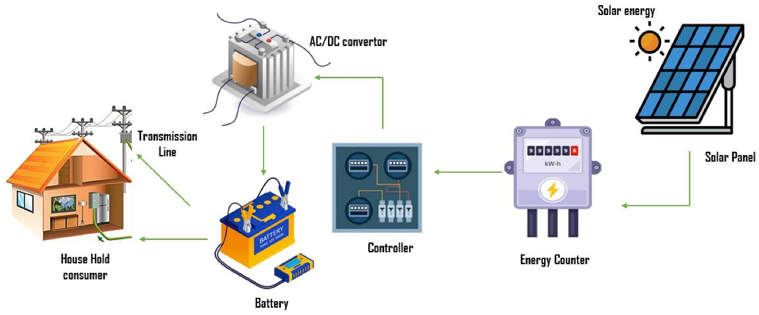
EMERGING TRENDS IN ELECTRICAL ENGINEERING
Renewable Energy Systems:
Wind Power: Turbine design, materials, and energy conversion efficiency have also improved in wind power. Larger turbines and aerodynamic innovations have increased wind farm capacity factors, making wind energy a viable and steady power source for many regions.
Solar Power Technologies: Solar power is cheaper due to panel efficiency improvements. Major advances include perovskite solar cells, which are cheaper and more efficient than silicon-based cells.
Figure 1: Advancements Solar Power Technologies

Slide 7
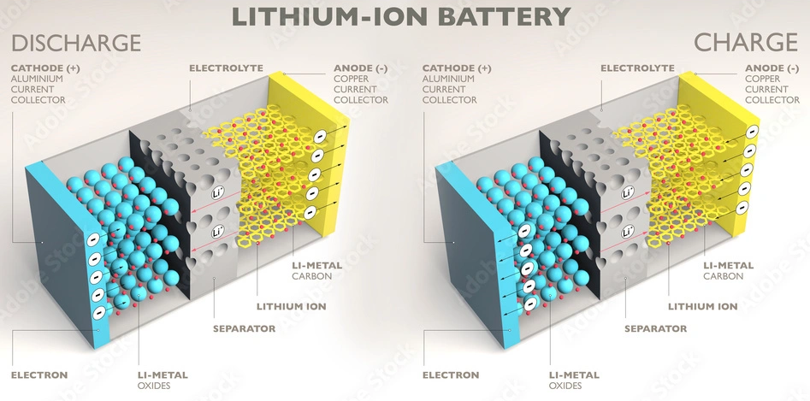
Energy Storage Solutions
Energy storage bridges the intermittent output of renewable sources like solar and wind. The biggest energy storage advances are:
Battery Technologies:. Lithium-ion batteries dominate the market, especially in electric vehicles (EVs) and renewable energy storage, while solid-state batteries are promising for increased energy density and safety, and flow batteries are scalable in large-scale energy storage.
Figure 2: Lithium-ion batteries
Grid-Scale Storage: Compressed air energy storage and pumped hydro storage are becoming more significant for power system balance and renewable power supply.

Slide 8
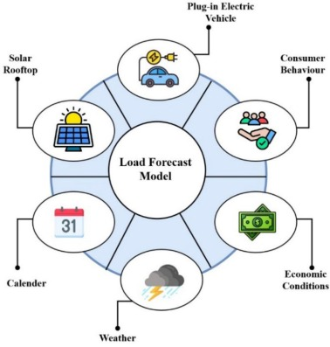
ROLE OF AI AND MACHINE LEARNING IN ELECTRICAL ENGINEERING
System Optimization and Fault Detection
Load Forecasting: AI helps utilities prevent grid overloads, maximize energy utilization, and coordinate variable renewable energy resources with demand through peak demand period forecasting and distribution adjustment. Energy waste is reduced and grid resource management is improved.
Fault Detection: Utility companies are using AI-based diagnostics to predict failures and prevent system collapse. Traditional defect detection uses human interaction or slow automated technologies. AI monitors the grid's health and detects anomalies that may suggest a malfunction.
Figure 3: Load Forecast Model

Slide 9
Energy Efficiency in Power Electronics
Modern electrical networks rely on power electronics like inverters, converters, and rectifiers to convert and flow electricity. These gadgets maximize efficiency without wasting energy through conversion procedures using AI and ML.
Control Systems: AI and ML algorithms calibrate real-time operating parameters to improve power converter operation, especially solar converters. Machine learning algorithms can optimize inverter operations to convert the most energy without loss. These enhancements provide more energy and reduce gadget wear, extending their lifespan.
Power Quality Improvement: Harmonic distortion and voltage swings can damage sensitive equipment and reduce electrical efficiency. Power quality is monitored and improved using artificial intelligence (AI) to detect and mitigate power supply outages. AI can detect voltage drops or harmonic distortion in real time and modify transformer or inverter settings. Stable, steady electricity reduces equipment damage and improves system efficiency.

Slide 10
CONCLUSION
Electrical engineering is being revolutionized by the incorporation of renewable energy sources, progress in power electronics, and the embracing of emerging technologies like artificial intelligence (AI), machine learning (ML), and the Internet of Things (IoT).
Such technologies are maximizing electrical systems, enhancing energy efficiency, and making power grids more intelligent and more resilient.
As the need for clean and dependable energy keeps growing, the new trends will be instrumental in determining the future of electrical engineering.
By adopting these technologies, sectors like healthcare, transport, and communication will gain from improved operational efficiency, lessened environmental footprint, and enhanced reliability, which will, in turn, lead to a more sustainable and integrated global energy system.

Slide 11
REFERENCES
Albu, M., Boicea, A. V., Calin, M., & Popa, M. (2011, June). Emerging smart grid topics in electrical engineering education. In 2011 IEEE Trondheim PowerTech (pp. 1-6). IEEE.
Chowdhury, A., Mahajan, V., Shahidehpour, M., & Singh, S. N. (Eds.). (2024). Emerging Technologies in Electrical Engineering for Reliable Green Intelligence: Proceedings of ICSTACE 2023. Springer Verlag, Singapore.
Dhavse, R., Kumar, V., & Monteleone, S. (2020). Emerging Technology Trends in Electronics, Communication and Networking.
Fleming, P., Lacquet, B. M., Sanei, S., Deb, K., & Jakobsson, A. (Eds.). (2019). Smart and Sustainable Engineering for Next Generation Applications: Proceeding of the Second International Conference on Emerging Trends in Electrical, Electronic and Communications Engineering (ELECOM 2018), November 28–30, 2018, Mauritius.
Frivaldský, M. (2020). Emerging trends in power electronics, electric drives, power and energy storage systems. Electrical Engineering, 102(1), 1-1.

Slide 12
Thank You

