Slide 1
DEEP FEATURE EXTRACTION FROM SIGNATURES FOR BIG FIVE
Submitted :Aghera Punamben J.,
Research Scholar, Surendranagar University [1]
Dr. Dhaval S. Vyas,
Professor, Surendranagar University[2]

Slide 2
Introduction
Behavioral biometrics: Signatures as markers of personality
Big Five Personality Traits: Openness, Conscientiousness, Extraversion, Agreeableness, Neuroticism
Deep learning and feature extraction for personality prediction

Slide 3
ABSTRACT
This study demonstrates the potential of deep learning techniques in predicting personality traits based on handwritten signatures.
By leveraging Convolutional Neural Networks (CNNs) for feature extraction and employing classification models such as Deep Neural Networks (DNNs), Support Vector Machines (SVMs), and Random Forest, the research highlights the effectiveness of automated handwriting analysis.
The highest classification accuracy of 90.1% achieved by DNNs indicates that deep learning methods can successfully uncover complex relationships between signature features and personality traits.

Slide 4
Key findings include statistically significant correlations between specific handwriting characteristics and the Big Five personality traits. For example, stroke width positively correlates with conscientiousness but negatively with neuroticism and pressure variation.
These insights suggest practical applications in fields like psychological profiling, recruitment processes, and forensic investigations, where signature analysis could provide additional behavioral and cognitive indicators.
Overall, this research contributes to the growing body of literature supporting the role of deep learning in personality assessment and highlights the real-world applicability of signature-based personality prediction.

Slide 5
Keywords
Deep Feature,
Extraction, Signatures,
Big Five Personality,
Trait Prediction,
Openness,
Conscientiousness,
Extraversion,
Agreeableness,
Neuroticism

Slide 6
Research Objectives
To investigate the relationship between signature features and the Big Five personality traits;
To improve the accuracy of personality trait prediction by deep learning-based signature feature extraction.

Slide 7
REVIEW OF LITERATURE
Jaiswal, Sharma, and Yadav (2022) used deep feature extraction with convolutional autoencoders to identify document forgeries.
Leghari et al. (2021) considered several feature fusion methods deep enough have been considered to allow their integration online with signatures to fingerprints for manifesting multimodal authentication.

Slide 8
Methodology
Data Source: Public dataset of handwritten signatures
Pre-processing: Grayscale conversion, noise reduction, normalization, binarization
Feature Extraction: CNNs (ResNet, VGG), PCA for dimensionality reduction
Models: DNN, Random Forest, SVM

Slide 9
DATA ANALYSIS AND RESULTS
  Data Pre-processing and Feature Extraction
  Table 1: Descriptive statistics for extracted signature features
Feature | Mean | Standard Deviation | Min | Max
Stroke Thickness | 0.48 | 0.12 | 0.21 | 0.73
Slant Angle | 15.2° | 3.8° | 8.1° | 22.5°
Pressure Variation | 0.62 | 0.14 | 0.31 | 0.88
Signature Length | 6.9 cm | 1.5 cm | 4.2 cm | 9.3 cm

Slide 10
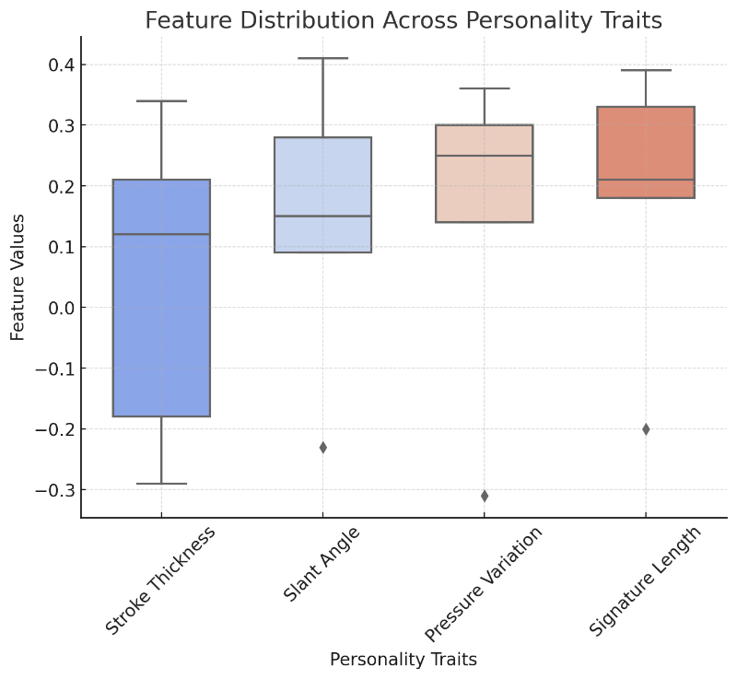
Figure 1: Distribution of Features Among Personality Traits

Slide 11
Table 2: Evaluation of Model Performance
Model | Accuracy (%) | Precision | Recall | F1-Score
Support Vector Machine (SVM) | 84.2 | 0.81 | 0.83 | 0.82
Random Forest | 86.7 | 0.85 | 0.86 | 0.86
Deep Neural Network (DNN) | 90.1 | 0.88 | 0.89 | 0.89

Slide 12
Figure 2: Model Accuracy Comparison

Slide 13
Key Features Extracted
Stroke Width
Slant Angle
Pressure Variation
Signature Length

Slide 14
Model Performance
DNN: Accuracy 90.1%
Random Forest: Accuracy 86.7%
SVM: Accuracy 84.2%

Slide 15
Correlation Analysis
Stroke Width: Positive with Conscientiousness, Negative with Neuroticism
Slant Angle: Positive with Extraversion, Conscientiousness
Pressure Variation: Positive with Openness, Conscientiousness; Negative with Neuroticism
Signature Length: Positive with Extraversion, Agreeableness

Slide 16
Conclusion
Deep learning effective for personality trait prediction from signatures
DNNs provide highest accuracy
Potential applications: Psychological profiling, recruitment, forensic investigation

Slide 17
Future Work
Address bias and interpretability challenges
Explore larger, diverse datasets
Hybrid deep learning and optimization techniques

Slide 18
Thank You

