Slide 1

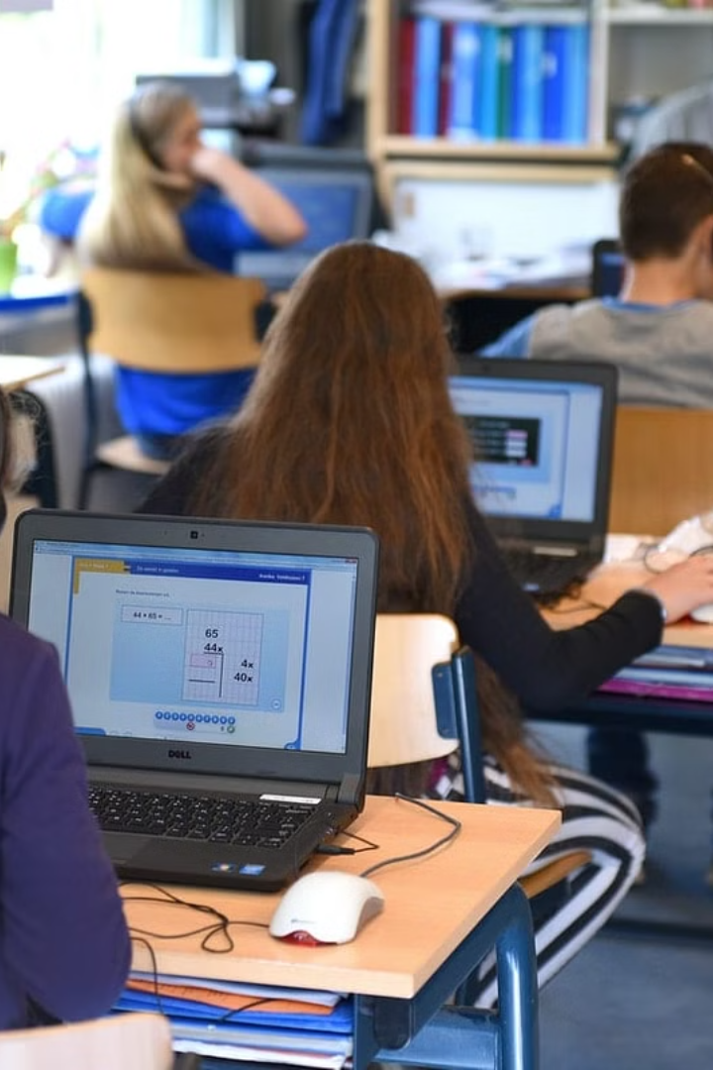
Transformative Approaches to Physical Education and Education in Higher Learning Institutions: Leveraging Smart Technologies

Slide 2
Dr. I. M. MAKKUBHAI
M.P.Ed., M.A., N.I.S., M.Phil., Ph.D., Ph.D.
Assistant Professor / Head Department of Physical Education and Sports Nehru Arts, Science and Commerce College Karnataka India
AVIA KRIPA
D’SOUZA
M..Ed., (Ph.D.)
Head Mistress
St. Ann’s High School
Nelamangala,
Bengaluru
Karnataka India
Prof.
K. KALEEMULLA
M.P.Ed., M.Phil., (Ph.D.)
Assistant Professor /
Head Department of
Physical Education and
Sports Anjuman Arts,
Science, Commerce
College and P. G. Centre,
Anjuman Abad,
Karnataka India
Prof.
SHARADAMMA B.
M.P.Ed., M.Phil., (Ph.D.)
Assistant Professor /
Head Department of
Physical Education
And Sports Government
First Grade College
Gauribidanur, Chikkaballapur
Karnataka India

Slide 3
Introduction
In the contemporary landscape of higher education, the convergence of digital technologies and pedagogical innovation has ushered in a new era of transformative approaches to teaching and learning. Across various disciplines, educators are increasingly leveraging smart technologies to enhance educational experiences, promote student engagement, and achieve learning outcomes. One area where this transformation is particularly evident is in the domain of physical education within higher learning institutions. Traditional models of physical education instruction are being re-imagined and revitalized through the integration of smart technologies, offering unprecedented opportunities for both educators and students. The aim of this research paper is to explore the multifaceted dimensions of leveraging smart technologies to advance physical education and education more broadly in higher learning institutions. By examining current trends, research findings, and practical implementations, this paper seeks to provide insights into the potential benefits, challenges, and implications of adopting transformative approaches in this domain.

Slide 4

Personalized and Adaptive Learning Experiences
1
Role of Wearable Devices
2
Opportunities for Gamification
Wearable technologies such as fitness trackers, smart watches, and heart rate monitors enable students to quantify their performance, set personalized goals, and monitor progress over time.
Wearable devices offer opportunities for gamification, social interaction, and immersive experiences, enhancing motivation and engagement among students.

Slide 5
Challenges in Traditional Physical Education
Classroom Haphazard
Students' Exercise Habits
Physical education, education classes are often regarded as unimportant classes by students, which is closely related to the examination-oriented education students received in the early days.
College students have not developed good exercise habits, which is closely related to their daily routines and daily habits.

Slide 6

Utilizing Smart Technologies for Autonomous Learning
1
Task of Higher Education
The task of higher education is not only to cultivate students' overall development of morality, intelligence, physique, beauty and labor, but also to cultivate students' autonomous learning ability.
2
Development of MOOCs
Colleges and universities can develop MOOCs, sports quality resource sharing courses, and sports video open courses, advocating that students use smart phones, tablet computers, and other network information devices to learn sports knowledge independently according to their needs.

Slide 7

Enhancing Teaching Methods with Smart Technologies
Change in Teaching Concept
Promoting Three-Dimensional Teaching Content
Teachers can publish teaching methods, teaching content, teaching steps, etc. on the exchange platform, so that students have a general understanding of the knowledge to be learned.
Combining the three-dimensional media to teach the complex sports technology and related knowledge can make the students' physical and mental development in an all-round and healthy way.

Slide 8
Promoting Diversification of the Evaluation System
1
2
Accentuation on Intra-curricular and Extra-curricular Activities
Harnessing the Three-Dimensional Form for Teaching Complex Techniques

Slide 9


Implications and Future Research
Implications of Smart Technologies
Future Research Needs
The integration of smart technologies presents transformative opportunities for advancing physical education and education more broadly in higher learning institutions.
Looking ahead, further research is needed to explore the long-term effects and outcomes of integrating smart technologies in physical education and education.

Slide 10
References
1
Anderson, M., & Chabot, E. (2019)
2
Chen, L., & Russo, C. J. (2020)
Integrating wearable technology into physical education: A systematic review. Journal of Teaching in Physical Education, 38(1), 76-85.
Virtual reality in physical education: A review of recent literature. Journal of Teaching in Physical Education, 39(1), 102-112.
3
Fitzpatrick, A., & Sanderson, M. (2018)
4
Gibbone, A., & Oliver, K. (2019)
The role of wearable technology in physical education: A systematic review. Journal of Physical Education, Recreation & Dance, 90(5), 8-15.
Wearable technology and its implications for pedagogy in physical education teacher education. Sport, Education and Society, 23(6), 557-569.
5
Gillett-Swan, J. (2017)
6
Greenleaf, C., & Heilig, A. (2019)
The challenges of wearable devices in all levels of physical education. Physical Education and Sport Pedagogy, 22(5), 503-516.
Virtual reality applications in physical education: A review of literature. Journal of Teaching in Physical Education, 38(4), 373-381.
7
Liu, J., & Plowman, T. (2020)
8
McMahon, E., & Penney, D. (2019)
Wearable technology in physical education: A systematic review. Journal of Physical Education, Recreation & Dance, 91(3), 43-49.
The potential of wearable technology in physical education: A literature review. European Physical Education Review, 25(4), 1079-1096.

