Slide 1
Early Detection of Coronary Artery Disease using
Machine Learning Models based on symptoms
Master of Engineering
in
Computer Engineering
(Software Engineering)
Prepared by : Dishita Upadhyay

Slide 2
Outline
Introduction
Literature Review
Motivation
Identified Issue (Research Gap)
Problem Statement
Abstract
Objectives
Scope of Proposed Work
Proposed Model
Expected Outcome
Timeline Chart
References

Slide 3
Introduction
Coronary Artery Disease (CAD) is the most common type of heart disease and has the highest mortality rate worldwide.Coronary Artery Disease (CAD) occurs when the coronary vessels become hardened and narrowed, limiting blood flow to the heart muscles. Early diagnosis of CAD can prevent the disease from progressing and can make treatment easier.
Traditional diagnostic methods, like angiography and stress tests, are invasive and expensive.
This study aims to evaluate the effectiveness of various machine learning models in detecting CAD more quickly and accurately.

Slide 4
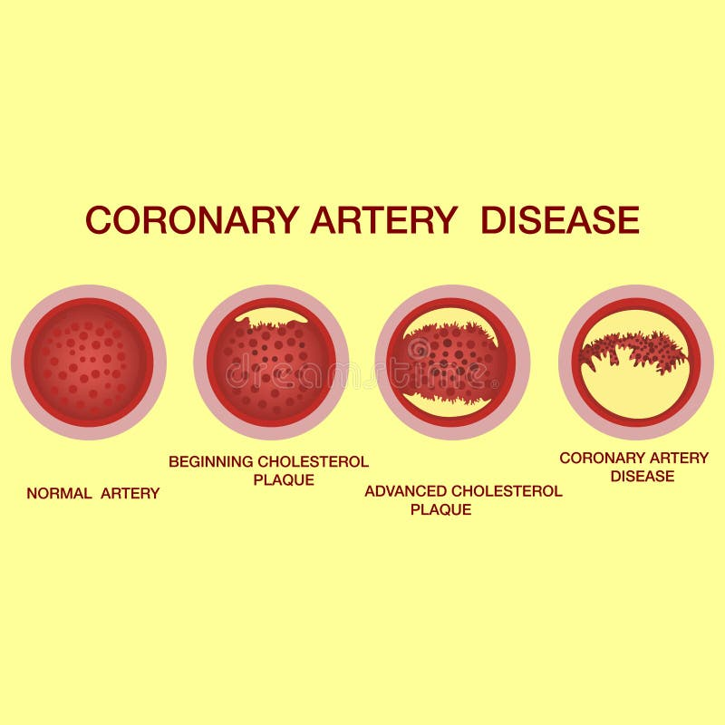
Introduction
Image [11]

Slide 5

Introduction
Image [12]

Slide 6
Comparison Study
Sr. No. | Publication & Year | Author | Model | Outcome
1 | 2021, ResearchGate | Hengjinda et al. | Comparative Study of ML Methods | Random Forest achieved the highest accuracy of 92%, outperforming other models in predicting CAD in early stages
2 | 2022, Elsevier Computers in Biology and Medicine | Huang et al. | ML-Based Risk Prediction Model | Deep learning-based model analyzing coronary artery calcification scores achieved 93% accuracy, proving robust for CAD prediction.
3 | 2019, IEEE Access | Singh et al. | Supervised ML Algorithms | Random Forest achieved the highest accuracy of 92%, demonstrating its effectiveness over SVM and logistic regression for heart disease prediction.
4 | 2021, ResearchGate Journal of Artificial Intelligence | Chen & Hengjinda | ML-Based Comparative Study | Random Forest stood out, achieving the highest accuracy of 90% compared to other supervised ML techniques used in CAD prediction.

Slide 7
Comparison Study
Sr. No. | Publication & Year | Author | Model | Outcome
5 | 2023, Springer Journal of Big Data | Baghdadi et al. | Advanced ML Techniques | Ensemble learning models (e.g., gradient boosting) achieved above 95% accuracy, demonstrating strong potential for real-time CAD detection
6 | 2024,Springer Journal of Medical Informatics | Zhang et al. | ML with High-Frequency QRS | Gradient Boosting and XGBoost achieved the highest accuracies, both exceeding 95%, showcasing their applicability in clinical environments.
7 | 2019, Elsevier (science Direct) Computers in Biology and Medicine | Alizadehsani et al. | Comprehensive ML Review | Deep neural networks achieved the highest accuracy of 96%, outperforming logistic regression and SVM in CAD diagnosis.

Slide 8
Comparison Study
Sr. No. | Publication & Year | Author | Model | Outcome
8 | 2020, ResearchGate | Perumal & Kaladevi | ML Techniques on Cleveland Dataset | Support Vector Machines (SVM) achieved the highest accuracy of 89% on the Cleveland dataset for CAD prediction.
9 | 2020, IEEE International Conference | Katarya & Srinivas | Survey of ML Models | Neural networks achieved the highest accuracy of 94%, emphasizing their capability in early-stage CAD prediction
10 | 2019, IEEE Access | Mohan et al. | Hybrid ML Techniques | Hybrid approaches combining Random Forest and Logistic Regression achieved 87% accuracy, offering a balance between efficiency and accuracy

Slide 9
Motivation
The Coronary artery disease often goes undetected until advanced stages, leading to serious health consequences. Traditional diagnostic methods are invasive, costly, and not always accessible, highlighting the need for alternative approaches.
This research is motivated by the potential to improve early detection, enabling timely treatment and reducing the mortality rate associated with CAD.
The goal is to leverage machine learning models to create a more accessible, accurate, and cost-effective diagnostic tool for CAD.
Deaths from cardiovascular disease (CVD) jumped globally from 12.1 million in 1990 to 20.5 million in 2021, according to a new report from the World Heart Federation (WHF).Coronary Artery Disease (CAD) was responsible for Globally, CAD contributes significantly to mortality rates; it is estimated that cardiovascular diseases account for approximately 17.9 million deaths each year worldwide.[13]

Slide 10
Identified Issue (Research Gap)
Limited Availability of Symptom-Based Datasets: Existing research heavily relies on imaging data, while symptom-based datasets remain scarce and often lack standardization or comprehensive annotation.
Model Interpretability: Many machine learning models act as "black boxes," making it difficult for clinicians to understand how predictions are made, reducing trust and adoption in healthcare settings.
Generalization to Diverse Populations: Models trained on specific demographic data may not generalize well to populations with different lifestyles, genetics, or healthcare access.
Integration with Clinical Workflows: Challenges persist in embedding machine learning solutions into real-world clinical settings for continuous monitoring and decision-making.

Slide 11
Problem Statement
Despite advancements in medical technology, early detection of CAD remains challenging. Traditional diagnostic methods are invasive, costly, and not suitable for large-scale screening. There is a need for a non-invasive, cost-effective, and accurate diagnostic tool for early CAD detection based on symptoms.

Slide 12
Abstract
This research explores the use of machine learning techniques for the early detection of Coronary Artery Disease (CAD) based on symptoms.
The study aims to enhance diagnostic accuracy and facilitate timely interventions by analyzing symptomatic data using advanced machine learning models. Various algorithms are evaluated for their effectiveness in predicting CAD.
The research identifies key features and datasets used in these models and discusses future research directions and potential improvements in the field.The objective of this paper is to analyse the various research works done on coronary artery disease .
The study focuses on optimizing models for low-resource environments and enhancing their interpretability to support clinicians in decision-making, ensuring accessible, efficient, and scalable CAD detection solutions..

Slide 13
Objectives
Develop Symptom-Based Machine Learning Models for CAD Detection
Train algorithms like Logistic Regression, Random Forests, and Deep Neural Networks using datasets comprising patient symptoms and clinical features.
Evaluate Model Performance Across Algorithms
Compare the efficacy of machine learning models such as Decision Trees, Support Vector Machines (SVMs), and ensemble techniques in detecting CAD based on symptoms.
Optimize Models for Clinical Applicability
Ensure that the models are computationally efficient and scalable for deployment in resource-constrained environments.
Enhance Model Interpretability
Focus on creating interpretable models to provide clinicians with insights into how symptoms contribute to predictions.

Slide 14
Scope of Proposed Work
Dataset Acquisition and Preprocessing
Gather publicly available datasets, such as Cleveland Heart Disease or similar repositories, containing symptoms-based patient data like chest pain type, cholesterol levels, blood pressure, and medical history.
Address issues such as missing values, feature selection, and class imbalance through data preprocessing techniques to ensure high-quality input for machine learning models.
Development of Machine Learning Models
Design and train machine learning algorithms, including Logistic Regression, Decision Trees, Random Forests, and Neural Networks, to detect CAD based on symptoms.
Evaluation and Comparison of Models
Compare the performance of different machine learning models using metrics such as accuracy, precision, recall, F1-score, and AUROC.
Evaluate the robustness of models and testing on external datasets to ensure generalizability.
.

Slide 15
Scope of Proposed Work
Real-World Application
The study will look for ways to make the solution easy to use and affordable, focusing on practical applications.
This will help improve access to healthcare in areas with limited resources and reduce the gap in medical services for underprivileged communities.
Model Interpretability
Develop interpretable machine learning frameworks that provide clear explanations of the predictions, enabling informed decision-making.

Slide 16
Proposed Model
Input raw Dataset
Pre-Processing
Feature Extraction
Classification
Performance Evaluation
Best Result

Slide 17
Expected Outcome
Early CAD Detection and Prediction
Provide a system capable of flagging high-risk patients based on symptoms, enabling timely medical intervention.
High Diagnostic Accuracy
Achieve accuracy comparable to or exceeding that of traditional diagnostic methods, targeting an accuracy range of 85-95%.
Real-Time Decision Support
Develop a system capable of delivering predictions within seconds, aiding rapid decision-making in clinical environments.
Adaptability and Continuous Learning
Implement retraining mechanisms for the model to adapt to new data, ensuring consistent performance over time.

Slide 18
References
[1] Hengjinda, P., Yodphat, P., Promwong, C., & Laokul, P. (2021). Early prediction of coronary artery disease (CAD) by machine learning method – A comparative study. ResearchGate.
[2] Huang, Y., Ren, Y., Yang, H., Ding, Y., Liu, Y., Yang, Y., ... & Zhang, Y. (2022). Using a machine learning-based risk prediction model to analyze the coronary artery calcification score and predict coronary heart disease and risk assessment. Computers in Biology and Medicine, 151, 106297.
[3] Singh, R. P., Nene, M. J., & Padole, M. Y. (2019). Predicting heart disease using supervised machine learning algorithms. IEEEAccess,7,34938-34948.
[4] Chen, J. I. Z., & Hengjinda, P. (2021). Early prediction of coronary artery disease (CAD) by machine learning method-a comparative study. Journal of Artificial Intelligence, 3(01), 17-33.
[5] Baghdadi, N. A., Abdelaliem, S. M. F., & Malki, A. (2023). Advanced machine learning techniques for cardiovascular disease early detection and diagnosis. Journal of Big Data. Retrieved from Springer.

Slide 19
References
[6] Zhang, J., Zhang, H., Wei, T., Kang, P., & Tang, B. (2024). Predicting angiographic coronary artery disease using machine learning and high-frequency QRS. Journal of Medical Informatics. Retrieved from Springer.
[7] Alizadehsani, R., Abdar, M., Roshanzamir, M., Khosravi, A., Kebria, P. M., Khozeimeh, F., ... & Acharya, U. R. (2019). Machine learning-based coronary artery disease diagnosis: A comprehensive review. Computers in biology and medicine, 111, 103346.
[8] Perumal, R., & Kaladevi, A. C. (2020). Early prediction of coronary heart disease from cleveland dataset using machine learning techniques. Int. J. Adv. Sci. Technol, 29(06), 4225-4234.
[9] Katarya, R., & Srinivas, P. (2020, July). Predicting heart disease at early stages using machine learning: a survey. In 2020 International Conference on Electronics and Sustainable Communication Systems (ICESC) (pp. 302-305). IEEE.
[10] Mohan, S., Thirumalai, C., & Srivastava, G. (2019). Effective heart disease prediction using hybrid machine learning techniques. IEEE access, 7, 81542-81554.

Slide 20
References
[11]https://thumbs.dreamstime.com/b/coronary-artery-disease-concept-healthy-narrowed-arteries-plaques-accumulation-cholesterol-blood-vessels-180136382.jpg
[12]https://th.bing.com/th/id/OIP.QYdLAgVAMe87pDX15amn9gAAAA?rs=1&pid=ImgDetMain
[13]Deaths from cardiovascular disease surged 60% globally over the last 30 years: Report - World Heart Federation

Slide 21
Thank
Thank
You

