Slide 1
NAME OF AUTHORS
1- SAIYAD AFZAL ALI
PhD IN ISLAMIC STUDIES
ALIGARH MUSLIM UNIVERSITY,
ALIGARH
2- MOHAMMAD FARAZ AHMED
PhD RESEARCH SCHOLAR
DEPARTMENT OF CIVIL ENGINEERING
MANGALAYATAN UNIVERSITY ,
ALIGARH

Slide 2
The Taj Mahal: A Symbol of Love, Legacy, and Mughal Architectural Excellence
An Exploration of its History, Architecture, and Engineering Mastery

Slide 3
Introduction
The Taj Mahal: An iconic symbol of love and architectural brilliance, one of the most admired monuments in the world.
The Taj Mahal, a breath-taking monument of gleaming white marble set against the vast Indian sky, is not merely an architectural feat; it encapsulates a profound story of love, loss, artistry, and remarkable engineering.
The Taj Mahal, located in Agra, India, is a 17th-century white marble mausoleum commissioned by Mughal emperor Shah Jahan in memory of his favourite wife, Mumtaz Mahal.

Slide 4
CONTINUE…
Significance: Recognized as a masterpiece of Islamic architecture, it combines elements from Timurid, Safavid, and Italian craftsmanship.
From the deeply emotional love story that inspired its construction to the talented artisans and engineers who brought it to life, the Taj Mahal stands as a harmonious blend of cultural influences and artistic traditions.
It explores the intricate history of the Taj Mahal, examining the historical events that led to its creation, the visionary design and architectural brilliance behind its construction, and the ongoing challenges of preserving this iconic structure for future generations.

Slide 5
LITERATURE REVIEW
The Taj Mahal, a renowned UNESCO World Heritage Site, has been widely studied for its architectural magnificence, historical importance, and cultural heritage. This paper offers a thorough examination of the Taj Mahal, focusing on its historical context, design features, engineering innovations, and the challenges it faces in terms of preservation.
Furthermore, the paper contributes to the ongoing conversation about the Taj Mahal's conservation (Bhushan, 2018; Kumar, 2020). It addresses the harmful impact of environmental pollution, mass tourism, and climate change on the monument’s physical condition and suggests measures to mitigate these threats.

Slide 6
SCOPE
This paper presents a comprehensive analysis of the Taj Mahal, highlighting its significance as a masterpiece of art, architecture, and enduring love. It begins by exploring the historical context, recounting the poignant love story of Shah Jahan and Mumtaz Mahal, which served as the inspiration for this magnificent monument.
The study then examines the architectural brilliance of the Taj Mahal, focusing on its perfect symmetry, intricate ornamentation, and symbolic use of materials. Key architectural elements, including the iconic dome, minarets, and reflecting pools, are discussed in detail, along with the contributions of the master builders who transformed the emperor's vision into reality.

Slide 7
COMMISIONING AND CONSTRUCTION
Symmetry and Ornamentation: Impeccable symmetry and intricate detailing exemplify Mughal artistic excellence.
Cultural Fusion: A harmonious blend of Persian, Ottoman, and Indian architectural traditions.
The Royal Palette
Red Stone and White Marble: The Taj Mahal’s contrasting materials symbolize the duality of life and death.
Materials: Red sandstone for the base, pristine white marble for the dome and mausoleum.

Slide 8
Continue…
Reinforcing the Ground
Stability for Centuries: A marvel of engineering to ensure the stability of the structure.
Foundation Techniques: Ingenious methods to prevent sinking or shifting, ensuring the Taj Mahal's longevity.
Ingenious Foundation Techniques
Strength and Durability: The foundation, built using a mix of brick, stone, and lime mortar, supports the entire structure.
Innovative Design: The platform was reinforced with layers of materials for enhanced stability.

Slide 9
Continue…
Crafting the Monument
Engineering Mastery in Every Detail: The Taj Mahal’s design reflects precision engineering.
Detailing: Calligraphy, decorative elements, and pietra dura inlays showcase the craftsmanship of the time.
Supportive Framework
Strength in Walls and Arches: The Taj Mahal's walls and arches provide both structural integrity and aesthetic elegance.
The Minarets: They stand at the corners, symbolizing the grandeur and balance of the monument.

Slide 10
Continue…
Architectural Innovation: The Majestic Dome
The Double-Shelled Dome: A stunning architectural feature, this dome stands as an engineering marvel.
Symbolism: Represents the heavens and provides a visual focal point for the entire structure.
Symbolism of Paradise
Garden Layout: The charbagh (fourfold) garden design symbolizes Paradise, with a central water channel and walkways. citeturn0search2
Reflective Pools: Water features mirror the monument, reinforcing the theme of an earthly paradise.

Slide 11
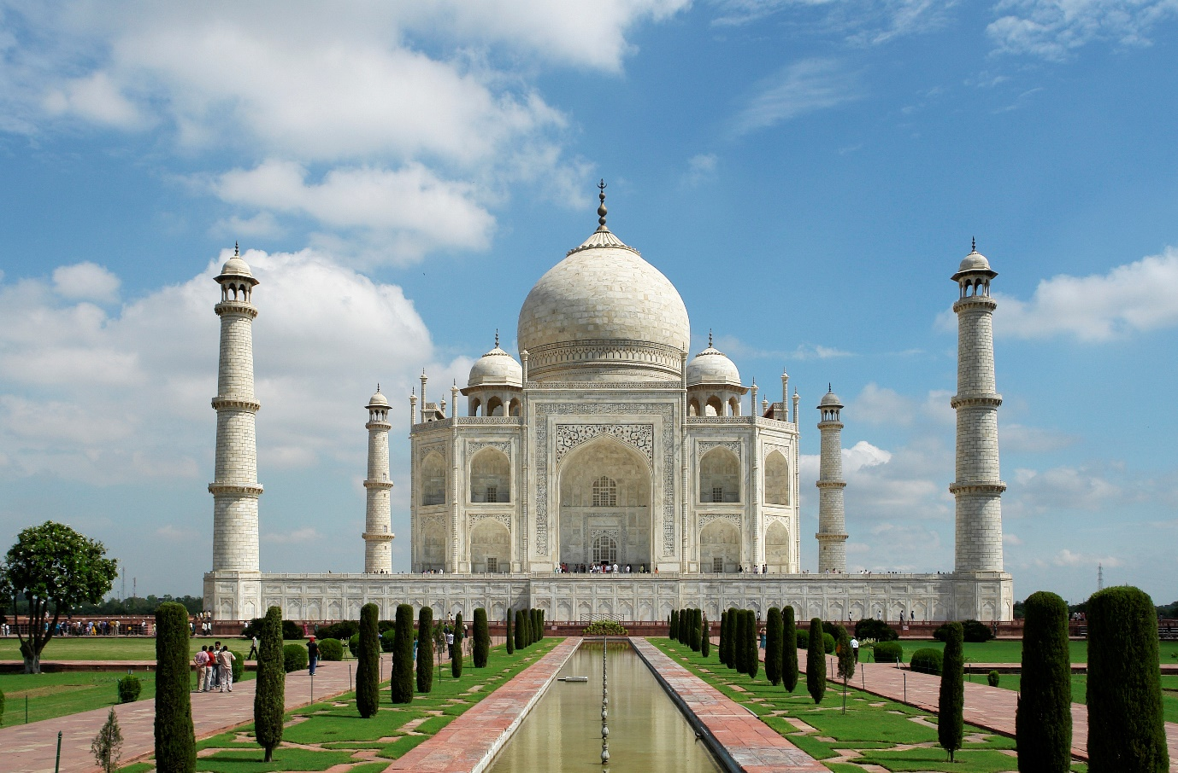
TAJ MAHAL IMAGE

Slide 12
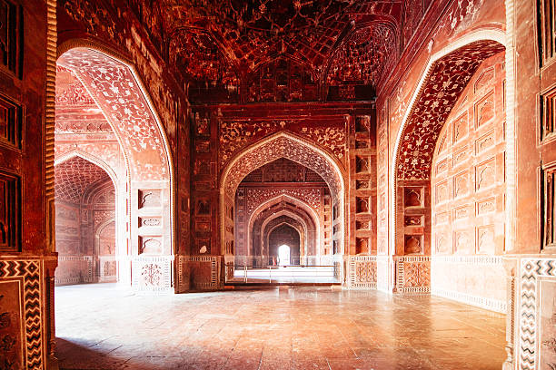
The Royal Palette: Red Stone and White Marble

Slide 13
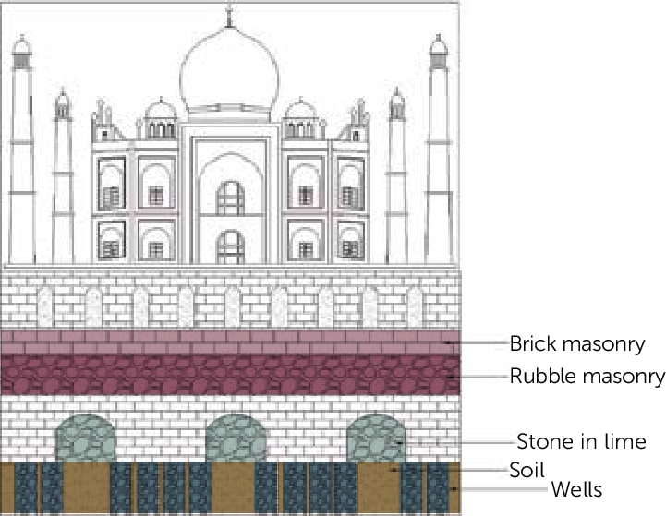
Ingenious Foundation Techniques: A Marvel of Engineering

Slide 14
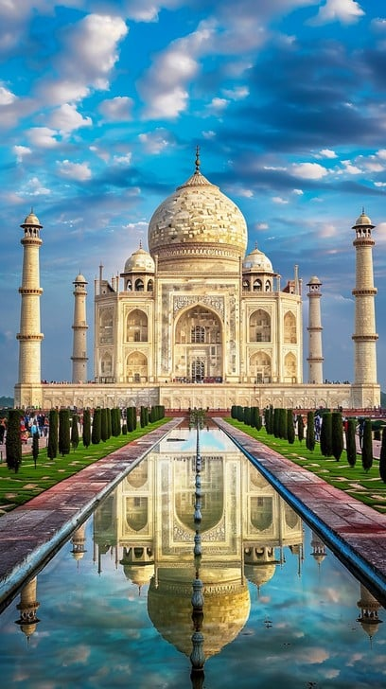
Reflecting Pools and Canals: Amplifying the Monument's Majesty
The reflecting pools in front of the Taj Mahal are far more than ornamental features; they serve a vital role in enhancing the monument’s visual grandeur. The still, mirror-like surface of the pool reflects the image of the mausoleum in perfect symmetry, amplifying the monument’s majestic presence and creating an almost ethereal, dreamlike effect.

Slide 15
CONCLUSION
The Taj Mahal, a monument conceived in love and brought to life through extraordinary artistry and engineering skill, stands as a potent symbol of human creativity and unwavering devotion.
Architectural Synthesis: The Taj Mahal harmoniously blends Islamic design principles with local craftsmanship.
Cultural Legacy: It stands as a testament to Mughal ingenuity and the rich tapestry of cultural influences in India.
The future of the Taj Mahal hinges on our collective responsibility to strike a delicate balance between preservation and accessibility, ensuring that its magnificence continues to inspire beautiful, wonder, and reflection for generations yet unborn.

Slide 16
THANK YOU
AND HAVE A NICE DAY

