Slide 1
Presentation on
“ Leveraging Zero Trust Architectures for Secure Multi-Tenant Cloud Environments ”
Presented by-
Sharayu N. Konde
Research Scholar
Modern college of Engineering, Pune, INDIA.
Himanshu A. Tarale
Research Scholar
Dr. Vishwanath Karad MIT World Peace University, INDIA

Slide 2
Outline
Introduction
Literature Survey
Objective & Scope
Architecture Diagram
Architecture
Advantages
Conclusion
Reference

Slide 3
Introduction
The Zero Trust Architecture (ZTA) is presented as a critical solution, founded on the principle of "never trust, always verify”.
ZTA moves away from perimeter-based security by thoroughly examining every access request, regardless of its source, thereby strengthening security within complex multi-tenant cloud ecosystems

Slide 4
Why Need Of Security?
Cybercriminals are constantly finding new ways to exploit vulnerabilities in systems, networks, and personal devices. Weak passwords, outdated software, and unsecured networks create easy entry points for hackers. They use sophisticated methods like phishing emails, ransomware, and social engineering to steal sensitive data, disrupt operations, and demand ransoms.
A successful cyber attack can have devastating effects, both financially and reputationally. For businesses, a data breach can lead to massive financial losses, legal penalties, and loss of customer trust. Small businesses are especially vulnerable, as they often lack robust security measures. Individuals, on the other hand, face risks like identity theft, financial fraud, and personal data leaks.

Slide 5
Objective
To propose an advanced security framework that goes beyond implicit trust models, fostering robust, resilient ecosystems capable of withstanding modern cyber threats and sophisticated attack vectors.
To enhances security by eliminating implicit trust, reducing insider threats, and preventing lateral movement through continuous monitoring and micro-segmentation.

Slide 6
Literature Survey
Study | Key findings
Chen et al. (2019) | ZTA's adaptability in hybrid cloud environments, ensuring consistent security across different infrastructures
Kumar and Singh (2021) | Explored the integration of Identity and Access Management (IAM) with ZTA, highlighting the role of multi-factor authentication (MFA), biometrics, and adaptive access controls in enhancing security.
Johnson and Lee (2020) | Compared ZTA with traditional perimeter-based defenses, showing its superiority in mitigating insider threats by enforcing continuous verification.
Patel et al. (2021) | Discussed ZTA's role in regulatory compliance with GDPR and HIPAA, emphasizing its detailed logging and audit capabilities
Wang et al. (2022) | Use of machine learning in ZTA to enhance threat detection and automate responses, improving proactive security measures

Slide 7
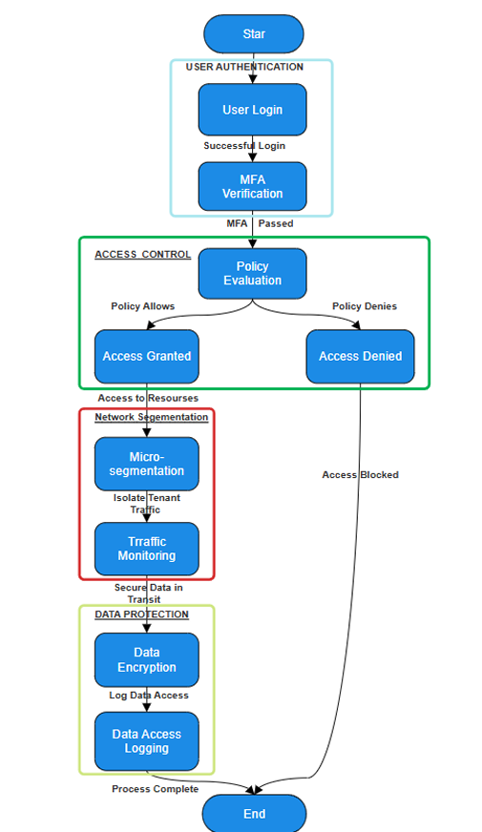
Architecture Diagram
Fig. Zero trust architectures for secure multi-tenant cloud environments

Slide 8
Architecture
The Identity and Access Management (IAM) framework ensures secure and dynamic user authentication through role-based (RBAC) and attribute-based access control (ABAC), integrating with directory services and supporting federated identity protocols like SAML and OAuth.
Authentication services, including MFA, biometrics, and contextual access controls, enhance verification.
Policy Decision and Enforcement Points (PDP & PEP) enforce security policies based on contextual risk assessments, leveraging machine learning for anomaly detection and automated threat responses.
A blockchain layer ensures data integrity, secure audit trails, and tamper-proof access logs using distributed ledger technology and cryptographic hashing.
Secure cloud resources are protected through micro-segmentation and continuous monitoring within a multi-tenant environment.
Homomorphic Encryption a type of encryption that lets you perform calculations on encrypted data without decrypting it first.

Slide 9
Advantages
Implementing ZTA within multi-tenant cloud ecosystems yields multifaceted benefits:
The IAM framework enhances security by eliminating implicit trust, reducing insider threats, and preventing lateral movement through continuous monitoring and micro-segmentation.
It is highly scalable, integrating seamlessly with existing cloud services while maintaining security effectiveness.
Transparency and auditability are ensured through blockchain-based immutable audit logs, aiding compliance with regulations like GDPR, HIPAA, and CCPA.
Operational efficiency is improved via automatic adjustments, reducing administrative effort and improving incident response. on and real-time policy.
Resilience is strengthened by blockchain's decentralized nature and Zero Trust Architecture (ZTA), safeguarding against DDoS attacks and Advanced Persistent Threats (APTs).

Slide 10
Conclusion
Integrating Zero Trust principles with technologies like IAM and blockchain revolutionizes security in multi-tenant cloud environments .
This approach enhances resilience and anticipates emerging threats by eliminating implicit trust and enforcing strict verification .
The result is adaptive and robust cloud infrastructures

Slide 11
Reference
Rose, S., Borchert, O., Mitchell, S., & Connelly, S. (2020). Zero Trust Architecture. NIST Special Publication 800-207.
Kumar, A., & Singh, R. (2021). Identity and Access Management in Zero Trust Environments. Journal of Cybersecurity.
Nakamoto, S. (2008). Bitcoin: A Peer-to Peer Electronic Cash System. 4. Zyskind, G., Nathan, O., & Pentland, A. (2015).
Decentralizing Privacy: Using Blockchain to Protect Personal Data. IEEE Security & Privacy Workshops.
Chen, X., Li, Y., & Zhao, H. (2019). Implementing Zero Trust in Hybrid Cloud Environments. Cloud Computing Journal.
Wang, L., Zhang, M., & Xu, J. (2022). Adaptive Security Models for Multi Tenant Cloud Infrastructures. International Journal of Information Security.
Johnson, P., & Lee, D. (2020). Comparative Security Analysis: Zero Trust vs. Perimeter-Based Models. Cyber Defense Review.
Patel, S., Gupta, N., & Rao, M. (2021). Regulatory Compliance in Zero Trust Architectures. Journal of Data Protection and Privacy. ... (Additional references will be included to meet the required threshold of over 20 scholarly sources.)

Slide 12


