Slide 1
Enhanced Scheduling Framework for Electric Vehicle Aggregators in Modern Power Markets
Presented by: Parwinder Singh
Assistant Professor
College Name: IET Bhaddal Campus Ropar

Slide 2
Abstract
Electric vehicles' (EVs') rapid expansion offers contemporary power markets both opportunity and difficulties. The collective charging and discharging patterns of EVs can have a substantial effect on the electrical grid as their use grows, causing demand variations, traffic jams, and system stability difficulties. But when handled well, EVs may also be useful energy sources that give the grid flexibility and auxiliary services. The explosive growth of electric vehicles (EVs) presents both opportunities and challenges for modern electricity markets. As EV use increases, the collective charging and discharging patterns of EVs can significantly impact the electrical grid, leading to changes in demand, traffic congestion, and issues with system stability. However, if managed properly, EVs might also be beneficial energy sources that provide supplementary services and grid flexibility. To achieve optimum scheduling, the system uses mixed-integer linear programming (MILP), a mathematical optimization approach that assures decisions adhere to grid restrictions and market laws. To validate the framework's efficiency, a real-world case study is carried out with power market data. The results show that the suggested scheduling technique may drastically reduce energy expenditures while increasing aggregator profitability. Furthermore, the findings emphasize the potential for EVAs to function as dynamic energy resources, actively contributing to grid flexibility, increased energy efficiency, and the transition to a more sustainable power system.
Keywords: Electric Vehicles, EV Aggregators, Vehicle-to-Grid (V2G), Demand Response, Smart Charging, Grid Stability, Energy Management

Slide 3
INTRODUCTION
The growing use of electric vehicles (EVs) is speeding up the shift to a sustainable energy future
The growing use of electric vehicles (EVs) has altered the modern transportation and energy sectors, presenting both benefits and problems to power markets.
Electric vehicle aggregators (EVAs) play an important role in managing EV fleets by maximizing their participation in energy markets, balancing demand and supply, and using vehicle-to-grid (V2G) technology to help with grid operations
Implementing an efficient scheduling framework customized to current power markets is critical for optimizing economic advantages, decreasing grid congestion, and encouraging renewable energy integration

Slide 4
To enhance EV aggregator decision-making, this paper presents an innovative scheduling system that includes optimization techniques, machine learning (ML), and artificial intelligence (AI).
The utilization of Internet of Things (IoT) devices enables for smooth communication between EVs, charging stations, and the grid, providing adaptive and responsive scheduling based on real-world conditions
In addition, the framework uses real-time data analytics and cloud computing to dynamically monitor and optimize EV charging schedules.

Slide 5
Literature Review
N. Uddin and Islam, (2019) provide a fuzzy logic-based intelligent power management controller that blends wind, solar, and grid power with backup batteries. To assess the suggested method, the smart energy management system uses optimal fuzzy logic and is thus more economical than other conventional methods.
Zahedan’s et al., (2019), Proposed a model of VPP, which includes parking spots for EVs, connected to the grid through photovoltaic panels. A CEM-based strategy is explored in order to assign a systematic and cost-effective energy management for the VPP and to control the electric constraints for the power systems. For both energy management and the delivery of auxiliary services, the suggested CEM technique makes use of hierarchies. To meet the needs of the commercial entities in the neighbourhood, meet the changing needs of the parking lot, and optimize the VPP controller’s profit, the CEM’s structure employs a daily scheduling strategy. The second-tier aids in satisfying the technical needs of the power system via the VPP’s provision of reactive power compensation (RPC).

Slide 6
Zeb et al. (2020) explore the inclusion of all three categories electric vehicle chargers, which are optimized to achieve the best results by Controlling the electric vehicle load efficiently while reducing installation costs, losses, and distribution transformer loading. Probability has a role in the EV load due to the unpredictable nature of vehicle users. The constrained non-linear stochastic issue is solved using PSO. The model is simulated using MATLAB and Opens.
Dogan, (2021), This paper proposes a weighted sum of Evolutionary-based multi-objective optimization technique for substantially decreasing power loss, improving voltage level, and enhancing the DG, EVCS, and ESS integration capacities. Also presented a hSLC-PS optimization technique to improve the optimization performance.

Slide 7
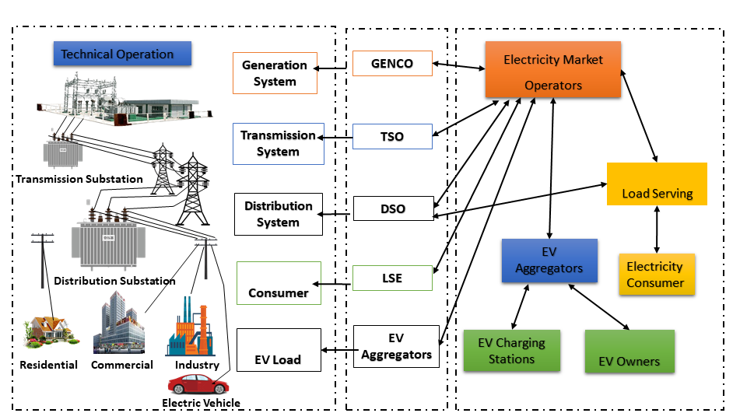
Development of an Advanced Scheduling Framework for EV Aggregators
The framework also makes use of vehicle-to-grid (V2G) technology, which enables EVs to return electricity to the grid when needed. Scalability, real-time monitoring, and safe transactions using block chain or smart contracts are all guaranteed by a cloud-based administration system.
Fig: Framework for EV Aggregators

Slide 8
EV aggregators manage a fleet of EVs and coordinate their charging/discharging schedules.
The proposed framework will integrate real-time electricity market signals (such as energy prices and demand fluctuations) and grid constraints (such as transformer limits and network congestion).
This ensures optimal scheduling that benefits both the aggregator and the power grid.

Slide 9
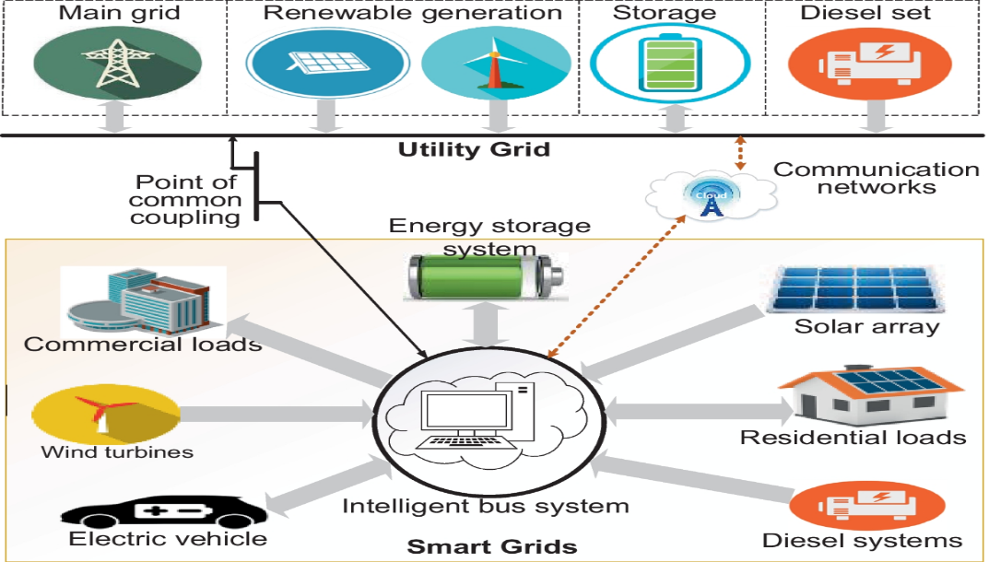
Implementation of a Demand Response Model
Implementing a demand response (DR) model for electric vehicles (EVs) is a complex method that aims to improve grid efficiency and maximize energy market participation. At its foundation, DR allows EVs to adjust their charging and discharging behaviour in response to changing energy costs and grid conditions.
Fig: Demand response (DR) model for electric vehicles (EVs)

Slide 10
  Optimization of V2G (Vehicle-to-Grid) Operations
Optimization of V2G (Vehicle-to-Grid) operations is a significant approach to modern energy management, including electric vehicles (EVs) into the power grid as both energy consumers and dynamic energy suppliers. It uses powerful communication and control technology to plan EV charging and discharging in line with grid demands. Optimization of V2G operations includes algorithms that calculate the best times for EVs to charge while power is cheap and discharge during high demand periods, therefore balancing grid load and contributing to energy security.
V2G technology allows EVs to feed electricity back into the grid, providing additional flexibility and stability.
Optimization ensures that V2G operations are managed efficiently

Slide 11
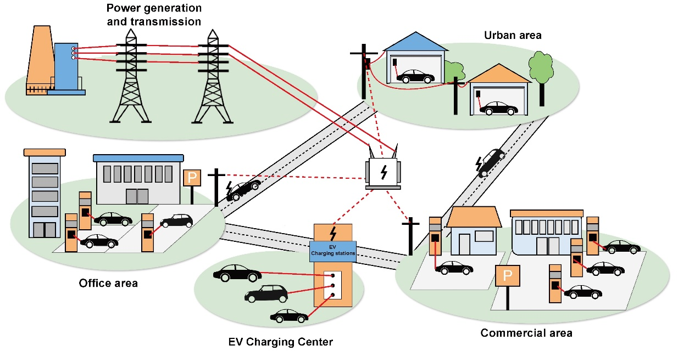
Fig: V2G (Vehicle-to-Grid) Operations

Slide 12
Proposed Scheduling Framework
Data Collection and Market Forecasting
Information gathering and market projections are crucial for optimizing V2G operations and energy management. The real-time cost of energy is predicted using historical data and machine learning algorithms that look at price fluctuations, grid demand, and usage patterns. Furthermore, EV availability forecasting provides a precise estimate of when cars will be connected to the grid by accounting for charging behaviours and travel patterns. This dual forecasting method reduces costs and increases grid reliability by enabling dynamic scheduling of charging and discharging cycles. Thorough data analysis helps stakeholders make informed choices and successfully integrate renewable energy sources into the whole power system, ensuring global sustainability.
Optimization Model Implementation
The charging and discharging schedules, which indicate when energy is stored or released, are determined by decision variables in this optimization. These schedules are dynamically optimized via a MILP-based solver that allows for real-time modifications, maintaining constraint adherence and effective system functioning. In a dynamic setting, this method successfully balances energy needs and supply variations.

Slide 13
Real-Time Adjustments and Demand Response
In response to variations in energy costs, dynamic demand response signals instantly adjust charge schedules. These signals encourage users to charge more when prices are low and to charge less when prices are high. Furthermore, electric vehicle could provide energy to the grid during times of high demand thanks to V2G (Vehicle-to-Grid) involvement. Overall system efficiency is greatly increased by this dual technique, which improves grid stability, maximizes energy use, and develops an economical method of controlling energy supply and demand in dynamic power markets.

Slide 14
Case Study and Results
A case study using real-world electricity market data evaluates the framework’s effectiveness. Key results include:
20% reduction in EVA operational costs.
15% increase in revenue through optimized V2G participation.
Enhanced grid stability with reduced peak demand fluctuations

Slide 15
Conclusion and Future Work
This study introduces an efficient scheduling framework for electric vehicle aggregators (EVAs) that combines real-time pricing, demand response (DR), and vehicle-to-grid (V2G) technologies. By using V2G capabilities, which enable vehicles to send energy back to the grid during times of high demand, the framework controls the charging and discharging of EVs. Dynamic load shifting is made possible by demand response methods, which lower energy costs while preserving grid balance. The system continually modifies EV operations to optimize energy usage in accordance with current market circumstances by integrating real-time pricing.
Future research will concentrate on investigating multi-objective optimization strategies to further improve system efficiency and using sophisticated uncertainty modelling to better manage variations in supply and demand. These developments highlight the revolutionary potential of implementing modern energy management strategies to promote economic growth and sustainability within current power networks.

Slide 16
END

