Slide 1



Dorembry: An AI driven Memory Reinforcement
An AI-Driven Adaptive Learning Reinforcement System for Seamless Knowledge Retention
Presented by
Aditi Patel
Peeyush Shandilya
01

Slide 2


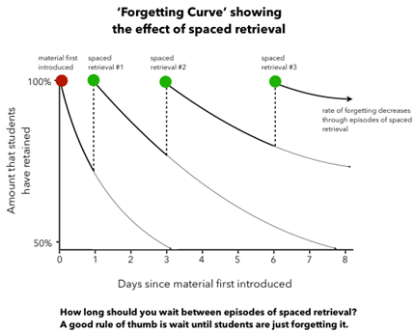
Problems Faced
Objectives
  Rapid Memory Decay: 90% of new knowledge fades within weeks without reinforcement.
  Effort-Heavy Tools: Flashcards and spaced repetition demand time and discipline, feeling unnatural.
  Study-Only AI: AI platforms (e.g., Duolingo) focus on learning sessions, not real-world recall.
  Lack of Context: Current methods don’t tie knowledge to practical, everyday situations.
  Retention Gap: Education prioritizes acquisition over long-term memory retention.
  Combat Memory Decay: Reduce the 90% knowledge loss within weeks by reinforcing recall.
  Seamless Integration: Embed learning into daily life without extra effort.
  Enhance Real-World Recall: Ensure knowledge is usable in practical contexts, not just study sessions.
  Personalize Reinforcement: Tailor AI-driven prompts to individual forgetting patterns and habits.
  Prove Effectiveness: Demonstrate 30-50% retention improvement through rigorous testing.
Tech Stack
  Frontend: JavaScript (browser ext.), Flutter (mobile app).
  Backend: Python (AI models), Firebase/AWS (cloud sync).
  NLP: BERT/spaCy (concept extraction, content generation).
  Memory Prediction: LSTM/GRU (forgetting curve modeling).
  Optimization: DQN (reinforcement learning for scheduling).
02

Slide 3
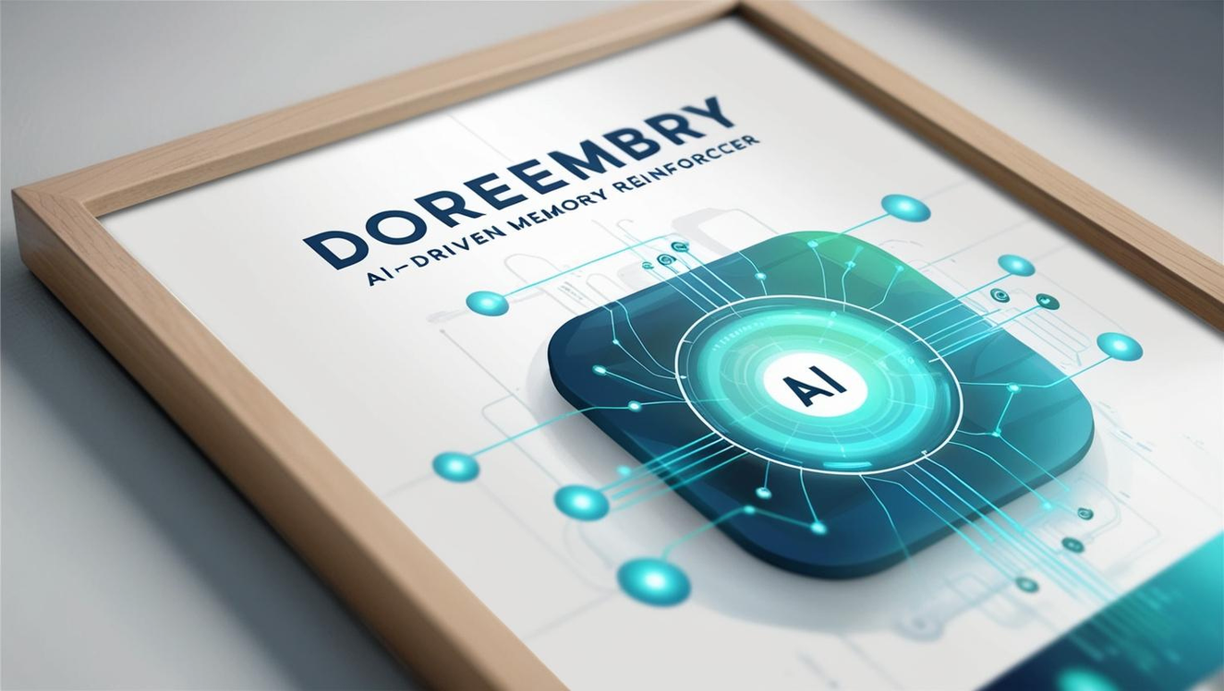

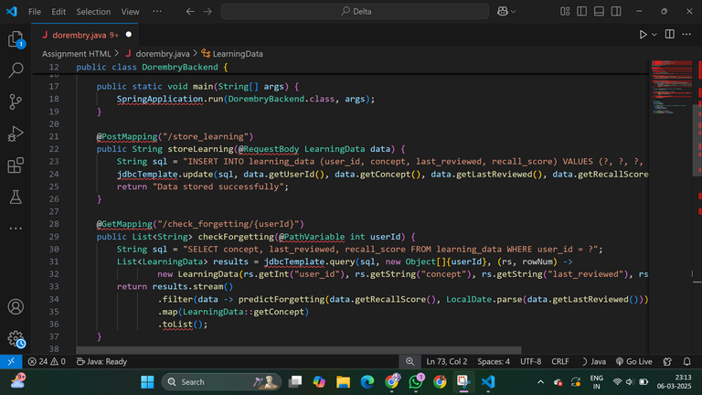
AI Tracks Your Learning & Memory Patterns
Why Dorembry is a Game-Changer
  Syncs with books, courses, videos, notes.
  Learns how fast you forget concepts and adapts reinforcement strategies.
  Knows when and how you recall information best.
  Never forget important knowledge again.
  AI integrates learning into your daily routine effortlessly.
  Turns education into a lifelong skill, not just an exam-cramming session.
Smart Memory Lock System – Right Info, Right Time
  Micro-reminders when needed (e.g., you’re about to speak in a meeting → Dorembry sends a key fact you studied last week).
  Fake Dilemmas & Challenges – AI texts you real-life scenarios to test application.
  Quizzes on Social Media – AI sneaks in memory boosts while you scroll.
AI That Feels Like a Thought, Not a Task
  Seamless habit-based learning – You don’t “study,” Dorembry simply integrates into daily life.
  Gamified tracking – Like a fitness tracker for your brain, keeping you engaged.
  Personalized reinforcements – AI learns what works for you and tailors the experience.
03

Slide 4
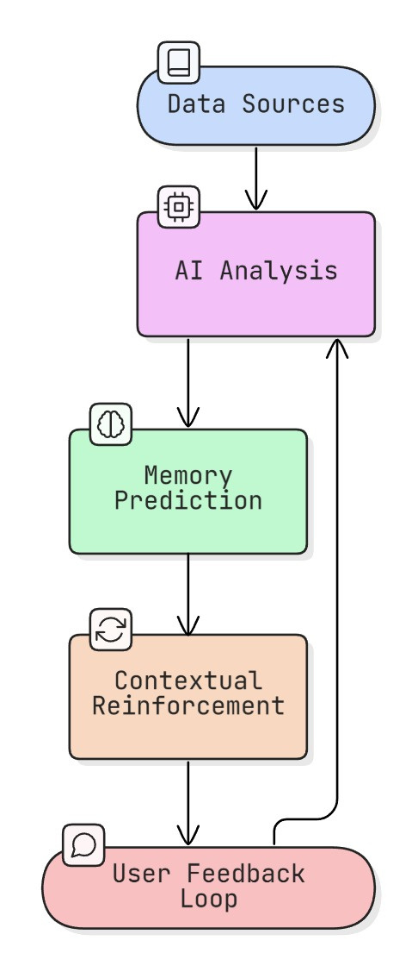
Uniqueness of the Project
  Real-world Memory Integration: Unlike traditional learning apps, Dorembry reinforces knowledge passively by embedding it into daily life through context-aware reminders.
  Forgetting Curve Optimization: Uses AI-driven memory prediction to detect when you're about to forget something and reinforces it at the perfect moment.
  Context-Aware Learning: Delivers knowledge when most relevant (e.g., financial tips before a transaction, language practice when traveling).
  Reinforcement via Real Scenarios: Instead of generic quizzes, it simulates real-world situations to test and apply knowledge dynamically.
  AI-Powered Personalization: Tracks engagement and adapts reinforcement methods (e.g., reminders, voice notes, interactive scenarios) to maximize retention.
  Seamless Integration: Works across multiple platforms (WhatsApp, AR pop-ups, wearables), blending into existing user behavior without disrupting daily tasks.
  Continuous Self-Improvement: Uses reinforcement learning (DQN) to refine trigger timing and content delivery, making memory reinforcement smarter over time.
04

Slide 5
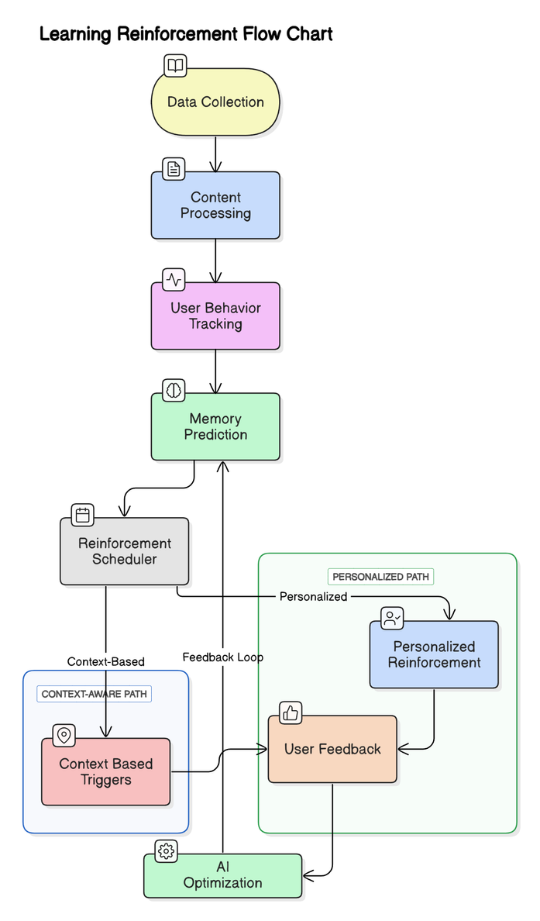

Insights
  Traditional learning methods lead to rapid forgetting; AI-driven reinforcement improves retention.
  Context-aware reminders deliver knowledge at the most relevant moments.
  Personalized schedules adapt to individual forgetting patterns for better long-term learning.
Implications
  Learning becomes effortless and naturally integrated into daily life.
  Users retain more with less effort, enhancing productivity and decision-making.
  Could transform education and workplace training from cramming to continuous learning.
05

Slide 6


Summary
Reffences
  AI predicts forgetting patterns and reinforces knowledge at the right time.
  Context-aware reminders integrate learning into daily activities.
  Personalized reinforcement adapts to each user’s needs.
  Passive learning reduces effort while improving retention.
  Transforms education and training into a continuous process.
  Ebbinghaus, H. (1885). Memory: A contribution to experimental psychology (H. A. Ruger & C. E. Bussenius, Trans.). Teachers College, Columbia University. (Original work published 1885)
  Roediger, H. L., & Butler, A. C. (2011). The critical role of retrieval practice in long-term retention. Trends in Cognitive Sciences, 15(1), 20-27. https://doi.org/10.1016/j.tics.2010.09.003
  Butler, A. C., & Roediger, H. L. (2008). Feedback and memory: The influence of feedback on long-term retention. Psychonomic Bulletin & Review, 15(5), 1052-1058. https://doi.org/10.3758/PBR.15.5.1052
  Sweller, J., Ayres, P., & Kalyuga, S. (2011). Cognitive load theory. Springer Science & Business Media. https://doi.org/10.1007/978-1-4419-8126-4
  Koedinger, K. R., & Corbett, A. T. (2006). Cognitive tutors: From the laboratory to the classroom. Interactive Learning Environments, 14(3), 179-210. https://doi.org/10.1080/10494820600997833
  Graesser, A. C., & D'Mello, S. K. (2012). Multimedia learning and deep learning: Implications for personalized learning technologies. Educational Psychologist, 47(1), 1-26. https://doi.org/10.1080/00461520.2012.635999
  Dunlosky, J., Rawson, K. A., Marsh, E. J., Nathan, M. J., & Willingham, D. T. (2013). Improving students' learning with effective learning techniques: Promising directions from cognitive and educational psychology. Psychological Science in the Public Interest, 14(1), 4-58. https://doi.org/10.1177/1529100612453266
  Dey, A., & Abowd, D. G. (2000). Towards a better understanding of context and context-awareness. In Proceedings of the 1st International Symposium on Handheld and Ubiquitous Computing (pp. 304-307). Springer. https://doi.org/10.1007/3-540-44498-6_30
  Anderson, C. A., & Dill, K. E. (2000). Video games and aggressive thoughts, feelings, and behavior in the laboratory and in life. Journal of Personality and Social Psychology, 78(4), 772-790. https://doi.org/10.1037/0022-3514.78.4.772
  10.Silver, D., Huang, A., Maddison, C. J., et al. (2016). Mastering the game of Go with deep neural networks and tree search. Nature, 529(7587), 484-489. https://doi.org/10.1038/nature16961
  Vaswani, A., Shazeer, N., Parmar, N., et al. (2017). Attention is all you need. In Proceedings of the 31st International Conference on Neural Information Processing Systems (pp. 6000-6010). https://doi.org/10.5555/3295222.3295400
  hneiderman, B. (2016). The new ABCs of research: Achieving breakthrough collaborations. Oxford University Press.
Future Scope
  Enhancing AI models for even more precise memory prediction and reinforcement.
  Integrating with AR/VR for immersive real-world learning experiences.
  Expanding into professional training, corporate learning, and skill development.
  Developing multi-language and cross-cultural adaptability for global reach.
06

