Slide 1


Bridging Disciplines for Innovation: The Power of Multidisciplinary Research
Ms.C.S.SNEKHA., M.A.,B.ED, KSRCASW, TIRUCHENGODE, snekhaganthi@gmail.com
This presentation will explore the benefits and challenges of multidisciplinary research and its critical role in driving innovation and solving complex problems.
by SNEKHA GANTHIMATHI

Slide 2
Defining Multidisciplinary Research
Integration of Knowledge
Distinct Approaches
Alzheimer's Research
Multidisciplinary research involves integrating knowledge from different disciplines to address complex problems that transcend traditional boundaries.
Multidisciplinary research contrasts with interdisciplinary, which aims to create a new discipline, and transdisciplinary, which seeks to transcend disciplinary boundaries.
A prime example is Alzheimer's research, which draws upon neurology, genetics, and computer science to understand and treat the disease.

Slide 3
Case Study 1: The Human Genome Project
Mapping the Human Genome
Disciplinary Collaboration
Key Breakthroughs
It involved a diverse range of disciplines, including genetics, molecular biology, computer science, and ethics.
The project yielded groundbreaking discoveries, leading to a deeper understanding of genetic diseases and the development of personalized medicine.
The Human Genome Project aimed to map the entire human genome, a monumental task completed in 2003.

Slide 4
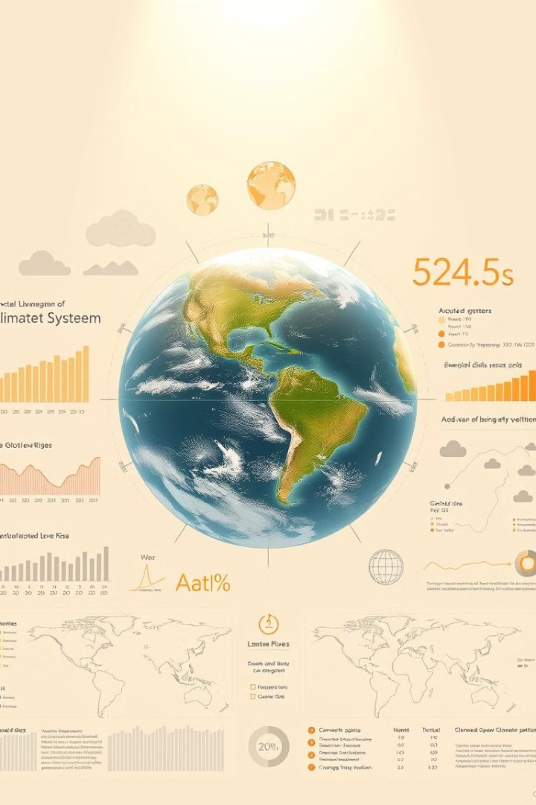
Case Study 2: Climate Change Research
1
Addressing the multifaceted challenges of climate change requires a broad spectrum of expertise.
2
Researchers from climatology, oceanography, ecology, economics, and political science have joined forces.
3
Key findings include a comprehensive understanding of greenhouse gas effects and predicting future climate scenarios.

Slide 5

Case Study 3: Materials Science and Engineering
1
Developing Novel Materials
2
Interdisciplinary Approach
Materials science and engineering focuses on creating new materials with specific properties.
This field blends knowledge from chemistry, physics, mechanical engineering, and materials science.
3
Graphene Applications
One notable example is the development of graphene, a versatile material with applications in electronics, energy storage, and biomedical fields.

Slide 6

Case Study 4: Artificial Intelligence and Healthcare
AI's Impact on Healthcare
Multidisciplinary Collaboration
AI-powered Solutions
AI is revolutionizing medical diagnostics, treatment, and drug discovery.
AI-powered tools are used for cancer detection, personalized treatment plans, and other healthcare applications.
This field integrates expertise from computer science, medicine, statistics, and data science.

Slide 7




Benefits of Multidisciplinary Research
Enhanced Creativity
Multidisciplinary research sparks new ideas and breakthroughs by fostering cross-pollination of knowledge.
Holistic Understanding
It provides a holistic view of complex systems, enabling researchers to see problems from multiple angles.
Problem-Solving Capacity
By bringing together diverse perspectives, multidisciplinary research enhances problem-solving capabilities.

Slide 8

Overcoming Challenges
Communication Barriers
Different disciplines may have distinct languages and approaches, creating communication hurdles.
Methodology Differences
Variations in research methodologies can pose challenges when integrating data and findings.
Institutional Silos
Traditional academic and funding structures can create silos, hindering interdisciplinary collaboration.

Slide 9
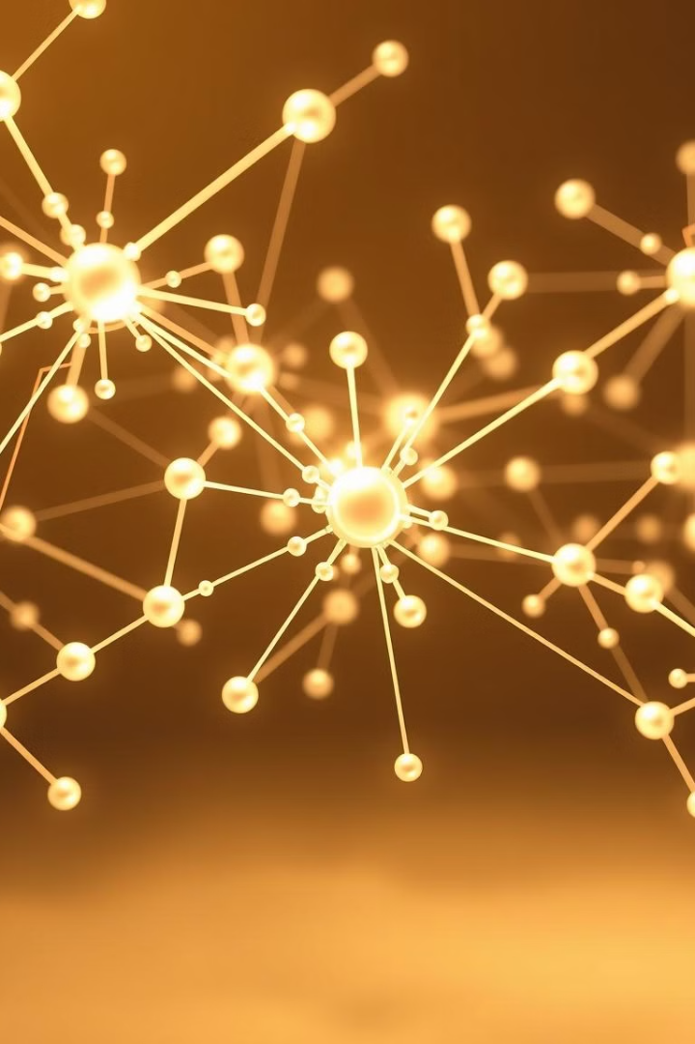



Fostering Multidisciplinary Collaboration
Creating platforms for knowledge exchange is crucial for fostering dialogue and collaboration between disciplines.
Encouraging cross-disciplinary education and training equips researchers with skills to work effectively in multidisciplinary teams.
Developing funding mechanisms that support team-based research is essential to incentivize interdisciplinary projects.

Slide 10

The Future of Innovation: Embrace Multidisciplinary Approaches
The future of innovation lies in embracing multidisciplinary approaches to address global challenges and unlock new discoveries.

