Slide 1


EV CHARGING WITH RENEWABLE ENERGY: A LONG-TERM PARTNERSHIP FOR A GREENER FUTURE
Authors :
Patel Ronak Vijaykumar Dr. Guge Nilam Nimaraj
Ph.D. Scholar, Associate Professor
Department of Electrical Engineering,
University of Technology-Jaipur,
Rajasthan.

Slide 2
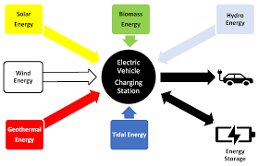
INTRODUCTION
The push for sustainability has made electric vehicles (EVs) and renewable energy more popular. Charging EVs with solar or wind power helps cut carbon emissions and reduces reliance on fossil fuels. Renewable energy also lowers greenhouse gas emissions and keeps energy costs stable.
Smart EV charging systems adjust power use based on the electricity grid, making energy consumption more efficient. To support the growing number of EVs, a strong and reliable charging system is essential.
The research studies how EV charging with renewable energy benefits transportation and looks at challenges and solutions for creating sustainable systems.
Figure 1: Integration of Renewable Energy Sources with EV Charging

Slide 3

THE BENEFITS OF RENEWABLE ENERGY
Produces less pollution, reducing air and water contamination.
Helps prevent climate-related damage, supporting sustainability.
Solar and wind energy are endless and do not run out like fossil fuels.
More reliable and stable as they are not affected by market prices or politics.
Smart energy management with renewables lowers
costs and improves efficiency. Figure 2: Benefits of Renewable Energy

Slide 4
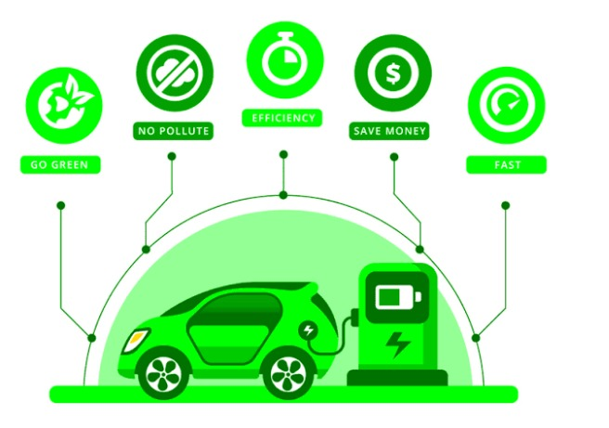
THE ADVANTAGES OF ELECTRIC VEHICLES
Produce less pollution, improving air quality in cities.
Require fewer maintenance parts and less fuel, reducing costs.
More energy-efficient than gasoline-powered cars.
Reduce dependence on foreign oil and lower transportation expenses.

Slide 5
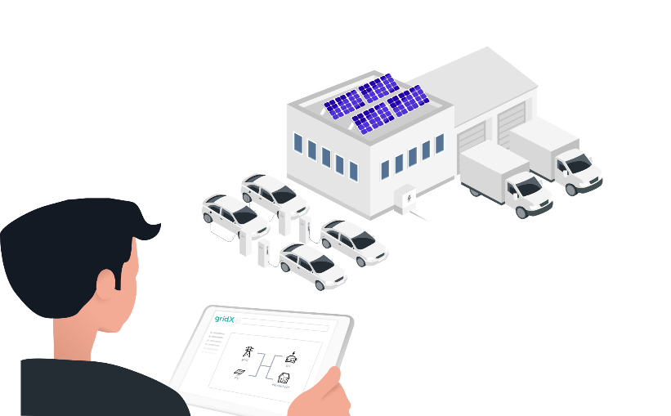
SMART EV CHARGING IMPORTANT
Adjusts charging speed and schedule based on cost and demand
Works best with renewable energy like solar and wind.
Enables real-time monitoring and trip planning via the internet.
Cost-Efficient – Adjusts charging speed and schedule based on electricity prices.
Energy-Efficient – Optimizes power usage to reduce waste.
Eco-Friendly – Works best with renewable energy sources like solar and wind.
Real-Time Monitoring – Allows tracking and control via the internet.
Convenient Trip Planning – Ensures efficient charging for long journeys.

Slide 6
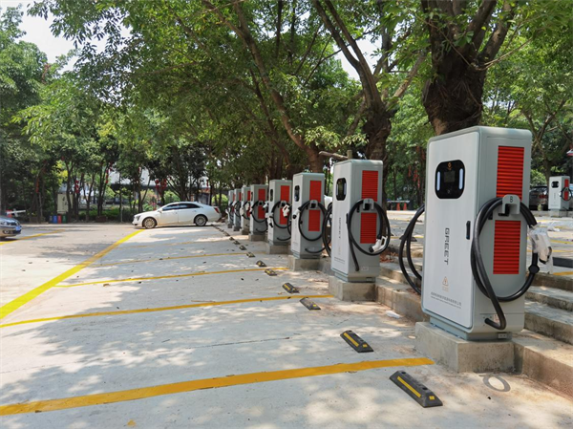
NEED FOR RELIABLE EV CHARGING INFRASTRUCTURE
Dependable Systems: EV adoption requires reliable and smart charging systems.
Accessibility: More charging stations need to be available for user convenience.
Multi-Vehicle Support: Stations should be compatible with multiple EVs.
Funding & Research: Public and private sectors must invest in renewable energy-based charging infrastructure.
Consumer Awareness: People must understand smart energy management and renewable benefits before choosing their EV solutions.

Slide 7
THE FUTURE OF RENEWABLE ENERGY AND SMART EV CHARGING
Reliable and smart EV charging systems are essential for widespread EV adoption.
Accessible and widely available charging stations encourage EV use.
Charging stations must support multiple vehicles and be compatible with various systems.
Public and private sectors should invest in renewable energy and clean charging infrastructure.
Financial incentives can promote the establishment of EV charging stations.
Consumers need awareness of smart energy management and renewable energy benefits.
Transitioning to renewable energy and efficient EV charging will reduce climate impact
and air pollution while decreasing fossil fuel dependence.

Slide 8
RENEWABLES AND EV CHARGING IN ACTION
For EVs to go mainstream, we need reliable and smart charging stations that work with multiple vehicles. More accessible and dependable stations will encourage drivers to switch to EVs.
Public and private sectors should invest in renewable energy-based charging infrastructure and offer financial incentives to boost adoption.
Consumers should understand smart EV charging and renewable energy benefits to make informed choices.
By working together, we can reduce climate change, clean the air, and cut fossil fuel dependence.

Slide 9
CONCLUSION
Smart EV charging and renewable energy are key to a sustainable future. Investing in efficient power management and expanding charging stations will cut fossil fuel use and help the environment. Innovation, partnerships, and awareness will drive a cleaner transportation system.

Slide 10
REFERENCES
Engelhardt, J., Zepter, J. M., Gabderakhmanova, T., & Marinelli, M. (2022). Energy management of a multi-battery system for renewable-based high power EV charging. ETransportation, 14, 100198.
Filote, C., Felseghi, R. A., Raboaca, M. S., & Aşchilean, I. (2020). Environmental impact assessment of green energy systems for power supply of electric vehicle charging station. International Journal of Energy Research, 44(13), 10471-10494.
Fu, Z., Dong, P., & Ju, Y. (2020). An intelligent electric vehicle charging system for new energy companies based on consortium blockchain. Journal of Cleaner Production, 261, 121219.
Liao, J., Liu, X., Zhou, X., & Tursunova, N. R. (2023). Analyzing the role of renewable energy transition and industrialization on ecological sustainability: can green innovation matter in OECD countries. Renewable Energy, 204, 141-151.
Mastoi, M. S., Zhuang, S., Munir, H. M., Haris, M., Hassan, M., Usman, M., ... & Ro, J. S. (2022). An in-depth analysis of electric vehicle charging station infrastructure, policy implications, and future trends. Energy Reports, 8, 11504-11529.

Slide 11
THANK YOU

