Slide 1

SAFETY AND RISK MANAGEMENT IN THE CONSTRUCTION INDUSTRY OF CRYOGENIC AIR SEPARATION PLANTS
IPS ACADEMY
INSTITUTE OF ENGINEERING & SCIENCE
(A UGC Autonomous Institute, Affiliated to RGPV)
FIRE TECHNOLOGY & SAFETY ENGINEERING DEPARTMENT
2025
Prepared By– Yogender Singh
Enrollment No. 0808ME23MT07
Branch- M.Tech. (Industrial Safety Engineering)
Subject- Dissertation Phase-II
Academic Year- 2025, IV Sem
Supervisor- MR. Manish Dubey (Associate Professor)

Slide 2
1. Abstract
2. Introduction
3. Literature Review
4. Literature Gaps
5. Objective of the Study
6. Methodology
7. Result & Discussion
8. Conclusion
9. Acknowledgement
10. References
CONTENTS

Slide 3
Safety and risk management are important concepts in construction of Cryogenic Air Separation Plants (CASP). Conventional Hazard Identification and Risk Assessment (HIRA) methods have proven ineffective in practice since many crucial aspects like structured safety management frameworks are often not taken into account. This study develops and integrate STARR Model (Select - Train - Assess - Review - Reinforce) into CASP construction Safety Management System (SMS) along with a comprehensive construction phase-wise HIRA process. The study emphasizes mechanism enhancement for hazard control, safety compliance, and the promotion of a strong safety culture in CASP projects. A multi-phase methodology has been employed, which included survey methods, expert reviews, and analysis of safety practices at a CASP construction site in North India. STARR Model ensures proactive safety measures through systematic workforce training, risk assessment, and continuous improvement, while the HIRA process is aimed at identifying, evaluating, and mitigating risks throughout all phases of construction. Results demonstrated that the integration framework is effective in incident reduction, regulatory compliance facilitation, and safety culture enhancement. It is concluded that the proposed model greatly enhances safety performance in CASP construction but is at present limited to application in one project. Further studies may explore wider industry implementations of the model, together with the incursion of advanced safety technologies into risk management, thereby enhancing sustainability in high-risk construction environments.
1. ABSTRACT

Slide 4
2. INTRODUCTION
Construction safety is imperative for high-risk industries such as the construction of Cryogenic Air Separation Plant (CASP) where there is complicated work, heavy equipment usage, hazardous gases, and extreme temperatures. Both safety and risk management need to be incorporated so that incidents may be avoided as missing links within systematic safety processes may have resultant drastic consequences ranging from work conflicts, unsafe workplace procedures, danger of fire outbreak, gas leakages, to cryogenic exposure. Construction safety management effectiveness is closely related to the efficiency of overall project management [1]. Strong Occupational Health and Safety (OHS) practices not only reduce incidents but also enhance worker morale, project efficiency, and adherence to regulatory standards [2]. But traditional Hazard Identification and Risk Assessment (HIRA) techniques assess risk mainly on the basis of severity and likelihood but tend to neglect key considerations such as exposure frequency and legal standards, and hence risk mitigation measures are restricted [3]. Construction projects with ill-organized risk management systems have increased fatality rates, delays, and inefficiencies, especially in areas where conventional approaches prevail over organized safety procedures [4]. Sophisticated safety models, like the Bayesian Belief Network (BBN), offer predictive functions for risk assessment and mitigation, and hence are a vital tool for enhancing hazard control in dynamic construction settings [4]. In addition, structured risk assessment methods such as HIRA and Job Safety Analysis (JSA) have been found effective in manufacturing environments, but their potential is yet to be realized in CASP construction [5]. Hence, in this study STARR Model is integrated within safety management system and a detailed step-by-step Hazard HIRA is applied across all key CASP construction & commissioning phases of CASP. The STARR model requirements are more significant for CASP construction where a stringent planning and execution is crucial to make workplace safe and secure.
E-mail Address: sy.singhyogender@gmail.com

Slide 5
3. LITERATURE REVIEW
These studies reveal that digital tools improve safety in general but are especially important for migrant workers, although their effectiveness is usually limited to certain areas [6]. Likewise, Construction Safety Management Information Systems (CSMIS) facilitate risk compliance, but these systems are not widely utilized in CASP projects [7].Integrated Management Systems (IMS) foster sustainability and mitigation of risks through real time monitoring and intervention. But these systems are not tailored for CASP commissioning that has specific safety issues [7].Although there are precautions like railings and safety nets, construction falls continue to be a significant contributor to construction site injuries [8]. Safety training, observation, and PPE usage are important, but current research fails to consider CASP-specific risks such as cryogenic injury, confined space entry, and oxygen deficient environments [8]. If there are aspects of an organization that could affect strategy, risk assessment and management, then those areas are the specific allocation of resources, the complexity of the site, and the management model since they have fundamental importance to safety [9]. The problem of resources and meeting OHS requirements places developing countries behind their counterparts since there isn’t enough money, workforce, and regulations [10].High risks industries, such as nuclear power plants, offer valuable lessons on the risk assessment strategies that CASP projects can benefit from [11]. Unlike hazard risky class systems of CASP application, Set Pair Analysis (SPA) and Trapezoidal Fuzzy Number (TPFN) are often put to more use, but their incorporation into CASP did not happen [11]. Deficiencies in the literature related to safety aspects within the scope of new construction include the launch phase where new possibilities emerge together with the new risks of system testing and operational handover [12]. Construction hazards include classifications such as financial, safety, design, and operational issues that need well-planned prevention and corrective measures [13]. But, the effective management of risks is still lacking in most areas which have a poorly defined regulatory structure and skill gaps [14].

Slide 6
4. LITERATURE GAPS
The above literature review shows that many studies focusing on construction safety and risk management, but not a single one of them adequately discusses CASP construction projects with in a methodical framework to manage and integrate safety from initial stage to completion of a CASP construction, also commissioning activities of CASP are yet another area that is not dealt with when it comes to risk mitigation. Construction safety is driven by leadership & management team and it is always a top-down approach, hence both teams must be safety-oriented and efficient in planning and setting targets for effective safety implementation and risk management from the initial stage of CASP construction projects, however this aspect is not strategically addressed in the literature review. The absence of these measures deserves acknowledgement and, therefore, calls for proper, specialized industry safety and risk management models to enhance CASP construction safety and other related outcomes.

Slide 7
5. OBJECTIVES
The aim of the study is Integrating the STARR Model into the Safety Management System (SMS) of CASP Construction to enhance control of hazards, enhance safety compliance and develop a robust safety culture in CASP construction projects. Further, the research also determines phase-wise construction activities, the possible hazards and their control measure utilizing eight steps of HIRA process to supplement the STARR model. This study also aims to prevent safety incidents and to promote safer operations for CASP construction projects by adopting structured safety models and proactive risk assessment techniques. The intention as framed by author is to improve safety and risk control in CASP construction and guarding of workforce.

Slide 8
6. Methodology
This study adopts a structured safety management approach by integrating the STARR Model (Select - Train - Assess - Review - Reinforce) into the Safety Management System (SMS) of CASP construction. To complement this framework and manage the associated risk, a detailed step-by-step Hazard Identification and Risk Assessment (HIRA) will be applied across all key CASP construction & commissioning phases. This approach will ensure that all potential hazards are systematically identified, assessed, and controlled at each stage of the construction process.
Enhancement of Safety Management Using STARR Model
The STARR Model is a structured safety management framework designed to increase risk control, competency of workforce and continuous improvement in CASP construction. This follows a systematic cycle of Selection, Training, Assessment, Review and Reinforcement, and ensures that safety measures are proactively identified, implemented, evaluated and sustained in the construction cycle. By integrating this model, the purpose of study is to strengthen hazard control, improve compliance and establish a resilient safety culture in CASP construction projects.

Slide 9
6. Methodology- Continued
There are five steps in STARR Model to enhance safety management in construction of CASP
STARR Model
Select (S)
Train (T)
Assess (A)
Review (R)
Reinforce (R)
Constructability Study for ASP
Risk Assessment and Control
Emergency Preparedness and Response
Monitoring, Measurement and Compliance
Continuous Improvement
Leadership and Commitment
HSE Planning
Communication and Consultation
HSE Training & Competency Development
Construction Execution Control and Safety Procedure
Management Review and HSE System Evaluation

Slide 10
6. Methodology- Continued
Select- Refers to identifying and selecting the essential safety prerequisites, including site conditions, design optimization, material handling strategies, workforce readiness, regulatory compliance, and HSE policy framework, to establish a strong foundation for safe CASP construction.
Train- Refers to developing workforce competency through safety training, risk awareness, emergency preparedness, and procedural adherence to ensure effective hazard control in CASP construction.
Assess- Refers to evaluating emergency preparedness, risk control effectiveness, safety engagement, and incident reporting to ensure continuous safety improvements in CASP construction.
Review- Refers to analysing safety performance, auditing compliance, investigating incidents, and identifying improvements to enhance risk management in CASP construction.
Reinforce- Refers to strengthening the HSE system by updating policies and procedures, aligning with best practices, and ensuring continuous improvement in CASP construction safety.

Slide 11
6. Methodology– Continued
Hazard Identification and Risk Assessment (HIRA)
HIRA is a systematic process that proactively detects potential workplace hazards, evaluates their risks, and establishes control measures to minimize incidents. It provides a structured framework for analysing task-specific dangers, ensuring worker safety, enhances decision-making in dynamic work environments and help to maintain regulatory compliance. This approach optimizes hazard control, improves safety culture, and reinforces continuous risk management in high-risk industries like CASP construction.

Slide 12
6. Methodology– Continued
Eight step process is followed to implement HIRA, across all key CASP construction phases.
Identify Hazards
Prepare Risk Control Plan
Establish and Monitor Control Measure
Review & Update the Risk Control Plan Regularly
Determine Risk (Who May be harmed and how)
Evaluate the Severity and Frequency of Residual Risk
Determine Control Measure
Classify Work Activity
HIRA Process
Figure 2: Eight Steps of HIRA Process

Slide 13
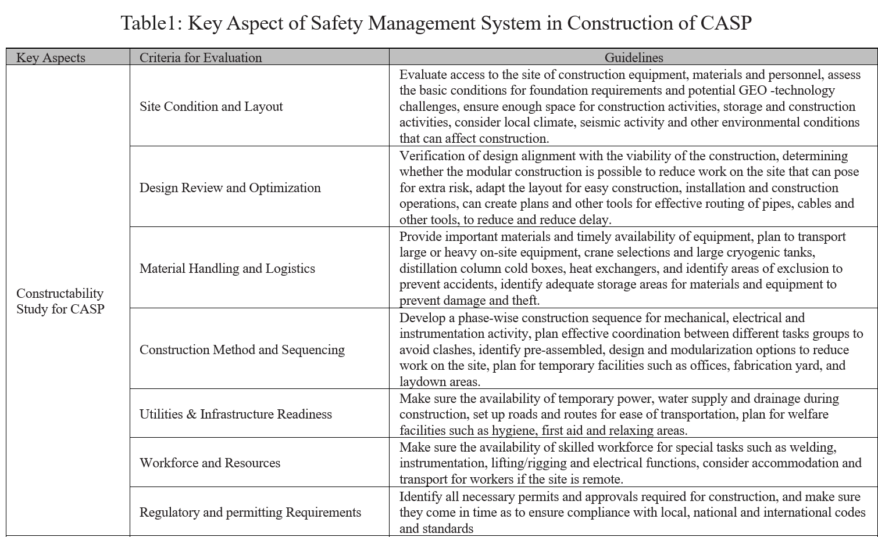
7. Result & Discussion
After careful establishment of STARR Model, the key aspect of safety management system in construction are affirmed (table-1), to make a stringent and effective safety management system tailored to CASP construction.
Table1: Key Aspect of Safety Management System in Construction of CASP

Slide 14
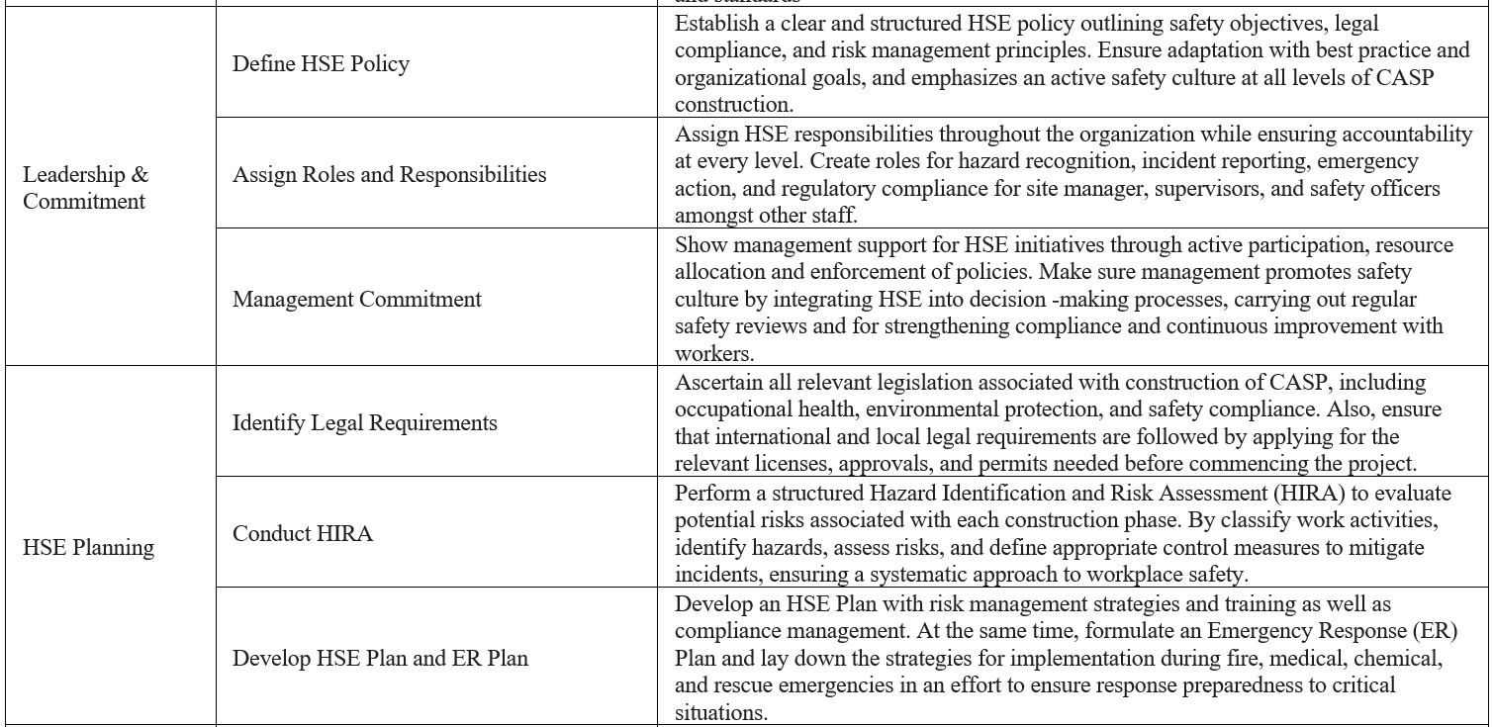
7. Result & Discussion - Continued

Slide 15
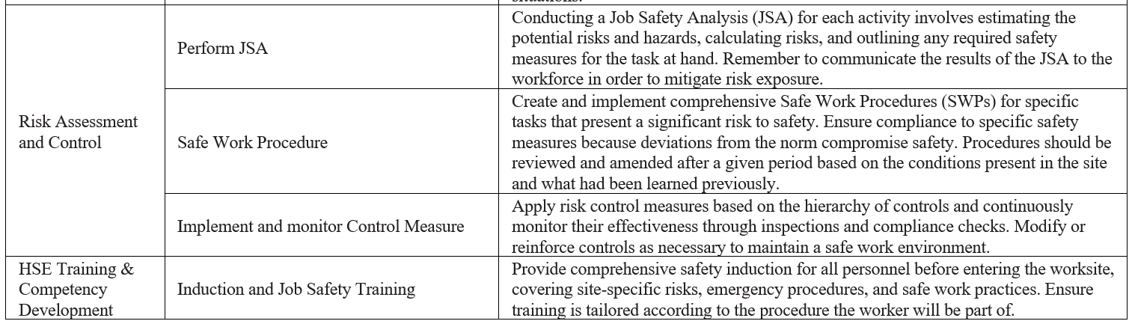
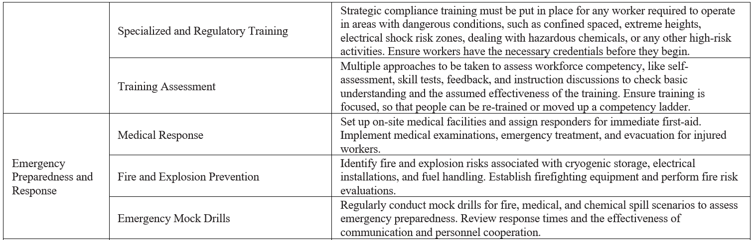
7. Result & Discussion - Continued

Slide 16
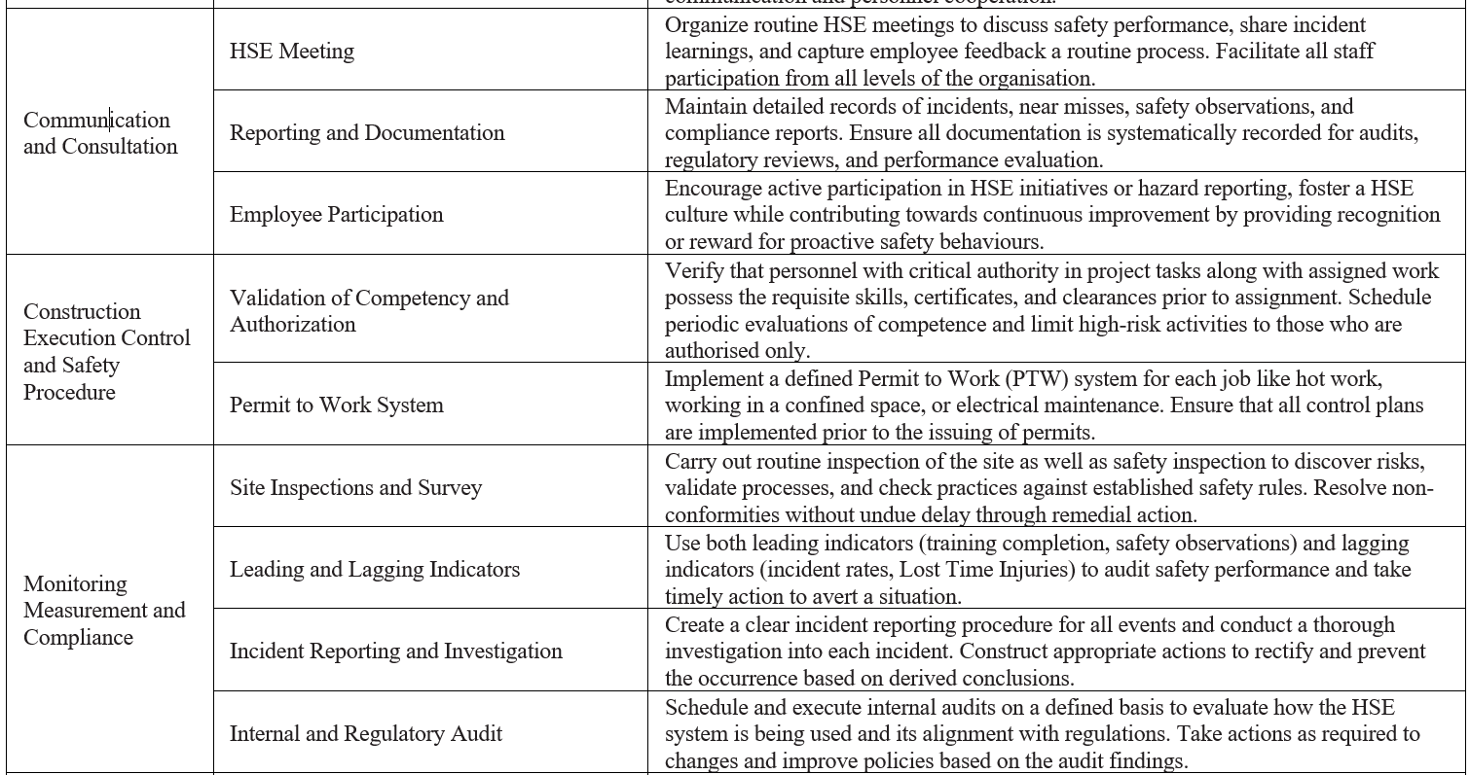
7. Result & Discussion - Continued

Slide 17
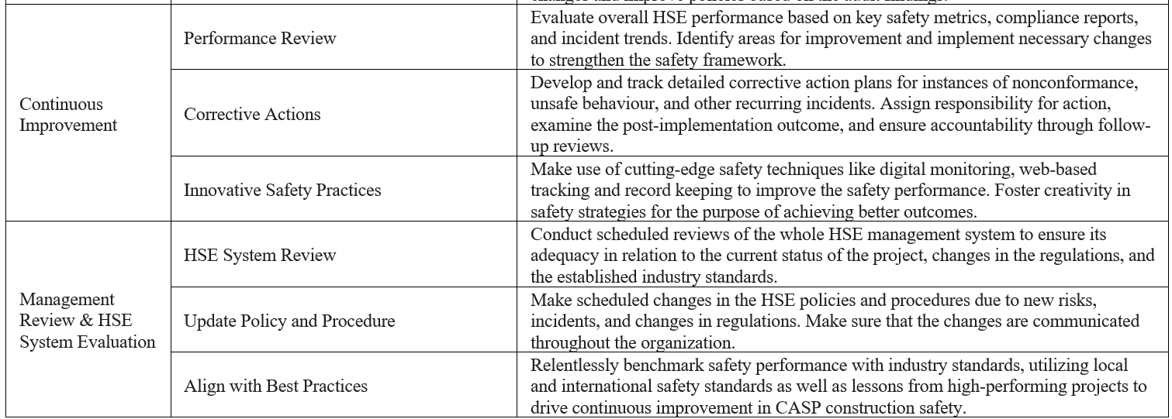
7. Result & Discussion - Continued

Slide 18
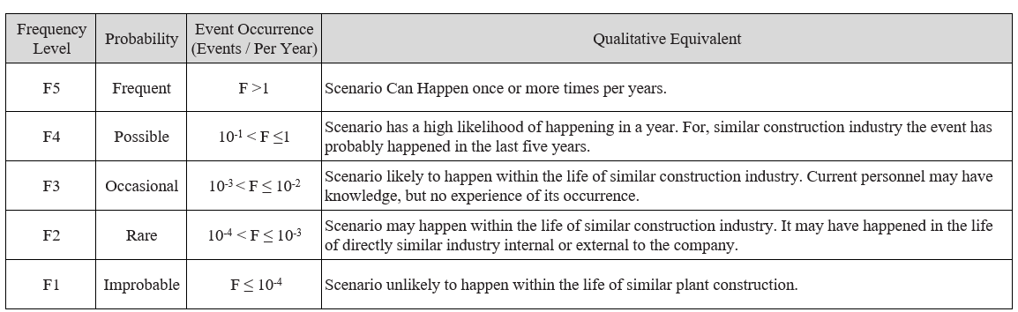
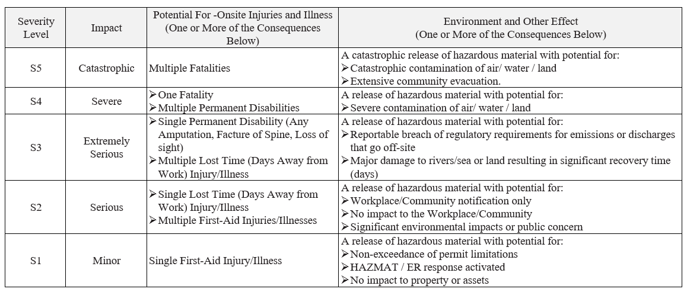
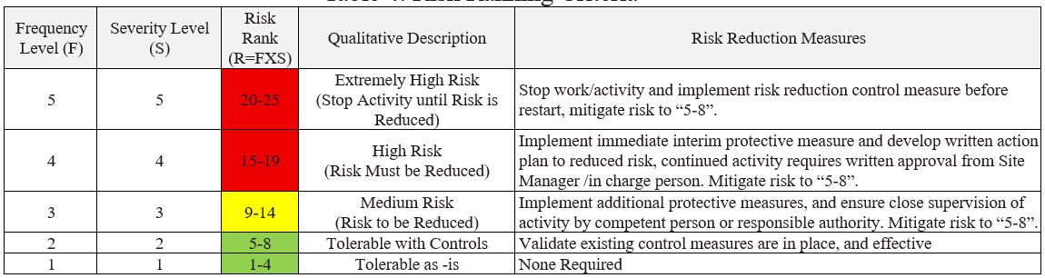
7. Result & Discussion – Continued
Table 2: Level of Frequency - Guidance Criteria
Table 3: Level of Severity - Guidance Criteria
Table 4: Risk Ranking Criteria

Slide 19
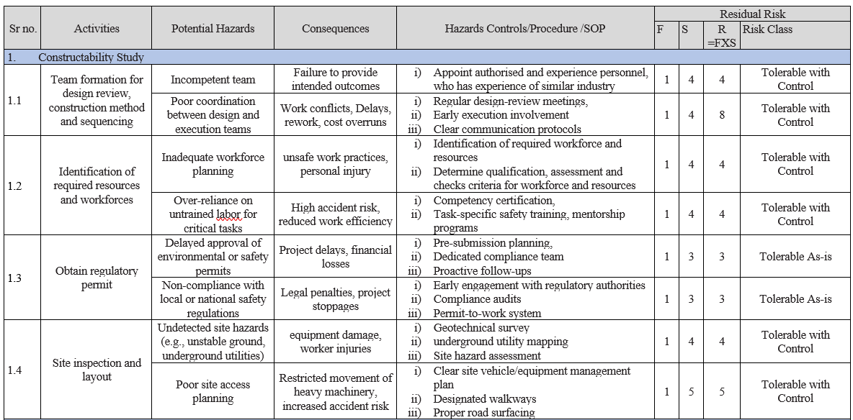
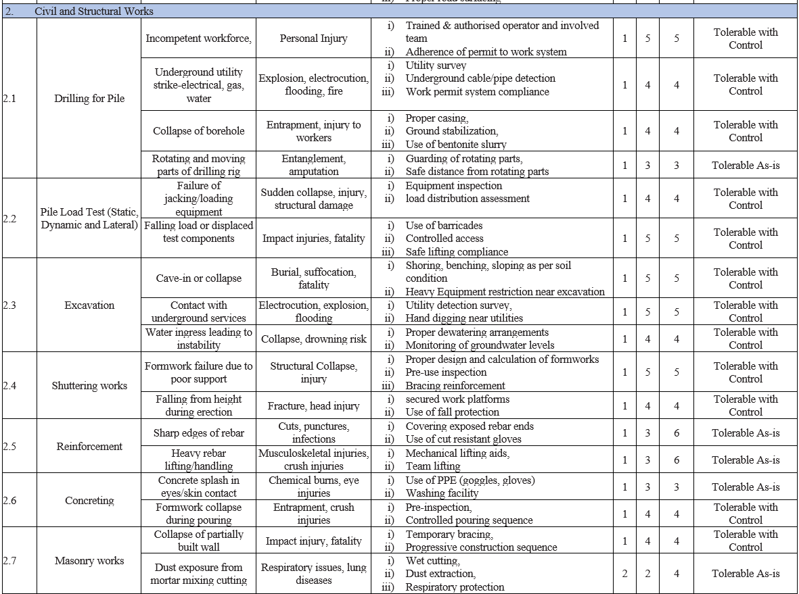
7. Result & Discussion – Continued
Table 5: Hazard Identification and Risk Assessment

Slide 20
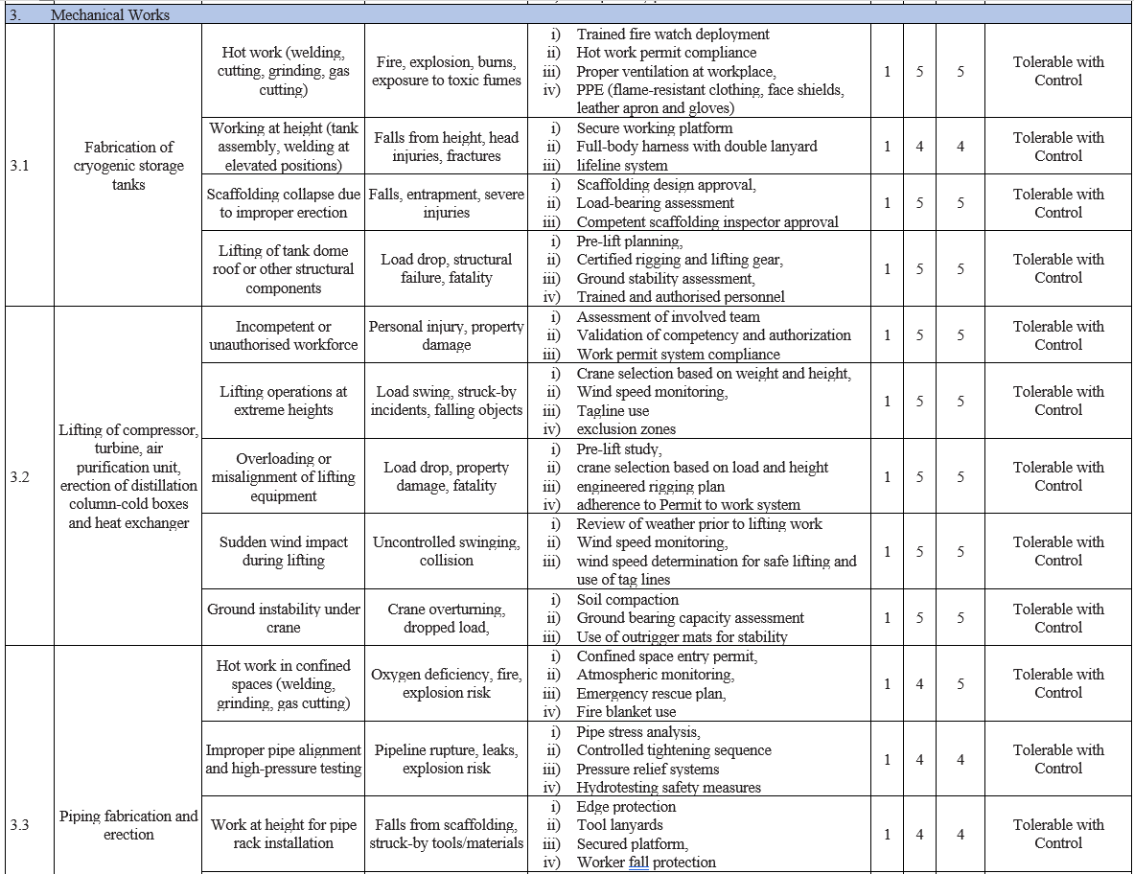
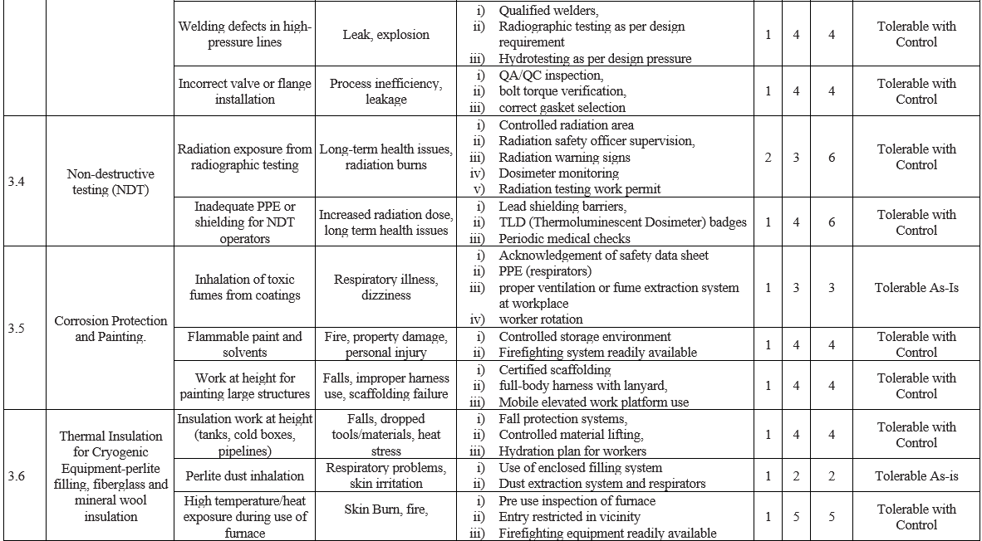
7. Result & Discussion – Continued
Table 5: Hazard Identification and Risk Assessment

Slide 21
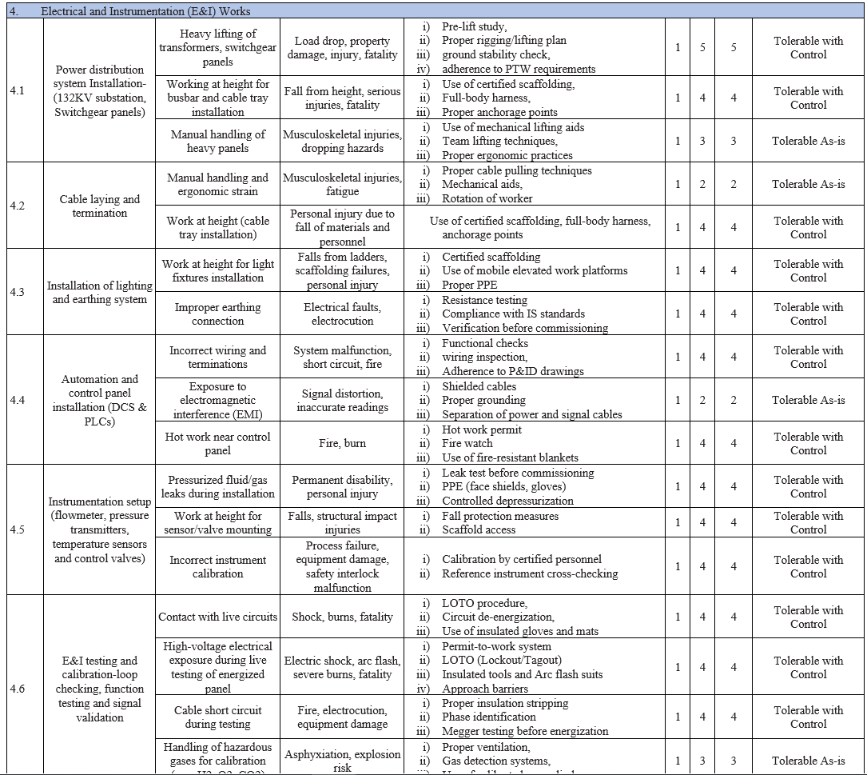
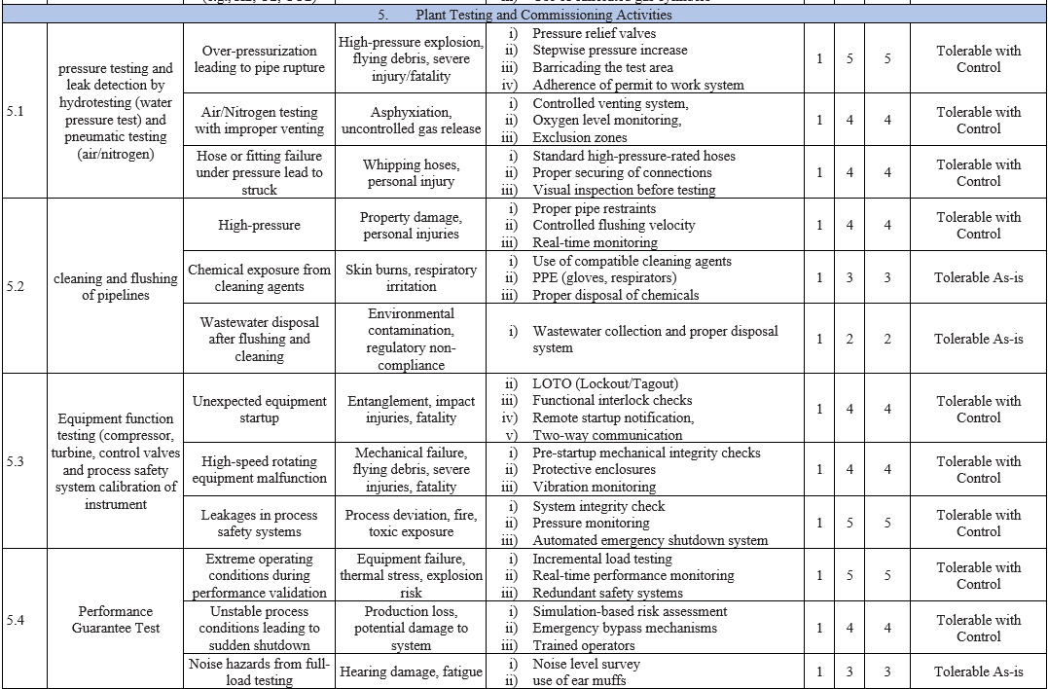
7. Result & Discussion – Continued
Table 5: Hazard Identification and Risk Assessment

Slide 22
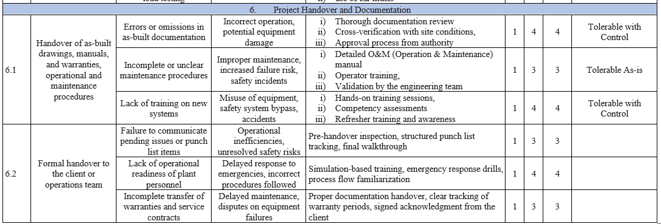
7. Result & Discussion – Continued
Table 5: Hazard Identification and Risk Assessment

Slide 23
8. Conclusion
This study outlines the need to fill the gaps in literature and industry practice by proposing an organized safety and risk management framework for the construction industry of CASP. It also suggests effective management of safety and risks associated with construction and commissioning by incorporating the STARR Model into the Safety Management System and using intricate step-by-step Hazard Identification and Risk Assessment processes. As a reaction to a shift in safety complexity, the important observations stress that the absence of a prescribed risk management approach in CASP projects has amplified safety problems, mainly during initial phase and the commissioning phase, which tends to be neglected. The HIRA design helps to ensures potential hazards are identified, assessed, and controlled at every stage, while the STARR Model ensures safety is integrated via recurrent training, evaluation, and enhancement. Such integration does not only improve hazardous conditions but also establishes safety culture and competency which reduces incidents occurrence. The adoption of a methodical and domain specific safety context can, as indicated by the study, significantly enhance CASP construction safety effectiveness, compliance, and construction productivity.
Despite the organized safety and risk management framework this study has some limitation. The proposed approach could not take into account the new safety and risk opportunities, and It was only applied to one practical CASP construction project. Risks in construction industry cannot be completely eliminated, the framework proposed, insists on continued monitoring and regular updating by the management to achieve effective implementation of safety measures and risk mitigation strategies. Moreover, this study can be further extended by considering other construction industries in India. In the long term, improving risk assessment models using modern sophisticated safety technologies will enhance the CASP construction industry's dependability and resilience while safeguarding its sustainability

Slide 24
9. Acknowledgement
I wish to express my heartfelt appreciation and gratitude to my research coordinator for their ceaseless support, counsel, and invaluable suggestions for this project. Their expertise was critical for the successful completion and direction of this study. I extend my gratitude to IPS Academy for the resources and database available to support academics which were the backbone of my research. Their undeterred assistance has been paramount in carrying out this study judiciously. My thanks go to the Air Separation Plant for allowing me to safety and risk assessment of its workplace, who contributed invaluable data and perspectives about the who, what, where, when, how, and why. The contribution of the workplace has added much depth and significance to this study. Last but not least, I thank the Science and Technology Department, which has been actively involved in this research. I appreciate their support and faith in the essentiality of this work, especially during the process of executing this study collaboratively.

Slide 25
10. Reference
[1] Edwin W. et al., “An analysis of the relationship between project management and safety management in the Norwegian construction industry,” Safety Science, vol. 180, 2024.
[2] Bourahla A. et al., “Managing Occupational Health and Safety Risks in Construction Projects to Achieve Social Sustainability – A Review of Literature,” Procedia Computer Science, vol. 239, 2024.
[3] Arumugaprabu V. et al., “Hazard Identification and Risk Assessment Using Integrated Exposure Frequency and Legislation Requirements (HIRA-FL) in Construction Sites,” Materials Today: Proceedings, vol. 56, 2022.
[4] Gladly P. et al., “Risk Management and Safety Assessment in Building Construction Projects,” Second International Conference on Next Generation Intelligent System (ICNGIS), 2022.
[5] Herlina L. et al., “Hazard Identification in Fabrication Fndustry Using Hazard Identification and Risk Assessment (HIRA) and Job Safety Analysis (JSA),” Journal Industrial Servicess, vol. 8, 2022.
[6] Guan Z. et al., “A Web-Based Safety Management Platform to Enhance Safety for Chinese Migrant Construction Workers,” Safety Science, vol. 181, 2025.
[7] Waqar A. et al., “An Integrated Management System (IMS) Approach to Sustainable Construction Development and Management,” Journal of Infrastructure Intelligence and Resilience, vol. 4, 2025.
[8] Son S. et al., “Assessment of Risk Priorities by Cause of Construction Safety Accidents: A Case Study of Falling Accidents in South Korea,” Heliyon, 2024.
[9] Forteza F. et al., “Organizational Factors and Specific Risks on Construction Sites,” Journal of Safety Research, vol. 81, 2022.
[10] Khan W. et al., “Occupational Halth and Safety in Construction Industry in Pakistan Using Modified-SIRA Method,” Science Direct, vol. 118, 2019.

Slide 26
9. Reference
[11] Sui Y. et al., “A Novel Approach for Occupational Health and Safety and Environment Risk Assessment for Nuclear Power Plant Construction Project,” Journal of Cleaner Production, vol. 258, 2020.
[12] Asgard T. and Jorgensen L., “Health and Safety in Early Ehases of Project Management in Construction,” Procedia Computer Science, vol. 164, 2019.
[13] Iqbal S. et al., “Risk Management in Construction Projects,” Technological and Economic Development of Economy, vol. 21, 2015.
[14] Belel Z. and Mahmood H., “Risk Management Practices in the Nigerian Construction Industry – A Case Study of YOLA,” Continental J. Engineering Sciences, vol. 3, 2012.

Slide 27
THANK YOU

