Slide 1
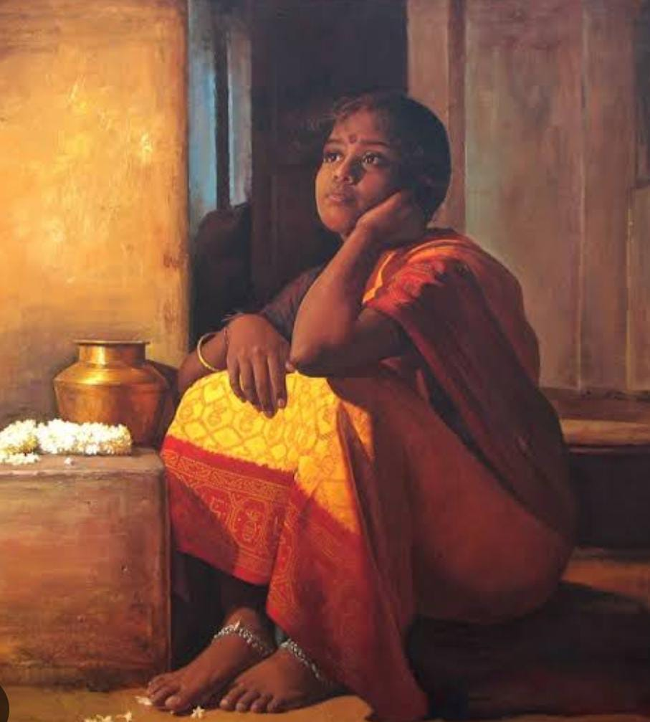
Fascist Feminism vs Alpha male: Is the new patriarchal narrative of ‘Women Question’ truly Fascist?
Dhritiparna Sarkar
Independent Researcher
Alumni of Presidency University, Kolkata
Department of Sociology

Slide 2
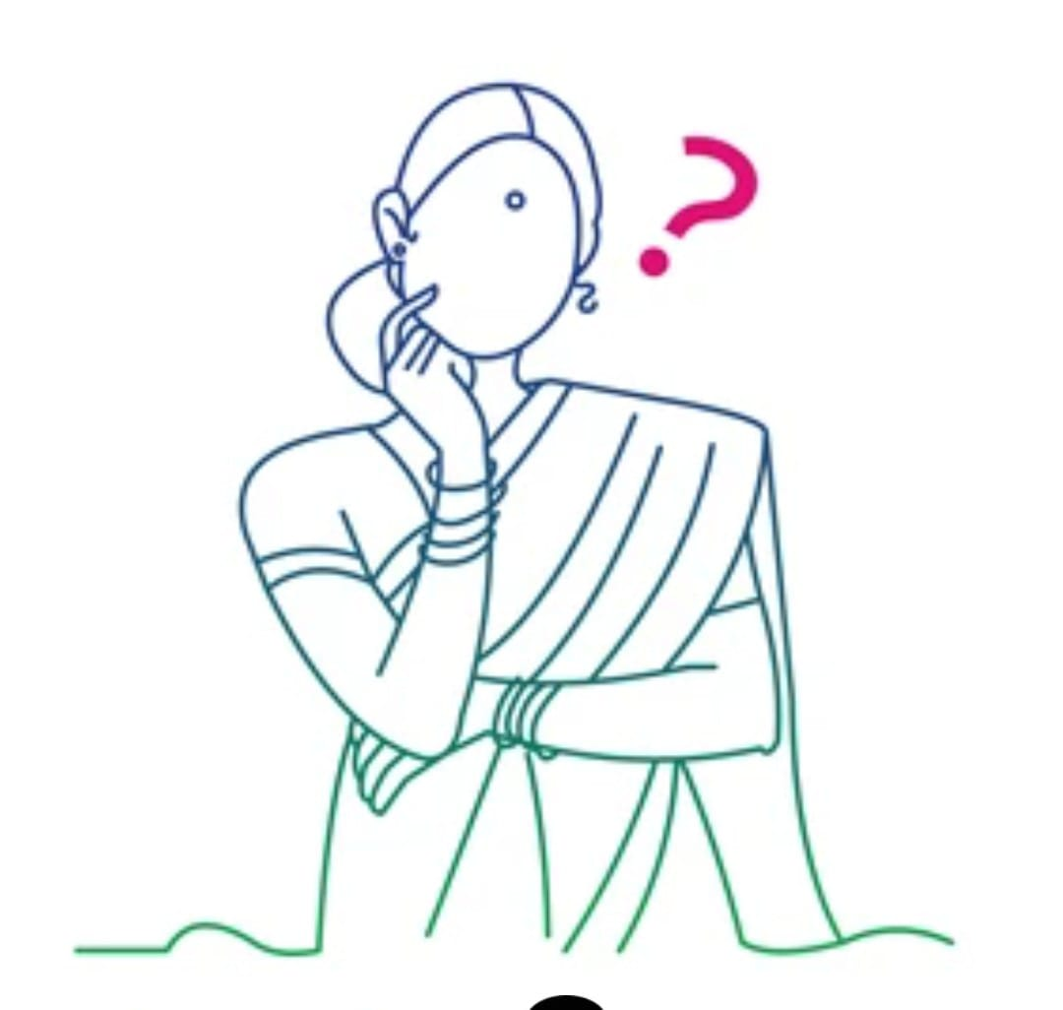
Research Question
Why there is a rise on a terminology - Fascist feminism?
How popular media has an influence in drafting the socio-cultural gender roles?
Why has women’s body an aspect of social dysphoria?
How has women’s body politics the genesis of Indian theater society?
What is this new gender narrative that has brought such heated debate across the nation?
What is new in this version of ‘Women’s Question’?

Slide 3
Introduction
Understanding of Feminism - Demand for equality and equal rights
What is fascist Feminism? A demand for restoring traditional feminism i.e. women being limited to domesticity performing their ‘primary function’ - To Reproduce?
It is a kind of argument that wrose with the rise of Fascism and Nazsim in Europe in the early 20th century.
How Colonial Indian narrative has an influence in Today’s Women Question?
Why the term ‘Fascist Feminism’ making headlines with the release of the film Mrs. a Hindi version of Malayalam Drama Film - The Great Indian Kitchen?
Is the film Mrs. truly Fascist? Is its men’s distinct understanding of feminism or feminist perspective of reality

Slide 4
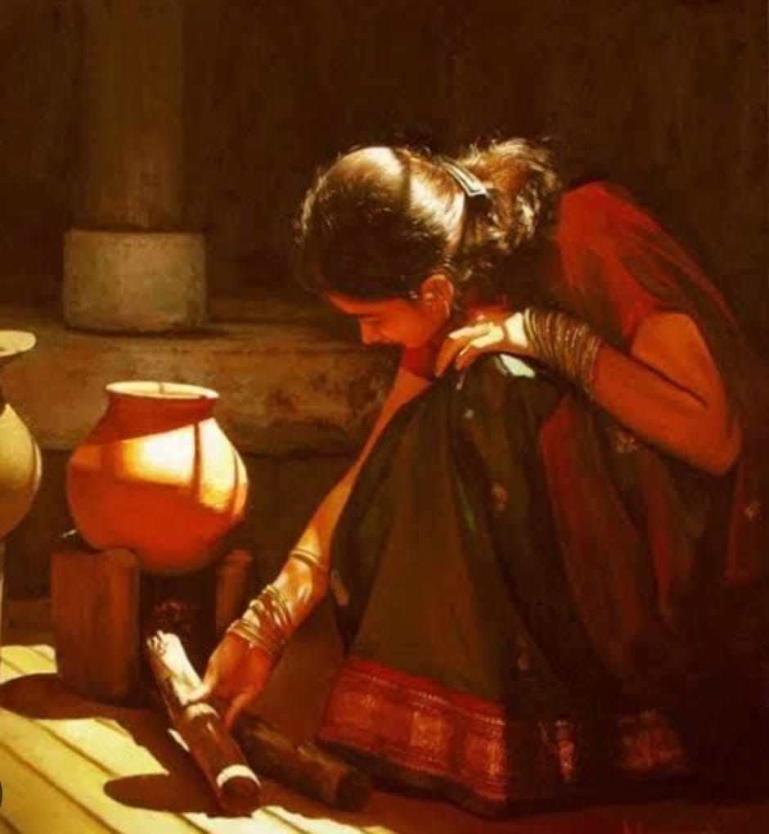

V/S

Slide 5
Historical Perspective: the Inception of public opinion and Theatre Society
The aspect of women question arose for the first time in 19th century colonial India during Bhadrolok nationalism, most prominently with the introduction of judiciary in India by the British.
The judicial judgement was used as a pathway to penetrate into Indian society and ingrain colonial politics in India as well as politics in India. It was women’s bodies and her private life that was used as a vessel to superimpose Western culture on Indian society in the name of modernity.
These Courtroom Dramas became agenesis of Indian Theater society - the need to update the general public, the uneducated mass about the court proceeding.
Methods like pictographic representation on the walls, concrete, saree, even enacting the court proceeding to a mass in a park called Tamasha, Nautanki, Jatra, Villu Pattu etc,
Partha Chatterjee called this new development as ‘New Patriarchy’ which not only transform Indian domesticity but completely politicise women body, drafting Indian Nationalism via their women’s honour and dignity as Nation’s prestige. This Illuminates Foucauldian concept of body discipline that reiterates the idea of ‘state’ which cannot be distinguished from women’s body.

Slide 6
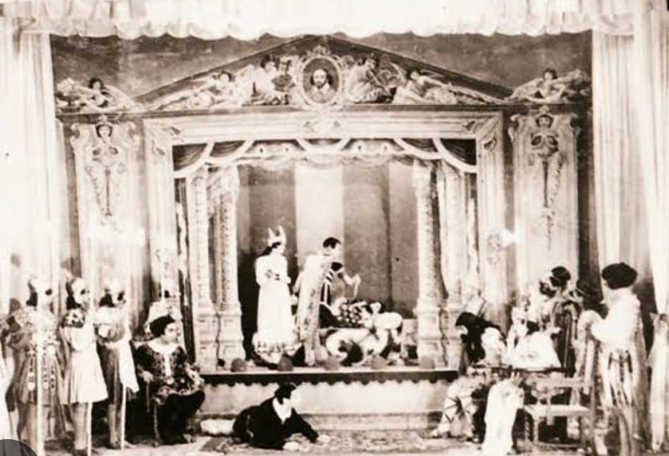
Few Early Theatre society pictures

Slide 7
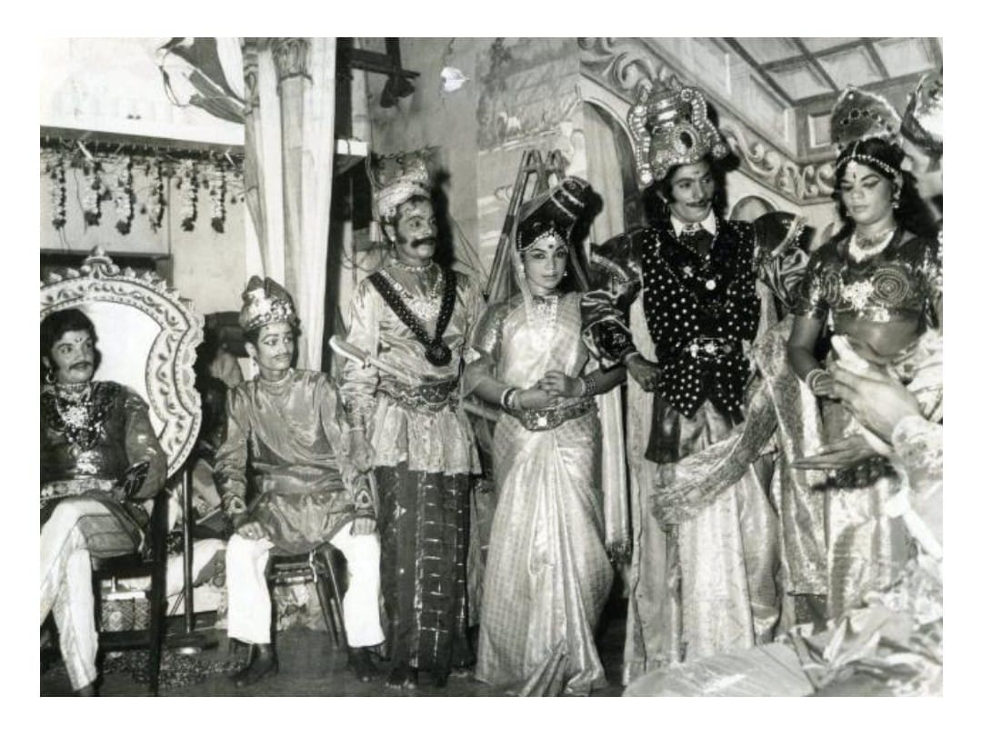

Slide 8
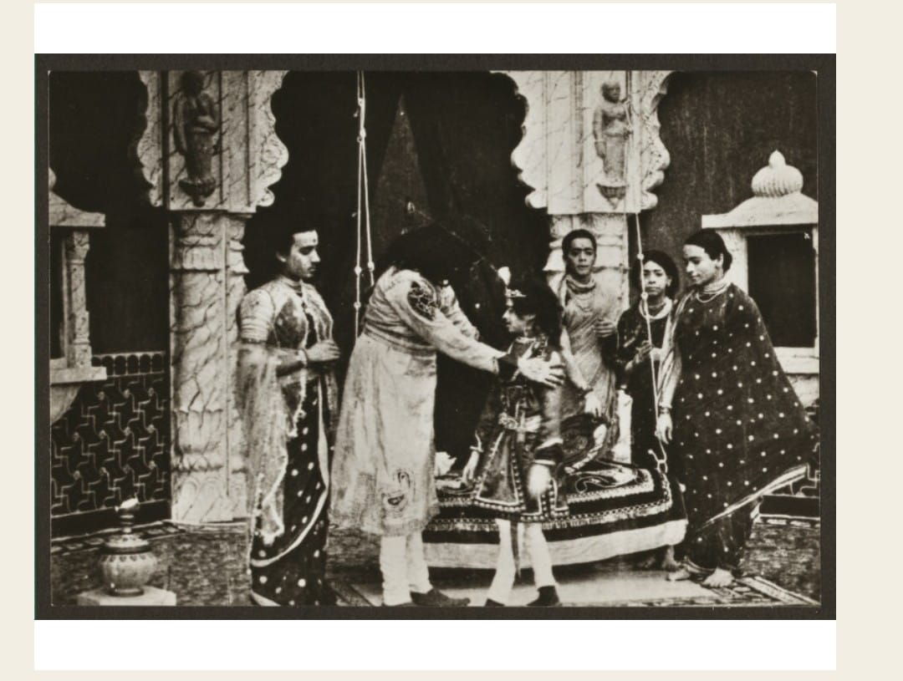
This is a Theatrical depiction of King Harishchandra's trial.

Slide 9
Evolution contemporary Narrative: women’s body politic in 21th century
As the nationalistic narrative unfolds into ‘half bearer’ of man i.e. man’s life is completed only when he taking a wife as argued by Prasad Das Goswami(1896) which lets to women being called ardhangin, disciplining limiting and rehearsing women’s body practice to the level men desires.
The entire subaltern discourse highlight absent of women’s voice, their opinion in the 18th and 19th century socio-cultural reformation, which leds to Gayatri Chakravorty Spivak question - ‘Can the subaltern speak?’
Judith E. Walsh in her book Domesticity in colonial India, on the other hand highlights the women’s magazines, woman journal written by men to instructing women, how to becoming a ‘new women’ the bhadramahila(Gentalwomen) and a ‘good wife’
This colonial elitism and imperial hangover continues even in the post-independence era, where women for longer time trying to fit in within notion of ‘good wife’, ‘ideal wife’ - ‘natural nurtur’, ‘passive meditation’ and the ability to ignite new sensibility and resonate the cord of behaviour, obediently performing household chores.
Popular media - cinema, theater, literature, has also inculcated the idea, defining Indian society in respect to the design drafted by the Europeans in contrast to their Western women, memsaheb.
Films like Biwi ho to Aisi, Maine Pyar kiya, or like Dilwale Dulhania Le Jayenge, Baazigar, Kuch Kuch Hota Hai, all reestablished the idea of authentic Indian women Bhadramahila at a mass level, a level that even British failed to reach.

Slide 10
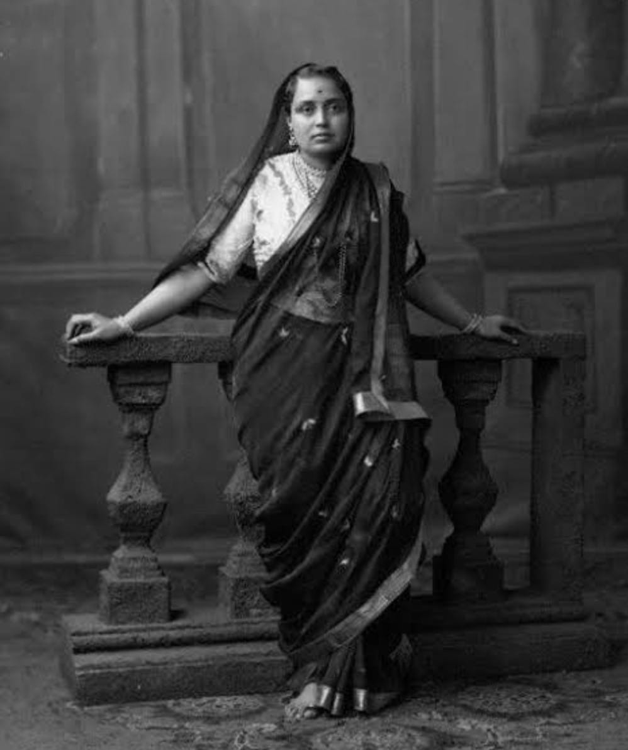
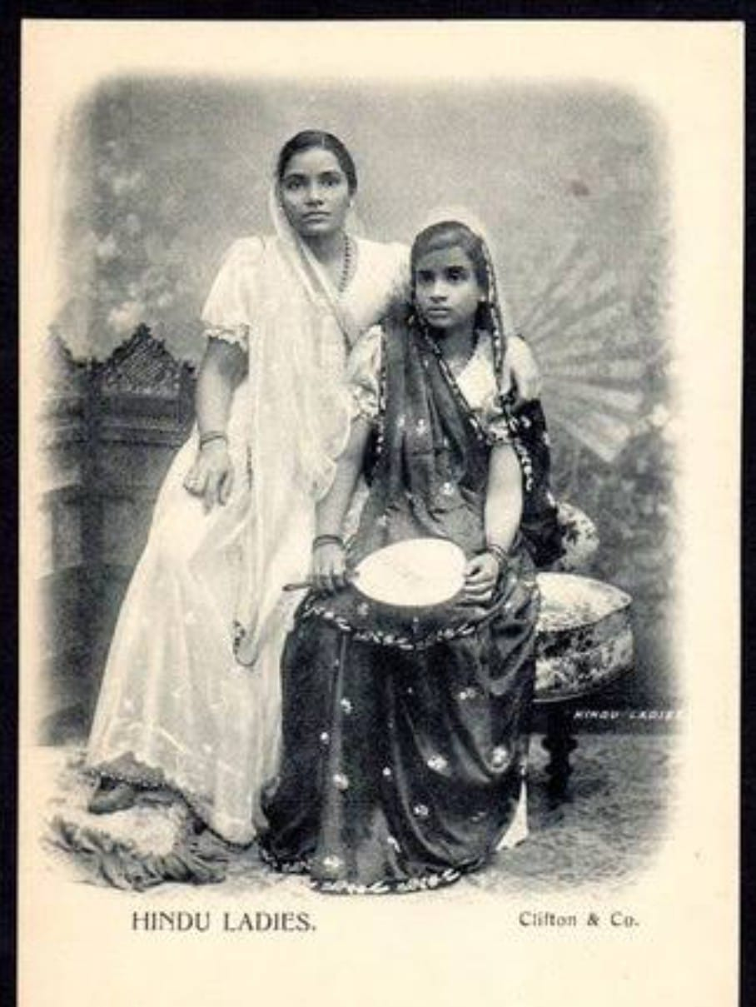
Picture of Bhadramahila, 19th century New women

Slide 11
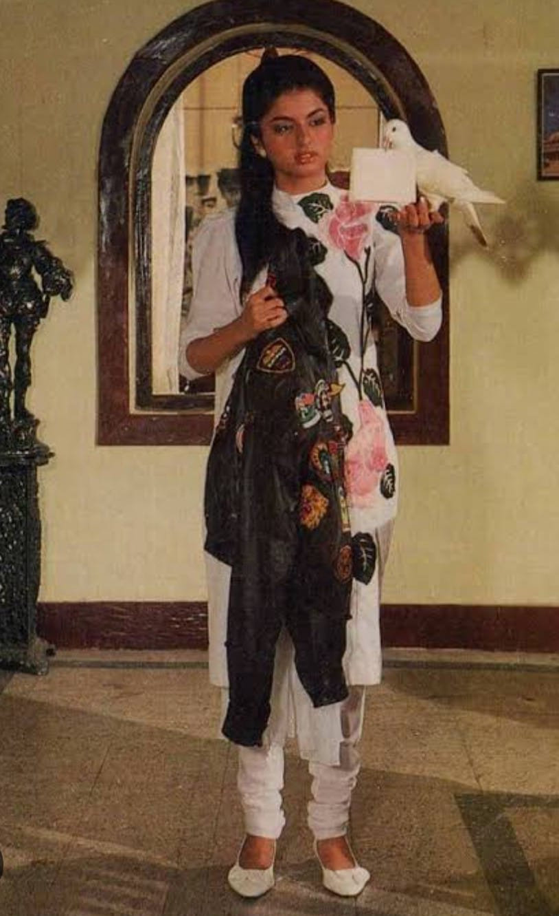
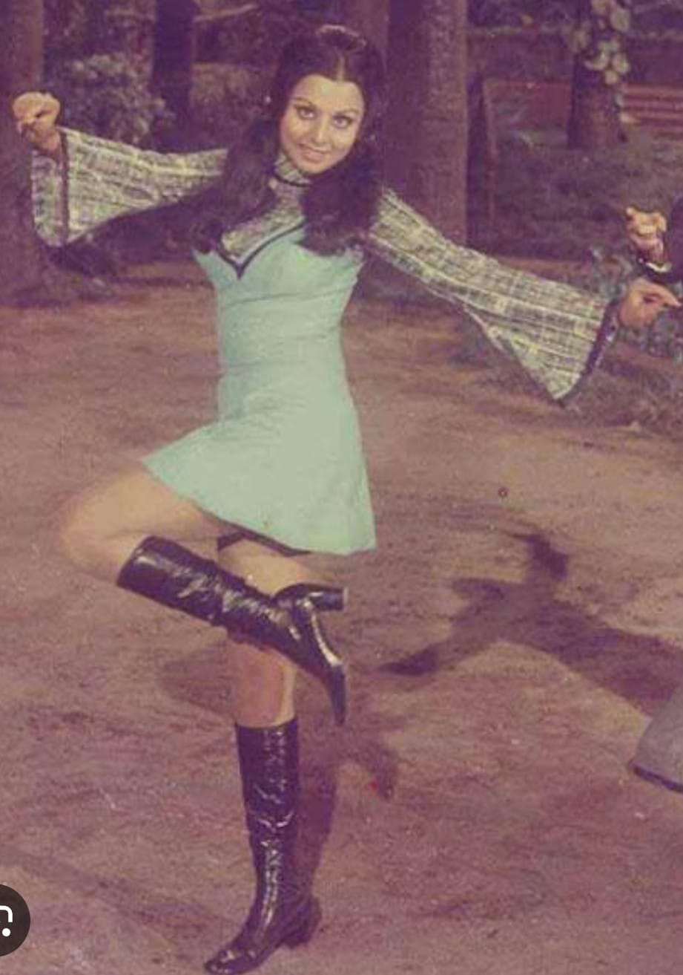
Late 20th century women

Slide 12
Present Debate and women's voice
The hitherto presupposition of women as peripheral character in cinema to protagonist have presented a distinct gaze presenting a strong role, confidence like in films like Dangal(2016), Pink(2016), Chak De India(2007), English Vinglish(2012), Kahani(2012) and others.
Following those films like the Kargil Girl, Mary Kom, Razzi, further illuminates a strong feminine narrative in society.
Mukherjee(2018) highlighted this strong and dominant female role in Bollywood expressess not only the confident and assertive expressing of their sexuality, but in a dormant manner excites men anxiety and their devaluation with women emancipation from generation of patriarchal subjugation.
This justifies the current pro-feminin and anti-men debate and the reason behind men rights organization calling films like Mrs or Thappad ‘fascist feminism’ - it is huge misinterpretation of term which the liberal media tried to clarify with an alternate terminology ‘toxic feminism’.
Therefore, the fight over the terminology completely overshadow the inhuman psychological and physiological assault not only by male members but also by the female members in her in-laws house in the name of Sanskari Bahu, or ideal Indian Bride, meticulously violating her civil and fundamental rights.

Slide 13
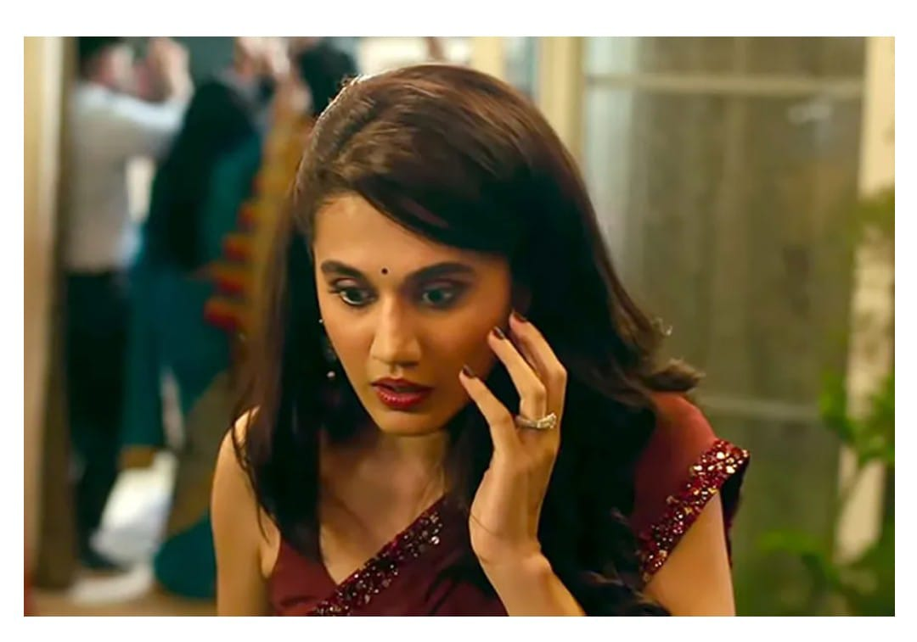
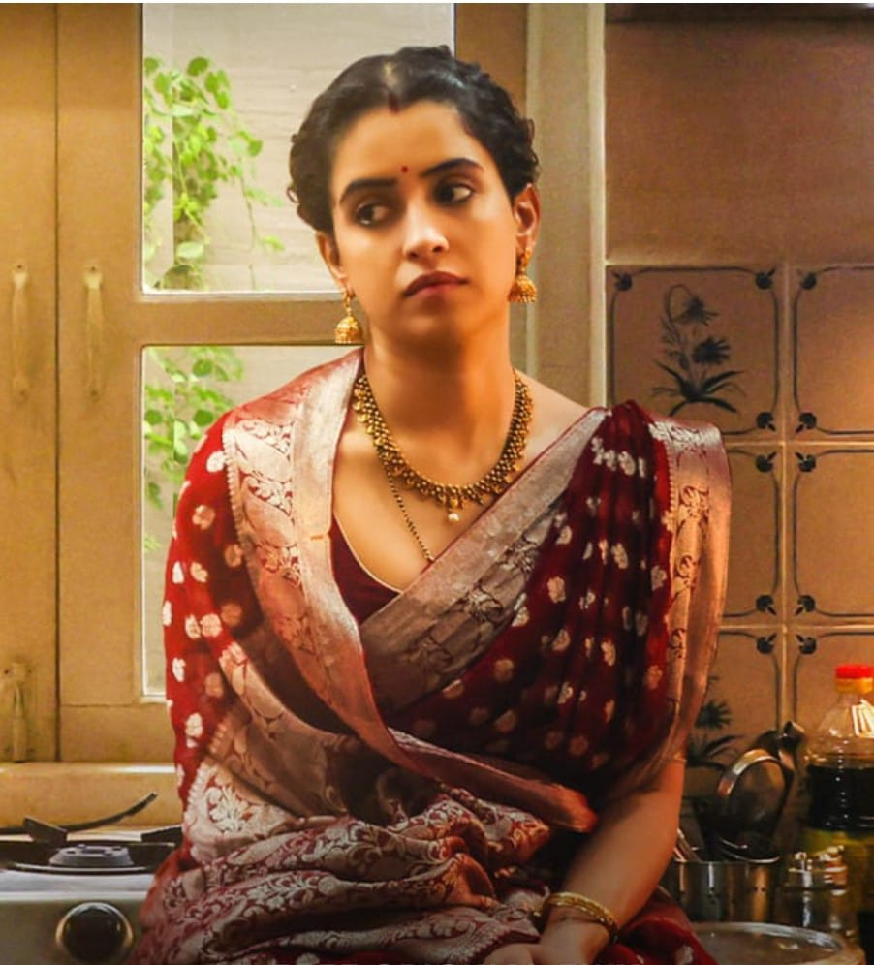
Representation of retaliated women on screen

Slide 14
Conclusion
The entire emergence of new narrative of ‘women quention’ highlights an aggression towards altering the idea of ‘Ideal Indian Badu’ to a Human being.
The entire colonial and subaltern discourse in the process of Socio-cultural transformation used women body as a vessel to inculcate western version of modernity and civility, where women’s ‘consent’, ‘her desires’ were never really a aspect to be consider, dehumanizing and objectifying, using them a material property owned by men.
Thus, at time rising them to a level of God at the same time reducing them to an aspect of trade or an object that exaggerates men’s honour and prestige.
Therefore, films like Thappare or Mrs. that highlights women’s retaliation against generation of patriarchal domination, ignites a deep seated anxiety and distrates, making men anxious over the fear that their traditional gender roles may be jeopardized.
Thank you

