Slide 1
SOCIAL MEDIA AS A NEW AGE MASS COMMUNICATION TOOL: CHALLENGES AND OPPORTUNITIES
Upadrista Esther Sankeerthana
Research Scholar
Journalism and Mass communication
B.E.S.T Innovation University, Ananthapur

Slide 2
Abstract
This research investigates social media as a new-generation mass communication platform, examining its challenges and opportunities using a mixed-methods study design.
The research looks at the population demographics of social media users, determines major challenges like misinformation, privacy issues, and information overload, and examines the potential that social media provides for real-time interaction, professional networking, and business expansion.
Through both quantitative survey data and qualitative interview results from typical users and industry specialists, the research points out the strong relationship between social media usage and fear of misinformation.
The results highlight the revolutionary potential of social media in communication, but also call attention to the urgent need for strategies to contain its pitfalls and unlock its potential.

Slide 3
INTRODUCTION
With the advent of the digital era, social media has become an evolutionary force in mass communication, revolutionizing the dissemination of information, human interaction, and the way companies interact with their publics.
Understanding social media as both an opportunity and a challenge for mass communication will help users optimize its advantages while controlling its drawbacks.
Users and professionals express the most serious worry about the spreading of untrue information. Online information transmission speed coupled with simple content creation methods results in swift propagation of false or inaccurate information throughout platforms.
Social media websites let users immediately share content that subsequently results in fast dissemination of news content alongside ideas and entertainment items.

Slide 4
LITERATURE REVIEW
Arijeniwa and Nwaoboli (2023) conducted research about how social media affects political participation through election campaigns targeting Nigerian youth. The authors emphasized that social media now plays a vital role in political engagement during "screen age" periods.
Dwivedi (2024) conducted an empirical analysis of social media marketing activity effects on brand equity through the representative mediation of self-congruity and consumer empowerment and brand experience.
Nordbrandt (2023) examined how social media affects affective polarization but assumed social media as its main cause. The Dutch panel data used in this research showed that social media usage did not cause polarization according to the findings. The research data supported the hypothesis regarding affective polarization leading to ensuing increases in social media usage instead of proving social media to be the cause.

Slide 5
RESEARCH METHODOLOGY
A mixed-methods strategy was used, combining both quantitative and qualitative methods.
The study targeted two main groups:
  General Users – Individuals aged 18–45 who actively used social media platforms.
  Industry Experts – Professionals in digital marketing, media, and communication.
The research involved 100 participants, including 80 general respondents who took the online survey and 20 industry experts chosen for in-depth interviews.
The research involved 100 participants, including 80 general respondents who took the online survey and 20 industry experts chosen for in-depth interviews.

Slide 6
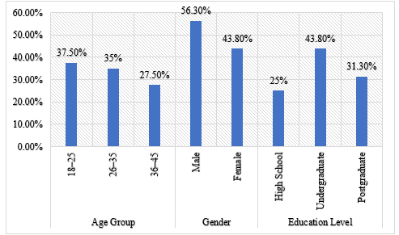
DATA ANALYSIS
Demographic Profile of Respondents
The age, gender, and educational profile of the overall respondents interviewed shows a representative spread across age, gender, and education. The largest number of respondents (37.5%) belonged to the 18–25 age group, followed by 26–35-year-olds (35%), and the 36–45 age group contributed 27.5% to the sample. On the gender split, male respondents (56.3%) were more than female respondents (43.8%). In terms of education background, the majority of respondents were an undergraduate (43.8%), followed by postgraduates (31.3%), and 25% were high school completers only.

Slide 7
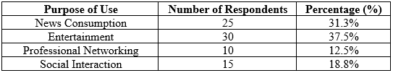
DATA ANALYSIS
Primary Purpose of Social Media Use
This Table shows the main reasons that respondents utilize social media. Entertainment is the most frequent reason with 37.5% of respondents reporting it as their main use. Consuming news is the second most frequent reason, with 31.3% of respondents reporting using social media to stay current with news events. Social interaction is the main reason for 18.8% of respondents, and the least frequent is professional networking for 12.5%.

Slide 8
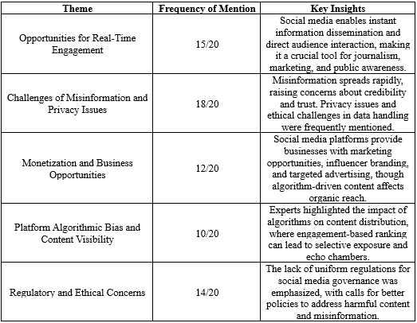
DATA ANALYSIS
Thematic Analysis of Interview Responses
Table 5 shows thematic analysis of interview feedback from 20 industry professionals and brings forth several important findings regarding social media as a mass communication medium. The most cited theme was Opportunities for Real-Time Engagement, noted by 15 professionals, which underscored the use of social media for instant dissemination of information and direct interaction with the audience, which is highly important for journalism, marketing, and public consciousness.

Slide 9
CONCLUSION
This research confirms the central position of social media as an influential new-age mass communication medium, influencing how individuals interact, consume information, and participate in professional and business activities.
The commonality of relationship between constant usage of social media and enhanced care for disinformation is evidence to demand more increased vigilance and judicious utilization practices.
As social media develops, it is important that users, companies, and policymakers utilize its potential without minimizing its threats, making it a useful and efficient mass communication tool.

Slide 10
REFERENCES
Ausat, A. M. A. (2023). The role of social media in shaping public opinion and its influence on economic decisions. Technology and Society Perspectives (TACIT), 1(1), 35-44.
Bradač Hojnik, B., & Huđek, I. (2023). Small and medium-sized enterprises in the digital age: Understanding characteristics and essential demands. Information, 14(11), 606.
Kanchan, S., & Gaidhane, A. (2023). Social media role and its impact on public health: a narrative review. Cureus, 15(1).
Khanom, M. T. (2023). Using social media marketing in the digital era: A necessity or a choice. International Journal of Research in Business and Social Science, 12(3), 88-98.
Kumar, V., & Nanda, P. (2024). Social media as a learning tool: A perspective on formal and informal learning. International Journal of Educational Reform, 33(2), 157-182.

Slide 11
THANK YOU

