Slide 1
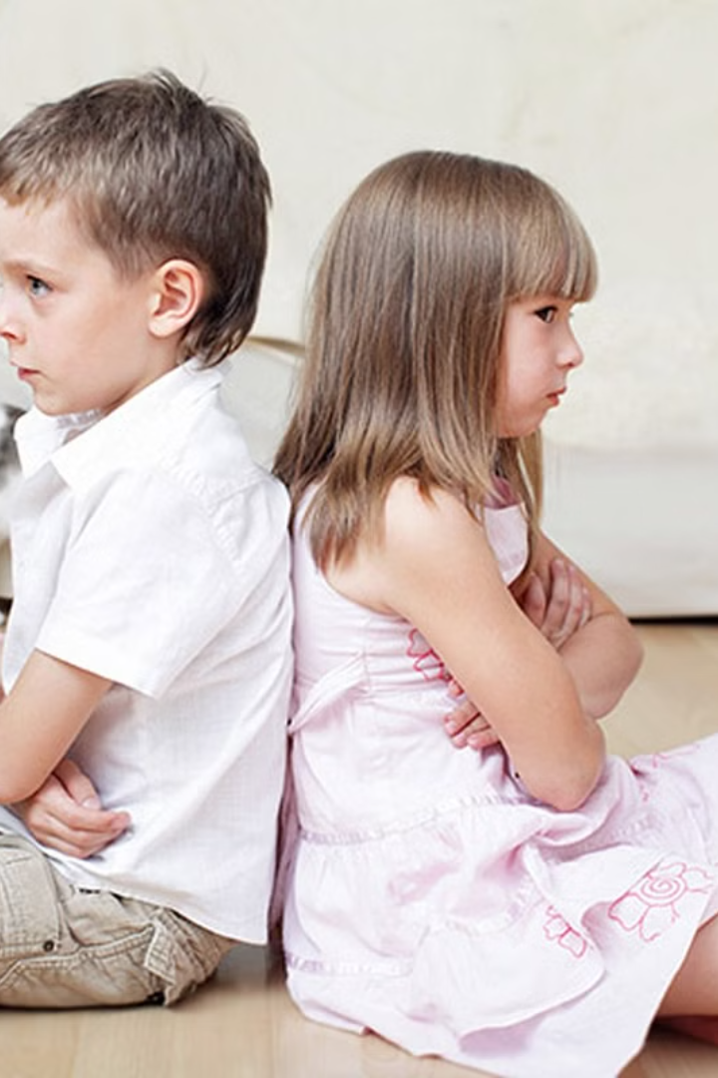

Sibling Rivalry: Factors, Manifestations and Implications
Subject: Psychology
Written & researched by: Varada V.S
This study offers qualitative insights into sibling rivalry dynamics among individuals aged 18-35. In-depth interviews and observations reveal diverse expressions, including verbal conflicts, competition for achievements, and subtle undermining behavior. Themes such as parental attention, resource allocation, and the impact of life events emerge, emphasizing the emotional intricacies within sibling relationships. The findings suggest a need for counseling support and highlight the role of life events and cultural influences. Despite limitations, this research lays a foundation for future exploration and targeted interventions promoting healthier sibling dynamics.

Slide 2

Understanding Sibling Rivalry
1
Parental Attention
Competition for parental attention is a prevalent theme in sibling relationships, contributing to feelings of rivalry and emotional intricacies.
2
Resource Allocation
The challenges of sharing limited resources, both emotional and material, often lead to feelings of rivalry among siblings.
3
Impact of Life Events
Major life events, such as parental divorces or relocations, can trigger or alleviate sibling rivalry, reshaping the dynamics between siblings.

Slide 3
Psychological Factors in Sibling Rivalry
Parental Behavior
Identity Formation
Social Learning Theories
Parental favoritism or differential treatment significantly impacts sibling relationships, contributing to feelings of rivalry.
Sibling relationships play a pivotal role in shaping an individual's sense of self and identity during childhood and adolescence.
Siblings observe and imitate each other's behaviors, perpetuating the cycle of rivalry through social learning.

Slide 4

Impact of Birth Order
1
Firstborn vs. Later-born
2
Differential Experiences
Birth order influences the unique roles and responsibilities assigned to each sibling, impacting their relationships and contributing to rivalry.
Firstborn, middle, and last-born siblings experience and express rivalry differently based on their birth order.

Slide 5
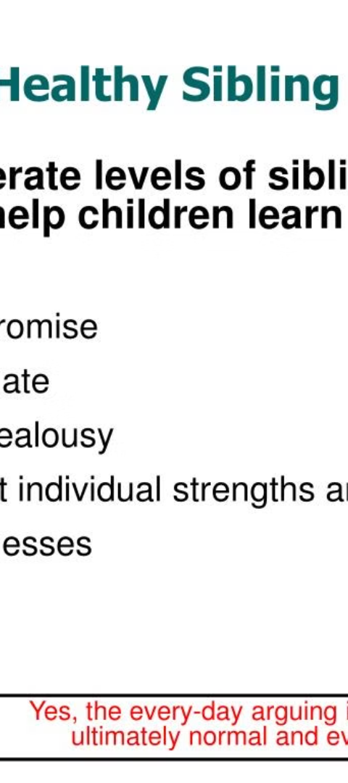
Cultural Influences on Sibling Rivalry
Communication Patterns
Family Structure
Cultural expectations contribute to variations in communication patterns and expectations within diverse family contexts, impacting the manifestation of sibling rivalry.
Parenting styles, family structure, and cultural factors play crucial roles in shaping the dynamics between siblings.

Slide 6




Qualitative Insights
Verbal Conflicts
Verbal conflicts are a common manifestation of sibling rivalry, contributing to the emotional intricacies within sibling relationships.
Competition for Achievements
Siblings often engage in a subtle yet persistent race for accomplishments, contributing to ongoing feelings of rivalry.
Subtle Undermining Behavior
Instances of subtle teasing, belittlement, or efforts to undermine each other's achievements contribute to a pervasive atmosphere of rivalry within sibling relationships.

Slide 7
Data Analysis Techniques
1
2
Data Familiarization
Coding
3
4
Identification of Themes
Refinement and Review

Slide 8
Comprehensive Understanding
Thick Description
To enhance the interpretive depth of the analysis, thick description was employed, providing detailed contextual information and illustrative examples within each theme.
Cross-Validation
To enhance the reliability and credibility of the qualitative findings, cross-validation was conducted, comparing themes and interpretations across multiple researchers within the team.

Slide 9
References
Bandura, A. (1977). Social learning theory. Prentice-Hall. Dunn, J., & Munn, P. (1986). Siblings and the development of prosocial behaviour. International Journal of Behavioral Development, 9(3), 265-284.
Erikson, E. H. (1964). Childhood and society.
Norton. McHale, S. M., Updegraff, K. A., & Whiteman, S. D. (2012). Sibling relationships and influences in childhood and adolescence. Journal of Marriage and Family, 74(5), 913-930.
Stocker, C. M., McHale, S. M., & Karniol, R. (1993). Children's perceptions of relationships with siblings, friends, and mothers: Comparisons, contrasts, and implications for social development.
Merrill-Palmer Quarterly, 39(3), 460-477. Sulloway, F. J. (1996). Born to rebel: Birth order, family dynamics, and creative lives.

