Slide 1
THE IMPACT OF EMPLOYEE ENGAGEMENT ON JOB SATISFACTION: A STUDY IN THE INDIAN HEALTHCARE SECTOR
Mr.Vikas sharma 1, Dr. Nirbhan Singh2
1Madhav Institute of Technology & Science, Gwalior, M.P., India
vgpanditjii121@gmail.com 2Madhav Institute of Technology & Science, Gwalior, M.P., India
drnirbhansingh@mitsgwalior.in

Slide 2
INTRODUCTION
The health sector is a vital support of any country's development, having a direct bearing on the health of its people and a major role in socio-economic development. In nations such as India, where the health scenario is characterized by diversity and disparity, the significance of this sector cannot be overemphasized.
Medical practitioners in India encounter a variety of challenges that impact their professional and personal lives. Long working hours, inadequate staffing, emotional and physical burnout, and stress of working under high-stakes conditions are ubiquitous problems throughout the industry.
The purpose of this research is to investigate the influence of employee engagement on job satisfaction in the Indian healthcare industry. Through an analysis of the most important drivers of engagement, including organizational support, recognition, work-life balance, and professional development, the study attempts to determine effective strategies that can be used to develop a more engaged and satisfied workforce.
The importance of this research is highlighted by what the COVID-19 pandemic has taught us, which visited historic unprecedented challenges upon healthcare systems globally. In India, the pandemic put tremendous pressure on a strained healthcare system, showing the strength and commitment of healthcare workers while revealing their vulnerabilities.

Slide 3
LITERATURE REVIEW
Building on Kahn's concepts, Schaufeli and colleagues (2002) illustrated engagement as a condition of vigor, dedication, and absorption in work. Healthcare, which is an emotionally demanding profession, tends to require employees to bring more than professional skills to their job—it asks for their resilience and empathy too.
Job satisfaction is not exactly the same direction. As Locke (1976) defined it, it is a positive affective state that stems from one's job or work life. It addresses how satisfied employees feel with their jobs. Both are influenced by two general categories: intrinsic factors, like autonomy, professional development, and fulfilling work, and extrinsic factors, like compensation, benefits, and policies at work.
By contrast, content employees are more inclined to remain productive, as they find pleasure and pride in what they do. Saks (2006) demonstrated that engagement is a valid predictor of satisfaction in all sectors, including health care. This is especially significant in emotionally charged jobs such as those in the health care profession, where experts gain from feeling accomplished and accepted.

Slide 4
CONCEPTUAL FRAMEWORK
The conceptual framework for this study is built upon two core constructs: employee engagement and job satisfaction.
These constructs are interconnected and play a significant role in shaping organizational performance, particularly in the healthcare sector, where the well-being of employees directly impacts patient outcomes.
By exploring the underlying factors that drive engagement and satisfaction, this framework provides a foundation for examining the relationship between the two concepts in the Indian healthcare context.

Slide 5
HYPOTHESIS DEVELOPMENT
H1: Higher levels of employee engagement are positively associated with greater job satisfaction among healthcare professionals in India.
H2: Organizational support has a direct positive impact on employee engagement.
H3: Recognition and rewards significantly enhance employee engagement, which, in turn, improves job satisfaction.
H4: Work-life balance positively influences both engagement and satisfaction levels.
H5: Opportunities for professional growth contribute to higher levels of engagement and satisfaction.

Slide 6
RESEARCH METHODOLOGY
Research Design: The study employs a mixed-methods research design, integrating both quantitative and qualitative approaches to provide a holistic understanding of the engagement-satisfaction relationship.
Population Target: The target population comprises healthcare professionals working in various capacities within Indian hospitals and clinics, including doctors, nurses, administrative staff, and paramedical workers.
Sampling Method: A stratified random sampling technique is adopted to ensure representation across various demographic and professional subgroups.
Data Collection Methods: Quantitative data is collected using structured surveys designed to measure employee engagement and job satisfaction.
Data Analysis Methods: Statistical tools, including regression analysis and correlation studies, are employed to examine the relationship between employee engagement and job satisfaction. The analysis focuses on identifying significant predictors of satisfaction and quantifying the strength of relationships between key variables.

Slide 7
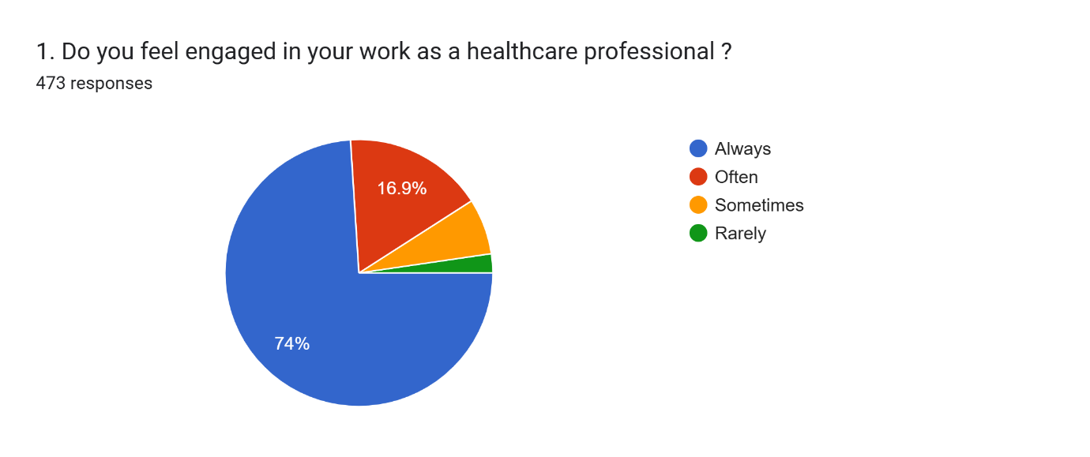
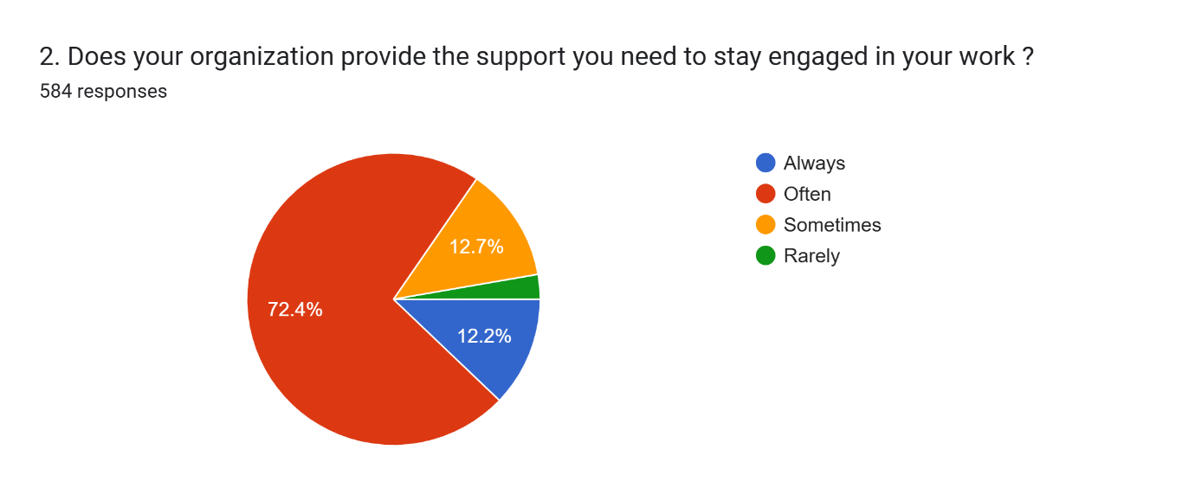
Qualitative Analysis
The integration of quantitative and qualitative findings ensures triangulation, enhancing the validity and reliability of the study. By combining numerical data with rich, descriptive narratives, the methodology provides a comprehensive perspective on the research problem.

Slide 8
ETHICAL CONSIDERATIONS
Informed Consent: Participants are provided with detailed information about the study's purpose, methods, and confidentiality measures. Consent is obtained before participation.
Confidentiality: Responses are anonymized to protect the privacy of participants. Data is stored securely and used exclusively for research purposes.
Voluntary Participation: Participation is entirely voluntary, and individuals have the right to withdraw at any stage without any consequences.
Bias Avoidance: Measures are taken to minimize researcher bias during data collection, analysis, and interpretation, ensuring the objectivity of the findings.

Slide 9
LIMITATIONS OF THE METHODOLOGY
Regional Constraints: While efforts are made to include professionals from diverse regions, the sample may not fully represent the entire Indian healthcare sector.
Cross-Sectional Design: The study captures data at a single point in time, potentially overlooking longitudinal trends in engagement and satisfaction.
Participant Availability: Healthcare professionals' busy schedules may limit participation, especially in rural or underserved areas.

Slide 10
CONCLUSION
This study highlights the critical role of employee engagement in enhancing job satisfaction within the Indian healthcare sector.
Through the exploration of key drivers such as organizational support, recognition, work-life balance, and professional growth opportunities, it becomes evident that fostering engagement is not only beneficial for healthcare professionals but also essential for improving patient care and organizational outcomes.
The findings underscore that engaged employees demonstrate higher levels of commitment, resilience, and motivation, which directly contribute to their overall satisfaction with their roles.

Slide 11
REFERENCES
Kahn, W. A. (1990). Psychological conditions of personal engagement and disengagement at work. Academy of Management Journal, 33(4), 692–724. https://doi.org/10.2307/256287
Locke, E. A. (1976). The nature and causes of job satisfaction. In M. D. Dunnette (Ed.), Handbook of Industrial and Organizational Psychology (pp. 1297–1349). Chicago: Rand McNally.
Schaufeli, W. B., Salanova, M., González-Romá, V., & Bakker, A. B. (2002). The measurement of engagement and burnout: A two-sample confirmatory factor analytic approach. Journal of Happiness Studies, 3, 71–92. https://doi.org/10.1023/A:1015630930326
Saks, A. M. (2006). Antecedents and consequences of employee engagement. Journal of Managerial Psychology, 21(7), 600–619. https://doi.org/10.1108/02683940610690169
Macey, W. H., & Schneider, B. (2008). The meaning of employee engagement. Industrial and Organizational Psychology, 1(1), 3–30. https://doi.org/10.1111/j.1754-9434.2007.0002.x

Slide 12
THANK YOU

