Slide 1
Analysis of the Influence of Electronic Payments on Consumer Purchasing Habits within India's Retail Sector
Mr. Avi Jain 1, Dr. Nirbhan Singh2
1Madhav Institute of Technology & Science, Gwalior, M.P., India
avijainnahata@gmail.com
2Madhav Institute of Technology & Science, Gwalior, M.P., India
drnirbhansingh@mitsgwalior.in

Slide 2
Introduction
In India, the quick digitization of financial transactions has changed how customers interact with retail establishments. The rise of electronic payment methods, such as Unified Payments Interface (UPI), mobile wallets, and credit and debit cards, has drastically changed how consumers make purchases.
Background of Electronic Payments in India: The payment ecosystem in India has changed significantly in the last ten years. Electronic payment systems are gradually replacing traditional cash-based transactions, which historically dominated retail business.
Evolution of Consumer Purchasing Habits in India: The advent of digital payments has brought about a dramatic change in consumer purchasing behavior. Due to insufficient banking infrastructure, security concerns, and a lack of financial awareness, Indian customers have always preferred cash transactions.

Slide 3
Literature Review
Numerous scholarly and business publications have addressed India's transition to digital transactions. Sharma and Gupta (2021) claim that the Unified Payments Interface (UPI), rising smartphone adoption, and reasonably priced internet connection have all contributed to India's digital payment landscape's extraordinary expansion.
In a similar vein, Mehta et al.'s (2020) research highlights how government regulations might encourage cashless transactions. The growth of digital payments was accelerated by the 2016 demonetization program, which resulted in the withdrawal of high-denomination currency notes.
The incorporation of electronic payments into e-commerce platforms is another important factor influencing consumer behavior. According to a study by Reddy et al. (2020), the use of digital payments has been closely associated with the growth of online purchasing. Due of the quickness, security, and availability of special online discounts, consumers favor digital transactions.

Slide 4
Conceptual Framework
Independent Variables (Electronic Payment Factors): These are the main elements that determine the features of electronic payments and how they affect the buying patterns of customers.
Mediating Variable: Consumer Perception & Trust: This variable serves as a link between consumer purchase patterns and the use of electronic payments. Customers' desire to engage in frequent electronic transactions is influenced by their impression of and confidence in digital payment systems.
Dependent Variables (Consumer Purchasing Habits): These are the outcomes that reflect how electronic payments influence consumer behavior in India's retail sector.

Slide 5
Research Methodology
Research Approach: This study adopts a mixed-methods approach, incorporating both quantitative and qualitative research methods.
Research Design: This study follows a descriptive and causal research design to explore the relationship between electronic payments and consumer purchasing behavior.
Sampling Techniques: A combination of probability and non-probability sampling methods will be used to select participants for the study.
Data Collection Methods: A combination of primary data collection and secondary data analysis will be used to obtain comprehensive insights.
Data Analysis Methods: An organized way for examining how electronic payments affect customer buying patterns in India's retail industry is offered by this study methodology.

Slide 6
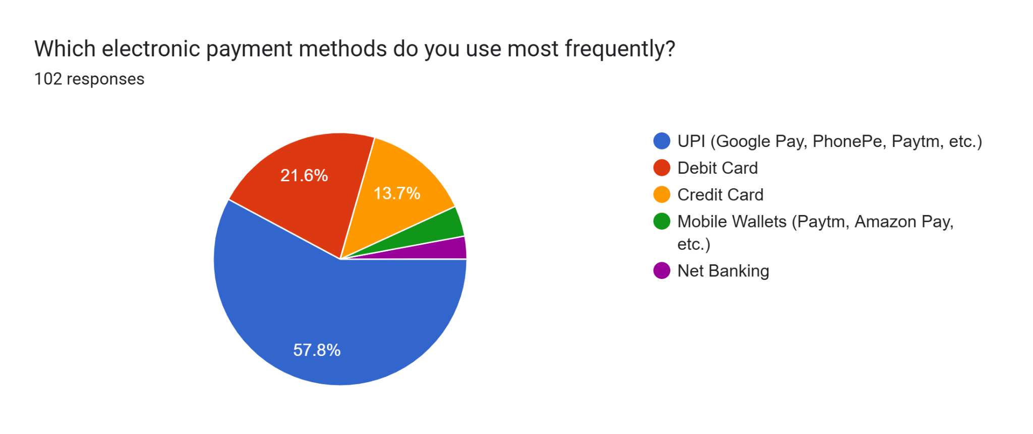
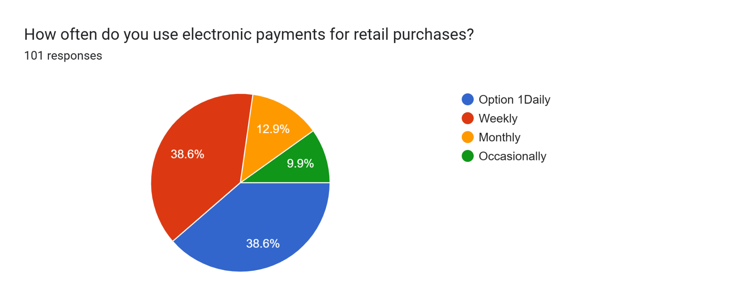
Data Analysis

Slide 7
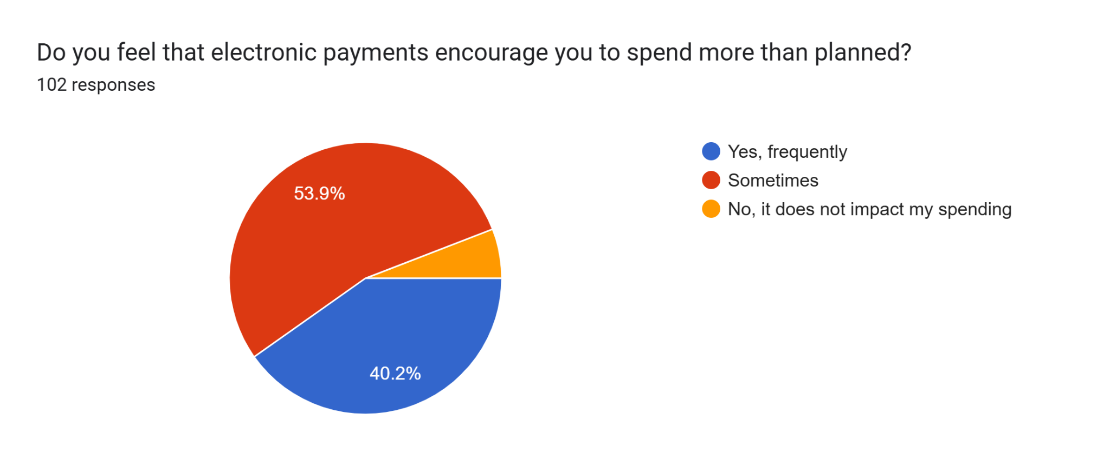
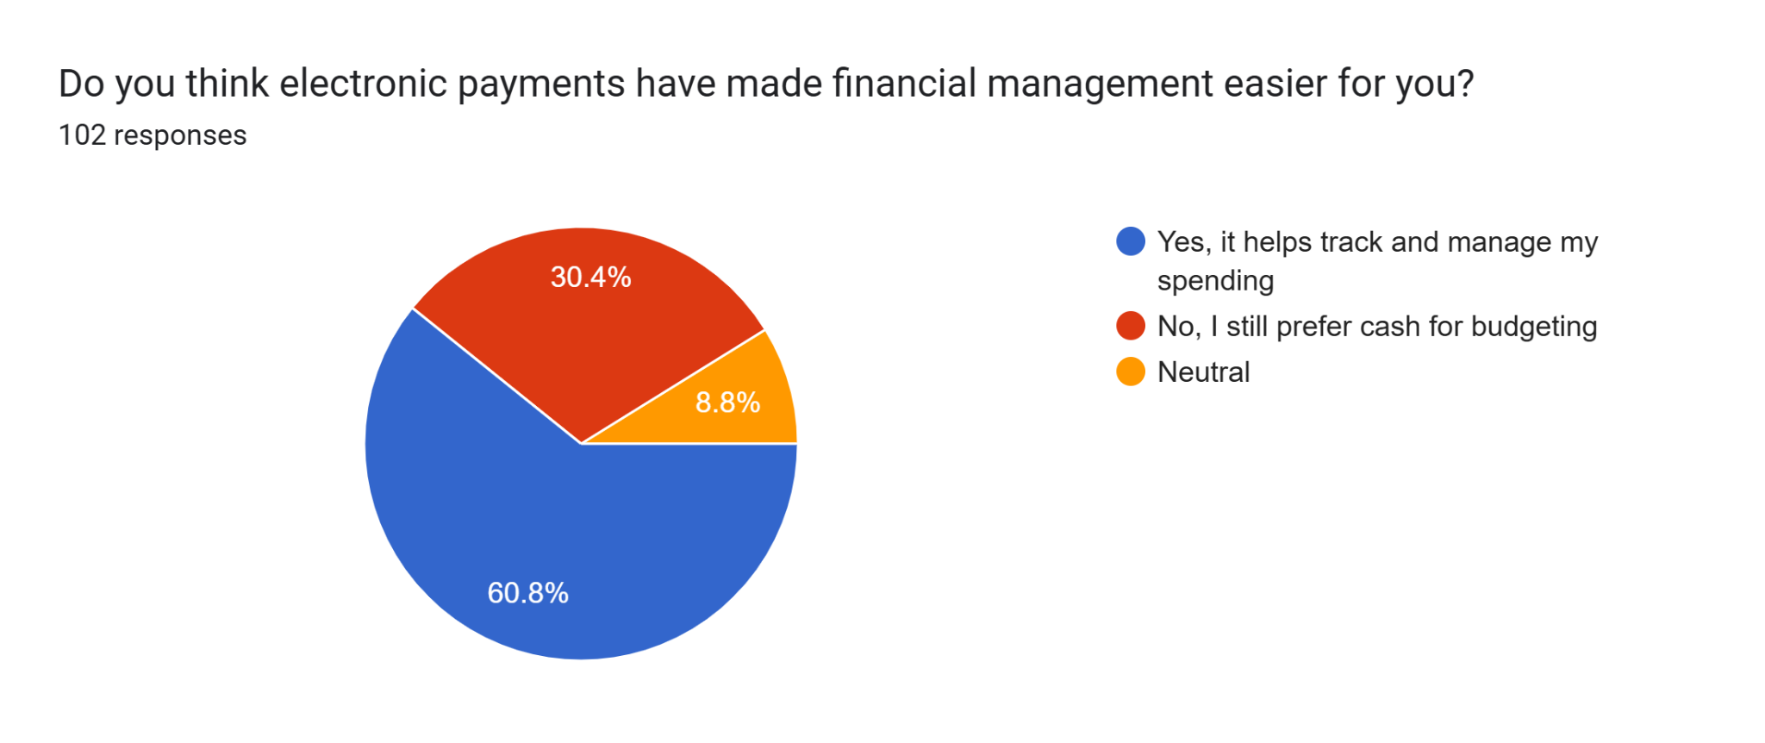

Slide 8
Discussion
Increased Convenience and Transaction Speed: The results of the study show that one of the main reasons why customers choose electronic payments over cash is convenience. Debit/credit cards, UPI, and mobile wallets have made it possible to make payments instantly, which has greatly decreased the need for actual currency.
Influence on Spending Patterns and Impulse Purchases: Digital payments were positively correlated with more spending, according to the study. Due to the simplicity of transactions and psychological distance from cash, several respondents acknowledged that using electronic payments encourages them to spend more.

Slide 9
References
Bharadwaj, S., & Pani, M. (2019). Digital divide and its impact on e-commerce adoption in India. Indian Journal of Marketing, 49(2), 23-37. https://doi.org/10.17010/ijom/2019/v49/i2/145234
Brynjolfsson, E., Hu, Y. J., & Rahman, M. S. (2013). Competing in the age of omnichannel retailing. MIT Sloan Management Review, 54(4), 23-29.
Chopra, S., & Meindl, P. (2016). Supply chain management: Strategy, planning, and operation (6th ed.). Pearson Education.
Dholakia, R. R., & Kshetri, N. (2004). The Indian e-commerce boom: Challenges and opportunities. International Journal of Electronic Business, 2(1), 33-54.
Goswami, S., & Ray, S. (2020). Omnichannel retailing in India: Challenges and strategies for success. Journal of Retailing & Consumer Services, 53, 101993. https://doi.org/10.1016/j.jretconser.2019.101993

Slide 10
Thank you

