Slide 1

Evaluating Respiratory Health Practices and Safety Outcomes Among Petrochemical Workers Using the Andersen Model
IPS ACADEMY
INSTITUTE OF ENGINEERING & SCIENCE
Industrial Safety Engineering
by
KUNWAR HIMANSHU
Under the Supervision of
DR. SUMIT BHATIYA
PROFESSOR

Slide 2
CONTENT
ABSTRACT
INTRODUCTION
LITERATURE REVIEW
AREA OF STUDY
PROBLEM FORMULATION
METHODOLOGY
OBSERVATION AND CALCULATIONS
INTERPRETATIONS
RESULTS AND DISCUSSIONS
REFERENCES

Slide 3
ABSTRACT
This study used the Anderson Behavioural Model to analyze factors influencing Low Flow Rate (LFT) and Peak Expiratory Flow Rate (PEFR) among petrochemical workers. A questionnaire based on the model and multi-stage sampling surveyed workers across city plants. Chi-square tests, logistic regression and binary logistic regression analyses were used to investigate the factors influencing lung function tests. The education (college/university: OR=0.142–0.348, p=0.003–0.0034) and medical affordability significantly impacted participation in lung function tests (PFT). Other factors included self-care (OR=4.92), daily activity (OR=7.68, p=0.02), and concern/depression (OR=14.40, p<0.0001). Gender differences showed 76.7% male vs. 98% female participation. To improve PFT engagement, the study highlights the need for education, financial support, respiratory health awareness, and psychological aid. Addressing financial and knowledge barriers through health checks and training can mitigate risks from chemical exposure.

Slide 4
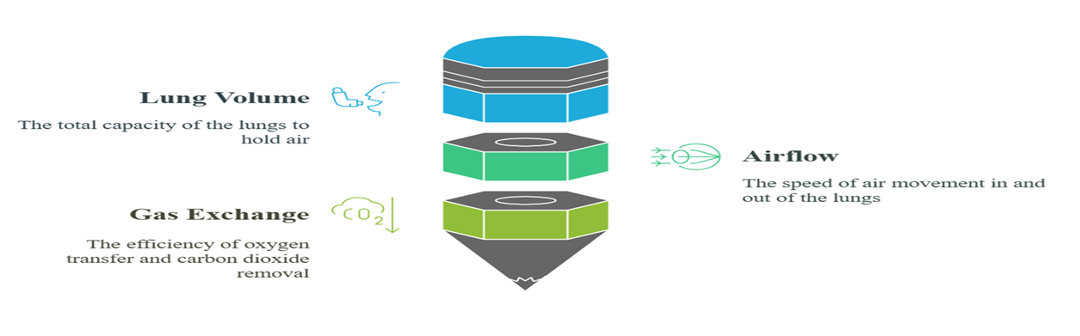
INTRODUCTION
A lung function test, also known as a pulmonary function test (PFT), measures how well your lungs are working. The National Health Mission (NHM) recommends an annual lung function check on people 40 years old and above. According to a survey report in 2016, 251 million people had COPD [3], and the number reportedly increased with population ageing. These tests assess various aspects of lung function, including:
Lung Volume: The total amount of air your lungs can hold.
Airflow: How quickly you can move air in and out of your lungs.
Gas Exchange: How efficiently your lungs transfer oxygen into your blood and remove carbon dioxide.
Figure 1: Key Components of Lung Function test.

Slide 5

OBJECTIVES OF THE PROJECT
Identify predisposing, enabling, and need-based factors affecting LFT compliance.
Assess the relationship between these factors and respiratory health outcomes, including Peak Expiratory Flow Rate (PEFR) and Body Mass Index (BMI).
Provide insights to improve workplace safety practices and respiratory health monitoring for petrochemical workers exposed to hazardous environmental and occupational risks.
Figure 2: project objective

Slide 6
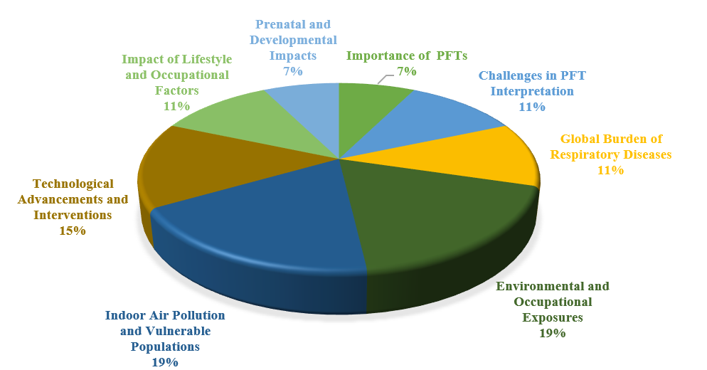
LITERATURE REVIEW
BASE PAPER: [15] Jiang et. al. (2023) highlight that Lung function tests (LFTs) are essential for detecting respiratory diseases in middle-aged and elderly populations, with the Healthy China Initiative recommending annual screenings for those over 40. His Research indicates that education level highly influences participation rates, as higher education is linked to better health knowledge and proactive health behaviours. In this research economic factors like healthcare affordability, also play a crucial role in access to LFTs. The findings of the current study support these trends, highlighting the need for targeted interventions to enhance participation in lung function testing and improve respiratory health outcomes in ageing individuals.
[1] Hirzel et. al. (2024) highlight a GIS-based approach to assessing the influence of the urban built environment on cardiac and respiratory outcomes in older adults. His Studies show that elements like building density, proximity to green spaces, and indoor air quality influence cardiovascular and respiratory conditions. He found that the Urban environment affects heart and lung health in the elderly, with factors like building age, location, and indoor air quality playing significant roles.
[2] Li et al. (2024) found that long-term exposure to air pollution significantly increases respiratory mortality risk. A UK Biobank study on 366,478 participants over 13.6 years showed a dose-response relationship, with PM2.5 posing the highest risk and a 44% increase in respiratory deaths at high pollution levels.
Figure 3: Pie chart based on the Literature review types.

Slide 7
LITERATURE REVIEW
[3] Lenssen et. al. (2024) say the impact of aviation-related ultrafine particles (UFP) on respiratory health, particularly in children residing near major airports like Schiphol Airport. His findings were:1. Aviation particles, especially ultra-fine particles (UFP), cause more breathing issues.2. Symptoms include wheezing and needing bronchodilators.3. Children near airports are most affected.
[4] Das and Wiseman (2024) highlighted street dust as a major contributor to urban air pollution. Their study in Toronto found that street sweeping reduced thoracic-sized road dust by 76%, lowering harmful metals like copper and zinc. Traffic volume and road conditions influenced dust levels, emphasizing the role of advanced sweeping in improving air quality and respiratory health.
[5] Pan et al. (2024) highlighted gas cooking as a significant source of indoor air pollution, linked to respiratory symptoms like shortness of breath (odds ratio = 1.38) and wheezing (odds ratio = 1.32). The study, involving 4,337 adults in 9 countries, found worsened symptoms among those using both gas hobs and ovens, bottled gas, and cooking over 60 minutes daily. This underscores the need for further research and policy measures to address indoor air pollution and protect respiratory health.
[6] Lin et al. (2024) reported that short-term increases in PM2.5 are linked to higher asthma and COPD hospitalizations and ED visits. Using the NYS SPARCS database (2014–2019), the study showed that after the 2017 Federal Tier 3 vehicle regulations, respiratory events tied to PM2.5, primary organic carbon (POC), and secondary organic carbon (SOC) increased, especially among vulnerable groups like children, seniors, and minorities. The findings stress the need for further investigation into pollution sources and health impacts.
[7] Jason et al. (2024) highlighted that traditional studies often miss key temporal and spatial variations. Their study, using data from 3,386 individuals with asthma or COPD in California, found that increased exposure to NO2, PM2.5, and O3 raised short-acting beta-agonist (SABA) use, directly linking air pollution to respiratory symptoms. This underscores the value of digital health sensors and the need for further research into causal mechanisms to improve public health strategies.
[8] Jawaa et al. (2024) highlighted Dhaka's severe air pollution, with PM2.5 levels exceeding WHO limits. The study found sulfur as the highest trace element, with peak pollution at midday, driven by soil dust and sulfur-rich petroleum. Males had higher respiratory doses during heavy exercise. These findings are crucial for developing strategies to reduce pollution in Dhaka.

Slide 8
LITERATURE REVIEW:
[9] Parvizi et al. (2024) found that 45% of female cooks in sub-Saharan Africa used LPG with polluting fuels, while 10% used LPG alone. Those stacking fuels had higher risks of respiratory and eye issues, with second-hand smoke linked to chest tightness and coughing. A full transition to LPG could reduce exposure to harmful pollutants and offer health benefits.
[10] Wu et al. (2024) found that air pollution contributes significantly to the global disease burden, especially affecting respiratory and cardiovascular health. While physical activity benefits lung function, outdoor exercise can increase pollution exposure, raising health concerns. Inconsistent findings on the interaction between air pollution and exercise highlight the need for more studies to establish safe pollution thresholds during outdoor activity.
[11] Abellan et al. (2024) found that urban environmental factors during pregnancy, such as air pollution, noise, and green space access, affect children's respiratory health. Higher air pollution (especially PM2.5) was linked to reduced lung function and increased wheezing risk, with poor outcomes in areas with high pollution and low green spaces.
[12] Li et al. (2024) found that exposure to air pollution and low-grade inflammation negatively impact lung function. Using data from 276,289 UK Biobank participants, they linked higher pollution levels (NO2, NOx, PM2.5) to lower lung function and higher inflammation. Inflammation further worsened lung function, with those exposed to both high pollution and inflammation having the poorest lung health.
[13]Jin et al. (2024) highlighted the impact of microplastics (MPs) on lung health, particularly through cellular ageing. They found that PVC MPs caused oxidative stress and cellular ageing in lung cells, leading to inflammation and physical impairment in mice. The study underscores MPs' potential role in lung diseases.
[14] Huang et al. (2024) researched the impact of incense smoke, especially auramine, on lung cancer cells. They found that auramine affects non-small cell lung cancer (NSCLC) by stabilizing DNA structures and improving chemotherapy responses in TP53-mutant cells, providing insights into overcoming chemoresistance in lung cancer treatment.

Slide 9
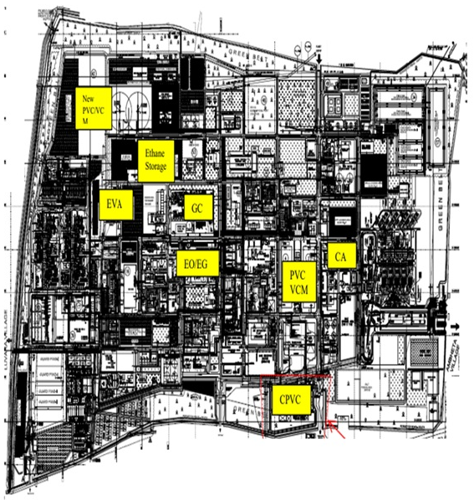
AREA OF STUDY
VCM & PVC – Increases lung cancer, bronchitis, and fibrosis risk.
Chlor-Alkali – Causes lung damage, COPD, and edema.
GCU – Heightens lung irritation and cancer risk.
EO/EG – Triggers lung inflammation and irritation.
HDPE & EVA – Leads to fume fever and fibrosis.
EPRU – Poses asphyxiation and irritation risks.
PTA & PET – Causes fibrosis and inflammation.
Power Plant – Triggers COPD, bronchitis, and cancer.
Figure 4: Plant Complex Layout

Slide 10
PROBLEM FORMULATION
In India, legal disputes between retired employees and employers concerning health issues contracted during employment often revolve around claims for compensation due to occupational diseases. Notable cases and legal provisions include:
Anju vs. Employees State Insurance Corporation (2020):
  Case Summary: The petitioner sought compensation under Sections 75 and 77 of the Employees' State Insurance Act, 1948, following her husband's death due to an occupational disease contracted during his employment as a loader.
  Outcome: The court examined the eligibility for compensation based on the nature of the disease and its connection to the deceased's employment.
2. Occupational Health & Safety Association vs. Union of India & Ors (2014):
Case Summary: The petitioner highlighted the lack of proper occupational health services in coal-fired thermal power plants, emphasizing the need for adequate facilities to address health issues arising from employment.
Outcome: The Supreme Court acknowledged the necessity for stringent enforcement of existing health and safety regulations to protect workers from occupational diseases.
Challenges for Retired Employees:
Retired employees often face difficulties in proving that their health issues are directly linked to their past employment, especially when symptoms emerge years after retirement. The latency period of certain occupational diseases complicates the establishment of a direct causal relationship.
While India's legal framework acknowledges occupational diseases and provides avenues for compensation, retired employees may encounter challenges in pursuing claims due to evidentiary requirements and the time elapsed since exposure.

Slide 11
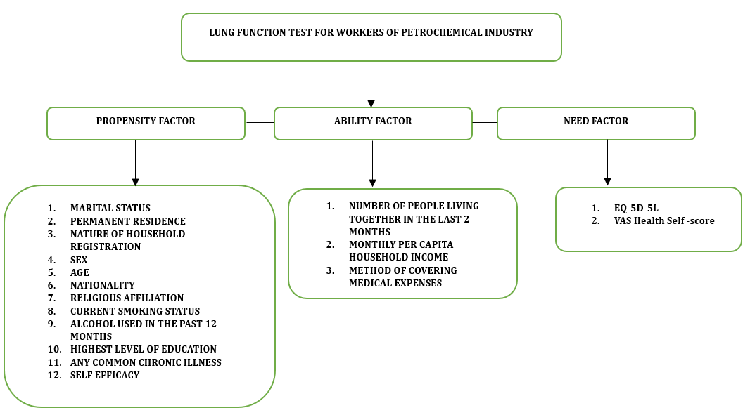
METHODOLOGY
Anderson Model: The Andersen Model, also known as Health Service Utilization, was developed by Ronald M. Anderson in 1968. It is a comprehensive framework used to understand the factors influencing individuals’ use of health services. It is particularly valuable for identifying and addressing disparities in healthcare access.
Figure 5: Anderson Model Framework.

Slide 12
METHODOLOGY
Peak Expiratory Flow Rate: PEFR is a simple yet effective way to assess lung function. It is measured in litres per minute (L/min) and reflects the strength and efficiency of the respiratory muscles and the airways. A higher PEFR indicates better lung function, while a lower PEFR may suggest airway obstruction or other respiratory issues.
An inclusion Criteria for the Anderson Model & Peak Expiratory Flow Rate
Must be an Indian nationality.
Permanent residence in India.
working in the petrochemical industry for at least 5 years.
Voluntary participation in the study.
B. Exclusion Criteria for Anderson method:
Person who was mentally sick or disoriented.
People who were taking part in other comparable research initiatives elsewhere.
People who refused to cooperate were the exclusion criteria. A mix of systematic checks and self-reporting was the major technique used to assess mental health status (certain local health institutions retain records).
C. Exclusion Criteria for Peak Expiratory Flow Rate:
Not taking non-hazardous chemicals.
People with known renal, breathing, endocrine, coronary, and nervous system ailments were left out of the study.
People who were taking part in other comparable research initiatives elsewhere.
People who refused to cooperate were the exclusion criteria.

Slide 13
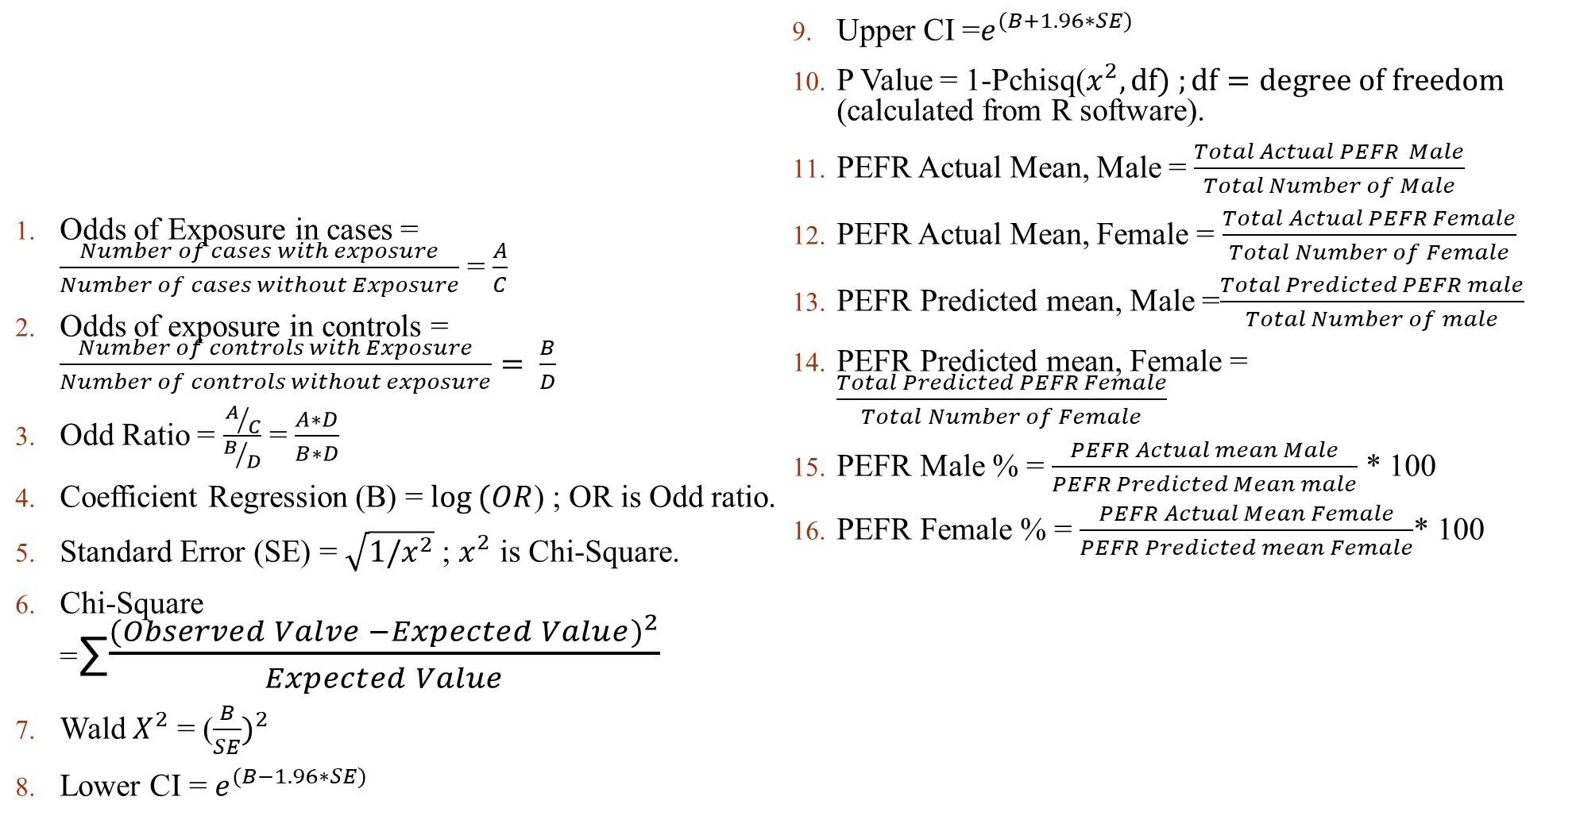
Formula Used in calculation
Odds of Exposure in cases = $\frac{Number of cases with exposure}{Number of cases without Exposure}$ = $\frac{A}{C}$
Odds of exposure in controls = $\frac{Number of controls with Exposure}{Number of controls without exposure}= \frac{B}{D}$
Odd Ratio = $\frac{A/C}{B/D}$ = $\frac{A∗D}{B∗D}$
Coefficient Regression (B) = $\log{(OR}$) ; OR is Odd ratio.
Standard Error (SE) = $\sqrt{1/x^{2}}$ ; $x^{2}$ is Chi-Square.
Chi-Square =∑$\frac{{(Observed Valve −Expected Value)}^{2}}{Expected Value}$
Wald $X^{2}$ = ($\frac{B}{SE})^{2}$
Lower CI = $e^{(B−1.96∗SE)}$
Upper CI =$e^{(B+1.96∗SE)}$
P Value = 1-Pchisq($x^{2}, df) ;df=degree of freedom$ (calculated from R software).
PEFR Actual Mean, Male = $\frac{Total Actual PEFR Male}{Total Number of Male}$
PEFR Actual Mean, Female = $\frac{Total Actual PEFR Female}{Total Number of Female}$
PEFR Predicted mean, Male =$\frac{Total Predicted PEFR male}{Total Number of male}$
PEFR Predicted mean, Female = $\frac{Total Predicted PEFR Female}{Total Number of Female}$
PEFR Male % = $\frac{PEFR Actual mean Male}{PEFR Predicted Mean male}$ * 100
PEFR Female % = $\frac{PEFR Actual Mean Female}{PEFR Predicted mean Female}$* 100
OUTCOMES
DISEASE (CASE) | NO DISEASE (CONTROL)
EXPOSURE | EXPOSED | A | B
 | UNEXPOSED | C | D

Slide 14
OBSERVATIONS AND CALCULATIONS
Table 1: Adjustable preps for Monovariate and Multifaceted analyses.
Factors | Parameters | Allocation
Tendency Aspect | Matrimonial status Place of permanent house Characteristics of household Sexuality Age Nationality Religious belief Cigarette habit Have you Gobbled Liquor in the last 12 months? BMI (kg/m2) The uppermost level of schooling. Any Usual chronic diseases (e.g. diabetes, high blood pressure, etc.) Self-Efficacy | Married = 0; Other = 1 Urban = 0; Rural = 1 Non-agro = 0; Agro = 1 Male = 0; Female = 1 26–44 = 0; ≥45 = 1 Indian = 0; Other racial = 1 No religious affiliation = 1; Religious affiliation = 0 Non- smoker = 0; Smoker = 1 Never drink = 0; Drink = 1 <18.5 = 0; 18.5–24.9 = 1; ≥25 = 2 Elementary school and below = 0; Junior high school, Senior high school, and secondary school = 1; College and above = 2 No = 0; Yes = 1 >30(high grouping) = 0; 20–30 (medium grouping) = 1; <20 (low grouping) = 2 (completely oppose = 1; oppose = 2; neutral = 3; support = 4; completely support = 5)
Aptitude aspect | Count of people cohabiting during the previous 2 months Monthly per capita household income (Rupees) How medical costs are Covered? | 0–1 individual = 0; 2–3 individuals = 1; >4 individuals = 2 ≤20000 = 0; 20001–30000 = 1; ≥30001 = 2 Self-sustained = 0; other = 1
Necessity aspect | EQ-5D-5L Movement Self-care Daily action Agony /discomfort Concern /depression VAS | Problematic = 1; No problem = 0 Problematic = 1; No problem = 0 Problematic = 1; No problem = 0 Problematic = 1; No problem = 0 Problematic = 1; No problem = 0 80–100 score (high category) = 0; 61–79 score (medium category) =1; 0–60 score (low category) = 2
Dependent parameter | Lung Performance Assessment Status | Has not Executed the deed = 0; Has Executed the deed at least one time = 1.

Slide 15
Table 2: Statistical features and consequences of monovariate analysis of lung purpose assessments in petrochemical industry workers (n=300).
Benchmarks | Sharing characteristics | Proportion of persons | Composition ratio (%) | proportion of persons tested | Detection rate (%) | χ2 | P
Matrimonial status | Wedded Other | 260 40 | 86.7 13.3 | 190 21 | 73.0 52.5 | 7.035 | 0.008
Count of people cohabiting during the previous 2 months | 0–1person 2-3person ≥4 persons | 146 94 60 | 48.7 31.3 20.0 | 110 71 30 | 75.3 75.3 50 | 14.86 | 0.0006
Place of permanent house | City Village | 190 110 | 63.3 36.7 | 164 57 | 86.3 51.8 | 42.74 | 0.00011
Nature of household | Non-agricultural Agricultural | 290 10 | 96.7 3.3 | 204 7 | 70.3 70 | 0.0006 | 0.98
Monthly per capita household income (Rupees) | ≤20000 20001–30000 ≥30001 | 16 61 223 | 5.3 20.3 74.4 | 7 58 146 | 43.7 95.0 65.5 | 25.85 | <0.00001
Gender | Male Female | 150 150 | 50.0 50.0 | 123 88 | 82.0 58.7 | 19.6 | 0.00001
Age | 26–44 ≥45 | 298 2 | 99.3 0.7 | 209 2 | 70.1 100 | 0.84 | 0.36
Ethnicity | Indian Other nationalities | 300 0 | 100 0.0 | 211 0 | 70.3 0.0 | N/A | N/A
Religious persuasion | Non-Religious persuasion Religious persuasion | 290 10 | 96.7 3.3 | 208 3 | 98.6 30 | 8.06 | 0.0045
Cigarette habit | No Cigarette habit Cigarette habit | 190 110 | 63.3 36.7 | 135 76 | 71.0 69.1 | 0.13 | 0.72
Over the past 12 months, have you consumed alcohol? | Never consumed in the past 12 months Consuming | 210 90 | 70.0 30.0 | 148 63 | 70.5 70.0 | 0.007 | 0.93
BMI (kg/m2) | <18.5 18.5–24.9 ≥25 | 116 126 58 | 38.7 42.0 19.3 | 73 109 29 | 62.9 86.5 59.0 | 30.34 | 0.0024
The Uppermost level of schooling | Preparatory school Intermediate school and secondary school College and above | 167 93 40 | 55.7 31.0 13.3 | 129 69 13 | 77.2 74.2 32.5 | 31.93 | 0.0011
How medical costs are covered? | self-sustained Non-self-sustained | 112 188 | 37.3 62.7 | 63 148 | 56.3 78.7 | 16.99 | 0.00004
Retired or not | No Yes | 300 0 | 100 0.0 | 211 0 | 70.3 0.0 | N/A | N/A
Any Usual chronic diseases (e.g. diabetes, hypertension, etc.) | No Yes | 163 137 | 54.3 45.7 | 118 93 | 72.4 67.9 | 0.73 | 0.4
VAS | High Category Medium Category Low Category | 171 116 13 | 57.0 38.7 4.3 | 123 85 3 | 71.9 73.3 23.1 | 14.60 | 0.0007
Self-Efficacy | High Category Medium Category Low Category | 154 134 12 | 51.3 44.7 4 | 118 88 5 | 76.6 65.7 41.7 | 9.042 | 0.011

Slide 16
Table 3: 5D valuation standing of the worker's population tested for lung purposes.
Dimensionality | No concern |  |  |  | Concern |  |  |  | χ² | P
 | Persons Proportion | Percentage of person proportion (%) | Tested People Proportion | Detection rate (%) | Persons Proportion | Percentage of person proportion (%) | Tested People Proportion | Detection rate (%)
Movement | 300 | 100 | 211 | 70.3 | 0 | 0.0 | 0 | 0.0 | 0 | 1.0
Self-care | 221 | 73.7 | 176 | 79.6 | 79 | 26.3 | 35 | 44.3 | 34.8 | 0.00045
Day-to-day action | 236 | 78.7 | 189 | 80.1 | 64 | 21.3 | 22 | 34.4 | 50.4 | <0.00001
Pain/ discomfort | 193 | 64.3 | 126 | 65.3 | 107 | 35.7 | 85 | 79.4 | 6.61 | 0.01
Anxiety/depression | 231 | 77 | 193 | 83.6 | 69 | 23 | 18 | 26.1 | 84.08 | <0.00001

Slide 17
Table 4: Multifaceted investigation of lung performance assessment in petrochemical industry workers.
Indicator | B | Standard error | Waldχ² | P | OR | OR95%C.I.
 |  |  |  |  |  | Upper limit | Lower limit
The Uppermost level of schooling (comparison group = primary school and below)
Intermediate schools | -0.166 | 0.300 | 0.306 | 0.580 | 0.847 | 1.526 | 0.470
College and above | -1.952 | 0.384 | 25.840 | 0.0034 | 0.142 | 0.302 | 0.067
Way of payment for Treatment costs (comparison group = self-pay)
Non-self-sustained | -1.057 | 0.261 | 16.401 | 0.0340 | 0.348 | 0.579 | 0.208
EQ-5D-5L Movement (Comparison group = no concern)
Concern | N/A | N/A | N/A | N/A | N/A | N/A | N/A
Self-care (Comparison group = no concern)
Concern | 1.593 | 0.281 | 32.158 | 0.0005 | 4.920 | 8.536 | 2.832
Day-to-day action (Comparison group = no concern)
Concern | 2.040 | 0.315 | 41.941 | 0.0002 | 7.680 | 14.083 | 4.100
Agony/discomfort (Comparison group = no concern)
Concern | -0.720 | 0.284 | 8.927 | 0.0030 | 0.487 | 0.085 | 0.280
Concern/depression (Comparison group = no concern)
Concern | 2.670 | 0.326 | 67.080 | <0.0001 | 14.400 | 27.300 | 7,59
Self-efficacy (Comparison group = High Category)
Medium Category | -0.560 | 0.283 | 3.916 | 0.0480 | 0.571 | 0.956 | 0.315
Low Category | -1.523 | 0.616 | 6.113 | 0.0130 | 0.218 | 0.729 | 0.065

Slide 18
Table 5: Multi-functional investigation of Peak expiratory flow rate in Petrochemical Industries
Factors | Number of people | Red zone % | Yellow Zone % | Green Zone % | PEFR Actual | PEFR Predicted (%)
 |  |  |  |  | Mean ± SD | Mean ± SD
Male | 150 | 0 | 23.3 | 76.7 | 422.7 ± 78.05 | 93.04 ± 13.30
Female | 150 | 0 | 2 | 98 | 515.6 ± 77.60 | 121.6 ± 10.43
Mean difference |  |  |  |  | 92.9 | 28.56%
Significance | T value |  |  |  | 10.33 | 18.08
 | P value |  |  |  | <0.00001, High | <0.00001, High

Slide 19
INTERPRETATIONS
1. Chi-square (χ²) Test
Increase in χ² value: Indicates a stronger association between the variables (e.g., education level and lung function testing).
Decrease in χ² value: Suggests a weaker association, meaning the variables may not be significantly related.
2. P-value
Decrease in p-value: This means the result is more statistically significant (i.e., the observed effect is less likely due to random chance).
Increase in p-value: Indicates weaker statistical significance, meaning the observed association might have occurred by chance.
3. Standard Error (SE)
Increase in SE: Suggests that the estimated effect (e.g., regression coefficient) is less precise and more variable.
Decrease in SE: Implies greater confidence in the accuracy of the estimated effect.
4. Regression Coefficient (B)
Increase in B: Shows that the independent variable has a stronger positive effect on lung function testing behaviour (e.g., higher education level increases the likelihood of testing).
Decrease in B (negative B): Suggests that the independent variable has a stronger negative effect (e.g., lower self-efficacy reduces the likelihood of testing).
5. Odds Ratio (OR)
OR > 1 (Increase in OR): The likelihood of lung function testing increases when the independent variable changes.
  Example: If OR = 2.205 for "non-self-funded medical expenses," it means people whose medical expenses are covered by insurance are 2.205 times more likely to undergo lung function testing compared to self-payers.
OR < 1 (Decrease in OR): The likelihood of lung function testing decreases when the independent variable changes.
  Example: If OR = 0.397 for "pain or discomfort," it means people experiencing pain are less likely to undergo testing.
6. Wald Chi-square Test
Increase in Wald χ²: Indicates that the independent variable has a more significant impact on lung function testing.
Decrease in Wald χ²: Suggests that the variable’s impact is weaker or not statistically significant.
7. Confidence Interval (CI) for OR
Narrow CI (Decrease in range): Indicates a more precise estimate of the effect size.
Wide CI (Increase in range): Suggests more uncertainty in the estimate.
If CI includes 1 (e.g., 0.95–1.10): The effect may not be statistically significant.
If CI does not include 1 (e.g., 1.2–2.5): The effect is statistically significant.

Slide 20
RESULTS & CONCLUSIONS
1. Factors Affecting Participation in Lung Function Tests:
Education & Awareness: Higher education levels increase participation.
Financial Incentives: Employer-funded tests encourage more participation.
Health Beliefs: Individual perceptions impact willingness to participate.
2. Barriers to Participation:
Health & Psychological Factors: Anxiety, depression, and chronic diseases (e.g., hypertension, diabetes) reduce participation.
Mobility & Relocation: Younger workers may resist relocation due to health concerns.
Self-Efficacy: Lower self-efficacy leads to lower participation.
3. Demographic & Occupational Influences:
Residence & Marital Status: Urban workers participate more.
Exposure & Cultural Beliefs: Occupational exposure and cultural attitudes affect participation.
4. Peak Expiratory Flow Rate (PEFR) Analysis:
Gender Differences: Women had better lung function (98% vs. 76.7% in men).
Mean PEFR Values: Women (515.6 L/min) had significantly higher PEFR than men (422.7 L/min).
5. Recommendations for Increasing Participation:
Address barriers related to education, financial support, and psychological factors to improve lung function test (LFT) participation.

Slide 21
REFERENCES
Hirzel, H. N., & Hirzel, A. H. (2024, February 27). A GIS-based approach to assess the influence of the urban built environment on cardiac and respiratory outcomes in older adults. Building and Environment, 253, 111-362.
Li, Z. H., & Wang, X. M. (2024, March 12). Long-term air pollutants exposure and respiratory mortality: A large. Ecotoxicology and Environmental Safety, 274, 116-176.
Lenssen, E. S., & Jannsen, N. A. (2024, May 17). Beyond the Runway: Respiratory health effects of ultrafine particles from aviation in children. Environment International, 188, 108-759.
Das, S., & Wiseman, C. L. (2024, April 24). Examining the effectiveness of municipal street sweeping in removing road-deposited particles and metal(loid)s of respiratory health concern. Environment International, 187, 108-697.
Pan, H., & Jarvis, D. (2024, January 6). Gas cooking indoors and respiratory symptoms in the ECRHS cohort. International Journal of Hygiene and Environmental Health, 256, 114-310.
Lin, S., Xue, Y., & Thandra, S. (2024, July 20). PM2.5 and its components and respiratory disease healthcare encounters –Unanticipated increased exposure-response relationships in recent years. Environmental Pollution, 360, 124-585.
Su, J. G., & Vuong, V. (2024, June 9). Health effects of air pollution on respiratory symptoms: A longitudinal study using digital health sensors. Environment International, 189, 108-810.
Jawaa, Z. T., Biswas, K. F., & Khan, M. F. (2024, February 6). Source and respiratory deposition of trace elements in PM2.5 at an urban location in Dhaka city. Heliyon, 10, 325-420.
Parvizi, K., Menya, D., & Nix, E. (2024, May 18). Burden of headaches, eye irritation and respiratory symptoms among females stacking LPG with polluting cooking fuels: Modelling from peri-urban Cameroon, Ghana & Kenya. Energy Nexus, 14, 100-304.
Wu, P., Guo, Q., & Zhao, Y. (2024, March 4). Emerging concern on air pollution and health: Trade-off between air pollution exposure and physical activity. Eco-Environment & Health, 3, 202-207.
Abellan, A., & Warembourg, C. (2024, January 12). Urban environment during pregnancy, lung function, wheezing, and asthma in school-age children. The Generation R study. Environmental Pollution, 344, 123-345.
Li , J., Yao, Y., & Shang, B. (2024, September 7). Ambient air pollution, low-grade inflammation, and lung function: Evidences from the UK Biobank. Ecotoxicology and Environmental Safety, 284, 116-998.
Jin, W., Zhang, W., & Tang, H. (2024, February 8). Microplastic exposure causes the senescence of human lung epithelial cells and mouse lungs by inducing ROS signalling. Environment International, 185, 108-489.
Huang, H. Y., & Chen, C. H. (2024, July 3). Incense-burning Smoke ingredient Auramine enhances lincRNA-p21 expression for chemosensitisation in p53-mutated non-small cell lung cancer. Journal of Hazardous Materials, 477, 105-135.
Jiang, H., Feng, B., & Wang, Y. (2023, February 8). Application of Anderson model to analyze the influencing factors of lung function test behaviour in middle-aged and elderly people in China. Dialogues in Health, 2, 100-138.
Yoon, S. H., Song, M. K., & Kim, D. I. (2023, January 1). Comparative study of lung toxicity of E-cigarette ingredients to investigate E-cigarette or vaping product associated lung injury. Journal of Hazardous Materials, 445, 130-454.
Fan, N. C., & Huang, H. Y. (2023, September 4). Association of exposure to environmental vanadium and manganese with lung function among young children: A population-based study. Ecotoxicology and Environmental Safety, 264, 115-430.
Wang, J., Yan, Y., & Si, H. (2023, March 2). The effect of real-ambient PM2.5 exposure on the lung and gut microbiomes and the regulation of Nrf2. Ecotoxicology and Environmental Safety, 254, 114-2023.
Wang, J., Janson, C., & Gislason, T. (2023, January 21). Volatile organic compounds (VOC) in homes associated with asthma and lung function among adults in Northern Europe. Environmental Pollution, 321, 103-121.
Ranzani, O. T., & Bhogadi, S. (2022, May 11). Association of ambient and household air pollution with lung function in young adults in a peri-urban area of South India: A cross-sectional study. Environment International, 165, 107-290.
Li, H., & Zhao, Z. (2022, March 4). Insight into urban PM2.5 chemical composition and environmentally persistent free radicals attributed to human lung epithelial cytotoxicity. Ecotoxicology and Environmental Safety, 234, 113-356.
Yue, H., Yang, X., & Wu, X. (2022, October 6). Maternal NO2 exposure disturbs the long noncoding RNA expression profile in the lungs of offspring in time-series patterns. Ecotoxicology and Environmental Safety, 246, 114-140.
Cordova, J., & Pfeiffer, R. M. (2022, October 12). Tobacco use profiles by respiratory disorder status for adults in the wave 1-wave 4 population assessment of tobacco and health (PATH) study. Preventive Medicine Reports, 30, 16-102.
Hachem, M., & Loizeau, M. (2021, January 1). Short-term association of in-vehicle ultrafine particles and black carbon concentrations with respiratory health in Parisian taxi drivers. Environment International, 147, 106-346.
Nowalk, M. P., & Balasubramani, G. K. (2020, 1 January). Physical health and mental health functional status during and following hospitalization for an acute respiratory illness. Brain, Behavior, & Immunity - Health, 1, 04-100.

Slide 22
THANKYOU!!

