Slide 1
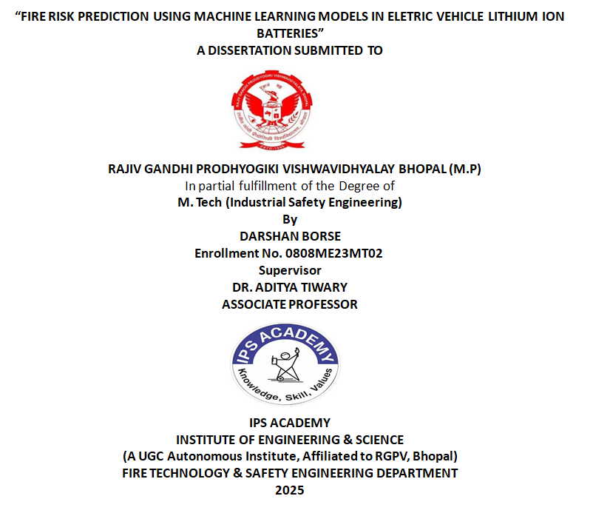

Slide 2
Contents
Abstract
Introduction
Introduction to the Problem
Machine Learning Models Used
Key Parameters for Fire Risk Prediction
Methodology
Exploratory Data Analysis
Results and Discussion
Cross-Validation Results
Recommendation and Future Scope
References.

Slide 3
ABSTRACT
Many factors point to the growing popularity of Electric Vehicles (EVs) as an environmentally friendly and renewable substitute to traditional vehicles due to improvements in battery technology. Nevertheless, battery fault related fire incidents continue to be a challenge. This research paper discusses the prediction of Fire Risk in EVs using ML techniques. In this work, we consider a dataset involving crucial battery fault parameters like SoC, Temperature, current and Voltage and carry out evaluation of performance of different machine learning models such as Linear Regression, Random Forest Regressor, Gradient Boosting Regressor (GBR), and Extreme Gradient Boosting (XGBoost) to predict it. Results show that Gradient Boosting Regressor yields the lowest Root Mean Squared Error (RMSE), the highest R squared (R²) value and the lowest Mean Absolute Error (MAE) compared to other models. Results show that machine learning (especially ensemble methods) is able to accurately predict the fire risk and improve the safety measure in EVs. The paper offers important results for development of safer and more reliable EV battery systems through the use of ML models for early fire detection and prevention.

Slide 4
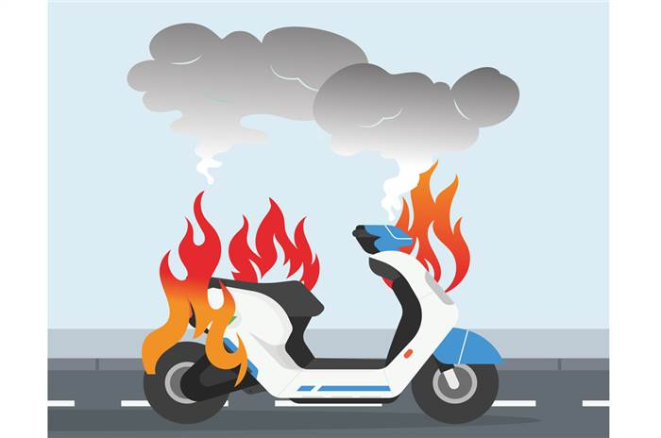
Introduction
India's Electric Vehicle (EV) sector is experiencing rapid growth, fuelled by government incentives, rising environmental concerns, and technological advancements. With initiatives like the Faster Adoption and Manufacturing of Hybrid and Electric Vehicles (FAME) scheme, India aims to significantly increase EV adoption, revolutionizing its transportation landscape towards sustainability and innovation.

Slide 5
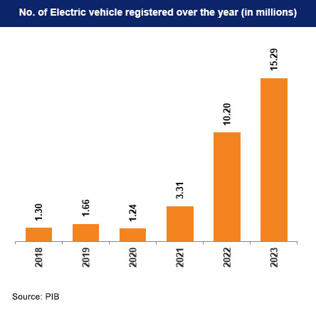
India has established an objective to elevate the proportion of Electric Vehicle (EV) sales to 30% in private cars, 70% in commercial vehicles, 40% in buses, and 80% in two-wheelers and three-wheelers by the year 2030. This equates to an ambitious objective of 80 million EVs on Indian roads by 2030.
Additionally, India strives for complete domestic EV production through the 'Make in India' initiative.
In 2023, the global electric vehicle market was valued at US$ 255.54 billion. It is forecasted to reach approximately US$ 2,108.80 billion by 2033, growing at a significant CAGR of 23.42% from 2024 to 2033.
Figure 2 – Increasing number of electric vehicles in India by years

Slide 6
Introduction to the Problem
What is Thermal Runaway?
Thermal runaway is a critical safety concern in electric vehicles (EVs), particularly involving lithium-ion batteries. It occurs when excessive heat triggers an uncontrollable chain reaction, leading to battery failure, fires, or even explosions.
Causes of Thermal Runaway in EVs
  Overcharging/Over-discharging – Exceeding voltage limits can cause internal short circuits.
  Physical Damage – Punctures or crashes can compromise battery integrity.
  Manufacturing Defects – Poor cell design or impurities in materials can increase risks.
  High Temperatures – External heat or poor thermal management accelerates degradation.
  Internal Short Circuits – Dendrite growth or separator failure can lead to self-sustaining heat generation.
Risks of Thermal Runaway
  Fire & Explosion – Lithium-ion batteries release flammable electrolytes and toxic gases.
  Rapid Spread – One failing cell can cascade to neighbouring cells (propagation).
  Difficult to Extinguish – Traditional fire extinguishers are often ineffective; large amounts of water or specialized methods are needed

Slide 7
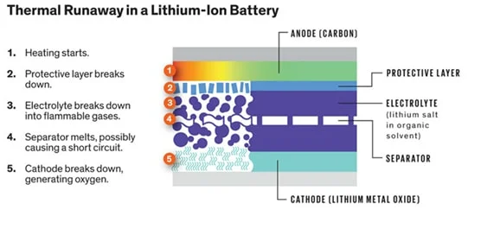

Slide 8
Machine Learning Models Tested
Models Compared:
Linear Regression (Baseline)
Random Forest Regressor
XGBoost
Gradient Boosting Regressor (GBR)
Linear Regression
Linear Regression functions as the base statistical technique which explains the connexion between dependent and independent variables. The model applies a linear relationship according to the following mathematical form [23]
y = β₀ + β₁x₁ + β₂x₂ + ... + βₙxₙ + ε
Where:
- y is the target variable.
- β₀ is the intercept.
- βᵢ are the coefficients for independent variables xᵢ.
- ε is the error term.
Residual Sum of Squares enters as the main objective to reach minimal values which represent the difference between actual and forecasted values. The technique operates commonly because it delivers straightforward logic combined with high interpretability together with efficient computations.

Slide 9
Random Forest Regressor
An ensemble learning method based on decision trees exists in the form of Random Forest Regressor. The training procedure generates various decision trees after which the model aggregates their output results through averaging for regression purposes to achieve better prediction quality. Key features include: [24]
Decision trees become more resistant to overfitting when numerous trees are built through this approach which helps handle complex interactions in large volumes of data.
XGBoost Regressor
XGBoost serves as a fast and productive implementation of gradient boosting which offers high scalability benefits [25]. The custom loss function optimization through gradient descent contains regularization terms which stop the model from overfitting.
XGBoost has gained fame through its successful competitions at Kaggle such as its ability to work with different dataset structures.
Gradient Boosting Regressor
Gradient Boosting Regressor builds multiple models one after another through loss function minimization. A weak learner such as a shallow decision tree gets fitted to the negative gradient of the loss function during each step of the algorithm. Loss Function Optimization Focuses on areas with high prediction error. A strong model emerges by combining weak learners through the process of Additive Modelling. The learning rate adjusts the weight of weak learner additions so the model avoids overfitting. Gradient Boosting works excellently with complex data relationships but demands precise optimization of its hyper parameters according to literature [26].

Slide 10
Key Parameters for Fire Risk Prediction
Validation Method:
Cross-validation to ensure model robustness.
Data & Parameters:
Dataset: 50,000 observations.
Input Features:
  State of Charge (SoC).
  Temperature.
  Current.
  Voltage.
Output: Fire risk (quantified as a regression target).
These parameters are directly linked to battery health and thermal stability.

Slide 11


Data Collection: 50,000 observations of SoC, Temp, Current, Voltage.
Model Training: Train and validate using cross-validation.
Performance Metrics: RMSE, MAE, R², Explained Variance.
RMSE (Root Mean Squared Error)
Measures the average magnitude of prediction errors.
Interpretation: Lower values = better fit (sensitive to outliers).
Formula-
2. MAE (Mean Absolute Error)
Average of absolute differences between predicted and actual values.
Interpretation: More robust to outliers than RMSE.
Formula:

Slide 12


R² (R-Squared, Coefficient of Determination)
Proportion of variance in the dependent variable explained by the model.
Interpretation: 0 (no fit) to 1 (perfect fit); can be negative if worse than a horizontal line.
Formula:
4. Explained Variance
Measures the proportion of variance in the target explained by the model.
Interpretation: Similar to R² but unbiased if the model has no intercept.
Formula:

Slide 13
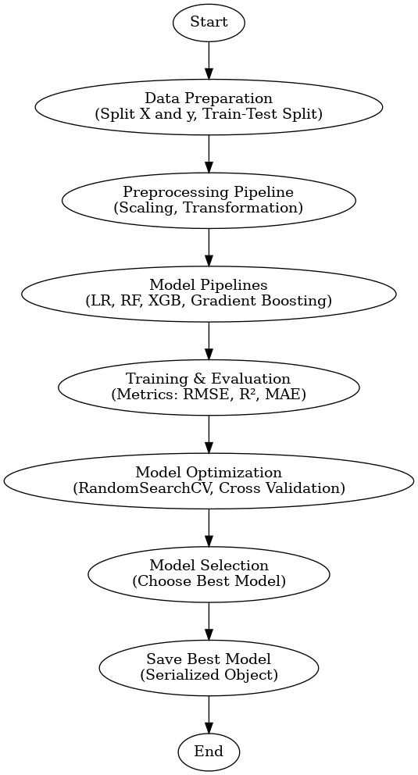
Methodology
Fig. 1 Flowchart of the proposed methodology

Slide 14
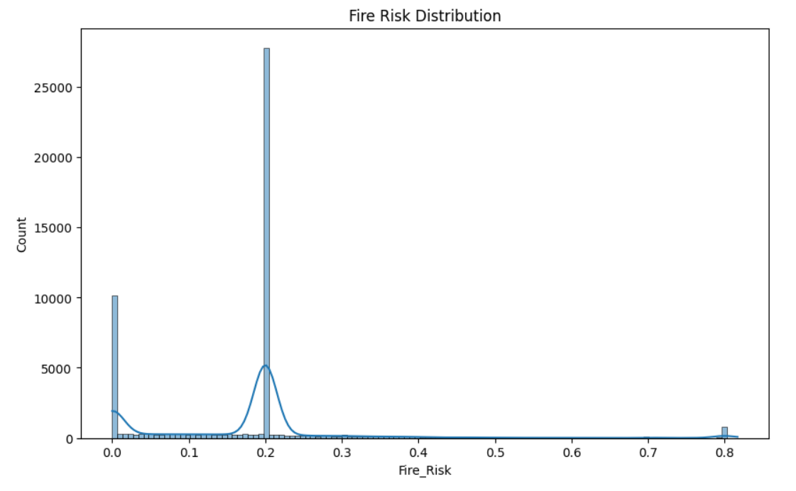
Exploratory Data Analysis
Figure 1- Exploratory Data Analysis for the 50000 observations considered

Slide 15
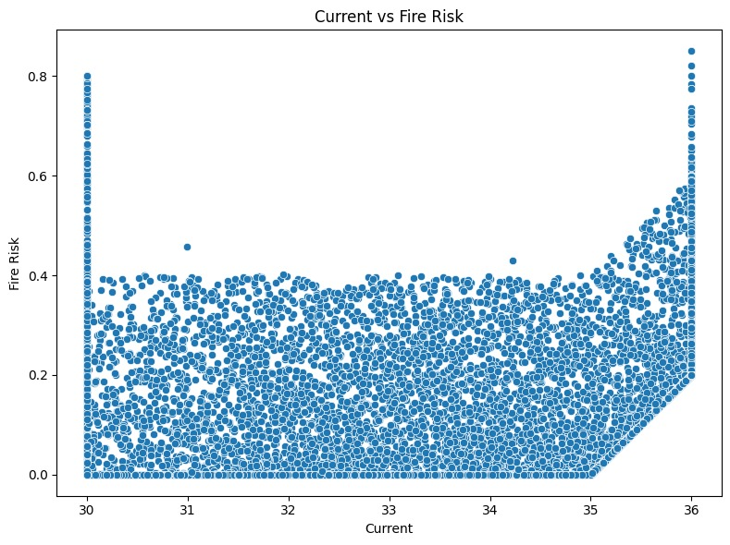
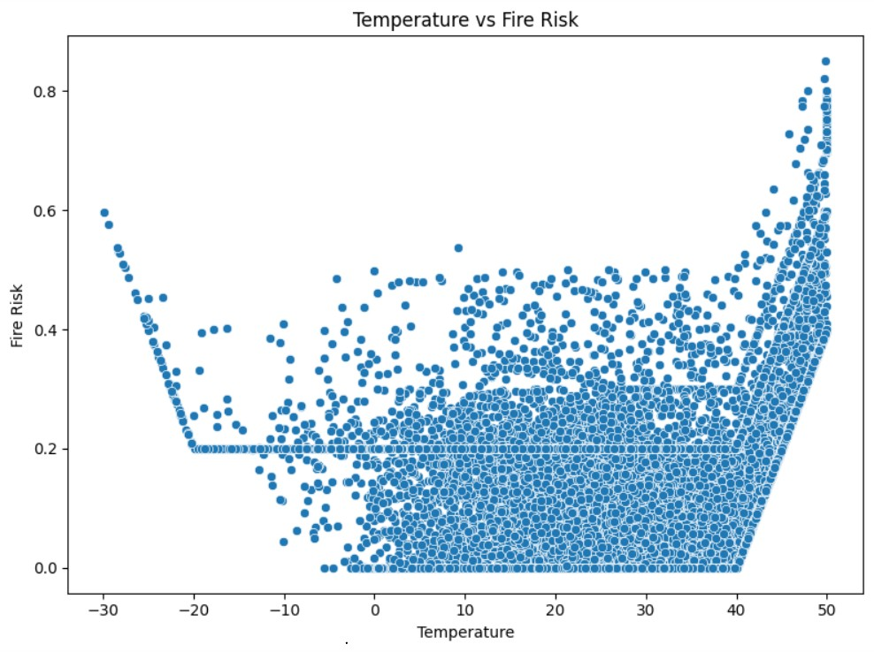
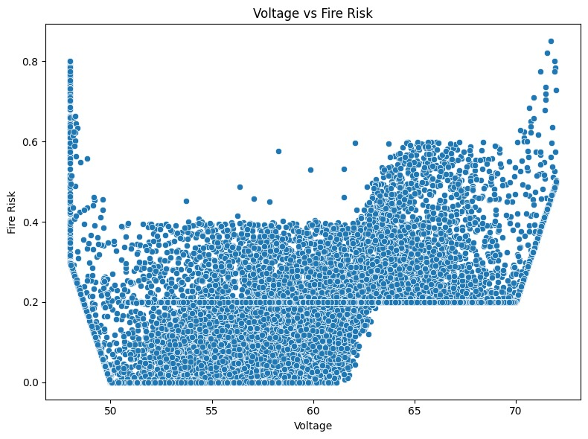
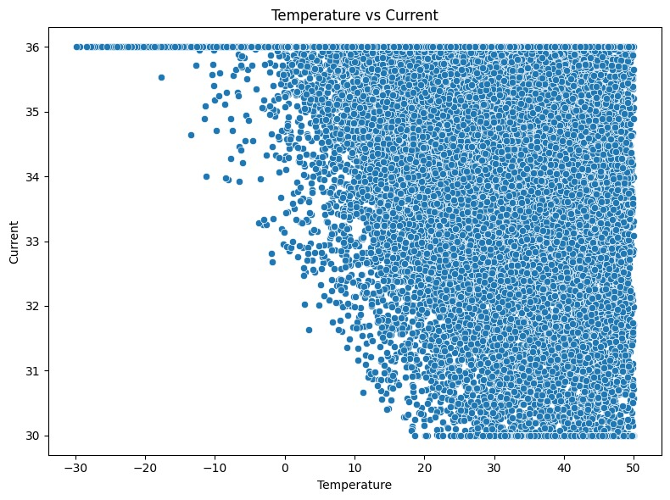
Figure 2- scatter-plot for various conditions

Slide 16
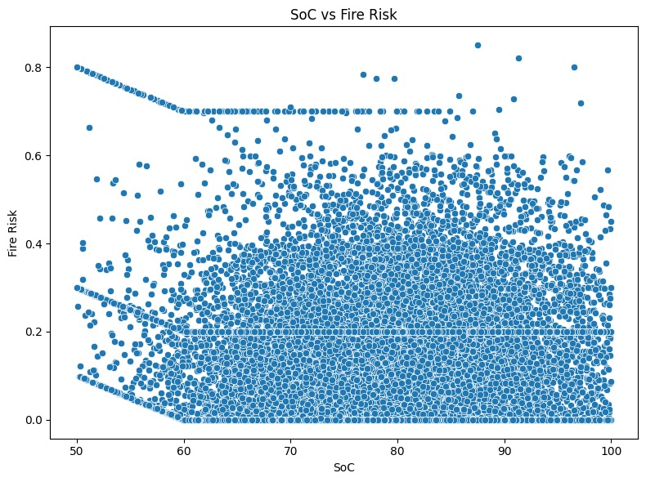
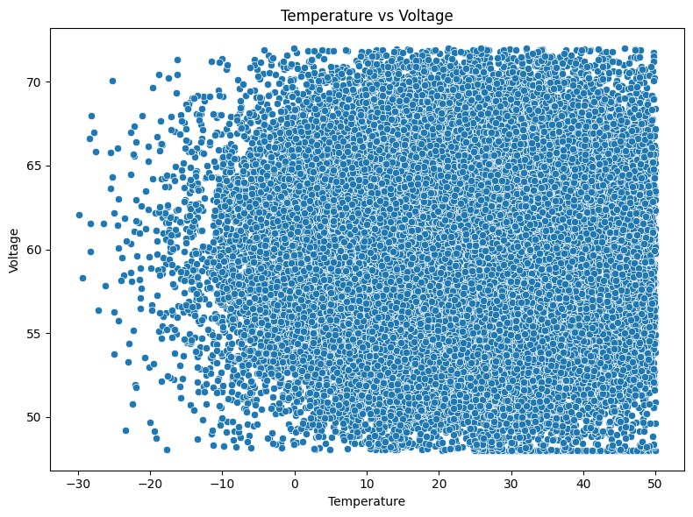
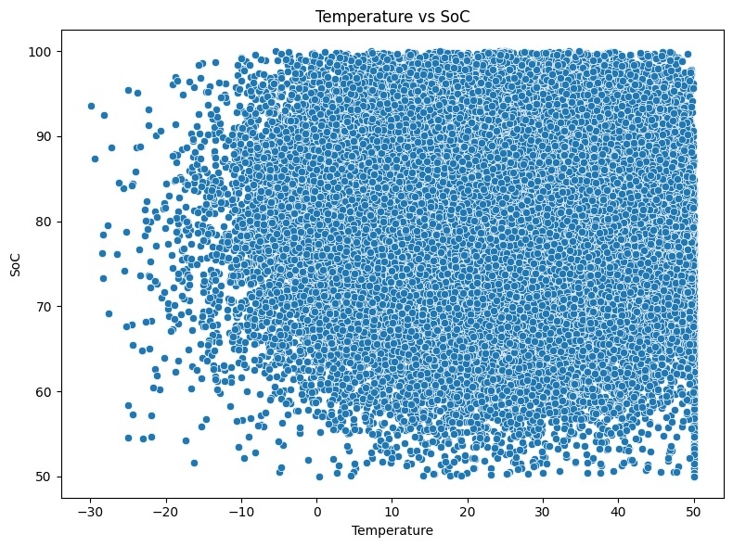
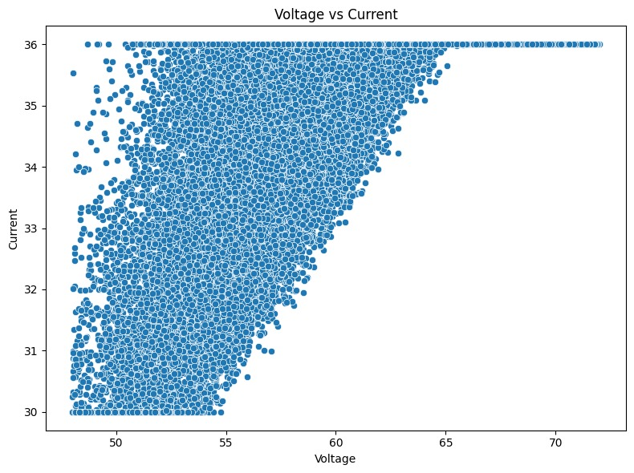
Figure 3- scatter-plot for various conditions

Slide 17
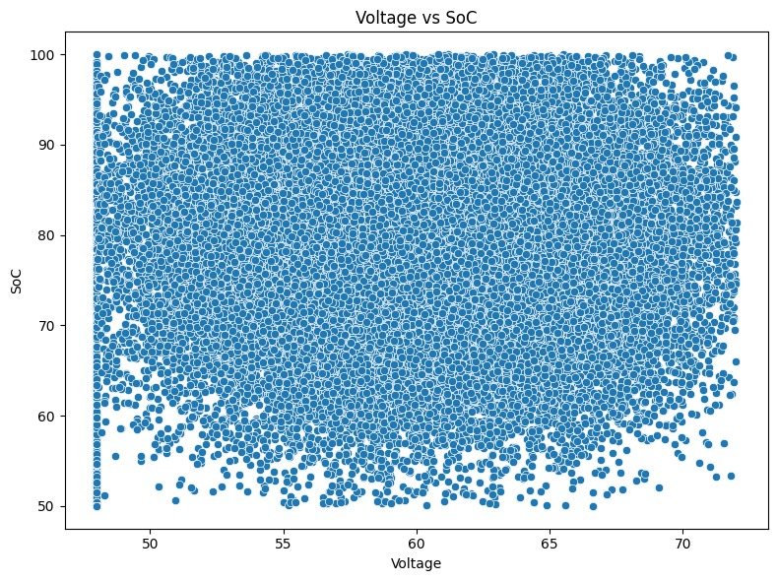
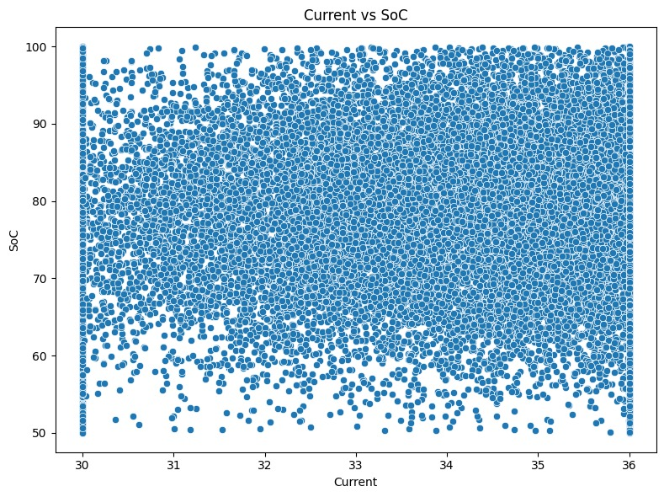
Figure 4- scatter-plot for various conditions

Slide 18
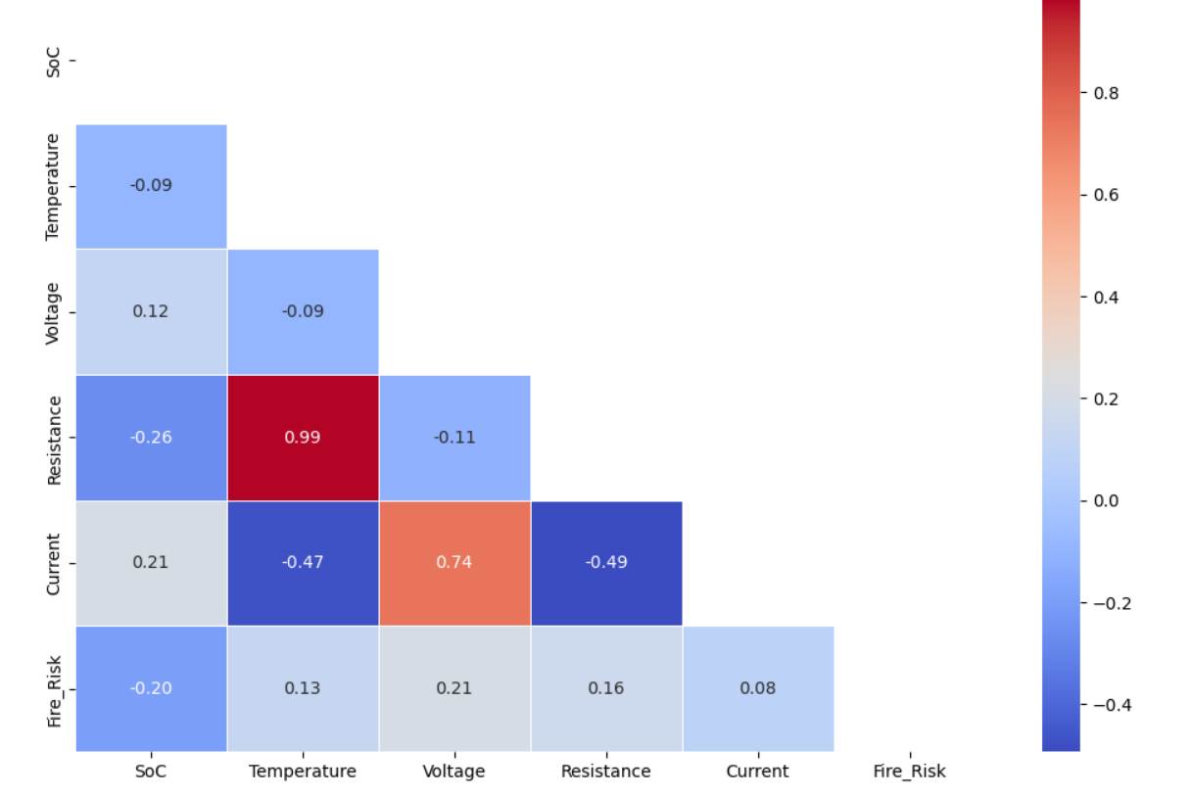
Featured Correlation Matrix
Figure - featured correlation matrix

Slide 19
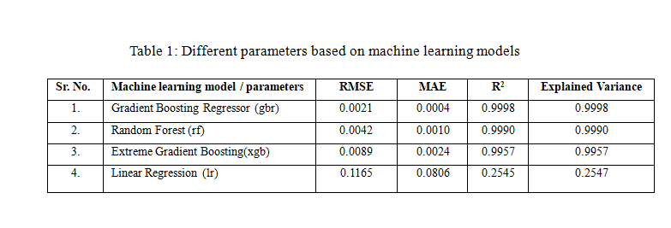
Results and Discussion
The results section of the research paper conducts an extensive evaluation between several machine learning models designed to predict fire risks within electric vehicles (EVs). Performance assessment focused on Gradient Boosting Regressor (GBR), Random Forest (RF), Extreme Gradient Boosting (XGBoost) as well as Linear Regression (LR). The analysis utilises RMSE (Root Mean Squared Error) and MAE (Mean Absolute Error) with R2 (R-squared) and Explained Variance as the performance measurement metrics. A dataset consisting of 50000 observations features the measurements of State of charge (SoC) alongside Temperature, Current along with voltage. Gradient Boosting Regressor demonstrates superior performance compared to Linear Regression and other methods for determining fire risks in electric vehicles because of its ensemble approach.

Slide 20
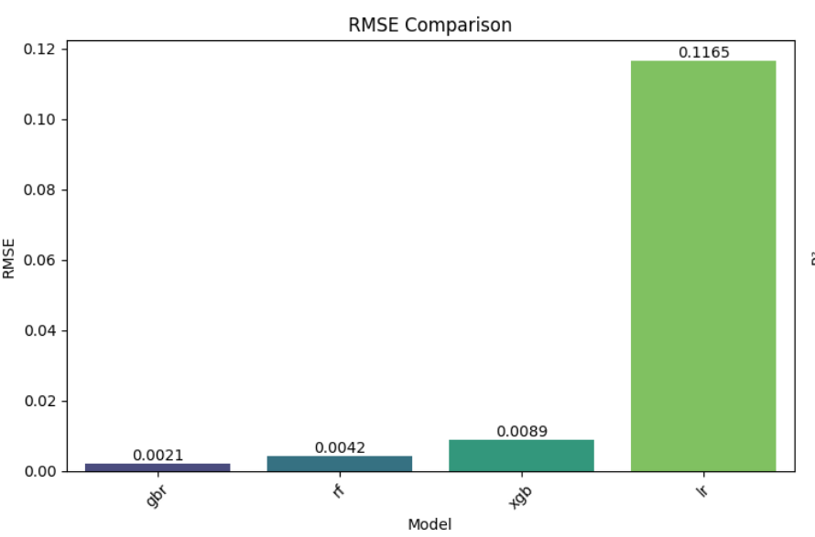
Figure 2 -Comparison of Root Mean Squared Error (RMSE) for Different Machine Learning Models
Visual data shows the comparison of RMSE values between four machine learning models. GBR achieves the best accuracy with the smallest RMSE value while RF follows then comes XGBoost and LR. Data from the graph establishes that GBR provides the most effective approach for lowering prediction error amounts.

Slide 21
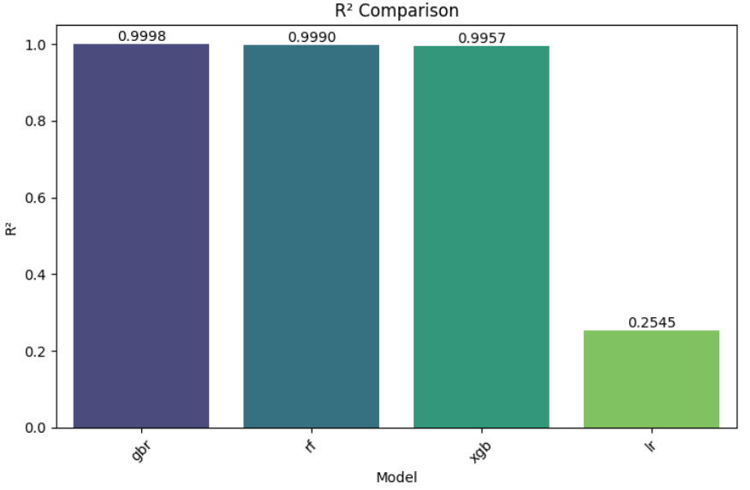
Figure 3 - Comparison of R squared (R²) for Different Machine Learning Models.
The R² values in this display show GBR at the top due to its superior fit against the data points. RF stands closest in line to the top spot but XGBoost and LR display lower performance. GBR demonstrates an excellent predictive power since its R² value indicates it explains almost the entire dataset variability

Slide 22
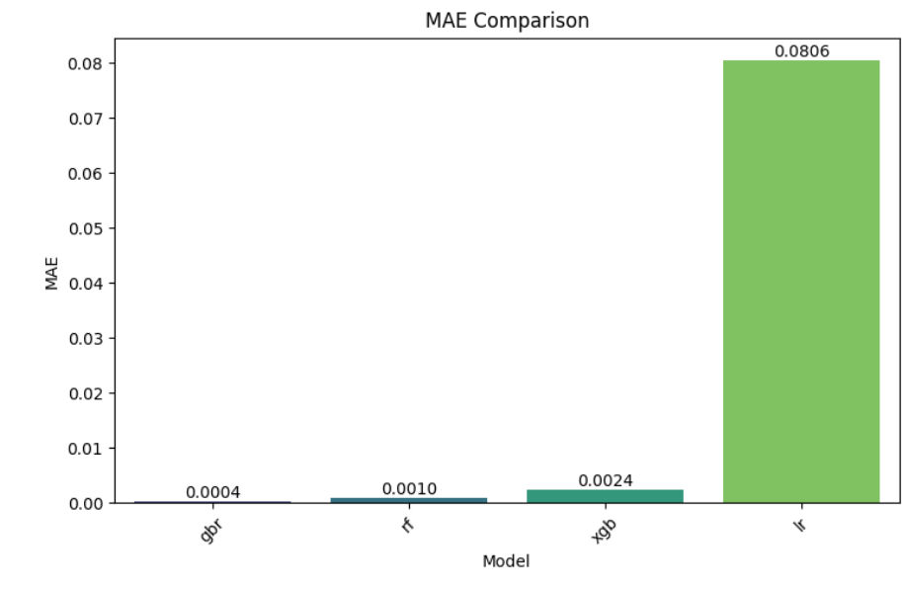
Figure 4- Comparison of Mean Absolute Error for Different Machine Learning Models
GBR stands out from other models because its MAE value remains the most minimal indicating it produces predictions with minimal average errors. The values for MAE indicate that RF and XGBoost yield higher deviations than LR which maintains the highest value indicating linear models have restricted applicability.

Slide 23
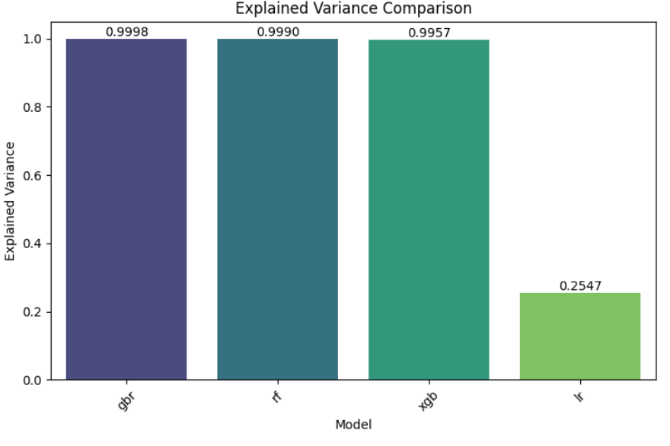
Figure 5 - Comparison of Explained Variance across Different Machine Learning Models
The Plot represents explained variance where GBR establishes itself as the leader. GBR demonstrates the highest Explained Variance because it absorbs almost all data variability which confirms its status as the most trustworthy model for fire risk assessment.

Slide 24
Cross-Validation Results:
Cross-validation procedures demonstrated the strong steadfastness of GBR by producing consistently low values of RMSE throughout all validation parts. GBR demonstrates strong abilities to predict unseen data effectively which makes it appropriate for real-world implementation.
The discussion highlights ensemble methods specifically GBR as powerful tools to predict EV fire risks which leads to a major improvement in EV battery system safety and reliability.
A research paper demonstrates that Gradient Boosting Regressor (GBR) from machine learning achieves suitable fire threat predictions in electric vehicle (EV) lithium-ion batteries by analysing their State of Charge (SoC) and Temperature and Current and Voltage properties. The GBR model achieved optimal prediction results through minimum RMSE and maximum R² values as well as minimum MAE after evaluating SoC and Temperature and Current and Voltage parameters. Gradient Boosting Regressor yielded superior outcomes than Random Forest and XGBoost and Linear Regression models. The validation tests confirmed that Gradient Boosting Regressor keeps its robust features while it maintains impressive generalization potential. Ensemble ML techniques demonstrate capability to improve EV battery safety by creating fire risk detection systems which lead to more reliable EV systems.

Slide 25
Recommendations and Future Aspects
Solid-State Batteries – Less prone to thermal runaway due to non-flammable electrolytes.
AI-Based Predictive Maintenance – Detects early signs of battery failure.

Slide 26
References
[1] R. K. Daniels, V. Kumar, and A. Prabhakar, “A comparative study of data-driven thermal fault prediction using machine learning algorithms in air-cooled cylindrical Li-ion battery modules,” Renewable and Sustainable Energy Reviews, vol. 207,pp- 1-23, Sep. 2024.
[2] M. M. Kiasari and H. H. Aly, “Enhancing Fire Protection in Electric Vehicle Batteries Based on Thermal Energy Storage Systems Using Machine Learning and Feature Engineering,” Fire, vol. 7, no. 9, pp- 1-21,Aug. 2024.
[3] J. Zhao, X. Feng, Q. Pang, M. Fowler, Y. Lian, M. Ouyang, A. F. Burke “Battery safety: Machine learning-based prognostics,” Progress in Energy and Combustion Science, vol. 102, pp. 101–142, May 2024.
[4] B. S. Nejad, P. Roch, M. Handte, and P. J. Marron, “A visual foreign object detection system for wireless charging of electric vehicles,” Machine Vision and Applications, vol. 35, no. 4, pp- 1-14, May 2024.
[5] B. Mao, J. Lu, Y. Zhang, N. Chen, Z. Lai, L. Zhu, R. Cheng, J.X. Wen “Mitigating the cascading effects of thermal runaway and fire propagation in enclosed clusters of 18,650-type lithium-ion batteries,” International Journal of Heat and Mass Transfer, vol. 239,pp-1-14 Dec. 2024.

Slide 27
[6]M. Mama, E. Solai, T. Capurso, A. Danlos, and S. Khelladi, “Comprehensive review of multi-scale Lithium-ion batteries modeling: From electro-chemical dynamics up to heat transfer in battery thermal management system,” Energy Conversion and Management, vol. 325,pp - 1-27, Dec. 2024.
[7]Y. Zhao, L. Geng, S. Shan, Z. Du, X. Hu, and X. Wei, “Review of sensor fault diagnosis and fault-tolerant control techniques of lithium-ion batteries for electric vehicles,” Journal of Traffic and Transportation Engineering (English Edition), vol. 6, pp-1447-1466, Dec. 2024.
[8]R. Yadav, M. Manas, and R. K. Dubey, “Enhanced accuracy in state-of-charge estimation for lithium-ion batteries in electric vehicles using augmented adaptive extended Kalman filter,” e-Prime - Advances in Electrical Engineering, Electronics and Energy, vol. 10, pp-1-8, Dec. 2024.
[9]S. Lee, D. Choi, Y. Jeong, M. Moon, H. Kwon, K. Han, H. Kim, H. Im, Y. Park, D. Shin, G. Gwak “Assessing fire dynamics and suppression techniques in electric vehicles at different states of charge: Implications for maritime safety,” Case Studies in Thermal Engineering, vol. 64, pp- 1-21,Nov. 2024.
[10]Abdelrahman Gasmelseed, M. A. Ismael, M. A. Said, F. Ahmad, and S. Osman, “Thermal Management Strategies for Lithium-Ion Batteries in Electric Vehicles: A Comprehensive Review of Nanofluid-Based Battery Thermal Management Systems,” Results in Engineering, vol. 24, Nov. 2024.

Slide 28
[11]K. Yu, P. Liu, B. Xu, J. Li, X. Wang, H. Zhang, L. Mao “Warning lithium-ion battery thermal runaway with 4-min relaxation voltage,” Applied Energy, vol. 377, Sep. 2024.
[12]F. Muram, P. Pop, and Md. A. Javed, “Assuring the safety of rechargeable energy storage systems in electric vehicles,” Journal of Systems Architecture, vol. 154, July. 2024.
[13]H. Alghamdi, M. F. M. Rosdi, A. Mukhtar, A. S. H. M. Yasir, and A. Alviz-Meza, “Controlling Thermal Runaway by Simultaneous Use of Thermoelectric Module and Phase Change Material in the lithium-ion Batteries of Electric Vehicles,” Case Studies in Thermal Engineering, vol. 52, Dec. 2023.
[14]Z. Wang, X. Zhao, L. Fu, D. Zhen, F. Gu, and A. D. Ball, “A Review on Rapid State of Health Estimation of lithium-ion Batteries in Electric Vehicles,” Sustainable Energy Technologies and Assessments, vol. 60, Dec. 2023.
[15]M. Mahmud, K. Rahman, M. Rokonuzzaman, A.K.M Habib, M. Islam, S.M.A Molakabber, S. Channumsin, S. Chowdhury “Lithium-ion battery thermal management for electric vehicles using phase change material: A review,” Results in Engineering, vol. 20, Sept. 2023.

Slide 29
[16]F. M. Khan, M. G. Rasul, A. S. M. Sayem, and N. Mandal, “Maximizing Energy Density of lithium-ion Batteries for Electric vehicles: a Critical Review,” Energy Reports, vol. 9, pp. 11–21, Oct. 2023.
[17]P. Sturm, P. Fobleitner, D. Fruhwirt, R. Galler, R. Wenighofer, S. Heindl, S. Krausbar, O. Heger “Fire Tests with lithium-ion Battery Electric Vehicles in Road Tunnels,” Fire Safety Journal, Nov. 2022.
[18]J. Dunn, A. Kendall, and M. Slattery, “Electric Vehicle lithium-ion Battery Recycled Content Standards for the US – targets, costs, and Environmental Impacts,” Resources, Conservation and Recycling, vol. 185, Oct. 2022.
[19]J. Hong, Z. Wang, C. Qu, Y. Zhou, T. Shan, J. Zhang, Y. Hou “Investigation on overcharge-caused Thermal Runaway of lithium-ion Batteries in real-world Electric Vehicles,” Applied Energy, vol. 321, June 2022.
[20]A. Li, A. C. Yin Yuen, W. Wang, I. M. De Cachinho Cordeiro, and C. Wang, “A Review on Lithium-Ion Battery Separators Towards Enhanced Safety Performances and Modelling Approaches,” 2021.
[21]R. D. McKerracher, J. Guzman-Guemez, R. G. A. Wills, S. M. Sharkh, and D. Kramer, “Advances in Prevention of Thermal Runaway in Lithium‐Ion Batteries,” Advanced Energy and Sustainability Research, vol. 2, no. 5, Mar. 2021.
[22] T. Hastie, R. Tibshirani, and J. Friedman, “The Elements of Statistical Learning: Data Mining, Inference, and Prediction”, 2nd Ed. New York, NY, USA: Springer, 2009.
[23] L. Breiman, “Random Forests, Machine Learning”, vol. 45, no. 1, pp. 5–32, 2001.
[24] T. Chen and C. Guestrin, “XGBoost: A Scalable Tree Boosting System”, in Proceedings of the 22nd ACM SIGKDD International Conference on Knowledge Discovery and Data Mining (KDD), San Francisco, CA, USA, 2016, pp. 785–794.
[25] J. H. Friedman, “Greedy Function Approximation: A Gradient Boosting Machine”, Annals of Statistics, vol. 29, no. 5, pp. 1189–1232, 2001.

Slide 30
THANK YOU

