Slide 1
Title of the Paper
AI Powered forecasting of Customer Lifetime Value: An analytical study based on empirical data.
Presented By:
Pratibha Khullar¹, Prabhjot Singh², Sodagar Singh³
Assistant Professors
(Gulzar School of Management, Khanna, Ludhiana, Punjab, India.)

Slide 2
Abstract:
Customer Lifetime Value (CLV) prediction is essential for estimating the long-term financial contribution of customers and optimizing engagement strategies. This study leverages artificial intelligence (AI) models, including Random Forests, Gradient Boosting Machines, and Neural Networks, applied to primary data collected from surveys and transaction records. Key indicators influencing CLV—such as purchase frequency, demographics, loyalty program participation, and sentiment derived through natural language processing—are identified. The AI-powered models demonstrate superior accuracy and adaptability compared to traditional techniques, effectively identifying high-value customers and those at risk of churn. The practical implications of this research include enhanced personalized marketing, improved customer retention, and revenue maximization. Despite limitations such as sample size, the study suggests future research directions involving real-time data for more dynamic CLV predictions.

Slide 3
Introduction
Introduction to CLV
CLV: Total revenue expected from a customer over the relationship . It is critical for budgeting, segmentation, marketing, and churn prevention. Predicting CLV helps identify high-value customers and allocate resources efficiently.

Slide 4
Role of AI in CLV Prediction
Traditional models use fixed assumptions and static methods
AI adapts to changing customer behavior and dynamic markets
ML models can handle large data and provide real-time predictions
Uncover hidden patterns from demographic, behavioral, and textual data

Slide 5
Objectives of the Study:
Developing AI-based models to predict CLV using primary data.
Identifying key variables influencing CLV.
Demonstrating practical applications for businesses, including personalization, retention strategies, and revenue optimization

Slide 6
Literature Review
Hardie & Fader (2009): Developed probabilistic models for customer base analysis.
Lehmann & Gupta (2003): Positioned clients as long-term business resources.
Venkatesan & Kumar (2004): Proposed a comprehensive framework for CLV estimation.
Recent Studies:
  AI models (e.g., Random Forest, GBM) offer superior predictive accuracy.
  NLP and behavioral analytics enhance customer insight.
Consensus: AI enables real-time, personalized marketing based on CLV predictions.

Slide 7
Research Methodology
Data Sources: Questionnaires, transaction logs, interaction records.
Sample Size: 108 customers (diverse demographics & behaviour)
Dependent Variable: CLV (total revenue per customer)
Independent Variables: Purchase frequency, AOV, demographics, feedback, loyalty, churn signs
Tool Used: SPSS (data coding & descriptive stats)

Slide 8
Analysis & Interpretation
Demographic Trends:
Predominantly young audience (64.8% aged 18–24) suggests targeting Gen Z consumers.
Balanced gender split indicates no strong gender bias in purchasing.
Spending & Purchase Behavior:
Majority shop monthly (51.9%) and spend ₹500–2000 (52.8%), reflecting mid-range purchasing power.
Quality (66.7%) drives purchase decisions—price and brand less significant.
Customer Satisfaction & Loyalty:
82% report satisfaction → strong product/service performance.
74.1% likely to recommend → high Net Promoter potential.
High digital (43.5%) and offline (46.3%) interaction → omnichannel engagement is effective.

Slide 9
Analysis & Interpretation
Social Media Engagement:
  62% follow brand online; 70.7% engage occasionally.
  Positive correlation observed between social media engagement and higher CLV.
Interpretation & Insights:
  High CLV aligns with: frequent buyers, positive sentiment, loyalty program participants.
  Digital engagement (reviews, social media, feedback) is a key predictor of loyalty and value.
  CLV prediction models benefit from incorporating real-time and behavioral data.

Slide 10
Analysis & Interpretation
Strategic Implications:
Focus marketing on young, digitally active consumers.
Invest in product quality and customer service for long-term loyalty.
Enhance social media campaigns and loyalty programs to boost CLV.
Use AI-driven insights to segment and target high-value customers dynamically.

Slide 11
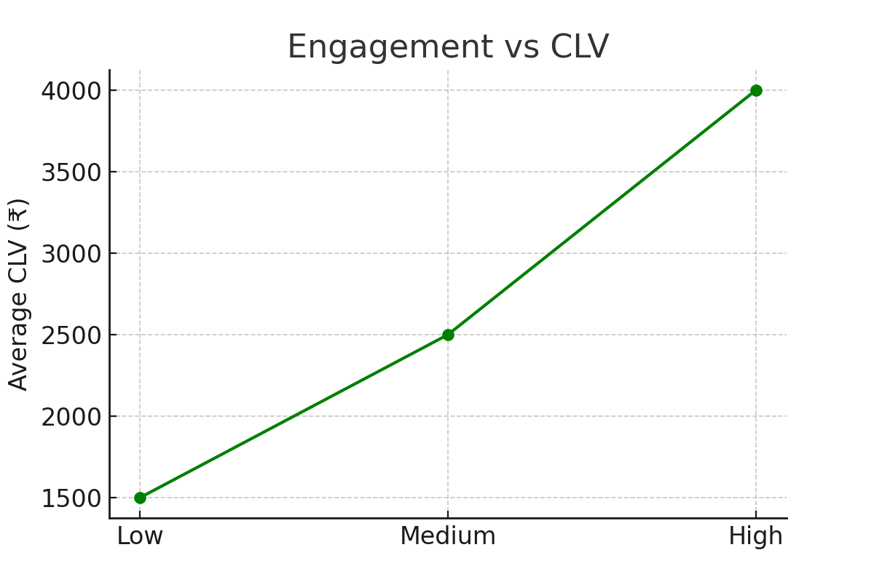
Analysis & Interpretation
Majority (64.8%) aged 18–24; 56.5% Male, 43.5% Female
51.9% shop monthly; 52.8% spend ₹500–2000; quality matters most
82% satisfied; 74.1% likely to recommend; strong digital interaction
62% follow brand on social media; 70.7% engage occasionally
CLV higher among engaged, satisfied, and loyal customers

Slide 12
Findings
Younger (18–24) and middle-income customers have the highest Customer Lifetime Value (CLV).
Frequent shoppers and moderate spenders significantly contribute to overall revenue.
Social media engagement and loyalty program participation strongly enhance customer loyalty and CLV.
Product/service quality is the most influential factor driving purchase decisions.
High customer satisfaction (82%) is linked to increased retention and CLV, though some room for improvement remains.
AI-based models enable accurate CLV predictions, allowing personalized marketing and optimized retention strategies.
Early identification of potential churners is critical for improving customer retention and profitability.

Slide 13
Suggestions
1. Build AI-Powered CLV Prediction Models:
Collect high-quality customer data regularly.
Apply machine learning techniques like decision trees and deep learning for accurate forecasts.
Implement real-time AI solutions to monitor retention and customer value dynamically.
2. Identify Key Factors Influencing CLV:
Segment customers by demographics and behavior to spot high-value groups.
Focus on improving engagement and satisfaction metrics.
Include behavioral data such as social media activity for a holistic CLV view.

Slide 14
Suggestions
3.Practical Applications for Businesses:
Use AI tools to monitor and enhance customer satisfaction.
Boost revenue by targeting valuable products and upselling to key customers.
Develop retention strategies, including personalized discounts and loyalty rewards.
Leverage AI for tailored offers and recommendations based on customer behavior.

Slide 15
Conclusion
AI-powered CLV prediction significantly enhances business decision-making by providing accurate customer value insights.
Demographics, purchase behavior, engagement, and satisfaction are key drivers of CLV.
Quality products and active social media engagement boost customer loyalty and lifetime value.
Real-time AI analytics enable personalized marketing and effective retention strategies.
Continuous data collection and AI model refinement are crucial for sustained success.
Future research should explore integrating larger datasets and advanced AI techniques for dynamic CLV prediction.

Slide 16
Refrernces
Hardie, B. G. S., & Fader, P. S. (2009). Probability models for customer bases.
Lehmann, D. R., & Gupta, S. (2003). Clients as resources.
Venkatesan, R., & Kumar, V. (2004). Framework for customer lifetime value.
Additional references as cited in the research paper.

