Slide 1
Conference: Recent Research Trends of AI in Various Streams of Engineering and Management
Date: May 31, 2025
“Smart Wearables and Artificial Intelligence for Real-Time Chronic Disease Management: A Predictive and Preventive Healthcare Approach”
Darshan Madhani
Affiliation: PhD Research Scholar, Department of Computer Science, Atmiya University, India
Date:-31/5/2025

Slide 2
A Presentation on
“Smart Wearables and Artificial Intelligence for Real-Time Chronic Disease Management: A Predictive and Preventive Healthcare Approach”
Submitted to
Conference: Recent Research Trends of AI in Various Streams of Engineering and Management
Prersented by
Darshan Madhani
PhD Research Scholar, Department of Computer Science
Atmiya University

Slide 3
Outline…
Introduction
Literature Review
Research Gap
Research Methodology Overview
Results and Discussion
Conclusion
Future Scope
References

Slide 4
INTRODUCTION
“Smart Wearables and Artificial Intelligence for Real-Time Chronic Disease Management: A Predictive and Preventive Healthcare Approach”

Slide 5
Introduction
Chronic diseases are leading causes of mortality, demanding better healthcare solutions
Traditional healthcare systems respond after symptoms worsen, delaying intervention
Wearable devices enable continuous physiological monitoring using biosensors
Integration with machine learning allows early detection and prediction of disease progression
Real-time alerts can improve treatment outcomes and reduce emergency events
This research promotes a shift from reactive to predictive healthcare
The aim is to develop a scalable AI-powered health monitoring system
Focus is on proactive chronic disease management using wearable technologies

Slide 6
Literature Review Summary
Sabry et al. (2022) achieved up to 99% accuracy using SVM and CNN for fall detection
Saad et al. (2024) showed 97.31% accuracy in epilepsy detection using SVM on EEG data
CNN models effectively analyze medical images like X-rays and CT scans
IoT-based wearable systems have been applied for COVID-19 detection and quarantine tracking
Deep learning techniques are widely used in monitoring hypertension and arrhythmias
Real-world case studies validate ML’s potential but lack integration and personalization
Most studies prioritize accuracy but neglect explainability and clinical usability
This research builds upon proven models and incorporates privacy and feedback mechanisms

Slide 7
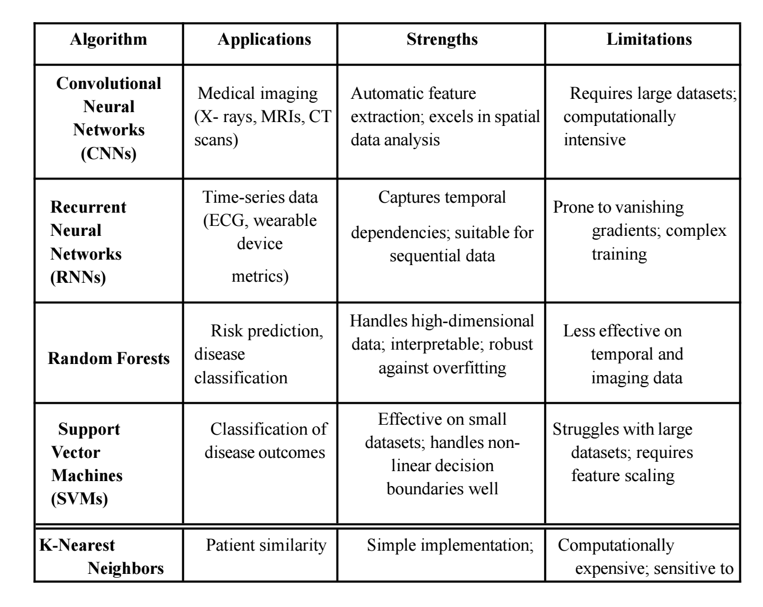
Literature Review Summary – Comparative Analysis of Machine Learning Algorithms in Healthcare

Slide 8
Research Gap Identification
Most wearable systems focus on data tracking rather than health prediction
Real-time processing and personalized alerts are generally missing
Existing models fail to adapt across diverse patient populations
Centralized storage of sensitive data raises privacy and compliance concerns
Explainability of AI models is often lacking, limiting clinical trust
Systems do not integrate well with hospital workflows or EHRs
Predictive insights are rarely used to adjust treatments dynamically
There is a need for a holistic AI framework addressing these concerns

Slide 9
Research Objectives
To develop a real-time, AI-based framework capable of predicting chronic disease progression using wearable sensor data.
To integrate machine learning models (e.g., CNN, RNN, SVM) with biosignals and imaging data to enable proactive healthcare interventions.
To ensure patient privacy and data protection through the use of federated learning, avoiding centralization of raw medical data.
To enhance clinical trust and decision-making by incorporating explainable AI techniques like SHAP, which clarify why a prediction was made.
To support continuous monitoring by combining edge computing for local processing and cloud computing for advanced analytics.
To validate the system’s accuracy and efficiency using real-world datasets, including ECG signals and oncology treatment records.
To compare the proposed framework's performance with existing machine learning models used in healthcare to highlight improvements in accuracy and response time.
To deliver personalized alerts and recommendations to patients and healthcare providers via mobile or web-based applications for real-time action.

Slide 10
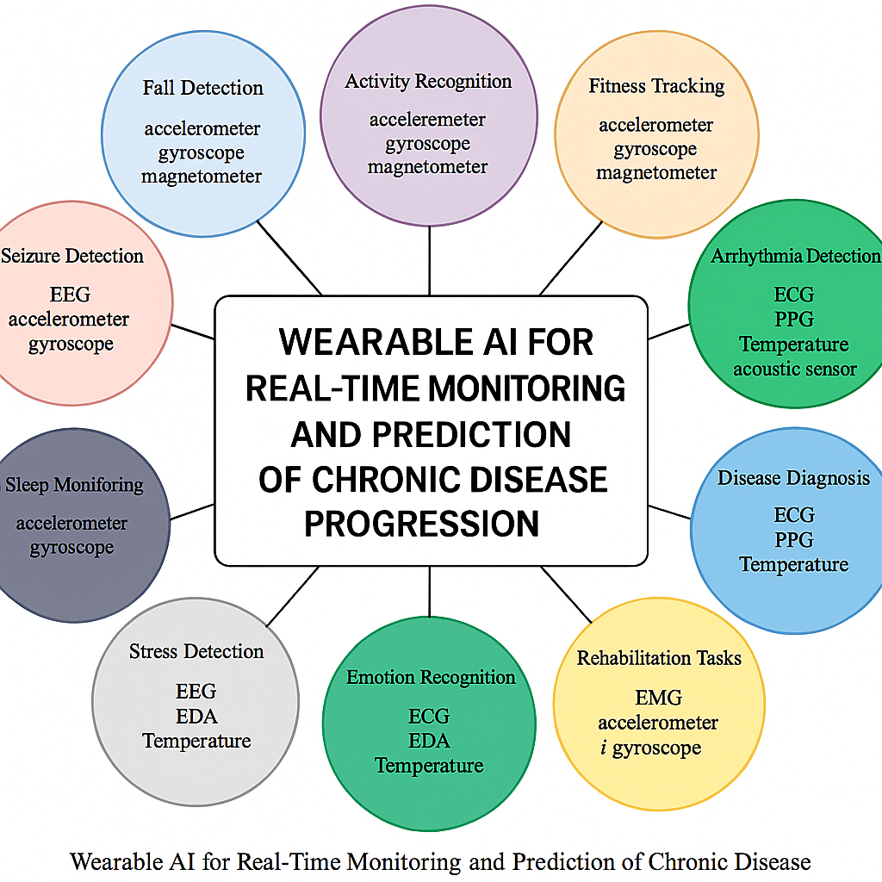
Research objective visual representation

Slide 11
Research Methodology :Data Collection & Preprocessing
Data sources include wearable sensors, imaging scans, and electronic health records
Wearables capture real-time data like ECG, SpO2, temperature, and activity level
Imaging data such as CT and MRI support deeper diagnostics using CNNs
EHRs provide context such as patient history, medications, and test results
Preprocessing involves cleaning data, removing noise, and standardizing formats
Missing data handled using interpolation and KNN-based imputation
Feature engineering includes extraction of HRV, sleep trends, and movement patterns
Final dataset includes both temporal and spatial data for multimodal learning
.

Slide 12
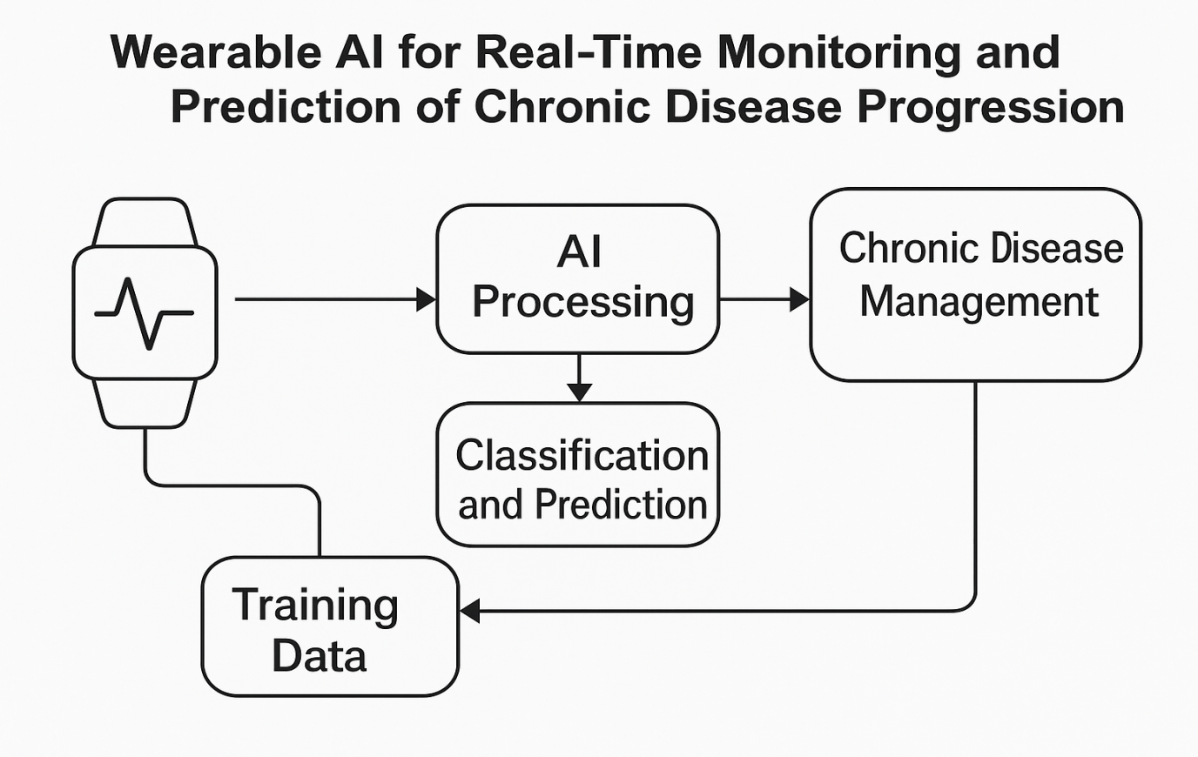
Understanding Research methodology
Visual Representation

Slide 13
Research Methodology : Implementation
Wearables capture real-time data like ECG, SpO2, temperature, and activity level
Imaging data such as CT and MRI support deeper diagnostics using CNNs
EHRs provide context such as patient history, medications, and test results
Preprocessing involves cleaning data, removing noise, and standardizing formats
Missing data handled using interpolation and KNN-based imputation
Feature engineering includes extraction of HRV, sleep trends, and movement patterns
Final dataset includes both temporal and spatial data for multimodal learning
.

Slide 14
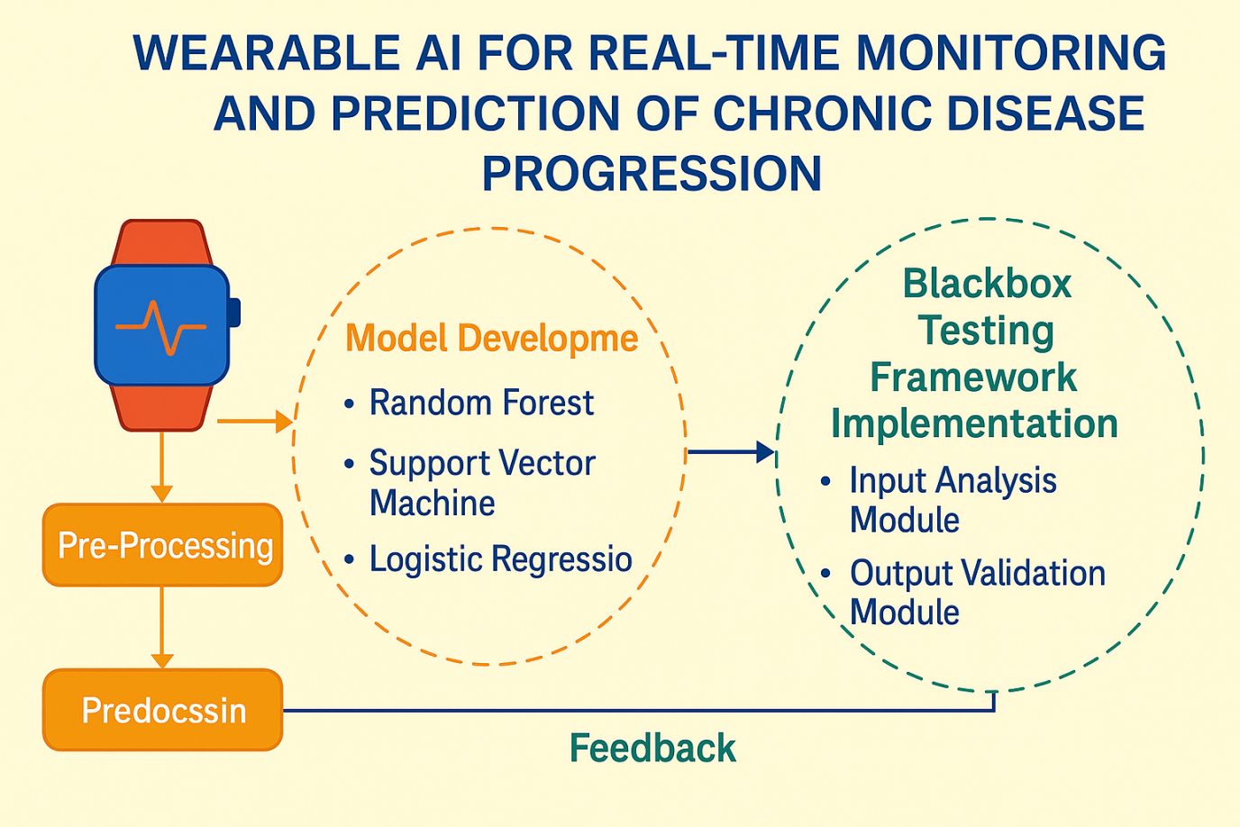
Research Methodology: Proposed Framework visual representation
.

Slide 15
Research Outcome
Model performance metrics for cardiology and oncology datasets
Dataset | Accuracy (%) | Sensitivity (%) | Specificity (%) | F1-Score | AUC
Cardiology | 94 | 91 | 96 | 0.93 | 0.97
Oncology | 90 | 88 | 92 | 0.89 | 0.94

Slide 16
Research Outcome
Results – Cardiology Dataset
Dataset includes ECG signals from over 500 patients
Achieved 94% accuracy in detecting arrhythmias using CNN + RNN
Sensitivity of 91% and specificity of 96% confirm clinical reliability
F1-score of 0.93 indicates strong performance even with class imbalance
AUC of 0.97 shows excellent model discrimination capability
Alerts helped initiate early treatment and reduce complications
Mobile integration delivered timely warnings to patients and doctors
Demonstrates the model’s practical application in cardiac monitoring
s

Slide 17
Research Outcome
: Results – Oncology Dataset
Dataset focused on predicting chemotherapy-induced side effects
Accuracy of 90% achieved using multimodal features from wearables and EHRs
Sensitivity of 88% and specificity of 92% supported early interventions
F1-score of 0.89 and AUC of 0.94 validate robustness
Predictive alerts enabled changes in treatment plans in time
Supports generalization of the framework beyond heart diseases
Highlights adaptability of the model across chronic conditions
Reinforces clinical relevance of the proposed AI system
s

Slide 18
Results and Discussion -Real-World Case Study
In a real-world pilot, wearable ECGs monitored 500 cardiac patients over 6 months
The system detected short-term arrhythmias often missed in standard monitoring
Real-time alerts led to early treatment and lifestyle modifications
Sensitivity and specificity remained consistent across patient groups
Mobile apps delivered personalized feedback and daily summaries
Clinicians used SHAP outputs to understand alert triggers
15% reduction in emergency hospital visits was recorded
Proves the effectiveness and usability of the system in practice
.

Slide 19
Challenges & Future Work
Privacy concerns require stronger encryption and local training methods
Power consumption in wearables limits long-term monitoring
Need for model fairness testing to avoid demographic biases
Lack of standardized communication protocols in IoMT infrastructure
Future work includes clinical trials across geographies and age groups
Blockchain will be explored for tamper-proof medical logging
Focus on personalization for rare or under-diagnosed chronic diseases
Collaboration with hospitals planned for deployment testing

Slide 20
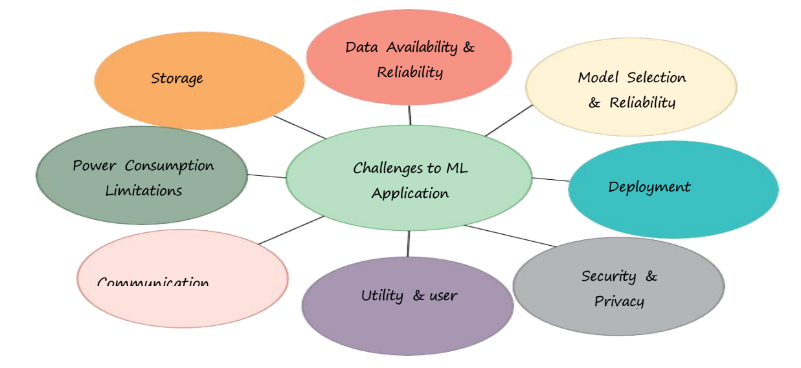
Challenges & Future Work A Visual Approach

Slide 21
Conclusion
Proposed a real-time, scalable, privacy-preserving wearable AI framework
Validated performance using real-world cardiology and oncology datasets
Integrated federated learning and explainable AI for trust and security
Demonstrated early detection, improved accuracy, and reduced hospitalization
Built a closed-loop system for predictive and preventive healthcare
Supported by multiple ML models and real-time feedback channels
Strong potential for clinical adoption and broader healthcare impact
Thank you – I look forward to your feedback and questions
.

Slide 22
Key References
Sabry, F., et al. (2022). An AI-based wearable system for real-time fall and stress detection using deep learning. IEEE Access, 10, 8897–8910.
(Used for understanding wearable-based ML models and real-time detection accuracy.)
Saad, M., et al. (2024). Machine learning in epilepsy and arrhythmia detection using wearable EEG/ECG data. Sensors, 24(1), 302.
(Highlighted model accuracy and biosignal usage relevant to this study.)
Shokouhifar, B., & Asadi, S. (2022). A survey on AI-powered wearable healthcare systems. Journal of Biomedical Informatics, 132, 104099.
(Provides a foundation for AI integration with wearable IoMT devices.)
Tubaishat, M. (2020). IoT-based health monitoring systems: a review of machine learning approaches. Healthcare Informatics Research, 26(3), 164–171.
(Informs on sensor types, data handling, and ML application trends.)
Rajpurkar, P., et al. (2017). Cardiologist-level arrhythmia detection with deep neural networks. Nature Medicine, 25, 433–438.
(Supports ECG-based prediction models and performance metrics.)
Wang, L., et al. (2023). Explainable AI for healthcare: applications in wearable devices and federated learning. ACM Computing Surveys, 55(4), 1–38.
(Validates your focus on privacy and SHAP-based explainability.)
Kwon, S., et al. (2021). Predictive analytics in chronic disease management using wearables and EHRs. IEEE Journal of Biomedical and Health Informatics, 25(6), 2034–2045.
(Demonstrates clinical utility of integrating EHRs and wearable data.)

Slide 23
THANKS!
Any questions?

