Slide 1

The Rise of Fintech and its Disruption of Traditional Banking Services

Slide 2


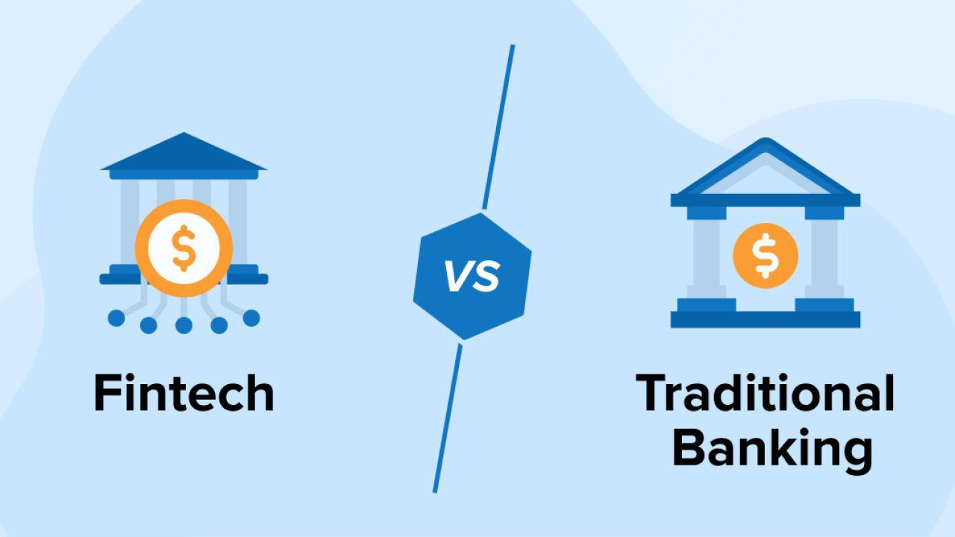
INTRODUCTION
Fin+Tech = Financial technology
Technological Advancements
Appeal to Young Consumers
Cost Efficiency
Challenges for Traditional Banks
Customer-Centric Approach

Slide 3


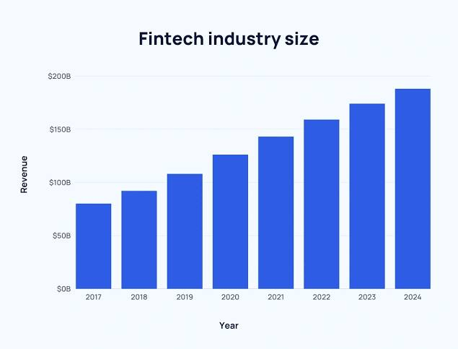
GOAL OF FINTECH
Disrupt Traditional Banking
Improve payment systems
Lower costs
Enhancing speed and convenience
Strengthen Security and Compliance

Slide 4


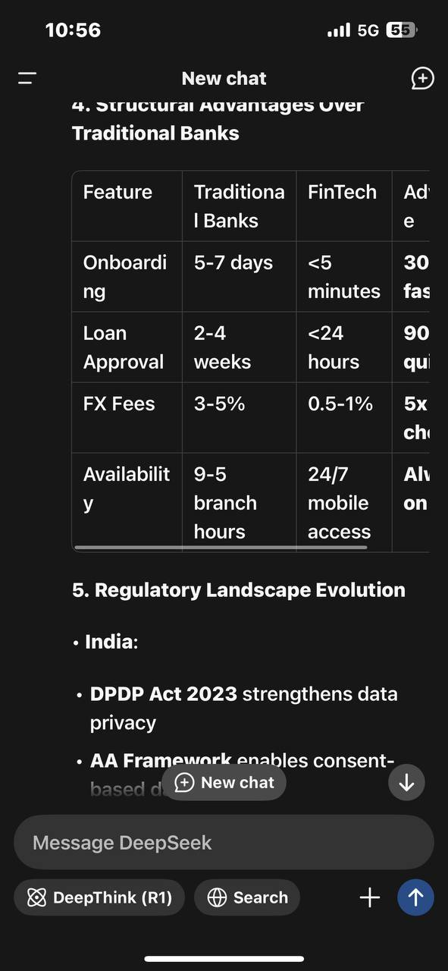
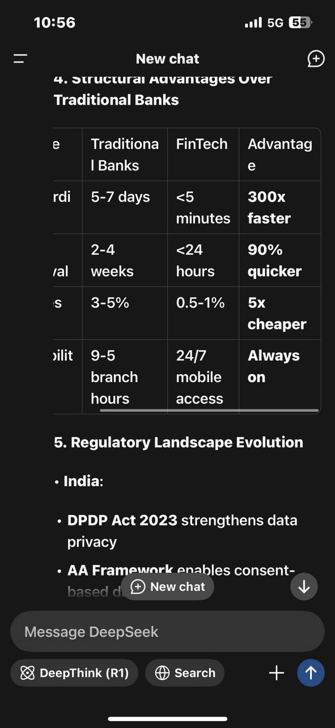
WHY FINTECH

Slide 5
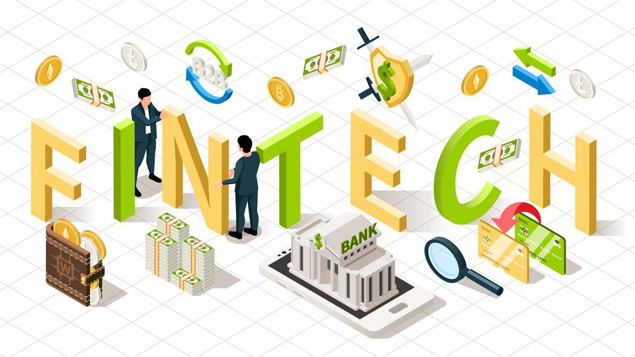
METHODOLOGY
the data is qualitative and it is collected through different sources
Approach- reviewed 100+ sources to identify patterns
Data sources- RBI/ NPCI reports provided stats
Academic Research papers

Slide 6
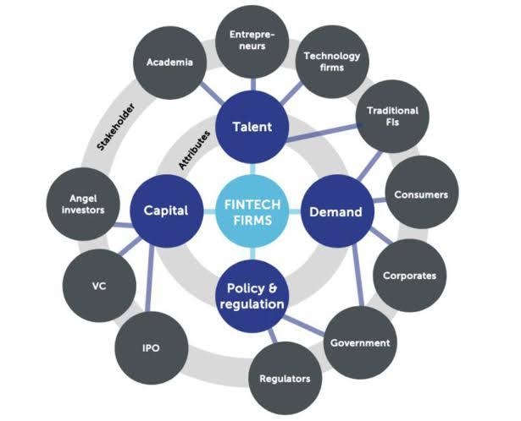
KEY FINDINGS
1. Digital Payments:
- UPI
- Impact: Small vendors now accept digital payments
2. Alternative Lending:
- FinTechs use non-traditional data
3. Customer Experience:
- AI chatbots

Slide 7

CHALLENGES AND RISKS
Operational Risks
• Fast scaling without strong infrastructure can lead to service crashes or errors.
Low Financial and Digital Literacy
• Many people don’t understand how digital finance works.
Sustainability of Business Models
• Some FinTechs burn large amounts of capital without profits.
Data Privacy Concerns
• Users worry about how their personal and financial data is used or sold.

Slide 8
CONCLUSION
FinTech is Changing the Game
• FinTech has made financial services faster, cheaper, and easier to access — especially for people in rural areas.
Traditional Banks Need to Evolve
• Banks can’t keep doing things the old way — they must go digital and offer smart, tech-friendly services.
The Future is Teamwork
• Instead of fighting FinTechs, many banks are now working with them.

Slide 9

Thank YOUU!
Presented by- Anjali Tomar

