Slide 1













THE ROLE OF AJ TO NJNJNISE THE FOOO WASTE IN THE FAST FOOO INOUSTRY
PRESENTED BY:
SHEETAL ROSHANI SAHANI
BY:
DR. PRERNA CHANDEL

Slide 2
Artificial Intelligence (AI) plays a crucial role in reducing food waste in the fast food Tndustry by optimizing inventory management, demand forecasting, and kitchen operations. Al-powered systems analyze historical sales data, customer patterns, and real-time inputs to predict demand accurately, helping businesses prepare the rTght amount of food.
Reducing Food Waste: Al Predicts demand more accurately, reducing overproduction and waste. Al driven forecasting can cut food waste by up to 30%. Optimizing supply chains: Al optimizes inventory and transportation, reducing spoilage by as much as 50%. Sustainable Packaging: Al helps design eco-friendly packaging, leading to a 20% reduction in Plastic use in recent years. Energy management: Al reduces energy consumption in manufacturing by 15%-25%, lowering the carbon footprint. Sustainable Sourcing: Al tracks raw material sustainability, reducing the carbon footprint by 10%

Slide 3
‘The Role of Artificial intelligence to Minimize food waste in the fast-food industry’ has taking attention in recent years due to its potential to enhance sustainability and optimize resource utilization and Al role in reducing overproduction, improving inventory management, and fostering circular economy practices.
NATIONAL AUTHORS
Kumari Behera et al. (2021), Chennai, Tamil Nadu
Al-Based Waste Classifier with YOLOv3 Developed an Al-based waste classification system using deep learning.
The Al model improved waste classification, aiding food waste management.
Sama et al. (2021) - Thapar Institute, Patiala & Chandigarh, India
Al-Based Management of Food Wastage
Built an Al-based framework to manage food wastage. Food waste reduced by 20% in pilot tests within university messes.
INTERNATIONAL AUTHORS
Mazloumian et al. (2020), Munich, Germany
Deep learning for classifying food waste Developed a deep learning model to classify types of food waste for better understanding and reduction.
The model provided useful insights and effectively classified waste, aiding in waste reduction.
Wu et al. (2023) - China (BISTU, Beijing)
Real-time robust optimization of perishable supply
chains using Digital Twins
Developed real-time optimization model
Enhanced real-time visi ty and decision-making in supply chain operations.

Slide 4

Dr. Ali et ol. (2022) - Hgderobod, Telongono Food Waste Reduction through Predictive Modeling and Al-Driven Inventory Management Evaluated predictive modeling and AI for inventory in reducing food waste.
Led to optimized storage and a 15⁰/»decrease in
spoiled inventory.
Fesenfeld et al. (2022) - Switzerland
Policy Framing, Design, and Feedback for Food Waste Regulation
Explored AI's role in aligning food waste
governance with sustainability..
AI helped integrate policies with sustainability, addressing the complexity of food waste governance.
Onyeaka et al. (2023) - UK (University of Birmingham)
Sustainable Al solutions for food waste management
Examined AI's sustainability role
AI reduces food waste while enhancing environmental sustainability.
Borigarde et al. (2024) - Kolhapur, Maharashtra Use of Machine Learning and Al in food spoilage detection
Early detection of food spoilage AI reduced spoilage by 15%.

Slide 5
Explore company Cases building an Al-Based framework to manage food wastages and
sustainable innovations in the food industry.
Evaluate Al and Machine IearnTng for detecting early signs of food spoilage.

Slide 6
The research methodology employed a multi-faceted approach, utilizing secondary data from national and international studies on Al in food waste management. Key data sources included neural network analysis of food images, IoT-enabled smart bins, regression models, and digital twin technologies. The study incorporated case studies and surveys across Germany, China, India, the UK, and the USA. Methodological approaches included bibliometric analysis, historical data analysis, predictive modeling, and policy-driven Al applications in the food industry.

Slide 7
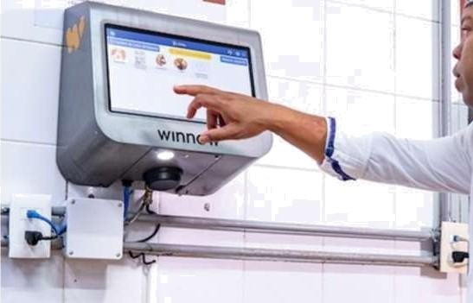


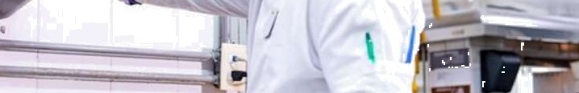

DISCUSSION
Marriott Hotels UK launches Winnow Al food
waste reduction technology
Marriott Hotels in the UK have adopted Winnow, an Al-driven food waste reduction technology, to enhance sustainability in their kitchen operations. The system uses smart scales and Al-powered cameras to track and analyze food waste in real-time. This data helps chefs and staff understand what is being wasted and why, enabling them to make informed decisions on menu planning, portion control, and inventory management.

Slide 8
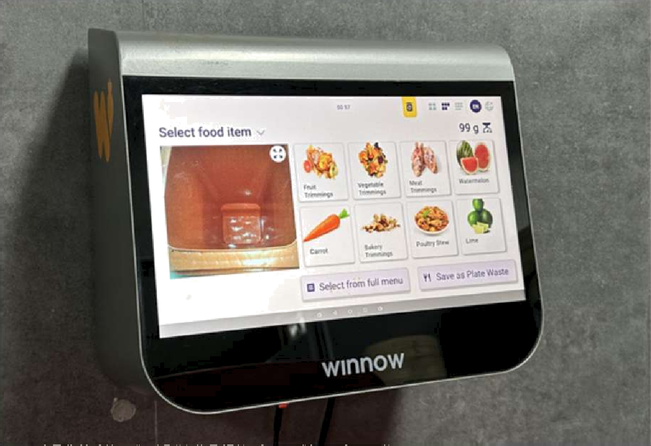
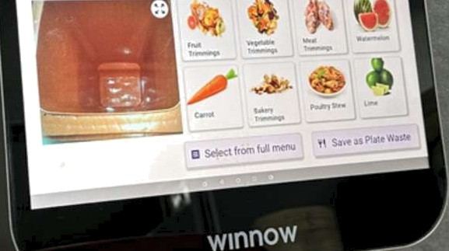
Hilton Singapore Orchard tackles food waste with Al tool
Hilton Singapore Orchard has implemented the Wicnow system, an Al-powered solution designed to reduce food waste ie commercia\ kitchecs. The system utilizes a motion- sensor camera and smart scales to identify and quantify food waste as it is discarded. By analyzing this data, the hotel can adjust portion sizes, refine menu offerings, and improve inventory managemect, leading to significant reductions ie food waste. This initiative aligns with Hilton's broader sustainability goals to cut landfill waste by 50% by 2030 .
The Winnow system allows the hotel to implement targeted strategies to pinpoint food waste streams from kitchen production

Slide 9
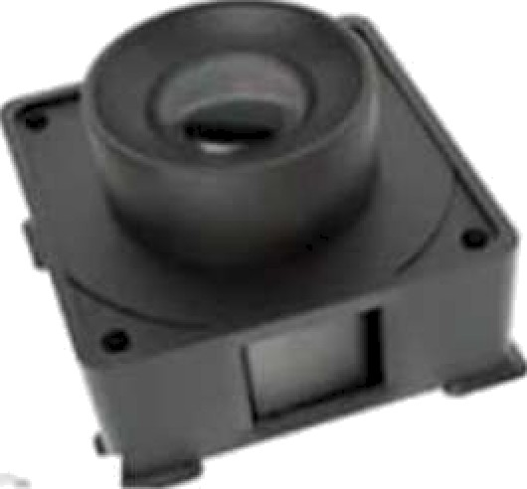
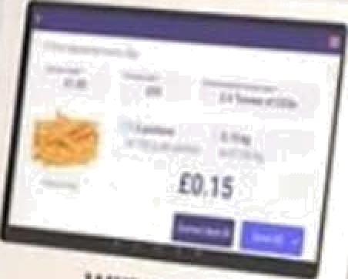
lntelligent Camera
Advance Garbage Bin
Food Identification
Food Cost
... ” +/>«>=
Winnow's Al-powered food waste tracking system, designed to help commercial kitchens
reduce food waste by leveraging intelligent technologies.
Breakdown of the Components:
Intelligent Camera
Advanced Garbage Bin
Food identification
Food cost display
Purpose and Benefits:
Waste Reduction
Cost savings
sustainability
Data-driven decision making

Slide 10


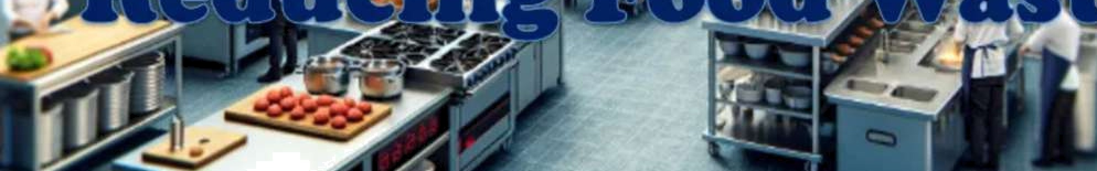
How #Technologies (Al,IOT,Camera) can
help in reducing Food Waste
Technologies like AI (Artificial Intelligence), IoT
(Internet of Things), and Intelligent Cameras are
” transforming food waste management by
” introducing automation, real-time data collection, and smart decision-making. Here's how each of these technologies contributes:
Artificial Ictelligence (AI)
Internet of Things (IoT)
Cameras (Computer vision)

Slide 11
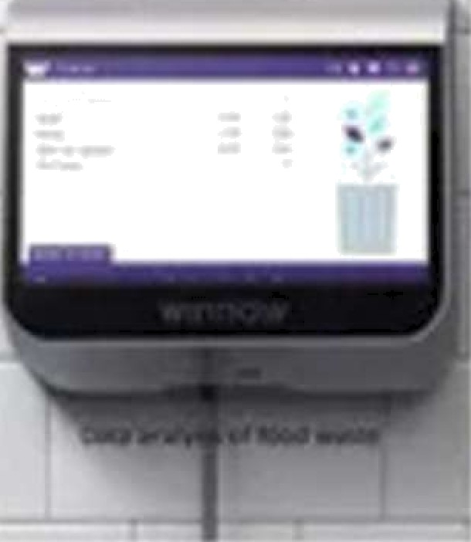
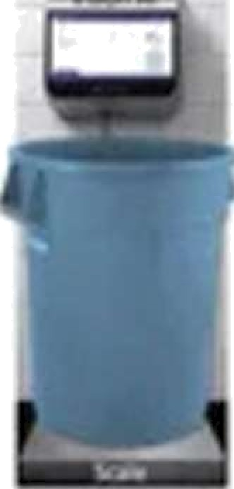
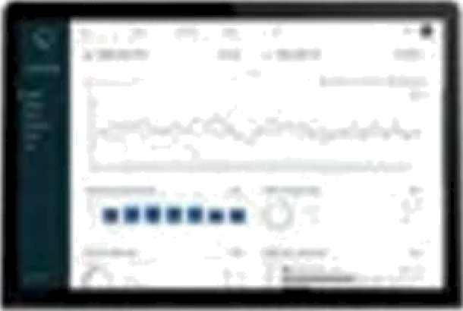
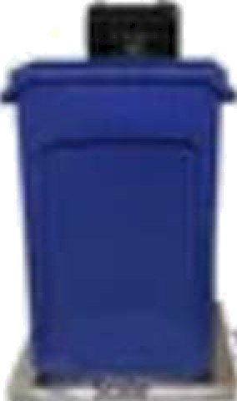
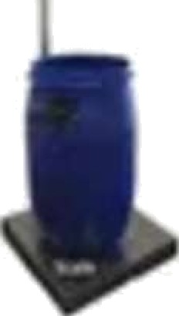
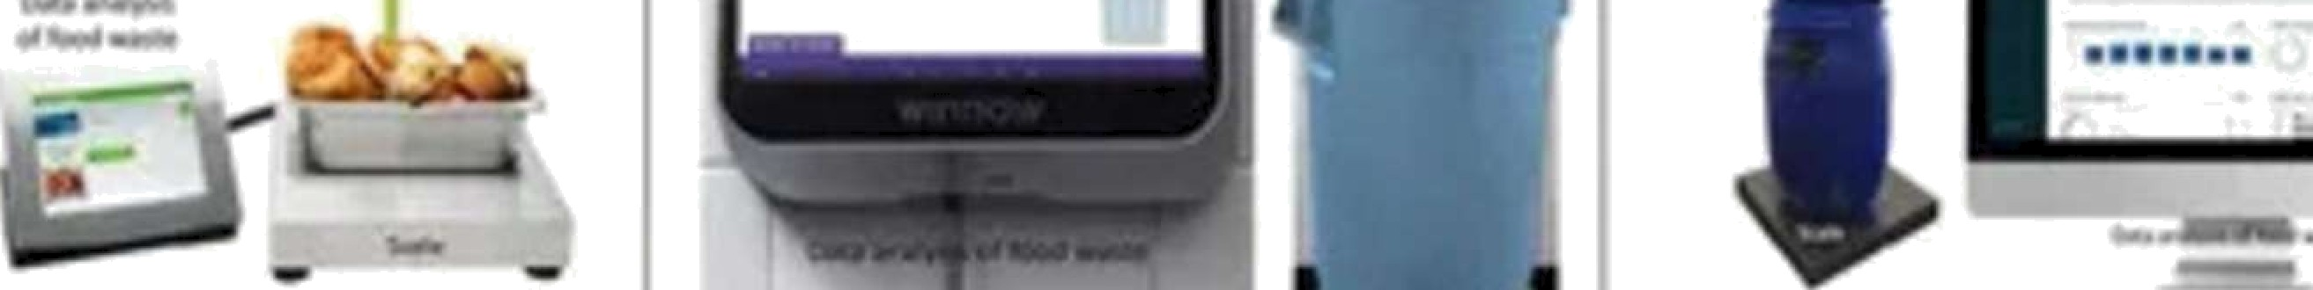
the potential of Al-driven food waste management strategies used
in the hospitality industry for application in househo\d settings
This study explores the potential for adapting Al-driven food waste management strategies from the hospitality industry for application in household settings. The hospitality industry, particularly hotels and restaurants, has implemented AI technologies through companies like Leanpath, Winnow, and Kitro, which use real- time data and predictive analytics to monitor, categorize, and reduce food waste.
(la) Leanpath's Solution (USA)
(lb) Wicnow's System (UK)
(1c) KITRO's System (Switzerland)

Slide 12
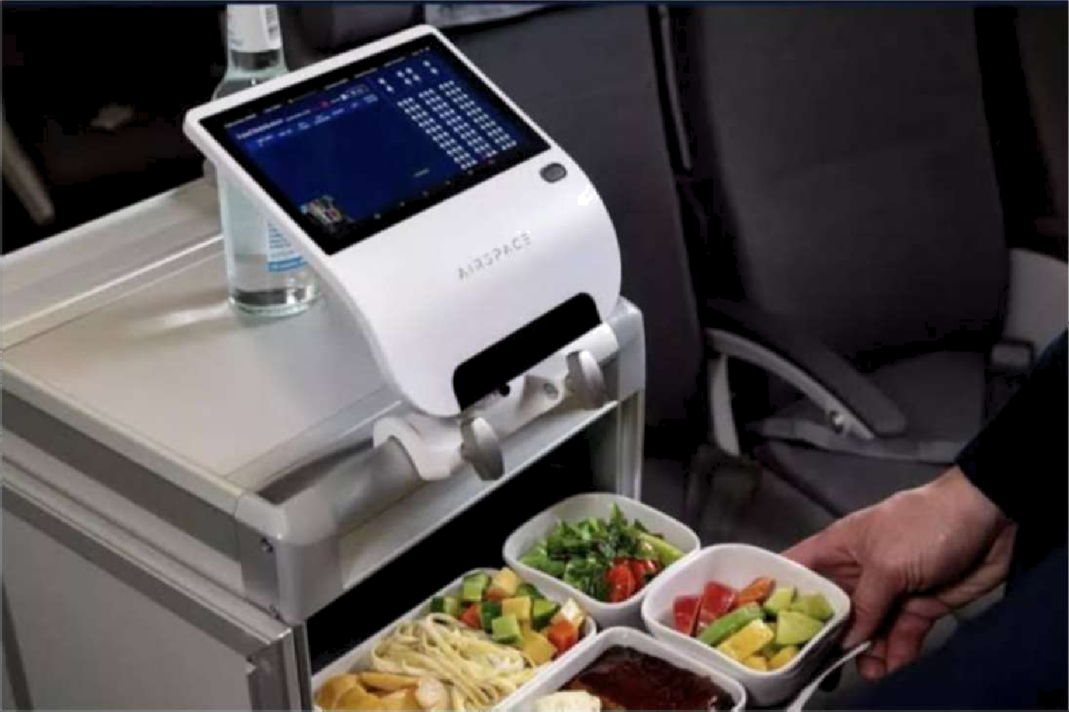
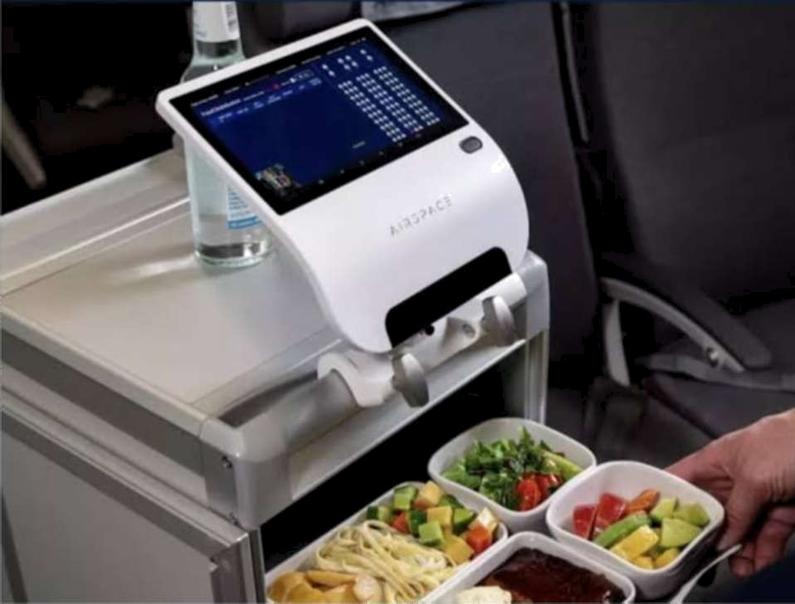
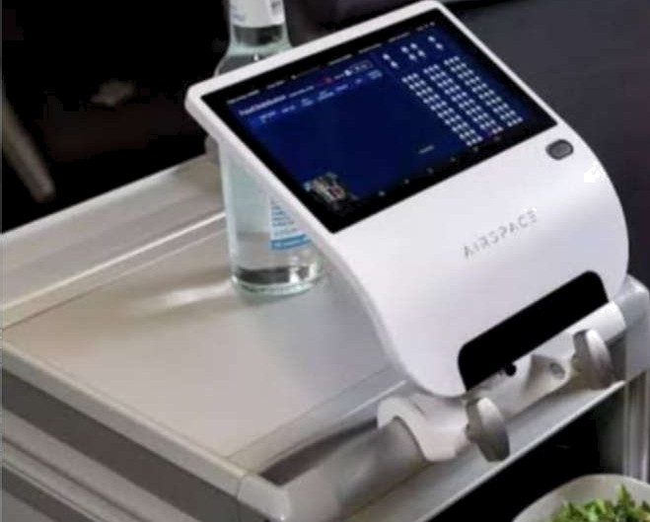
A smart food service system used in airlines, integrating digital technology to enhance meal
service and potentially reduce food waste.
Key Features and Interpretation:
Smart Tablet/Device (AIRSPACE branded)
Meal Tray with Pre-portioned Dishes
Use of Technology in Food Logistics

Slide 13


Food waste is a major problem in hospitality. The JW Marriott Hotels uses the Winnow Al food waste reduction system, which leverages smart scales and computer vision to track food waste in real-time. Similarly, Hilton Singapore Orchard employs Al tools to track food waste patterns and predict future demand. These systems help kitchens prepare only what's needed, reducing waste. The integration of Al and loT devices, such as smart cameras and sensors, provides real-time data for waste management and promotes sustainability. Future innovations could include Al-powered fridges that track expiry dates, helping prevent waste at the source. ThTs TndTcates a significant potential for scalable, personalized food waste management.

Slide 14


