Slide 1
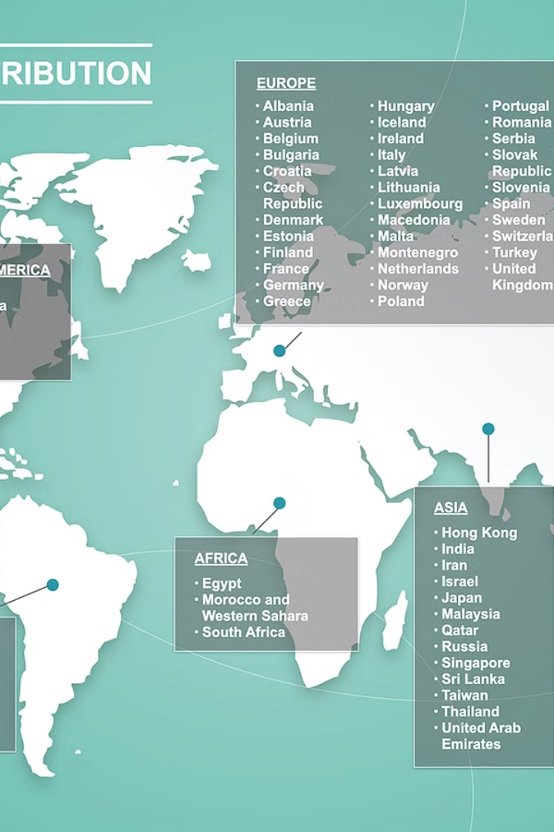

AN EXPLORATORY STUDY ON THE SUPPLY CHAIN MANAGEMENT PRACTICES OF A DISTRIBUTOR
Santosh K, Management - Logistics

Slide 2
Distribution has become a key aspect of the business in recent times, especially with the global markets being open and reachable for all without any geographical limitations. International Brands of commodities such as mobile phones, laptops, electronic goods, luxury jewels, clothing, footwear, food products, spices, oil, etc. being produced in one country are now available in other countries, posing a challenge to all the suppliers to make their products available across the globe through their subsidiaries or through their distributors.

Slide 3

Scope of Supply Chain Management Practice
1
Forecasting & Purchasing
A structured way of forecasting is done to procure the right quantity of products with due input from the sales and the management of the company.
2
Import by the distributor
A distributor can use modes of transport such as land, sea, or air depending on the distance, cost, and requirement of products to be distributed.
3
Storage by a distributor
A distributor stores the goods received by the supplier using different methods as suitable and convenient for the goods to be exported and distributed.

Slide 4
Challenges and Strategies
Challenges
Strategies
Examine the challenges faced by the distributor in managing the supply chain.
Explore the strategies used by the distributor to manage the supply chain.
For low-value cargo such as FMCG products, fertilizers, grains, cloths, etc., generally a distributor uses sea if the distance is far or land if the distance is short.
For high-value goods such as mobile phones, laptops, etc., distributors use Air for the fact that their shipment reaches fast and can be distributed as quick as possible.

Slide 5

Case Study Approach
1
Data Collection
2
Primary Data
The proposed research will be conducted through a case study approach. Survey method and Questionnaires will be used to collect data.
The primary data will be collected through interviews with the key stakeholders.

Slide 6

Data Analysis
Content Analysis
Patterns and Trends
Data thus collected through interviews and self-experience and data from literature review will be analyzed using content analysis.
The analysis will help identify the supply chain management practices, challenges, strategies, and best practices used by the distributor.

Slide 7


Expected Outcome
Identify Practices
Examine Challenges
Identify the current supply chain management practices of the distributor.
Examine the challenges faced by the distributor in managing the supply chain.

Slide 8


Conclusion
Valuable Insights
Useful Findings
The proposed research study on the supply chain management practices of a distributor will provide valuable insights into the supply chain management practices of the distributor.
The findings of the study will be useful for the supply chain management professionals with a special focus on the distributor in improving their supply chain management practices.

Slide 9
References
Johnson, P. F., & Leenders, M. R. (2012). Purchasing and supply management. McGraw-Hill Education
Armstrong, J. S. (2001). Principles of forecasting: A handbook for researchers and practitioners. Springer Science & Business Media
Chopra, S., & Meindl, P. (2016). Supply chain management: Strategy, planning, and operation. Pearson
Study of Select Issues of Resilient Supply Chain by Dr. Rajesh 2017

