Slide 1
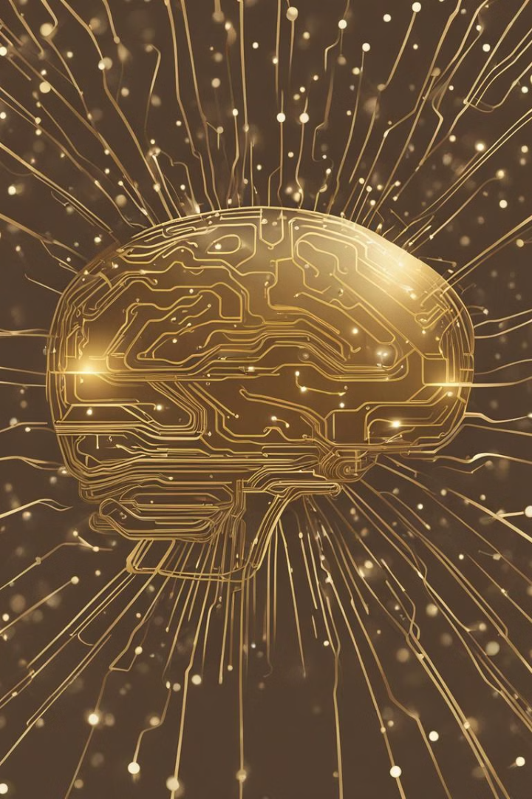

The Brain-Computer Interface: A Deeper Understanding
Bushra Khatoon Zaidi, Mangalayatan University, India, bk.zaidi2020@gmail.com
Dr. Meena Chaudhary, Mangalayatan University, India, meenachaudhary9350@gmail.com
Dr. Javed Wasim, Mangalayatan University, India, javed.wasim@mangalayatan.edu.in

Slide 2
Introduction
A technique known as brain-computer interface, or BCI, allows a person to use brain impulses to operate an external equipment. Research on BCI has mostly focused on biomedical functions, such as assisting those who are neurologically ill, have had a stroke, or have sustained a physical injury. Among other things, BCIs could help the disabled and improve public safety capacities. For BCI investigation, experimenters can utilize a variety of vibrant software tools and platforms, including as BCI2000, OpenViBE, TOBI, BCILAB, and BCI. Software with a variety of features, such as source localization, shaft detection, artefact rejection, diapason analysis, and connectivity assessment capabilities, is also briefly analyzed in relation to one another. An aspect of this paper also aims to help readers and users of tech to understand the ethics and concerns which this technology builds in its boundaries and limitations.

Slide 3

Understanding the Mechanism
1
BCI Types
There are two types of brain activity tracking techniques: invasive and non-invasive brain activity communication. The usage of EEG signals is non-invasive. The scalp is covered in electrodes to record brain activity. CIS and augment intelligence technologies are intended to assist individuals suffering from motor nerve damage, among other goals.
2
BCI Functionality
BCI is the study of central nervous system activity monitoring, recording, analyzing, and translating brain signals into actions, as well as measuring and converting data into an output that may be sent into a computer to be utilized as an input signal.

Slide 4
Decoding Thoughts to Text- How?
Accessing AAC Systems
Neuroprosthesis
Brain-computer interfaces (BCIs) offer ways to access AAC (Augmentative and Alternative Communication) systems by detecting cerebral activity via electroencephalography (EEG), functional near-infrared spectroscopy (fNIRS) and other neuroimaging techniques.
A neuroprosthesis that can directly decode artificial speech from neural signals in the brain regions responsible for speech production is the basis of another cutting-edge method.

Slide 5
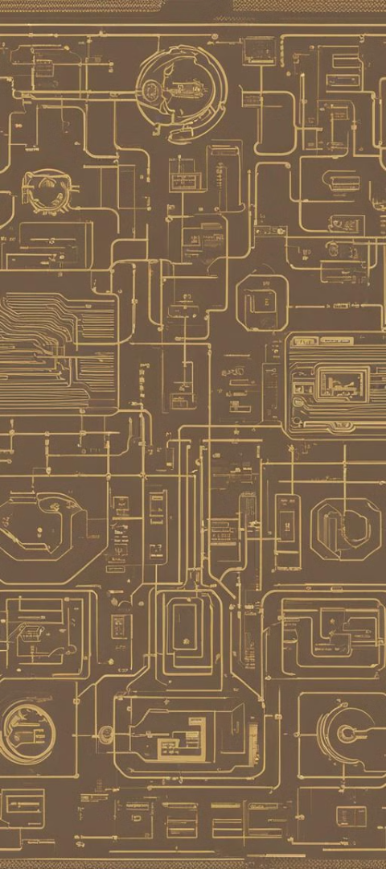
A.BCI2000
Software Suite
Compatibility
A software suite for investigating brain-computer interfaces (BCIs) is called BCI2000. It is a general-purpose, open-source software system available for free for non-commercial usage.
BCI2000 is compatible with multiple brain signals, study/feedback paradigms, and data access methods.

Slide 6
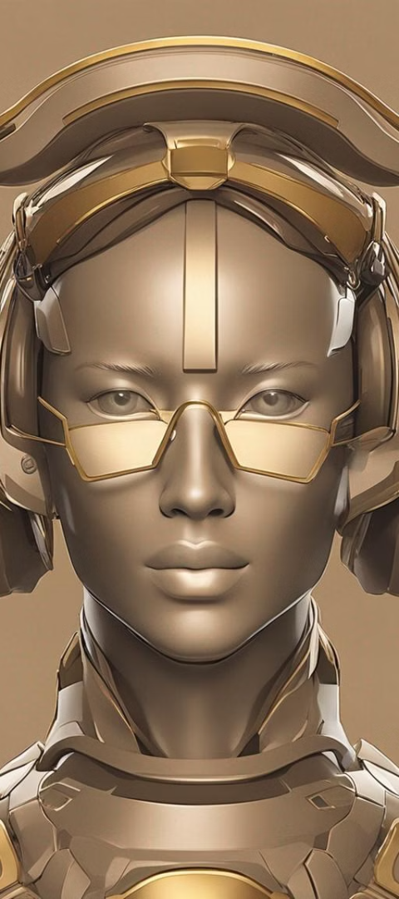
B.Open-ViBE
1
Real-Time Neurosciences
2
User-Friendly Interface
Software for real-time neurosciences, or real-time brain signal processing, is known as OpenViBE. Brain signals can be captured, filtered, processed, classified, and visualized in real time with this technology.
OpenVIBE stands out for having a user-friendly graphical user interface (GUI) that enables building a BCI application fast and easy.

Slide 7
C.BCILAB
1K
2
Powerful Toolkit
Feature Extraction
The goal of the toolbox is to accelerate industrial innovation by providing the BCI community with a powerful toolkit for technique research and assessment.
The toolbox makes it easier to create and develop novel techniques for feature extraction, feature selection, and cognitive state classification.

Slide 8



D.BCI++
Framework Modules
Graphical User Interface
The BCI++ framework consists of two main modules that talk to each other over TCP/IP. The first module, referred to as the Hardware Interface Module (HIM), is in charge of processing signals in real time and storing, displaying, and acquiring them.
The second module, called AEnima, provides a Graphical User Interface (GUI) and is built upon a sophisticated 2D/3D graphics engine.

Slide 9
Unnatural Powers- An Ethical Consideration
Enhancement of Intelligence
BCIs enhance, expand, augments, and restores human intelligence.
Autonomy Impact
If a BCI device is directly responsible for a person's decision-making, then that person's autonomy—that is, their capacity for free will—may be negatively impacted.

Slide 10
Conclusion
Despite any potential risks, the ability to fuse the complexity of the human mind with the capabilities of modern technology is a remarkable scientific accomplishment that is beginning to challenge our own ideas about what it means to be human. The promise of BCI technology is beginning to materialize swiftly, resulting in technological improvements that actually enhance our quality of life. It is imperative that we chart a clear course for ethical neuro-engineering going ahead, with the goal of enabling technology and the human mind to collaborate to surpass our own biological constraints. Five of the most popular BCI frameworks have been covered in this article. Every platform has unique features and benefits, even though some, like Open Vibe and BCI2000 (5), have been around for a while and offer a ton of capabilities.

Slide 11
References
Admin. “Discover Openvibe.” OpenViBE, 19 Nov. 2018, openvibe.inria.fr/discover/.
BCI2000, “System Features” National Centre for Adaptive Neurotechnologies,”.Burwell, S., Sample, M., & Racine, E, “Ethical aspects of brain computer interfaces: A scoping review,” BMC Medical Ethics, 18(1), Nov. 2017.
Chandler, J. A., Van der Loos, K. I., Boehnke, S., Beaudry, J. S., Buchman, D. Z., & Illes, J, “Brain Computer Interfaces and communication disabilities: ethical, legal, and social aspects of decoding speech from the brain,” Frontiers in human neuroscience, 16, 841035, Apr. 2021.
Kögel, J., Jox, R.J. & Friedrich, O. “What is it like to use a BCI? – insights from an interview study with brain-computer interface users”. BMC Med Ethics 21, 2 (2020). 10.1186/s12910-019-0442-2.
Kothe, Christian Andreas, and Scott Makeig. “BCILAB: a platform for brain-computer interface development.” Journal of neural engineering vol. 10,5 (2013): 056014. doi:10.1088/1741-2560/10/5/056014
MyNewsdesk, “Brain-Computer Interface Market Share, Size Raising to USD 2,564 Million by 2024 with Noteworthy CAGR 15.1%,” Ameco Research on Global Brain Computer Interfaces Market.
Portillo-Lara, R., Tahirbegi, B., Chapman, C. A., Goding, J. A., & Green, R. A, “Mind the gap: State-of-the-art technologies and applications for EEG-based brain–computer interfaces,” APL Bioengineering, 5(3), July 2021.
“The Core Components.” Tools4bci, tools4bci.github.io/core/. Accessed 16 July 2023.
U.S. Governmental Accountability Office, “Brain-Computer Interfaces,” GAO-22-106118.
Zeng, Y., Sun, K., & Lu, E, “Declaration on the ethics of Brain–computer interfaces and augment intelligence,” AI and Ethics, 1(3), pp. 209–211, Jan. 2021.

