Slide 1
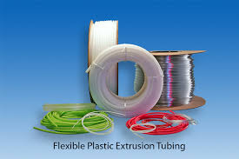
Flexible Plastic Hose Pipe – Research Report
Using 90% Recycled HDPE
By Rahul Kumar

Slide 2
Abstract & Objective
This report documents a flexible hose pipe formulation using 90% recycled HDPE with LLDPE and virgin HDPE, reinforced with galvanized steel wire (Ø 0.18 mm). The recipe is presented for a 100 kg batch with weights in grams, alongside pipe sizes (16, 20, 24, 40 mm), indicative mechanical properties, hose structure diagrams, and a concise extrusion process description suitable for production and QA documentation.

Slide 3
Material Composition
Recipe for 100 kg batch (HDPE, LLDPE, Virgin HDPE, Black MB)
Recipe Part
Component | Weight (g)
HDPE (Recycled) | 90000
LLDPE (Sabic 219ZJ) | 4500
HDPE (GS Caltex TR144) | 5000
Black Masterbatch | 500

Slide 4
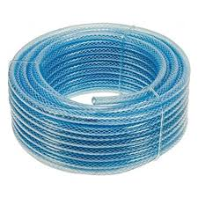
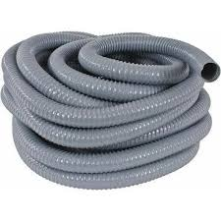
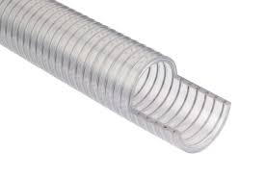
Pipe Sizes & Applications
Sizes: 16 mm, 20 mm, 24 mm, 40 mm
Applications: General-purpose flexible hoses with abrasion resistance and UV protection.

Slide 5
Mechanical Properties
Indicative targets: Tensile strength, density, melt flow rate.
Verify via ASTM D638, D792, D1238; ISO 4427.

Slide 6
Hose Structure
Cross-section: Inner liner, wire reinforcement, outer cover.
Longitudinal view: Galvanized wire spiral reinforcement.

Slide 7
Extrusion Process
Material prep: Ensure pellets are dry; if moisture >0.03% w/w, pre-dry to prevent surface defects.
Compounding/feed: Blend recycled HDPE, LLDPE, virgin HDPE, and black MB per recipe; maintain homogeneous mixing.
Temperature profile (HDPE-dominant blend): Barrel 180–205°C; Head/Die 190–205°C; Melt 200–220°C.
Extrusion and sizing: Use annular die; calibrate with vacuum sizing/cooling tanks; maintain concentricity and wall control.
Wire reinforcement: Apply Ø 0.18 mm galvanized wire as a controlled spiral between liner and cover; ensure adhesion/embedding.
Cooling and haul-off: Multi-stage cooling to avoid residual stress; set line speed to maintain target dimensions.
Marking & QC: Print pipe size, batch, date; perform routine tests (dimensions, tensile where applicable, visual, pressure/burst if required).
ESG Steering Committee: Production, QA, HSE, Procurement, Finance—monthly review of dashboard & actions.
Data Quality & Assurance: Metered data; quarterly internal audit; annual limited assurance before publishing ESG report.
Supplier ESG Due Diligence: Annual audits for recyclate, virgin HDPE, masterbatch, wire; corrective actions tracked.
Operation Clean Sweep (OCS): Plant‑wide SOPs, training, incident logging and KPI reporting.
LCA Roll‑out: ≥50% SKUs in FY2026; 100% in FY2027; use LCA to steer materials/energy decisions.
Community Program: MoU with local NGO to quantify diversion; publish outcomes in ESG report.

Slide 8
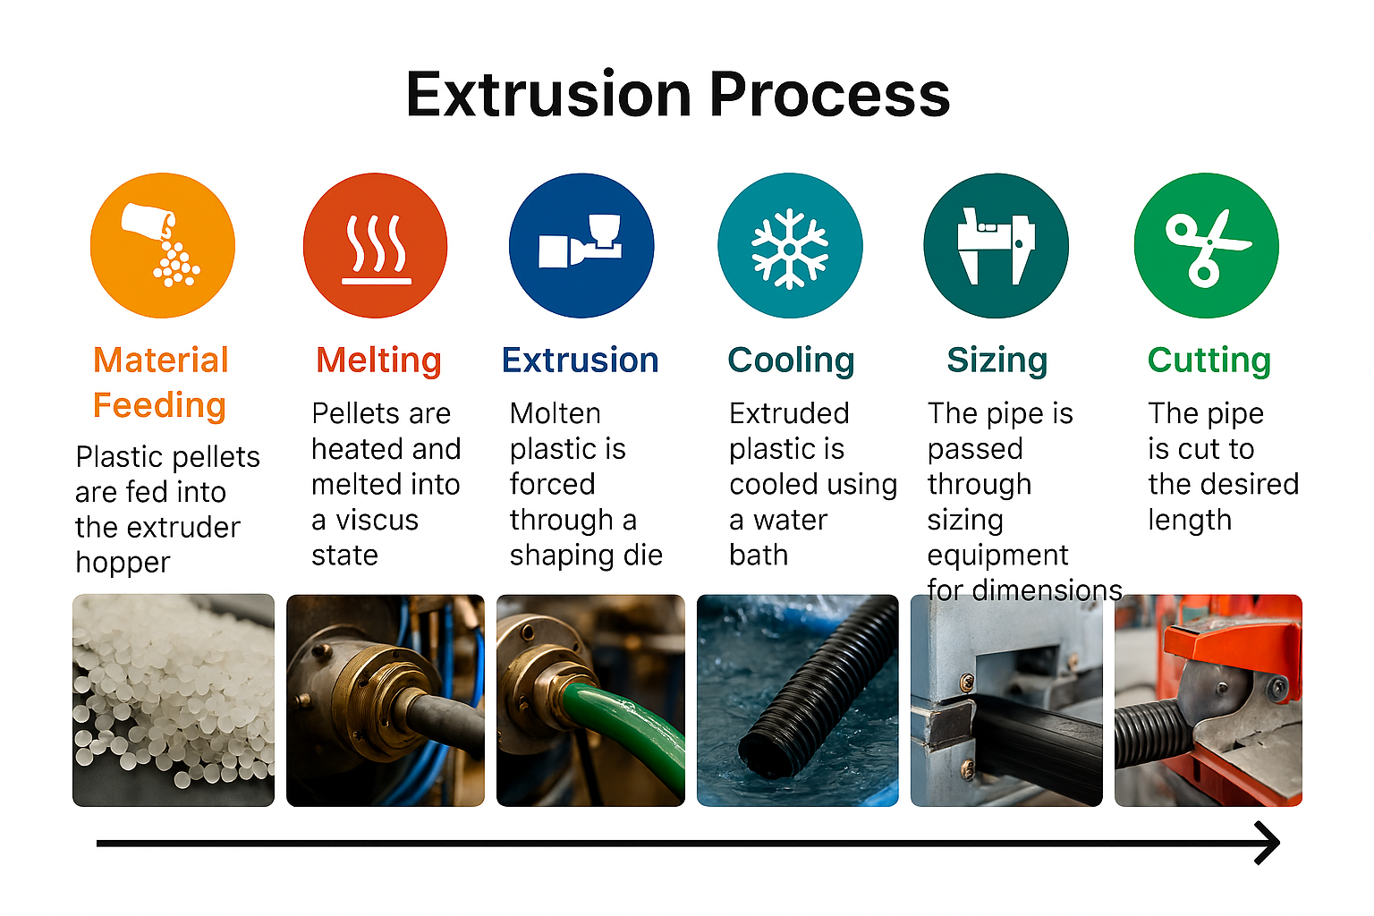

Slide 9
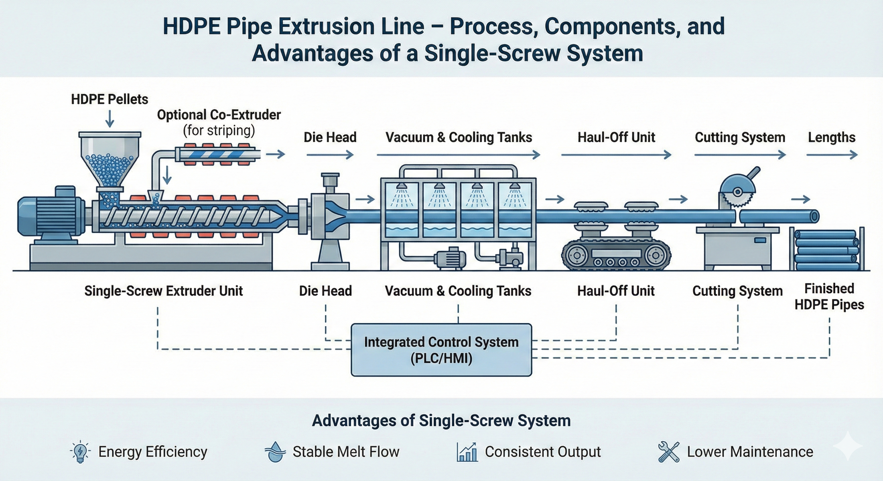
HDPE Pipe Extrusion

Slide 10
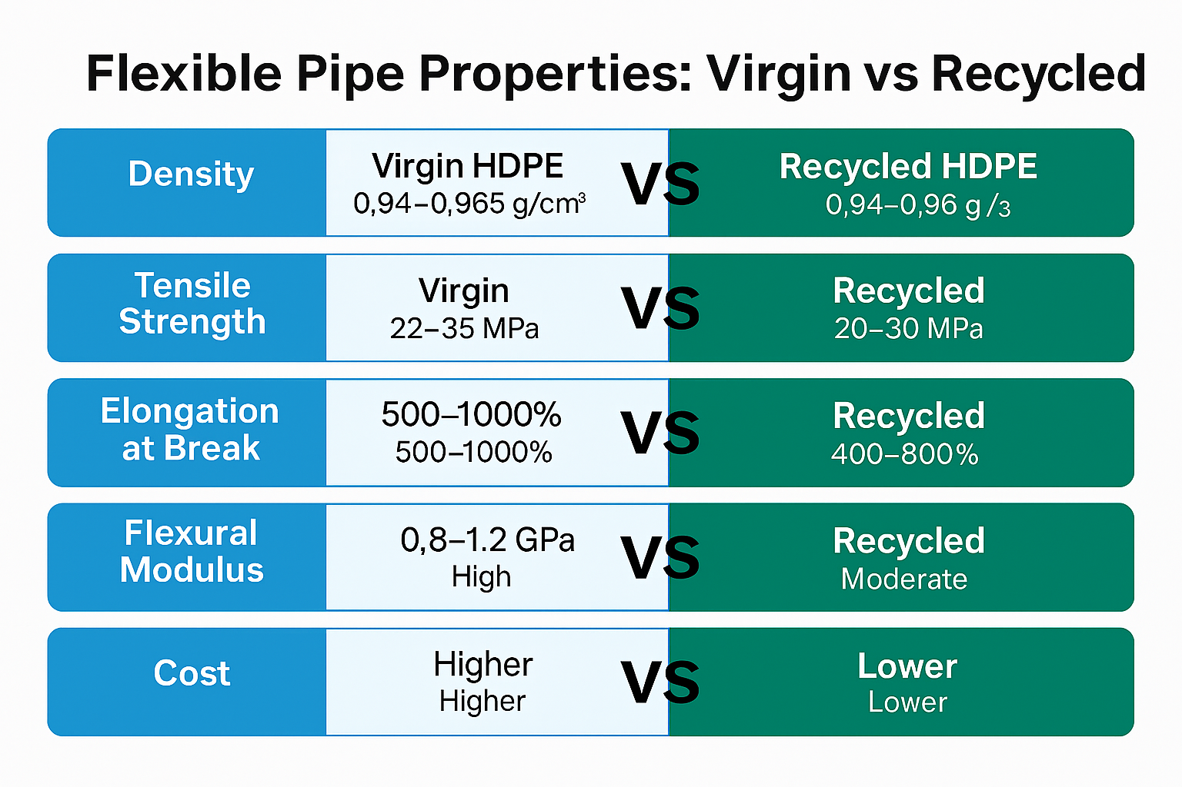

Slide 11
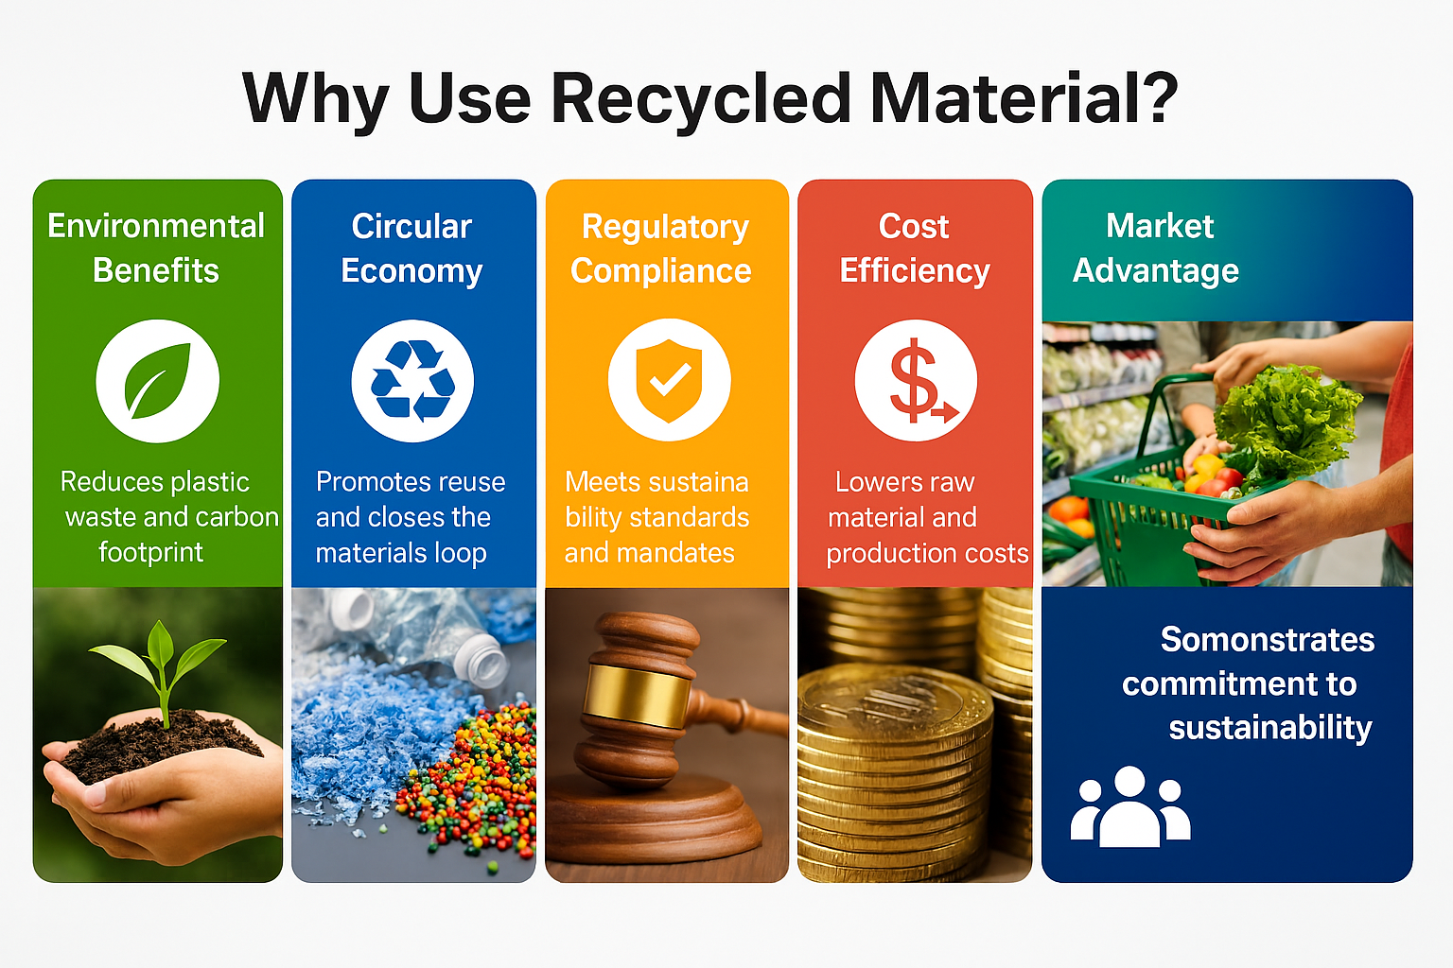

Slide 12
Benefits of Recycling
Environmental Sustainability 90% recycled HDPE reduces virgin plastic usage and supports circular economy. Lower carbon footprint and compliance with ESG goals. Cost Efficiency Recycled material lowers raw material costs. Energy optimization reduces operational expenses. Market Advantage Aligns with global sustainability trends and customer demand for eco-friendly products. Enhances brand reputation and ESG ratings. Regulatory Compliance Meets Extended Producer Responsibility (EPR) and ISO/ASTM standards. Future-proof against stricter environmental regulations. Performance Assurance Maintains flexibility, strength, and durability despite high recycled content. Wire reinforcement ensures pressure resistance for industrial applications. Social & Governance Impact Promotes safe working conditions and community plastic recovery programs. Transparent ESG reporting builds stakeholder trust.

Slide 13
Risk & Mitigation
ESG risk register highlights.
Governance processes: ESG Steering Committee, audits, supplier due diligence.

Slide 14
Conclusion & Next Steps
The presented recipe and process enable production of flexible PE hoses with high recycled content and wire reinforcement. Final mechanical and pressure performance must be validated to the intended service using ASTM/ISO methods. Pipe sizes 16, 20, 24, and 40 mm can be produced by adjusting tooling and SDR selection to meet application demands.

Slide 15
ESG KPI Dashboard

Slide 16
Thanks

