Slide 1
THE IMPACT ASSESSMENT OF TRIBAL WELFARE PROGRAMME ON DEVELOPMENT OF TRIBES OF NAMKUM BLOCK, RANCHI, JHARKHAND
Nitu (Research Scholar)
University Department of Sociology
Ranchi University, Ranchi(Jharkhand)
Supervisor: Dr. Umesh Kumar
HOD, Department of Sociology
Ranchi University, Ranchi(Jharkhand)

Slide 2
ABSTRACT
This research explores the socio-economic impact of welfare schemes on tribal communities in Jharkhand, focusing specifically on the Namkum Block of Ranchi District.Through an analysis of secondary data, the study reveals that while targeted interventions have successfully improved livelihoods and income—particularly in sectors like sericulture—significant barriers remain. Despite these gains, the findings highlight persistent issues such as low awareness, limited program reach, and structural inefficiencies that hinder holistic development. The paper concludes by advocating for localized, tailored strategies to bridge implementation gaps and more effectively address the unique needs of Jharkhand’s Scheduled Tribe population.

Slide 3
INTRODUCTION
Tribal communities in Jharkhand, including the Santhal, Munda, and Oraon, face historical marginalization driven by geographical isolation and limited access to essential social services.
Despite the state’s creation in 2000 to foster regional growth, over 46% of these populations still endure severe economic hardship and a lack of local employment opportunities.
Central and State initiatives like MGNREGA and the Dharti Aaba Janjatiya Gram Utkarsh Abhiyan are vital tools intended to bridge these persistent socio-economic inequalities.
However, the specific micro-level impact of these welfare programs remains largely underexplored, particularly in regions like the Namkum Block of Ranchi District.
This research investigates how policy implementation translates into tangible outcomes for tribal households, identifying both successful interventions and critical implementation gaps.
The study ultimately aims to provide data-driven insights to help tailor future welfare strategies to the unique cultural and economic needs of Jharkhand's tribal heartland.

Slide 4
Research Gap & Rationale
Limited micro-level studies in peri-urban tribal blocks
Gaps between policy intent and implementation
Need evidence-based evaluation for welfare effectiveness

Slide 5
Objectives and hypothesis of the Study
To analyse the socio-economic profile of tribal households in Namkum Block.
To examine access to and participation in major welfare programmes.
To evaluate the impact of welfare schemes on income, employment, education, and health.
To identify gaps in implementation and service delivery.
To suggest policy measures for effective tribal development.

Slide 6
HYPOTHESIS
H₁: Welfare programmes significantly improve household income among tribal communities.
H₂: Welfare programmes positively influence education and skill development.
H₃: Employment-based schemes reduce migration and unemployment.
H₄: Implementation gaps limit the full benefits of welfare schemes.

Slide 7
RESEARCH METHODOLOGY
Descriptive & analytical research design
Secondary data sources (Census, Govt Reports)
Study area: Namkum Block, Ranchi
Tools: Tables, trend analysis & interpretation

Slide 8
Socio-Economic Profile: Namkum Block
Indicator | Value / Statistic
Total Population (Approx.) | 1,45,841 (as per Census 2011)
Scheduled Tribe (ST) Population | 87,472
Percentage of ST Population | 59.98% (~60%)
Major Tribal Communities | Munda, Oraon, Santhal, Lohra
Overall Literacy Rate (Namkum) | 73.72%
Scheduled Tribe Literacy Rate | 58% (Estimated)
Female Literacy Rate (ST) | 46% (Estimated)
Sex Ratio (ST) | 1,010 (Females per 1000 Males)
Average Household Size | 5.2 Members
Primary Occupation | Cultivation & Agricultural Labour (48%)
Source: Census 2011; District Statistical Handbook, Ranchi

Slide 9
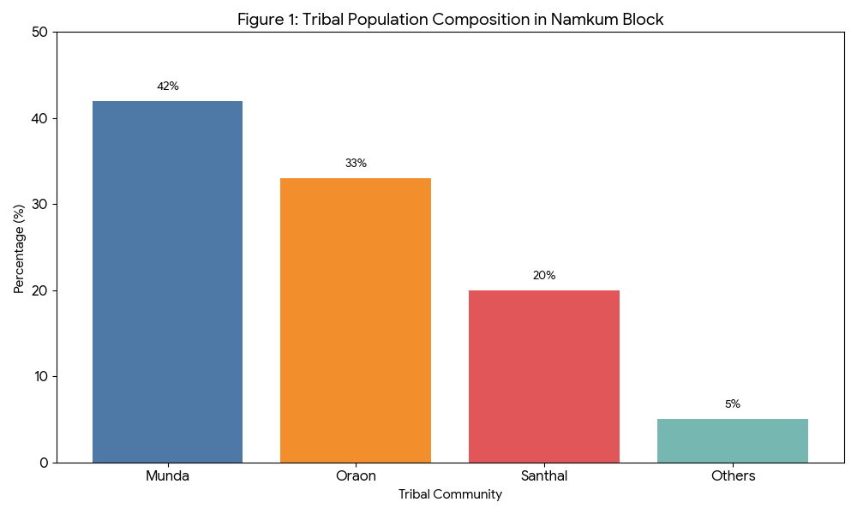
Tribal Population composition in Namkum
Tribe | Munda | Oraon | Santhal |  | Others
Population Percentage | 42% | 33% |  | 20% |  | 5%

Slide 10
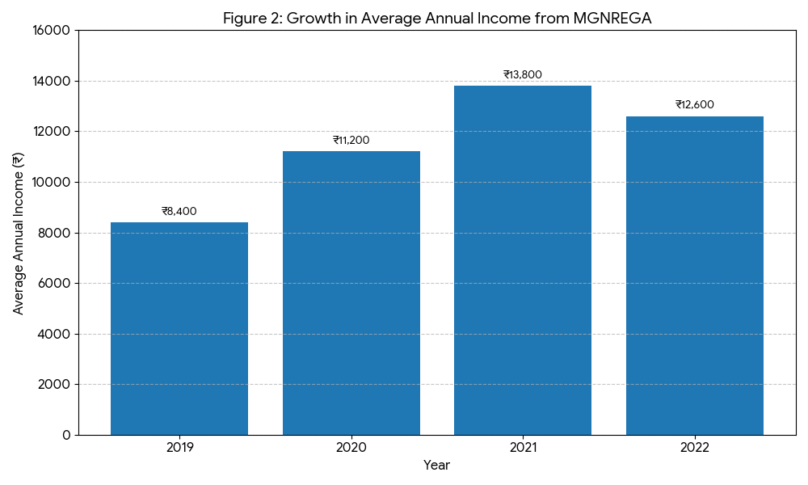
Income Growth under MGNREGA
Year | Job Cards Issued | Avg. Days of Employment | Avg. Annual Income (₹)
2018–19 | 6,200 | 42 | 8,400
2019–20 | 6,750 | 55 | 11,200
2020–21 | 7,100 | 63 | 13,800
2021–22 | 7,480 | 59 | 12,600

Slide 11
Impact of Sericulture on Income
Category of Farmer | Annual Income Before Scheme (₹) | Annual Income After Scheme (₹) | Percentage Increase (%)
Marginal (Less than 1 hectare) | 7,500 | 18,000 | 140%
Small (1–2 hectares) | 12,000 | 35,000 | 191%
Medium (2–4 hectares) | 18,000 | 60,000 | 233%

Slide 12
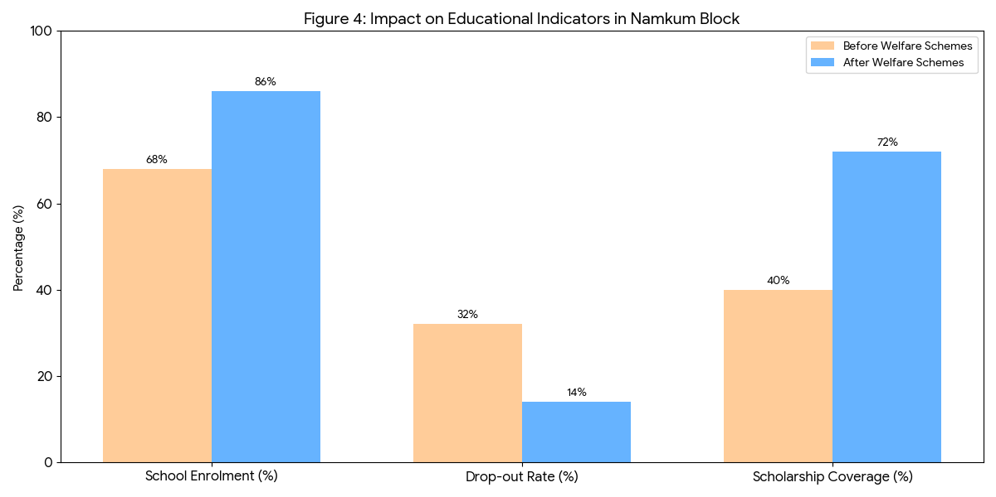
Impact on Education
Indicator | Before Welfare Schemes | After Welfare Schemes | Change (Variance)
School Enrolment (%) | 68% | 86% | +18%
Drop-out Rate (%) | 32% | 14% | -18%
Scholarship Coverage (%) | 40% | 72% | +32%

Slide 13
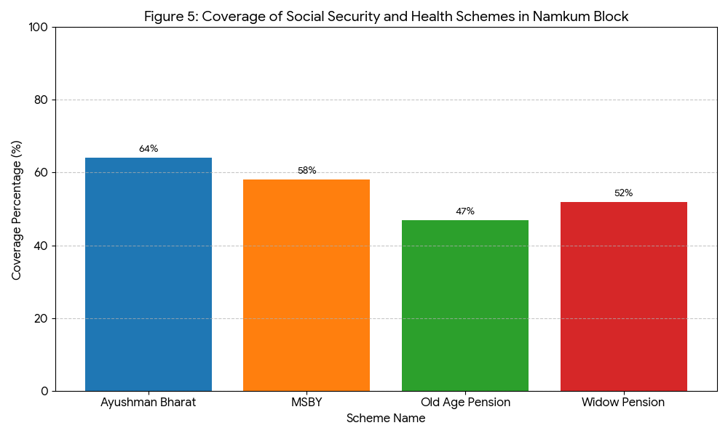
Impact on Health and Social Security
Scheme | Coverage (%) | Description / Impact
Ayushman Bharat | 64% | Provides health insurance for secondary and tertiary care.
MSBY (Mukhya Mantri Swasthya Bima Yojana) | 58% | State-level health insurance complementing central schemes.
Old Age Pension | 47% | Monthly financial assistance for tribal elders (60+).
Widow Pension | 52% | Financial support for destitute and widowed women.

Slide 14
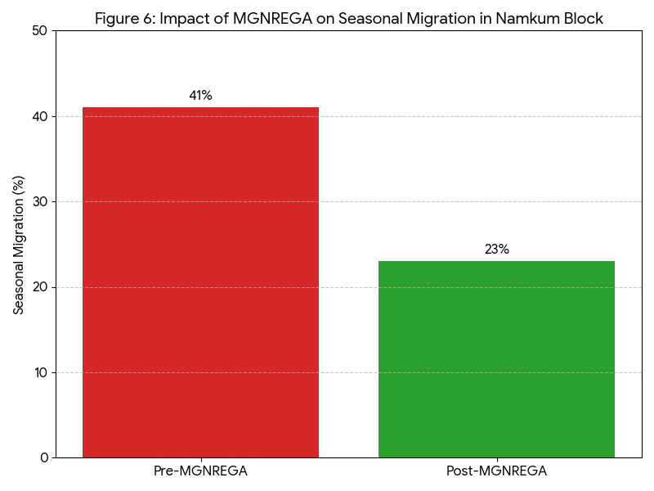
Migration Trends
Period | Seasonal Migration (%) | Impact Description
Pre-MGNREGA | 41% | High dependency on external labor markets; disruption of children's education.
Post-MGNREGA | 23% | Significant decline in distress migration; increased local labor participation.

Slide 15
Discussion of Findings
Employment & livelihood schemes most effective
Education outcomes show consistent improvement
Health & pension coverage still inadequate
Awareness & administrative gaps persist

Slide 16
Conclusion & Policy Suggestions
Welfare programmes positively impact tribal development
Strengthen Gram Sabha participation
Improve scheme awareness & monitoring
Focus on women-centric & livelihood-linked schemes

Slide 17
Thank You
-NITU

