Slide 1
V IOLENCE AGAINST WOMEN
- A N OV ER V IE W
By SAYANTAN ROY
PhD [LAW] Research Scholar of Sikkim Skill University Namthang.

Slide 2
Women are not dying because of a disease
we cannot treat
They are dying because societies have yet to make the decision that their lives are worth savi•ng
MAMOUD FATHALLA/ PRESIDENT FIGO 1997

Slide 3

Violence against women is perhaps the most shameful human rights violation.
And it is perhaps the most pervasive.It knows no boundaries of geography,culture or wealth.
As long as it continues,we cannot claim to be making real progress towards equality,development and peace".
- Kofi Annan

Slide 4
WHAT DO WE UNDERSTAND BY "VIOLENCE AGAINST WOMEN"
"Violence against women" means any act of gender-based violence that results in, or is likely to result in, Physical, Sexual or Psychological
harm or suffering to women, including threats of such acts, coercion or arbitrary deprivation of liberty, whether occurring in public or in private life.

Slide 5



TERMS A ND TERMINOLOGY
IPV­ INTIMATE PARTNER VIOLENCE
GBV­ GENDER BASED VIOLE NCE
DV­ DOMESTIC VIOLENCE
FOGSI NO TO VAW COMMITTEE 2022-2025

Slide 6




VIOLENCE AGAINST WOMEN ENCOMPASSES - BUT NOT BE LIMITED TO

Slide 7




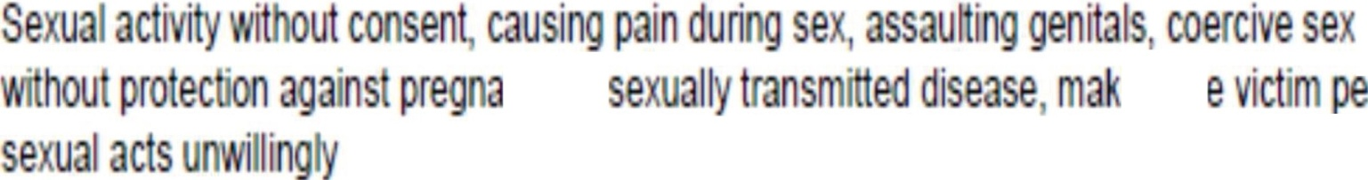

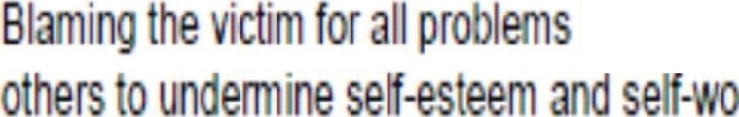
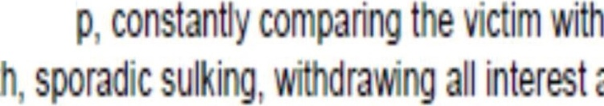

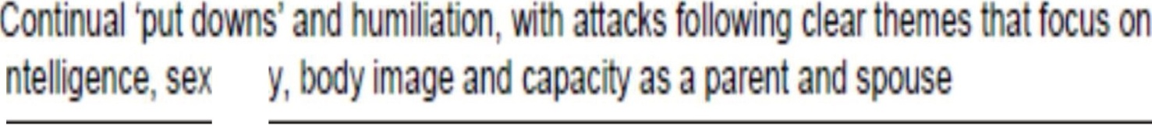
g
t in fr nt f
n
n r
In h
rt
I bu ·
in h r
n hi
.....a•WI rt
)
I b
'U lit

Slide 8



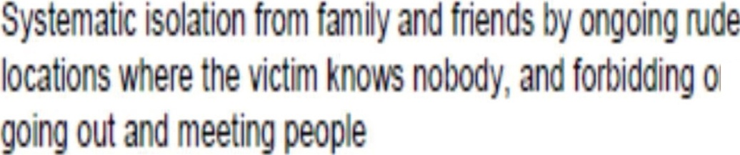
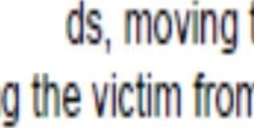




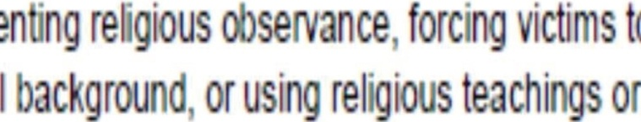
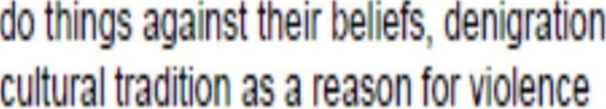
n
r h
ii n f · n
ntin
u
D

Slide 9
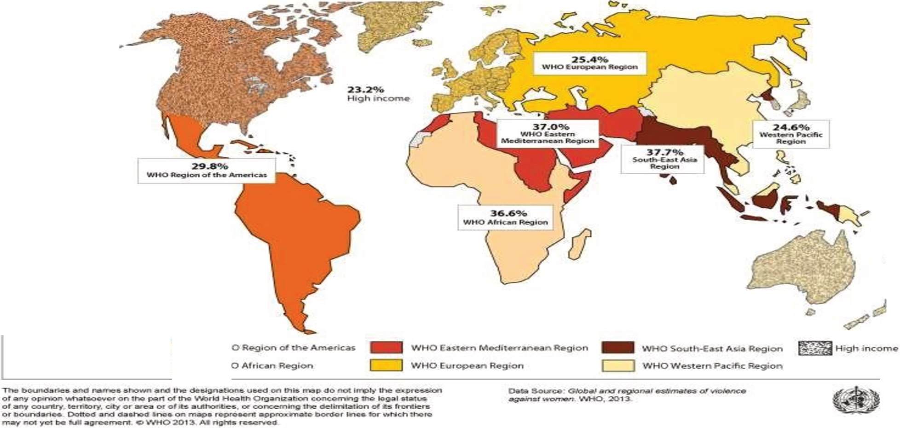

Prevalence rates of intimate partner violence by WHO region*
2010
'
Regional prevalence rau.s ant pre&enu.d or lilJYHO t.,.gJQn inc:tuclng low- nd
middlo-lncx>m c:oun | , ' Ii | '"1C<>rnct
eoun an$yr | ry
WHO Afri n Region
World Health
Orga ni2ation
,
I /
9
'

Slide 10

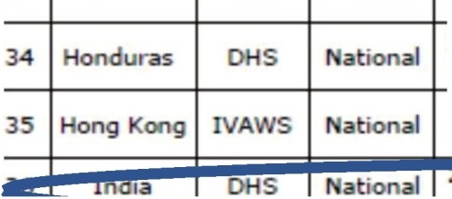
Violence against Women Prevalence Data:Surveys by Country
Compiled by UN Women {as of March 2011)
Intimate P
Physical
Sexual
Forced Abuse
Country
Survey Coverag
Year
first during
sex
<-> <->
Last
12
Ufe-
time
Last
12
Life-
time
UN WOMEN MARCH 2011 VAW PREVALENCE DATA
SURVEYS BY COUNTRY
26 E iopia
0 Provi ce
2.002
29
.7
.4 58.6
53.7
70.9
55.9
16.6
7.5
27 FinIan
ot r
2005
6.3 17.6 2
4.3 7.9
3.5
28
France
IVA
200
.5
0.9
10
29 Georg-a
2005
1.6 4.8 0.3 1.5
2
5
30 Germany
2003
23
7
25
37
13
0
31
G a a
008 18 0.6 s. 8.
0
.9 17. 36.6
18.8
44.5
4.9
5.
32
2002 8.6
3.5
33 ²⁰⁰⁵⁻ 11.5 2006 |  |  | 1 .3 | 9.8 | 10.8 | 16.8 | 20 | 15.6 | 26.5
2005- _{6.3} 2006 |  |  |  |  |  |  |  |  | 1 .7 | 8.7
2005 1 6 9' 2 1 3 14 21
37 |  | 1.4 | 35. |  |  |  | 37.2 | 18.9 | 33.5 |  | 8.5 |  | 3.07
38 | 2003 | 1.4 | 13 | 0.7 | 8 | 3.2 | 14.5
39 | 2006 | 1.7 | 12.2 | 1 | 6.1 | 2.4 | 14.3 | 2.7 | 18.8 | 3.5 | 23.7 | 5.4 | 31.9
5.6
o
l[)HEERA

Slide 11

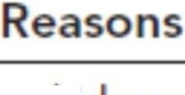


omnipresent
200 06
B r s
o e y
Arg e Goes o t
oo I oes o coo
17.8
27 .6
27 .
35.
Im
MENANDWOMEN IN EQUALITY; ENDOWED WITiiTiiE SAME DIGNITY.
ell i g
eglects t e c i ld re
Re ses o ve sex
i erco rse it
2.5
S e o s disres ect to/
egle s i -la s
A leas o e s ecified re son
6.7

Slide 12
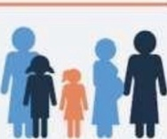





SHADOW PANDEMIC
The Shadow Pandemic: Violence Against Women and Girls and COVID-19
At 1tay-a1-bama ordera aitpond ta contain the spread ol Iha virus, women with violent partneraIncreasingly find th msel,,.. lsala1 d from th• pooplo and ,..ourcas that con help lhem.
women
V.io&ence ogo1mt womeri ond g r1s Is pervos:.., but Cl tl>e $0"'8 ...., W>dely undeM porl&d Less
The globe• COS! ol vi ence
ogo1nst womM hod
were lnrem>onolly lti Pd
p been Ml•moted
In 20 7 Th mo,0<1ty
ol the ngo were
C'Ofl'tMlllod by on lnUmo:e
than 0 of 'Qmen
OI opp< 0101 ly
trillion
Globally,
partner or fa"'l'Y mombef
ot the V1CT1m
who e:icpet ence v,o rice
That lrgurt con only be
r po•t th e er me1 or
sack help 01 ony sort
ds1119 05 vtoloncc lnaeoscs
now, ol'ld conunves In the
million
women ond gllls aged 1!>-49 hove been '"bJe<:led 10
pefP"ltOlt!d by an lnllmall! punnet 1n I e "'""""" 12 montos.
oftennalh of Ule pandenuc
/Oi.lllm1'.
The surge In COVID-19 ca..,.Is straining even th• matt advanced and bflt­ resourc9d health ll'(llem
10 th• breaking poinl,
lncludlng lhosa at tho front
In• In vlolonco retpon...
0omostit VOnte th .tet5
ore reod>lng capocdy, 01
unable 10 10 new vit1 "''
The number Is likely to INCREASE as security, health, and money worries heighten tensions and strains are accentuated by cramped and confined living conditions.
Emorglng data •howl that llnce tho oulbrealr of COVt0-19 , olanco a9aln1t
-m n and 9ll1s (VAWG),and par1icula11y domasoc ot nco, hat IN'IENSIFIED.
duo o lod:down and &OCIOI dt11onctng meosurN In otttef coses, lhey oro being
to>-p<trpo$11d 10 S rve OJ
heahh centers.
Na1lonal rospon1n 10 COVID·l9 must Include:
In Fronce, tepOtlS of domestic. v10 e.ce have
In CypNt and Slngapo•o he4pl nes hovo reg1stefed on lncroas& In colll ol 30l! ond
lncrllOSed by 30!6 11 .:.rhe
lacown on Mor¢ 17
Hll, respectJYofy
Sorvla>1 to oddrou
vlolenee 090ln1t women
A strong mess-ago from low enforcement that impunity wUI no1 bo
loloralod l'OJlce ond
)Ullice odors must ensure
Paychosociol 1upport to• woman and gls a1focll!d by lhe oulbfeo gendar-boed
and girls, mdud ng
\l)Olet'ce SW'il\iOtl, t1oou no
lncr9(Jted CDOe1 of domesl.c
lr<:rooJO<f IOSO<>lces 10
'"'pport s le<S
 | , l>otfl•! | !S
C011 | ntell'ng
heo th worcers and other lron111ne 10001 suppo llalf
VIOlorlCe ond domond tor
ond onllo
l""1 lnc>de•ll• ol VAWG
ore 9'_, Igh pnon"f
must be pnor <Jed
In Argent1no emtKgEJnCy co'ls
emergt!'KY ho"9 olSO bee<1
T ase essenhal 1ef'Yice5
or dorna;1c v1olenc. COiet
111potllld Conado, Gormony,
Spain, lhe United Kingdom
o I.ho Untttd Sta....
sh<>u b@ ""POnded
ond adopted 10 II- Cl1SI$
olld core must be to n to
ha"9 lncr"Osed by 2511 since
o
ddro5
5 the mo111testot1on.s
UN -; ;;
WOMEN H
Illelocoown °" Morch 20
°"'text to ttSura turvlYOJS
of "'°' nett e<nerglng '"
occeu to lllppon
"" conle>d of OOV!D 19

Slide 13
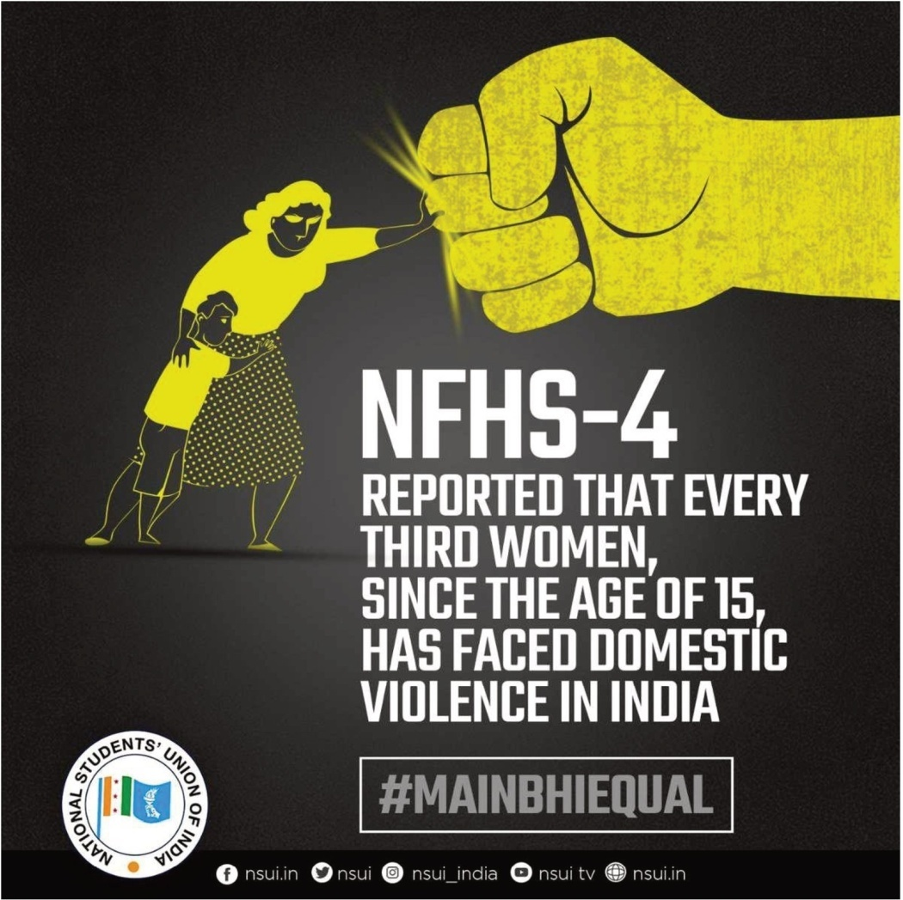



DUBI OUS Di m NCTION
> Women experiencing spousal violence (in
%) as
reported in NFHS IS
TN I Information was gathered from
27,929 households, 25,650women,and 3.372 men
>NFHS-5 fieldwork for Tamil Nadu was conducted from January 6,2020 to March 21,2020 prior to the lockdown and from December 21,2020 to March 31,2021 post lockdown by School of Public Health,SRM University
NHFS 5 (2020-2021)
States
Urban
NHFS findings - 4
(2015-2016)
TN | 32.9 | 42.2 | 38.1 | 40.7
AP | 28.8 | 30.8 | 30.8 | 43.4
Karnataka | 445 | 44.4 | 44.4 | 20.6 I
Telangana | 27.3 | 423 | 36.9 | 42.9
Kerala | 9.9 | 9.9 | 9.9 | 14.3
Delhi | 22.8 | nil | 22.6 | 26.8 I
Maharashtra | 21 | 28.6 | 251 | 21.3 I
Punjab | 10.2 | 12.6 | 11.6 | 20.5 I
West Bengal | 22.9 | 28.7 | 27 | 33 I

Slide 14
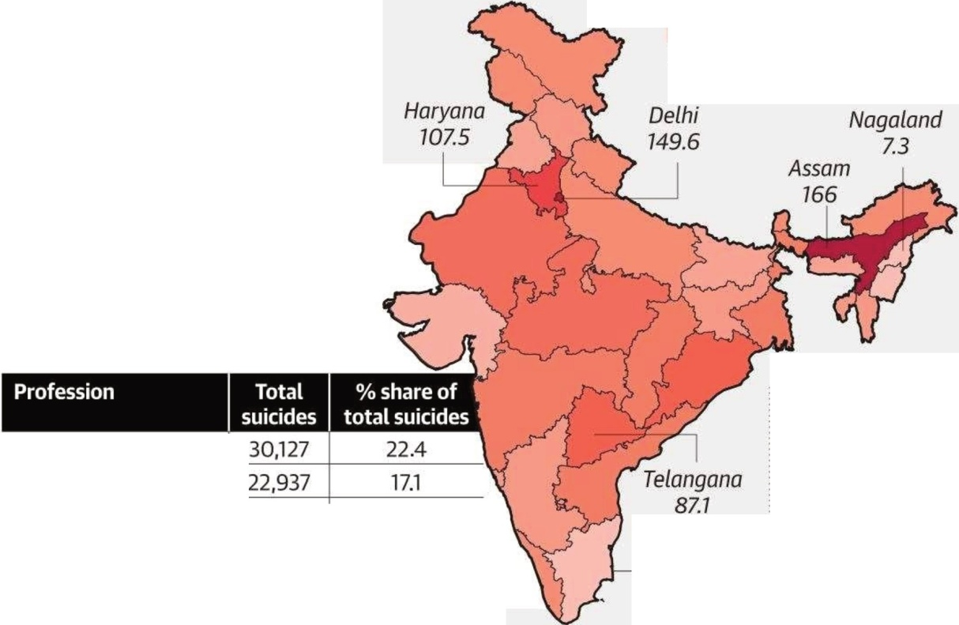
Unsafe spaces
The rate of crimes against women per one lakh of their population increased to 58.8 in 2018 from 57.9 in 2017.
RATE OF TOTAL CRIMES AGAINST WOMEN
7.3 166
Suicides in 2018
As many as 30,127 daily wage earners
committed suicide in 2018, the highest among all professions. The number of suicides among persons engaged in agriculture came down by 2.9% in 2018, compared to 2017
Assam recorded 166 crimes per one lakh women, the highest in the country, followed by Delhi (149.6)
Daily wage earner
Housewife
Student |  | 10,159 | 7.6
Farmer I cultivator | 5,763 |  | 4.3
Agriculturallabourer | 4,586 |  | 3.4
Tamil Nadu 15.4
Source: National Crime Records Bureau's report for 2078

Slide 15

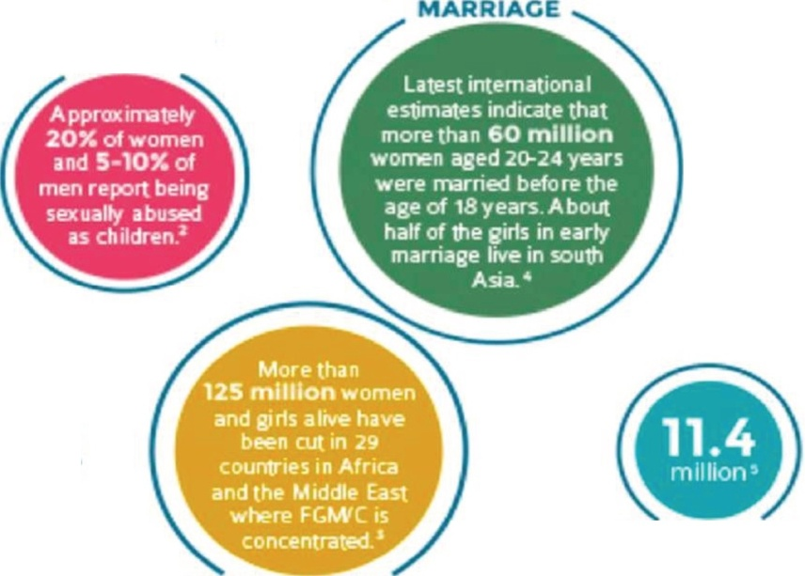
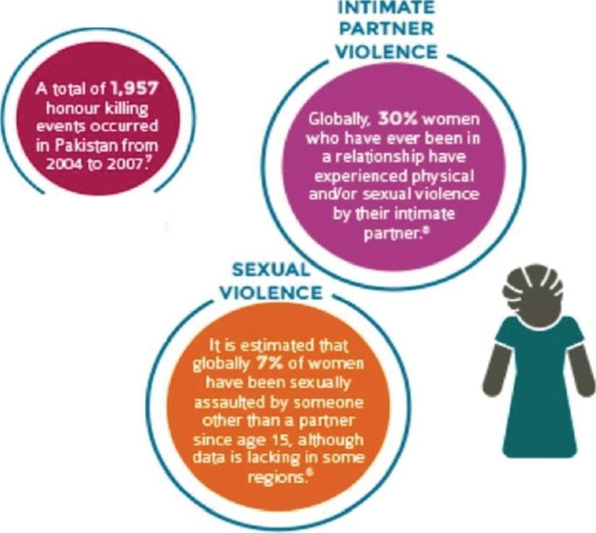

VIO ENCE EC S CilR S A D WO E A
EVERY AGE A o STAGE OF LIFE
FORCED/EARLY
CMILO SEXUAL
ABUSE
KllllNCS I N
HE NAME OF
HONOUR
I
II
TRAFFICKINC OF WOMEN ANO GIRLS
FEMALE CENITAL MUTILATION / CUTTINC
II
A FEW COMMON TYPES OF v OILE E

Slide 16

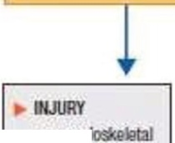
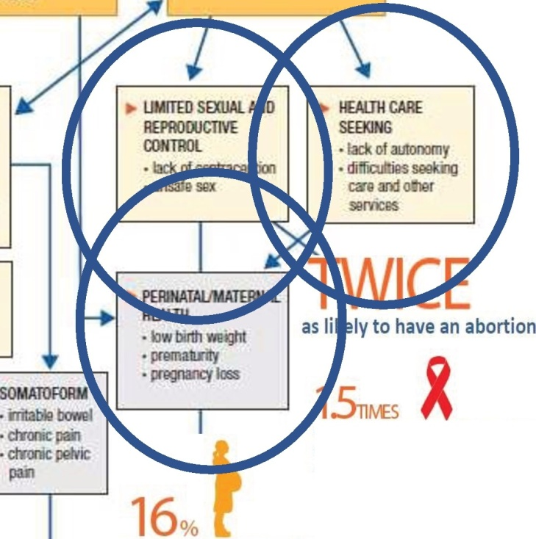
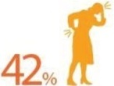

Pathways & hea Ith effects
CE
PHYSICAL TRAUMA
PSYCHOLOGICAL TRAUMA/ STRESS
FEAR AND CONTROL
muscu
soft iissue
gD1:lJ trauma
·dher
OOALHEMJH
PROBLEMS
·PTSO
ety
dapressl1n
lllllirgdisordi!rs
suicidality
_ _ _..,.
SUBSlANCE USE
alcobol
o1hGr itugs
IObacoo
of women who have experienced physical or sexual violence at the
hands of a partner have experienced
.- NOHCOMMIHCABlE
OLSEASES
cardia.-ascu lar
hypert&OSioo
injuries as a result
..
more likely to acquire HIV and 1.5 times more likely to contract syphilis infection, chlamydia or gonorrhoea
Mental Health
TW1Ct6\.
more Iikely to have a low birth-weight baby
as likely to experience depression
TWicEd
4.5
times as likely to attempt suicide
as likely to have alcohol use disorder.
of all murders of women globally were reported as being committed by their intimate partners
16

Slide 17



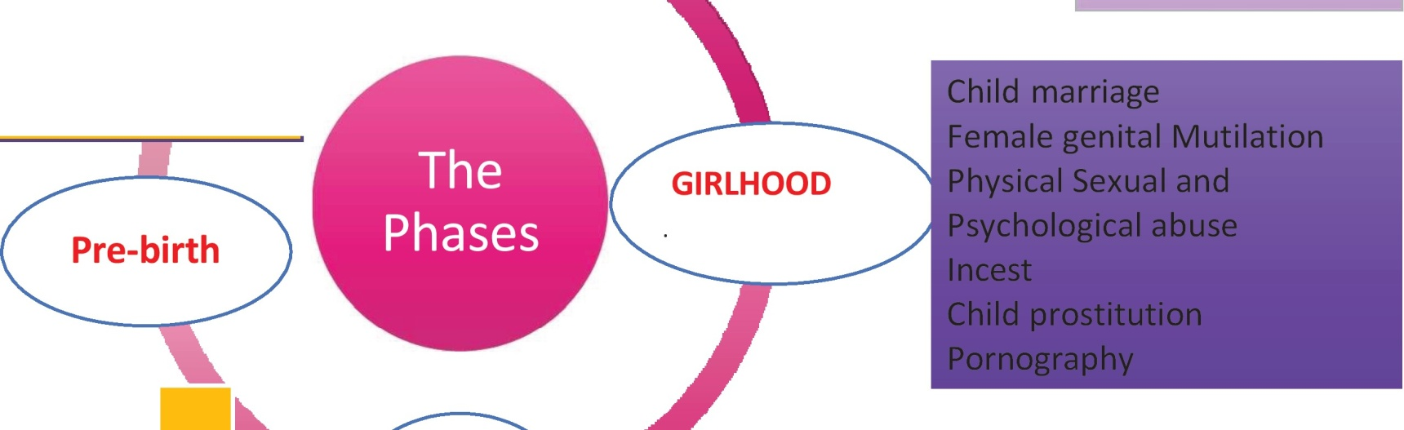
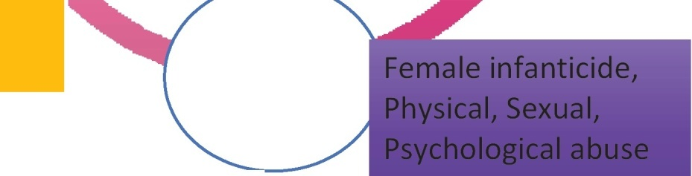
60 million women globally are married before 18 years
50% of child
---- marriages occur in
....._--
---------------
-----------------
....---------
--- . South Asia
Trafficking
^{-'-} Honour killings Partner violence
Marital rape, Dowry abuse
Murders
Abuse of women with disabilities Rape. Sexual harassment;
Forced prostitution, Pornography
Forced pregnancy
125 million women in 29 countries in Africa and middle east experienced FGM
.--------------
1957 women in Pakistan
Acid throwing and date rape Economically coerced sex Incest
Sexual abuse in the workplace
killed in the name of honor between 2003-
2007
11.4 million women - trafficked globally
30 % experience intimate partner violence
7% sexually assaulted by some one other than partner
Sex-selective abortion, Effects of battering on
pregnancy & childbirth
INFANCY
20% of women experience child sexual abuse

Slide 18
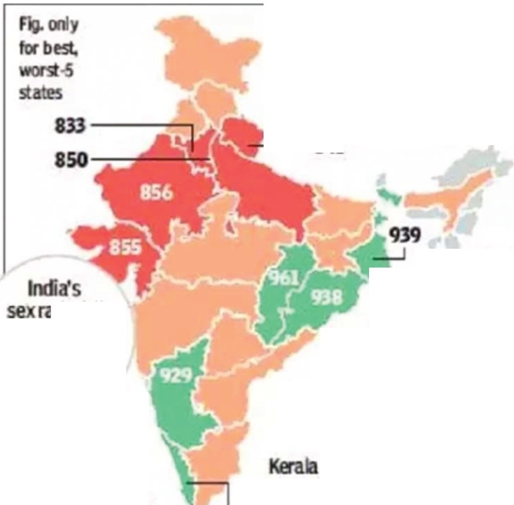


SEX RATIO FELL,
MEANS .7 I LS
Male vs Female surviva l
HAVE GONE 'M SS NG'
1rvM.;;;:.-841
Between 2014·16
Md 2015-17,Assam dockl!d
the bqgest inpron
Child sex Ratio-
According to the 2012 World Development Report,the number of missing women is estimated to be about 1.5 million women per year, with a majority of the women missing in India and China
itio feJI
from909 it
fdl<Mted by
e G rat.
201H3to 6
Mate.rElt.ra. Andlva and nga,
it 20J.5.17
In t o anupt.D<.
HafyMa and mad\al too,
marg' p
88M20
920 & ab e
sa the biggest
fmm 9&31D 9
b s nee tssex ratbwasso I hto n
948
th.It fsseand ly to O\hat:isgarh
MISSING WOMEN

Slide 19

GBV is under-reported:
Analysis of DHS survey data from 24 countries collected between 2004- 2011 disclosed:
40°/o of women experiencing GBV previously disclosed to someone
BUT only 7°/o reported to a formal source (regional variation, 2°/o inIndia and East Asia to 14°/o in Latin America and the Caribbean).
unicef W.
Palermo, T., Bleck, J ., & Peterman, A. (2014). Tip of the Iceberg: Reporting and Gender-Based Violence in Developing Countries. American Journal of Epidemiology, 179( 5), 602-612. http://doi.org/10.1093/aje/kwt295
I
Social Dvelopment
, Direct
for every child

Slide 20

The United Nations report in 1995
Repro.ductive
Forced pregnancy,
Forced abortion,
Forced sterilisation or
Denial of fa mily planning
as forms of violence.
In Indian DATA such form of reproductive coercion existed in 22.7% to 50%
coercion
a norm rather than exception

Slide 21
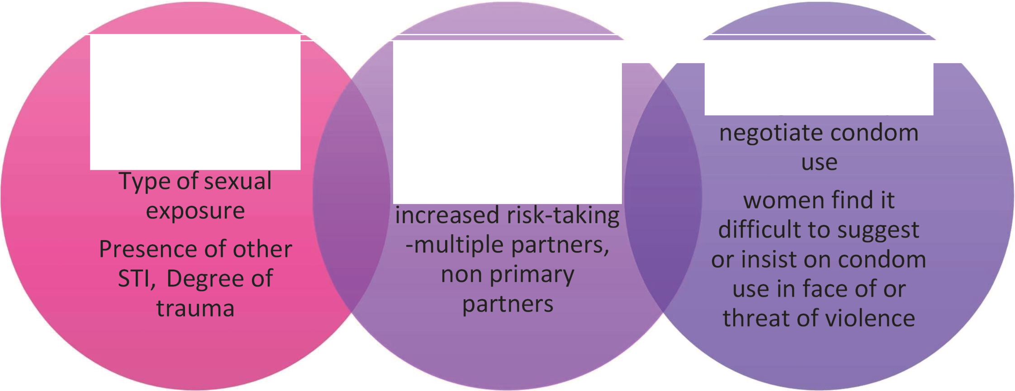
W HERE AND HOW DO
VIOLE NCE A ND HIV/A lDS INTERSECT?
Direct transmission through sexual violence-
Indirect transmission through sexua I risk taking-
violence is linked to
Indirect transmission through inability to

Slide 22
Effects of IPV on pregnancy
MOTHER
Abortion
Fetal injury
Maternal injury( 47%)
Depression (2 times)
Substa nce abuse (2 times)
Death-homicide (37%)
HIV (1.5 TIMES)
• WH0 2005
CHILD
Low birth weight {16%)
Sleep disturba nce
Bed wetting
Withdrawal
Aggression
Poor school performa nce
Anxiety disorders
Victims of child abuse

Slide 23
Effects of DV on Pregnancy
DV before pregna ncy is a major independent risk factor for hypertension, oedema, vagina l bleeding, placenta l problems, severe nausea and vomiting,dehydration,diabetes, kidney infection and/or urinary tract infection, as well as premature rupture of membranes (Silverma n et a l. 2006).
DV is responsible for greater disease burden than many well-known health risk factors such as high blood pressure, smoking and obesity (Vos et a l. 2006).
Pregnancy has also been identified as a period of high risk for the onset or worsening of DV incidents (Taft 2002; WHO 2000).

Slide 24
Table 4: Type of physical violence
JSAFOG
Type of violence
Slapping Kicking
Knife (sharp object) Fracture
Throwing from 1st floor
Head injury Forceful abortions
Denying food/starvation Reproductive coercion
Sexual violence Violence by in-laws Whip
Bums
Electric shock
Number
38
25
1
2
1
2
5
5
25
7
10
1
1
1
Percentage
34.54
22.72
0.9
1.8
0.9
1.8
10.5005/ jp- journals-1 0006-1578
⁴.5
4.5
22.72
6.3
9
0.9
0.9
0.9
PROSPECTIVE OBSERVATIONAL STUDY
Effects of Intimate Partner Violence
on Pregnancy Outcome
1Kiranmai Devineni,²S Shantha Kumari,³Nagamani Sodumu,⁴Ruchika Garg

Slide 25

SIGNIFICANT MORBIDITY IN IPV GROUP
Table 5: Comparison of maternal morbidity between two groups
PREECLAMPSIA AND ECLAMPSIA
HAEMORRHAGIC SHOCK
Maternal morbidity | Group I | Group II | p-value | Relativ€ risk
Abortions | 10 (9.1%) | 12 (6.8%) | 0.2 | 1.2
Abruption | 03 (2.7%) | 03 (1.7%) | 0.2 | .3
IUFD | 10 (9.1%) | 10 (5.7%) | 0.1 | 1.33
Preedampsia and eclampsia | 04 (3.6%) | - | 0.01 | 2.66
Hemorrhagic | 03 (2.7%) | - | 0.02* | 2.64
shock
Uterine perforation | 01 (0.9%) | - | 0.1 | 2.61
APH | 01 (0.9%) | - | 0.1 | 2.61
Anemia | 12 (10.9%) | - | 0.000003* | 2.8
Rupture | 01 (0.9%) | - | 0-1 | 2.61
Fractures | 02 (1.8%) | - | 0.07 | 2.63
Death | 02 ( .8%) | - | 0.07 | 2.63
I
ANEMIA
PROSPECTIVE OBSERVATIONAL STUDY
Effects of Intimate Partner Violence on Pregnancy Outcome
¹Kiranmai Devineni,²5 Shantha Kumari,³Nagamani Sodumu,⁴Ruchika Garg

Slide 26
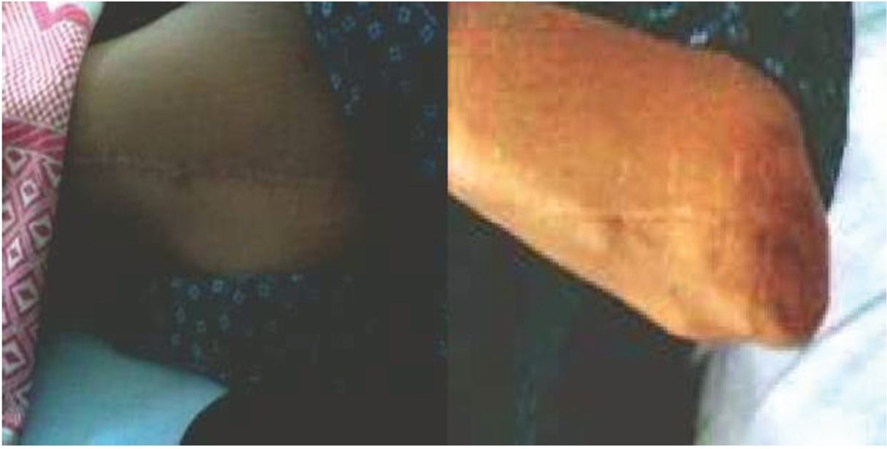
PARTNERS IN LIFE !
Violence in pregnancy
PUSHED FROM 2N° FLOOR-ABANDONED IN LABOUR !
G3P2L2-2 Previous LSCS-Full Term Thrown from third floor 2 yrs back­
rod implanted-fracture femur/hip joint. Collapsed in front of a hotel
Brought to GMH-Naya pul-108-
in active labor with severe hypertension Emergency LSCS done-consent by RMO

Slide 27
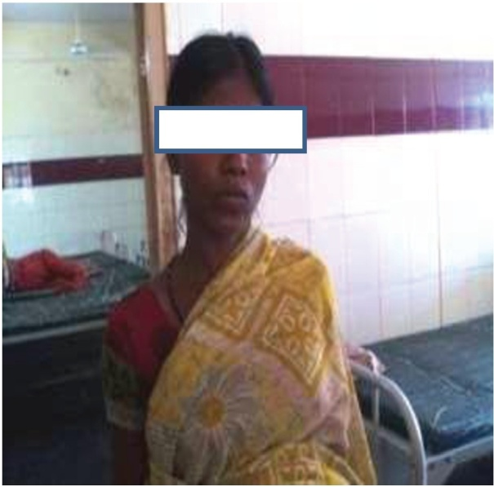
PARTNERS IN LIFE !
KICKED ON THE ABDOMEN
G3P2LOD2 with 2pr LSCS - 36 wks -severe anemia
Both times H/O Physical violence -kicking on the abdomen brutally by husband-followed by loss of feta l movements.
3rd pregna ncy- parents brought her home­ Transfused blood - LSCS-Live baby

Slide 28
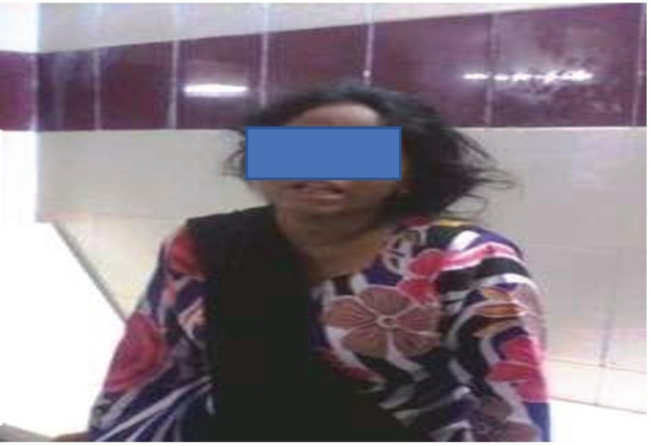
PARTNERS IN LIFE !
Violence in pregnancy
NEAR MISS MORTALITY-BR UTAL VIOLE NCE CAUSING APH
G3P2L2 28 WKS -2 LSCS
husband kicking on abdomen APH-shoc k-placenta accreta
Hysterectomy-10-blood transfusions-bla dder invoh

Slide 29
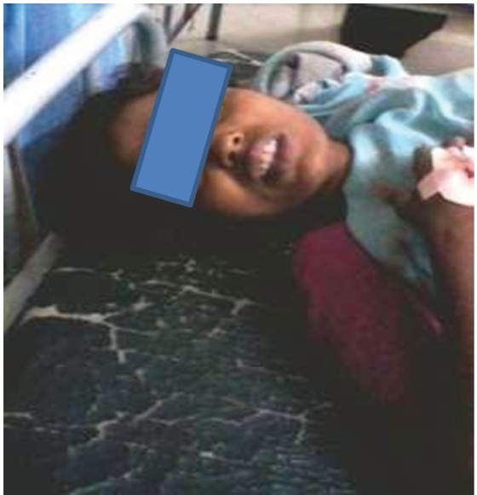
FOR NOT BEARING A MALE CHILD!
•G6P2L2A3
•2 previous cesarean sections
•3 induced- illegal abortions by
husband
•Acute Hemorrhage, shock, sepsis, incomplete abortion
•Severe for m of physical ,emotiona l violence
•DV history brought out only by SCREENING
•RECEIVED 4 TRANSFUSIONS-TUBECTOMISE D
IPV is a consistent and strong risk factor for UNINTENDED PREGNANCY, induced ,unsafe
morbidity( ref-3)
abortion and severe

Slide 30
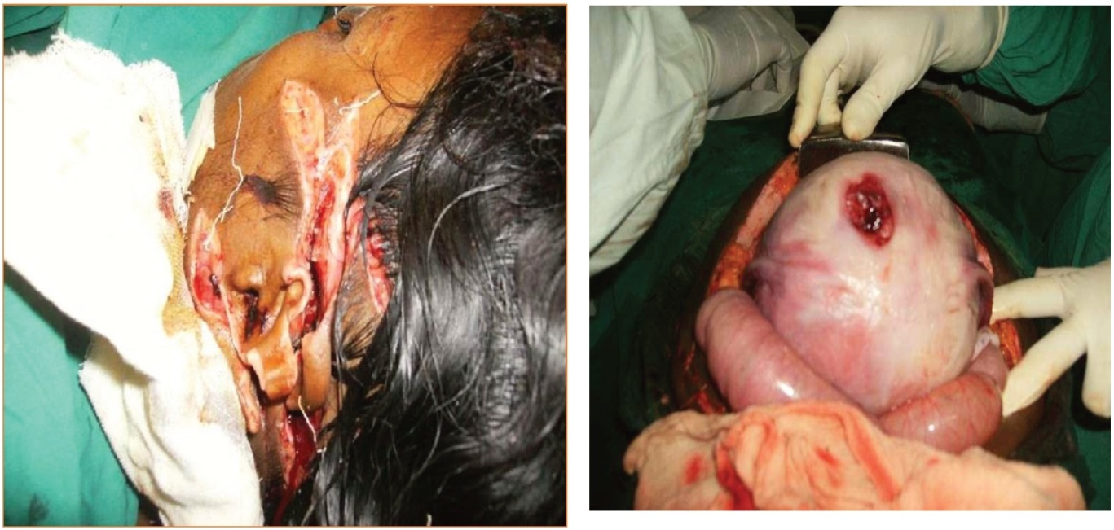
STAB INJURY- HUSBAND-inebriated- lacerations on face Perforation-uterus-IUFD­ LAPAROTOMY-RENT REPAIR
Buddy T-A woma n has a 68% probability of death if the
abusive
partner Is also alcoholic !

Slide 31
Case Scenario
•Primi
•22 yea rs
•34 weeks
•Severe PE
•Advised admission - termination
•Properly counselled - RMC was ensured
•ANM ASHA counselled the fa mily with home visits
•Ca re a nd a dmission refused by husba nd
•Decision ma ker wa s husba nd a lone
, PHC MO followed up
•Pregna nt Woma n when asked a bout her wish said she will follow husbands decision
•After one week , pregnant mother is brought in more serious situation , severe
a nasarca imminent ecla mpsia - LSCS done Due care given - post op developed severe sudden pulmona ry edema - Prolonged morbidity- Maternal Near miss
•Husba nd puts allegation on Hospital

Slide 32

To understa nd the widespread menace of VIOLENCE AGAINST WOMEN and how it intersects health issues in women.
To focus on impact of VAW during pregna ncy.
To focus on the role of Obstetricia n And Gynecologist in detecting VAW.
link with referrals /support systems I rehabilitate

Slide 33


All women are likely to seek health services at some point in their lives
Health-care providers are often trusted by women and serve as role models in the community.
Violence is an underlying cause of injury and ill health.
unicef W.
Social Dvelopment
, Direct
for every child
I

Slide 34
Many opportunities for intervention that occur during the course of
( Adolescence
J
( Pregnancy,
J
( Family planning,
J
Annua l exa minations,
o
Other women's health visits.
lHEERA

Slide 35
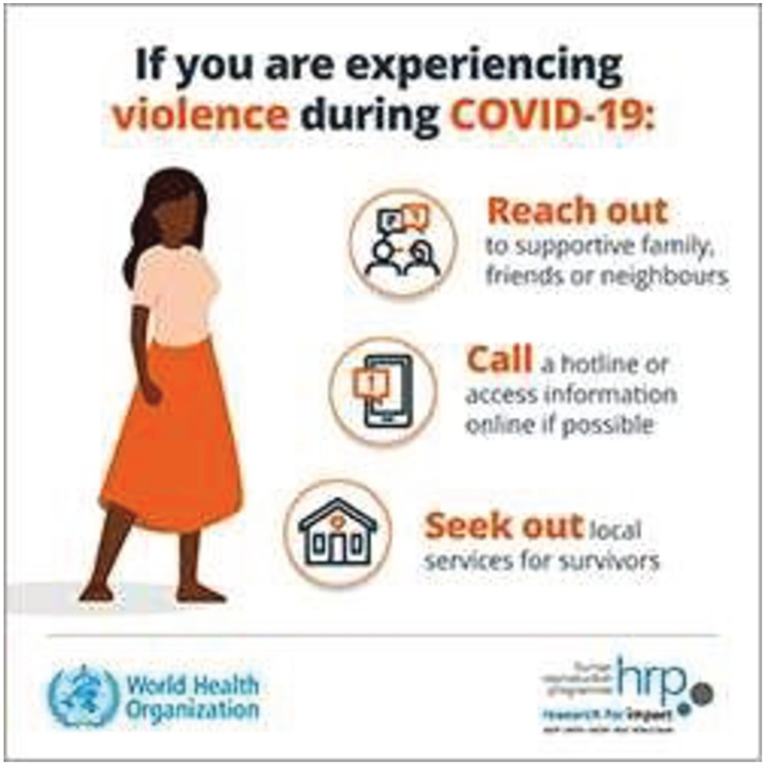





Health systems can help women survivors of violence during
COVID-19
Identify and share information
on support services,
including opening hours and contact deta ils
+
Establish
referral linkages
Find out what survivors of violence need and how best to reach them safely
tlWorld Health
Organization
reprod^{h}u^{u}c^{m}tioªn^{n hf P.}•
programme
research for impact •

Slide 36


Health care workers are NOT responsible for:
x "Solving" violence for the survivor
x Mediating relationship problems between a couple
x Forcing a survivor to leave an abusive relationship
x Forcing a survivor to report the assault to the police
x Determining the legal aspects of the violence or assault
x Determining whether a client is telling the truth about GBV
x Verifying the accuracy of a survivor's story by interviewing the aIleged perpetrator or witnesses
unicef .
Social Dvelopment Direct
for every child
"""' )

Slide 37
Domestic Legal Remedies In India
The Constitution of India: Article 14 on equality
The National Commission for Women, set up as a statutory body in January 1992 under the National Commission for Women Act, 1990
The Dowry Prohibition Act (DPA)
498A IPC-This is the most widely used provision against domestic violence
The Protection of Women From Domestic Violence Act (PWDVA), 2005

Slide 38
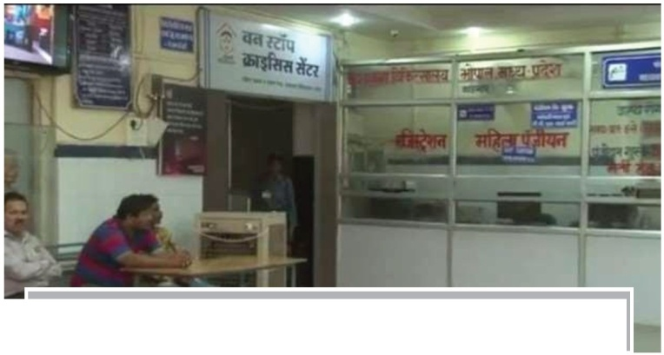
THE CONCE PT OF ONE STOP CRISIS CENTRES
A 'One Stop Crisis Centre' (OSCC) caters to the immediate medica l, legal and psychologica l needs of women who are
survivors of physica l and mental abuse, wit h an assura nce that their consent and confidentia lity will be respected and protected .
234 OSCC/OCC
all over India Sakhi centres
Gauravi at Madhya Pradesh
A joint initiative of the Department of Public Health and Family Welfare, Government of Madhya Pradesh, and ActionAid, supported by the police department, Gauravi's staff of 10 focuses on the victim's needs, without compartmentalising services. June 2014

Slide 39
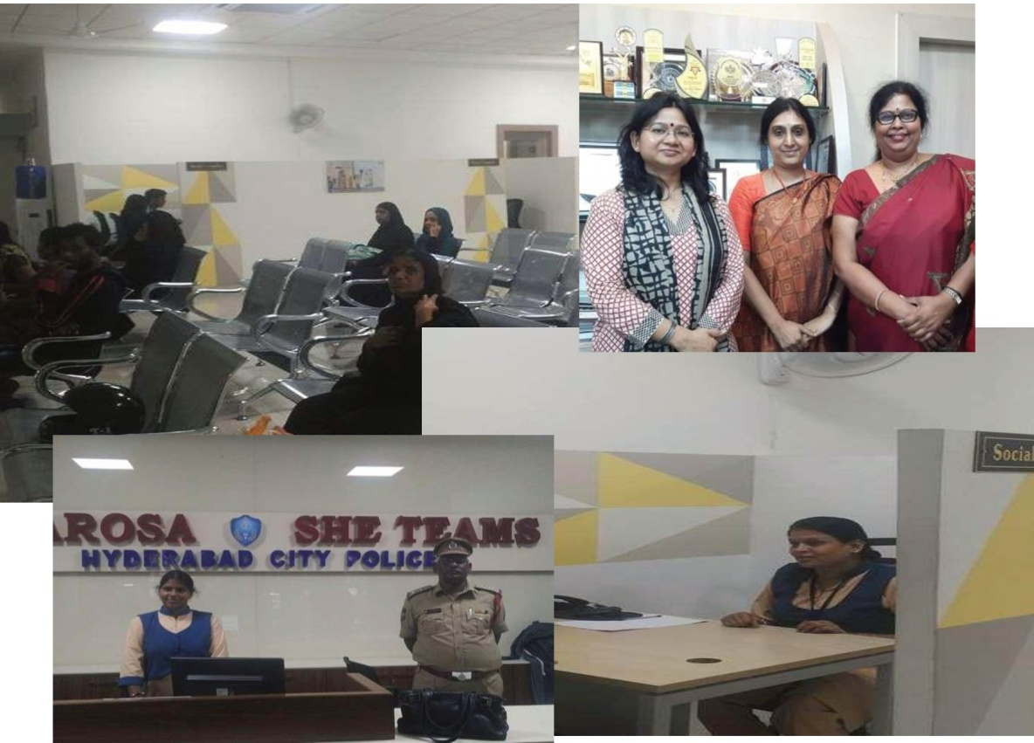
Bharosa (trust)
234 OSCC/OCC
all over India
Sakhi centres
 | Bharosa
centre and SHE tea ms office,
An all in one for violence against women with police, counsellors, psychologist, legal advisor, ,medical help.
The help line is 100 and will be directed to Bharosa if it's violence
A woman can walk in with the assurance that her consent and confidentiality
will be respected and protected.

Slide 40
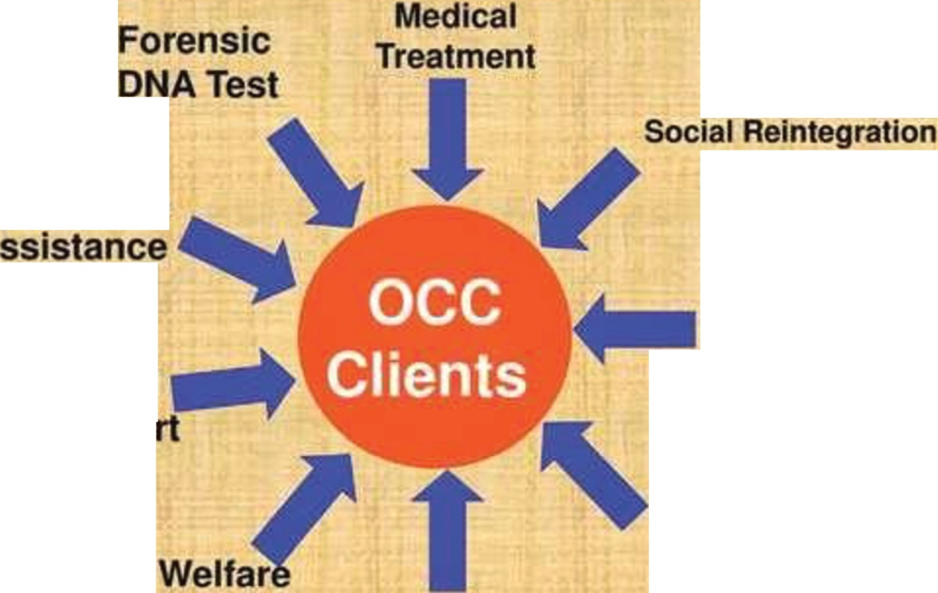

234 OSCC/OCC
all over India Sakhi centres
Pol ee
A
Safe Custody/ Shelter Home
egal
uppo
Rehab1111a ion
ervice
P ye o oc al
Coun elin

Slide 41







Who to contact (numbers)
All India Women Helpline­ Women in Distress
1091
Women' s Domestic Abuse Helpline
181
National Commission for Women
011-26942369
011-26944754
Delhi Commission for women
011-23378044
011-23378317
011-23370597
Outer Delhi Helpline
Local Bodies
011-27034873
011-27034874
Local Champions
NGOs
Police Station
Find Out Your Local City Helpline Numbers and Share with your Group/School

Slide 42
Many women in many parts of the world speak the same language-the language of silence.

