Slide 1

Design and Fabrication of Die-set for Compacting the Powder to Synthesize Green Pallet of Nickel-based Solid Lubricant Nano-composites

Slide 2
Authors
Shams Tabrez
Sudesh Singh
Vineet Kumar
Department of Mechanical Engineering, Sharda School of Engineering and Technology, Sharda University, Greater Noida, U.P., India-201310.
Department of Mechanical Engineering, Sharda School of Engineering and Technology, Sharda University, Greater Noida, U.P., India-201310.
Department of Mechanical Engineering, Sharda School of Engineering and Technology, Sharda University, Greater Noida, U.P., India-201310.Vineet.kumar5@sharda.ac.in
sudesh.sengar@gmail.com

Slide 3
Applications of Powder Metallurgy
Automotive
Medical
Aerospace
Common products include gears, bushings, and filters.
Used in medical devices and equipment.
Components for aircraft and spacecraft.

Slide 4



Advantages of Powder Metallurgy
Material Flexibility
Offers higher flexibility than other manufacturing techniques.
Controlled Characteristics
Allows for controlled characteristics of the generated materials.
Component Fabrication
Allows component fabrication without material decomposition.

Slide 5
Die and Punch Material
Material
AISI D3 die steel
Density
7.7 g/cm³
Max Compressive Stress
2151 MPa

Slide 6
Die-set Design and Safety Calculations
1
Design Parameters
Inner diameter: 25mm, Outer diameter: 80mm
2
Applied Working Load
Applied load of 800 KN for safe working conditions.
3
Stress Calculations
Stress analysis ensures the die and punch can sustain the load.

Slide 7


3D Design of Die-set
SOLIDWORKS 14
Assembly
Stress Analysis
Used for creating the 3D model of the die-set.
Prepared the die-set assembly in SOLIDWORKS 14.
Analyzed stress distribution using ANSYS 2023R1.

Slide 8
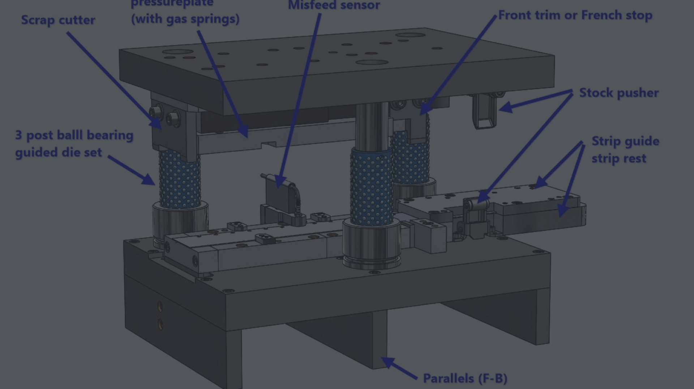
Fabrication and Testing
1
Material Selection
2
Machine Operations
3
Testing
Selected AISI D3 steel for die and punch fabrication.
Performed facing, turning, drilling, and boring operations.
Evaluating the die-set using a universal testing machine.

Slide 9
Finite Element Analysis
Analysis Type
Stress Distribution
Model Meshing
Used static structural analysis in ANSYS 2023R1.
Analyzed stress distribution in the fabricated die block.
Meshed the model using SOLID 65 tetrahedron at size level 4.

Slide 10
Conclusions
The current study focused on designing and fabricating a die-set to make green pallets for powder metallurgy products. The die-set was fabricated using high-grade steel (AISI D3) as it exhibits more significant mechanical and thermal properties. The compaction die-set was successfully developed and manufactured to create a Ti3C2Tx composite with an 800 KN load on UTM. The graphite coating inside the die block and outside the punch periphery can decrease the friction between the punch and die block and help easy removal of the component after compacting. Solidwork14 and ANSYS 2023R1 analysis demonstrated that the die and top punch had the lowest stresses, while the bottom punch had the highest. Ti3C2Tx composite can be successfully synthesized by using the die-set under a compaction load of 800 KN.

Slide 11
References
Suryanarayana, C., & Al-Aqeeli, N. (2013). Mechanically alloyed nanocomposites.Progress in Materials Science, 58(4), 383-502.
Al-Qureshi, H. A., Galiotto, A., & Klein, A. N. (2005). On the mechanics of cold die compaction for powder metallurgy. Journal of Materials Processing Technology, 166(1), 135- 143.
Guo, W., Liu, B., Liu, Y., Li, T., Fu, A., Fang, Q., & Nie, Y. (2019). Microstructures and mechanical properties of ductile NbTaTiV refractory high entropy alloy prepared by powder metallurgy. Journal of Alloys and Compounds, 776, 428-436.
1. Qian, M., Yang, Y. F., Yan, M., & Luo, S. D. (2012). Design of low cost high performance powder metallurgy titanium alloys: some basic considerations. Key Engineering Materials, 520, 24-29.
1. Robertson, I. M., & Schaffer, G. B. (2010). Review of densification of titanium based powder systems in press and sinter processing. Powder metallurgy, 53(2), 146-162.

